Slide 1




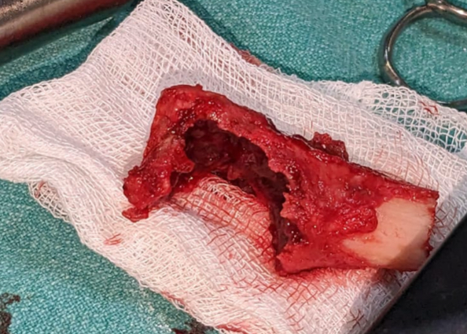
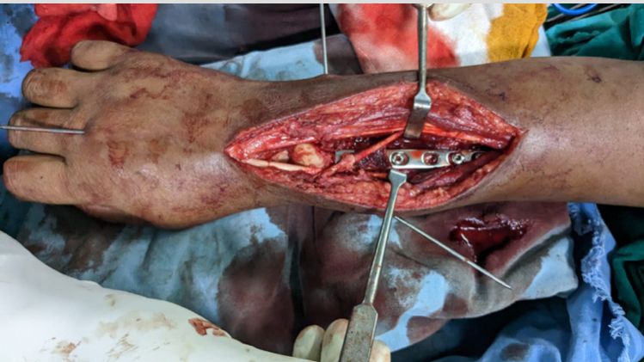
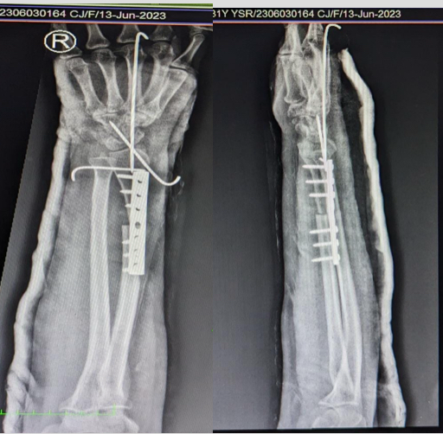
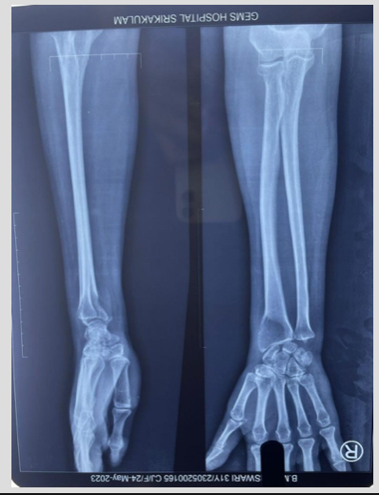
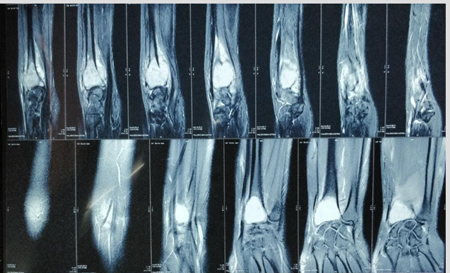
55th Annual Conference of Orthopedic Surgeon Society of Andhra Pradesh
TITLE: CAMPANACCI GRADE III GIANT CELL TUMOR OF THE DISTAL RADIUS MANAGED BY EN BLOC RESECTION AND NON-VASCULARISED FIBULAR AUTOGRAFT RECONSTRUCTION: A CASE REPORT
PRESENTING AUTHOR: DR. G. NAMRATHA
2ND YEAR POST GRADUATE, GEMS
CO-AUTHOR: DR. M. SANTOSH BABU
ASSOCIATE PROFESSOR, GEMS
Date 6 – 8 February,2026, Venue : Kurnool Medical College
Organized by : Department of Orthopaedics, Kurnool Medical College Kurnool
INTRODUCTION
OPERATIVE FINDINGS
DISCUSSION
Distal radius GCT behaves more aggressively than other locations
• Curettage associated with high recurrence in Grade III lesions
• Wide resection provides superior oncologic clearance
• Arthrodesis sacrifices wrist motion
• Prosthesis associated with cost and long-term failure concerns
• Non-vascularised fibular graft offers structural stability and functional wrist preservation
• Technically reproducible with low donor site morbidity
•Giant cell tumour of distal radius demonstrates aggressive local behaviour
• Higher recurrence after intralesional curettage
• Campanacci Grade III lesions require oncologic resection
• Reconstruction must preserve stability and useful wrist function
• Wide resection with fibular reconstruction is a commonly used limb-salvage option
• Extensive cortical destruction
• Extra-osseous soft tissue extension
• Articular surface not salvageable
• Wide en-bloc resection performed with safe margins
• Large segmental bone defect created
• Reconstruction using non-vascularised proximal fibular graft
CASE REPORT
•A skeletally mature female presented with a three-month history of pain and progressive swelling for one month. Clinical examination revealed a 4 × 3 cm firm, tender mass in the distal forearm, resulting in painful terminal wrist movements.
•X-ray: Eccentric expansile lytic lesion
•MRI: Cortical breach + soft tissue extension
•Diagnosis: Campanacci Grade III GCT
CONCLUSION
Wide en-bloc resection is preferred in Campanacci Grade III distal radius GCT.
Non-vascularised fibular graft reconstruction provides oncologic safety, stable wrist and satisfactory functional outcome.
Wide resection with fibular reconstruction is an established limb-salvage procedure in advanced lesions
IMMEDIATE POSTOP
X-RAY
PRE
OP
XRAY
AND
MRI

