Slide 1




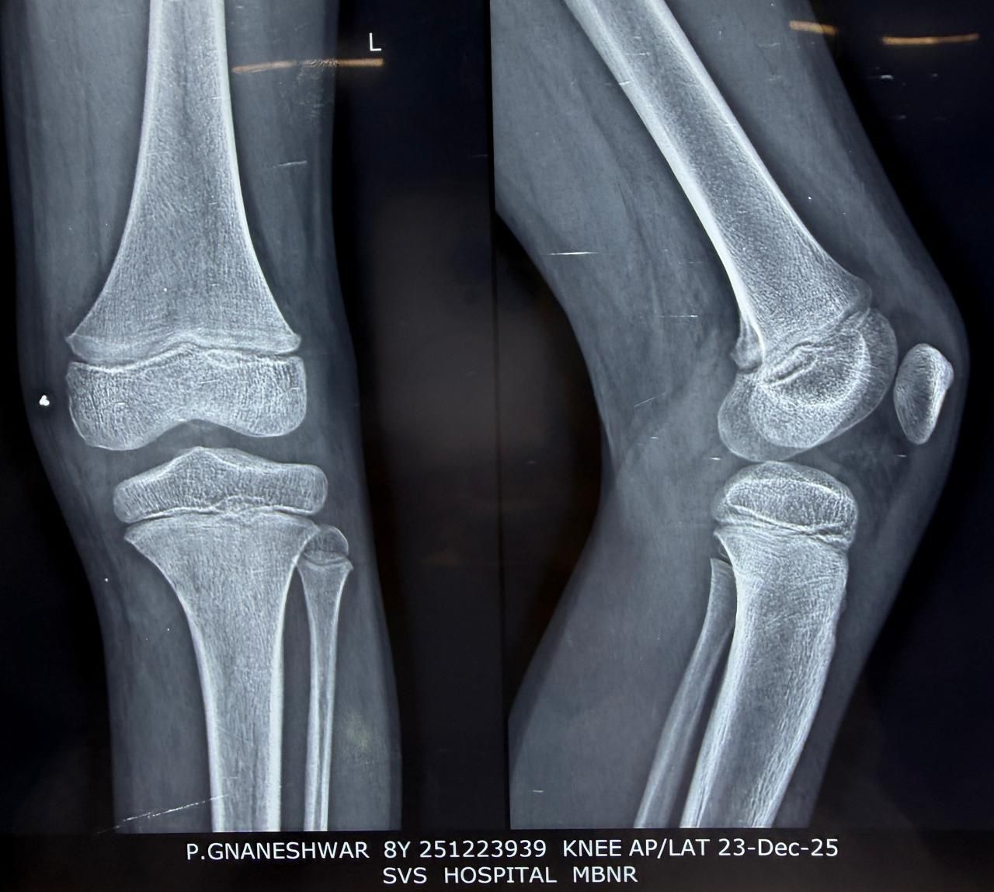
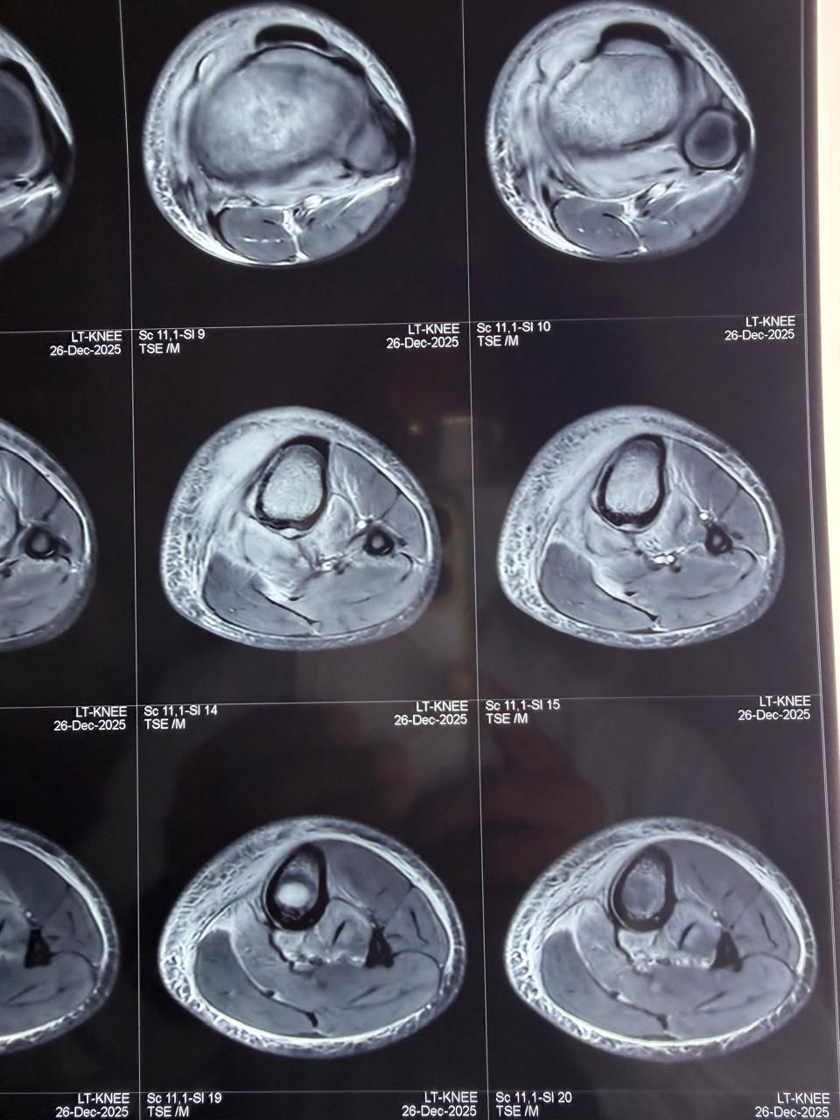
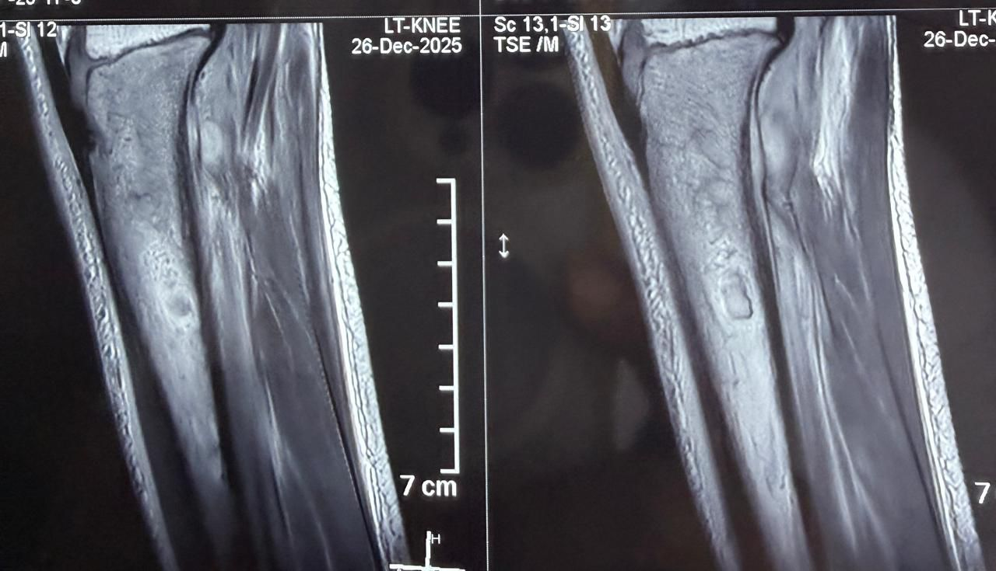
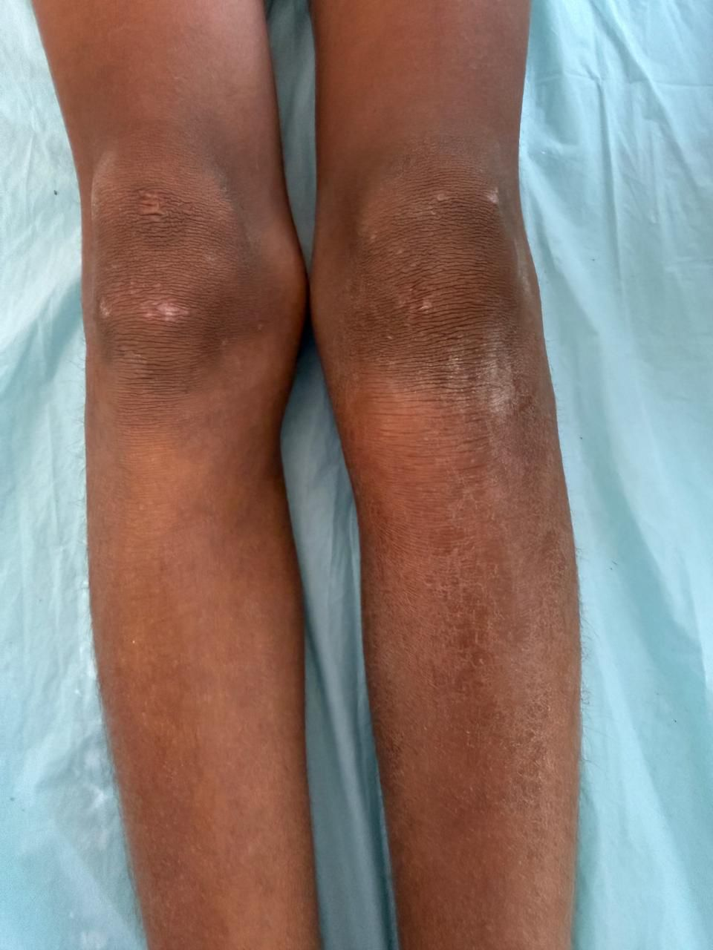
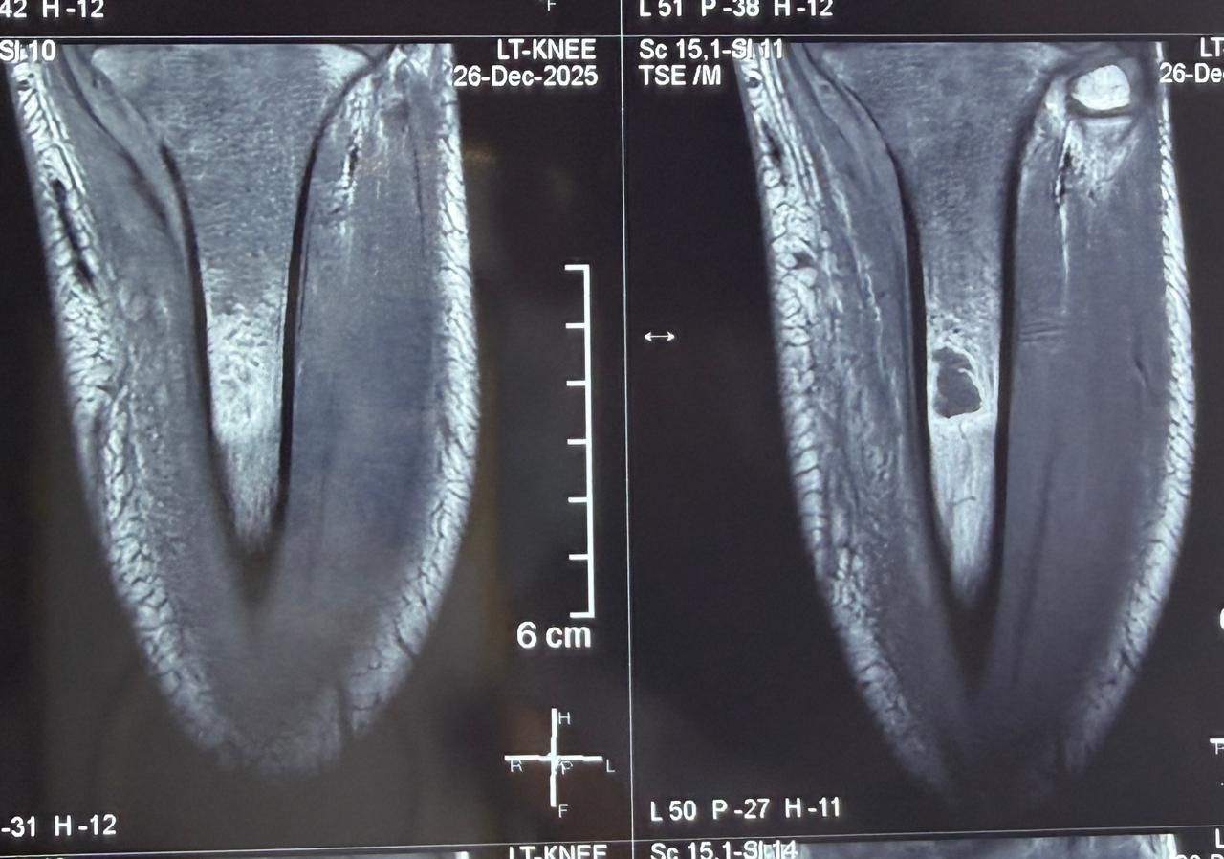
55th Annual Conference of
Orthopedic Surgeon Society of Andhra Pradesh
Date 6 – 8 February,2026, Venue : Kurnool Medical College
Organized by : Department of Orthopaedics, Kurnool Medical College Kurnool
Early Diagnosis in Acute osteomyelitis- Case report
Presenting Author: Dr. Amear Ghori Co-authors: Prof. Dr. K.J.Reddy , Prof. Dr. K.ANJANEEYULU;
SVS Medical College, Mahabubnagar, Telangana - 509001
ID: OSSAP-530
INTRODUCTION
OPERATIVE FINDINGS
DISCUSSION
Acute hematogenous osteomyelitis commonly affects children and typically involves the metaphysis of long bones due to its rich vascular supply.
Early diagnosis is often challenging as initial radiographs may be normal.
MRI plays a crucial role in early detection,
X-Ray findings:
Rarefraction in proximal metaphyseal area and metadiaphyseal area,
Thinning of cortex
Soft tissue swelling in metaphyseal region
No periosteal reaction
Pediatric metaphyseal osteomyelitis often presents with nonspecific symptoms
MRI is the most sensitive modality for early detection and assessment of disease extent.
Timely management prevents physeal damage and progression to chronic osteomyelitis.
MRI Findings:
Locally aggressive intramedullary proximal tibial lesion with cortical breaches.
Anteromedial infective collection adjacent to cortex showing diffusion restriction.
Marrow signal alteration with heterogeneous enhancement and central necrosis.
Extensive muscle edema involving anterior, posterior compartments with fascial spread.
Diffuse circumferential subcutaneous edema; features favor osteomyelitis.
CASE REPORT
8yr/M C/O pain in left proximal leg since 10 days
H/O fever + No H/O trauma
O/E : Swelling +, LROT +, Tenderness +, ROM painful
CONCLUSION
High clinical suspicion and early MRI are key to diagnosis.
Prompt antibiotic therapy can achieve complete recovery without surgery.

