Slide 1




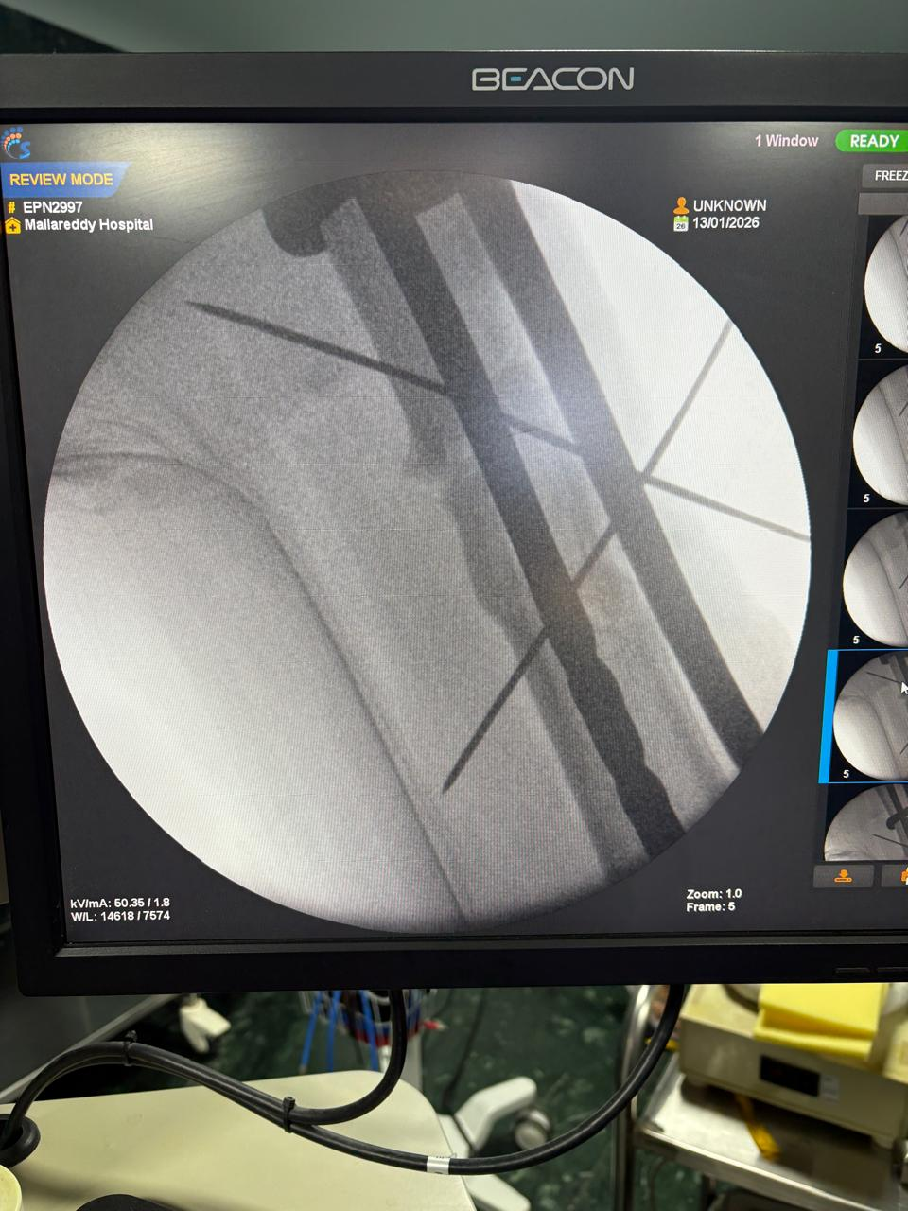
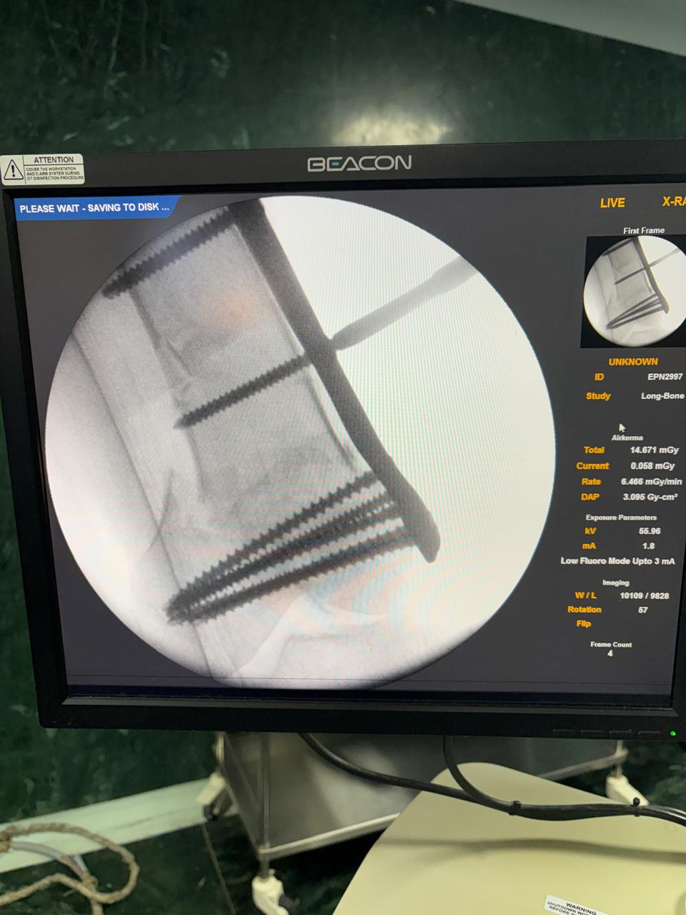
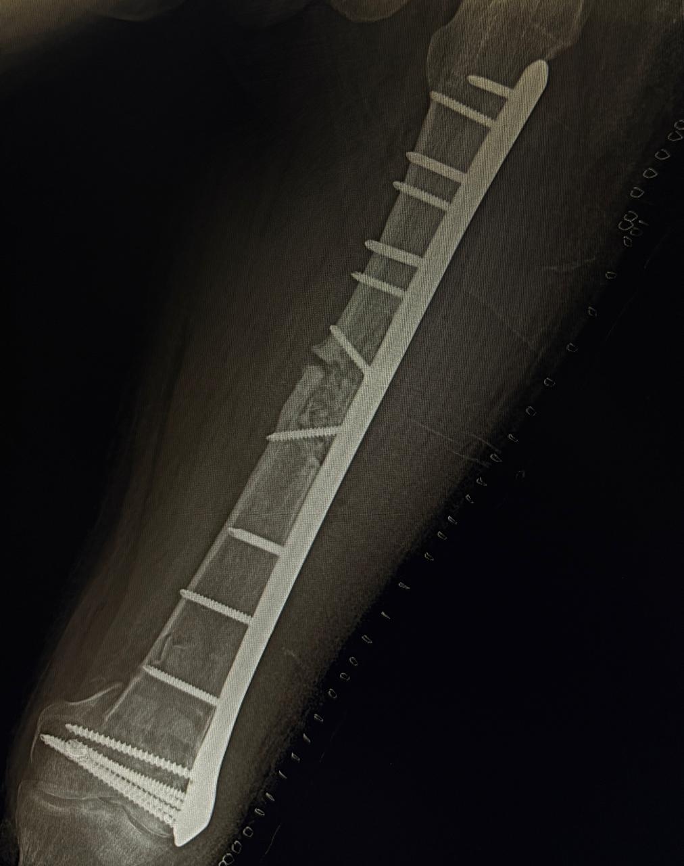
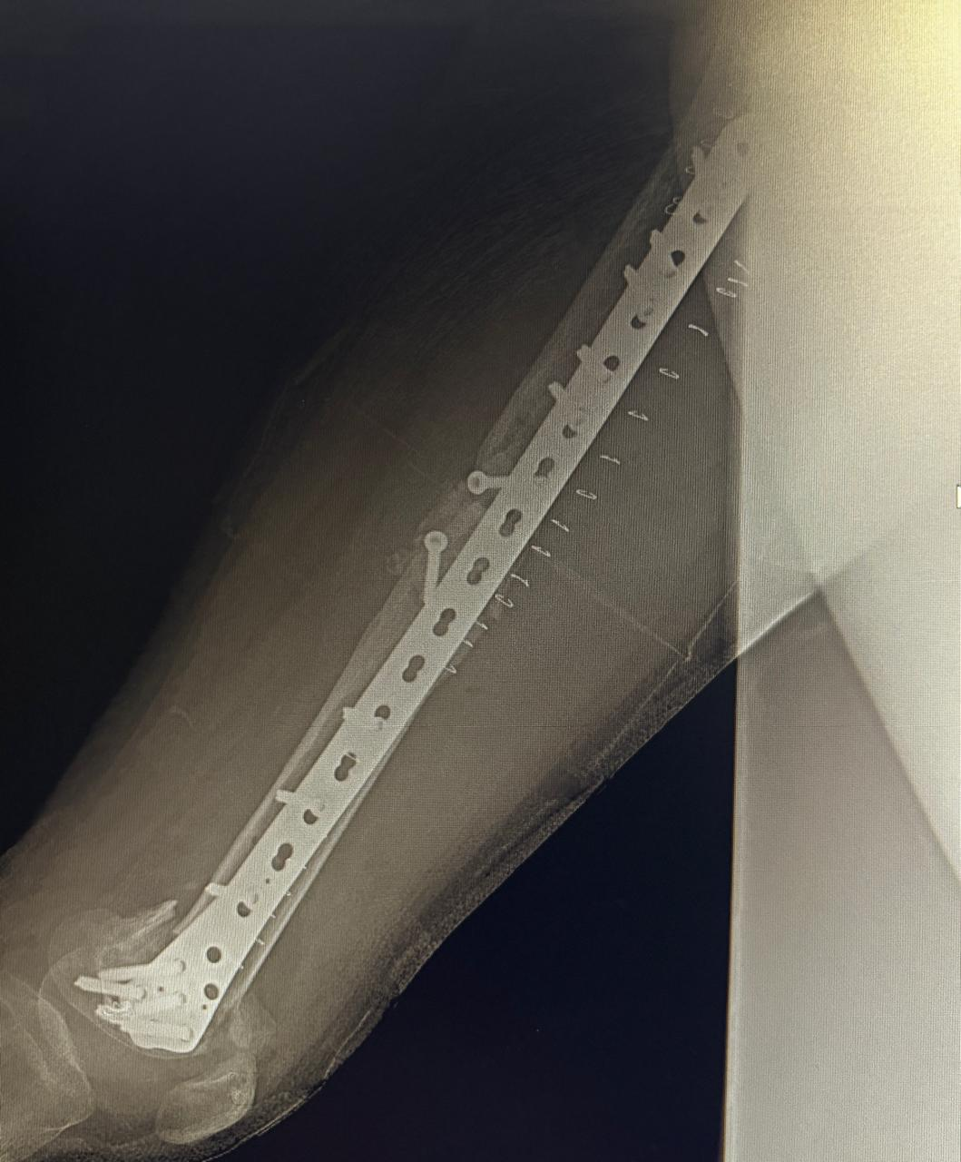
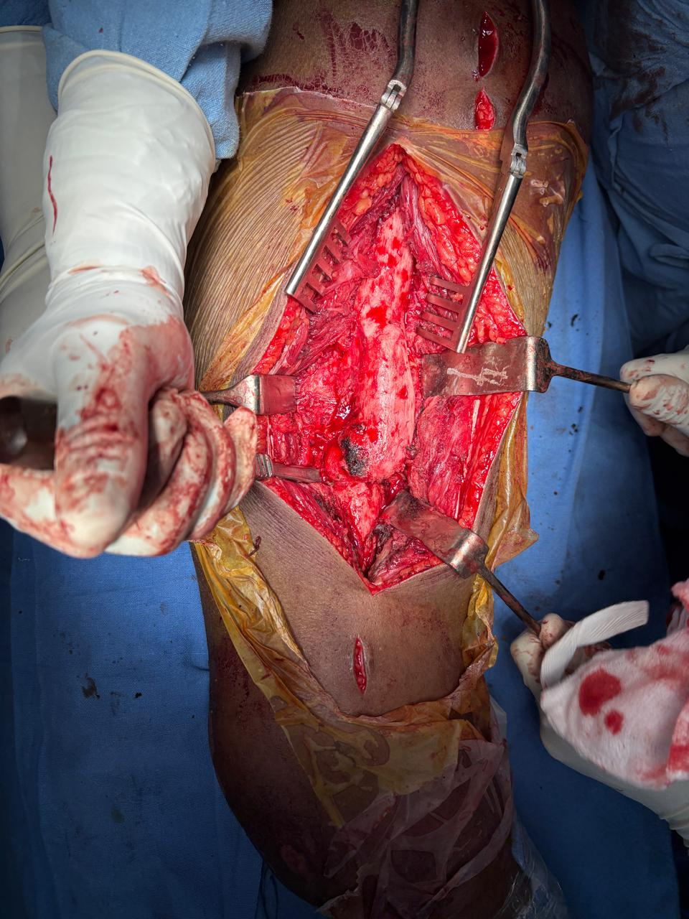
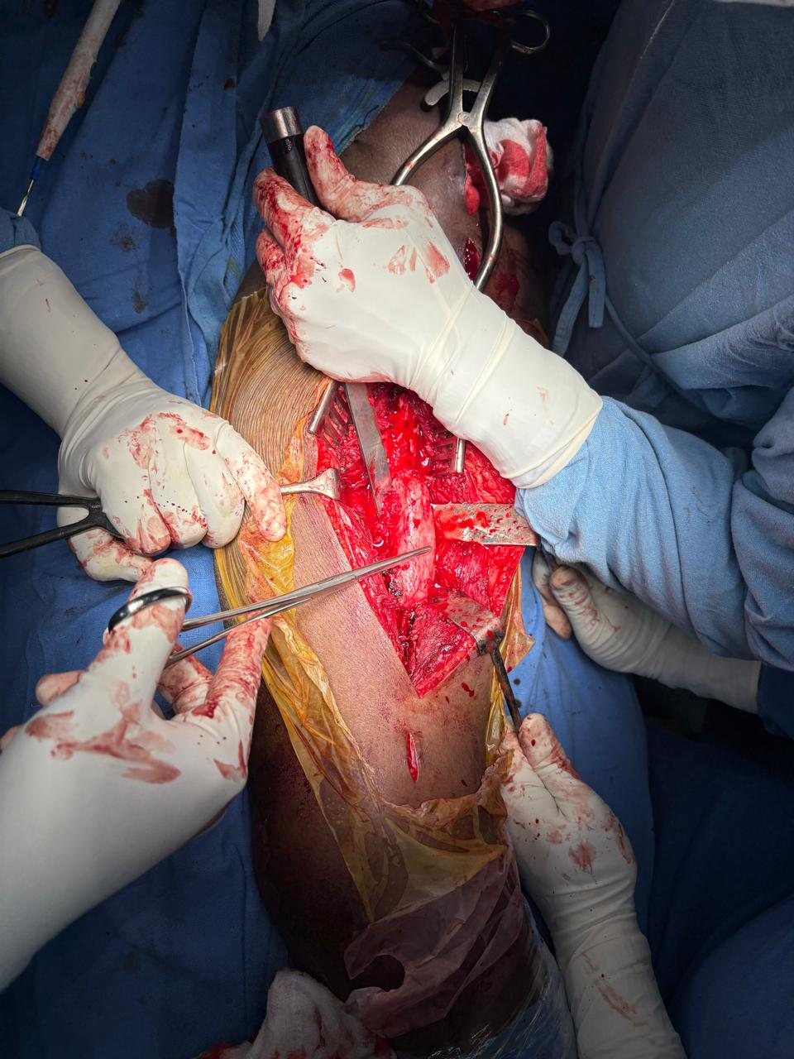
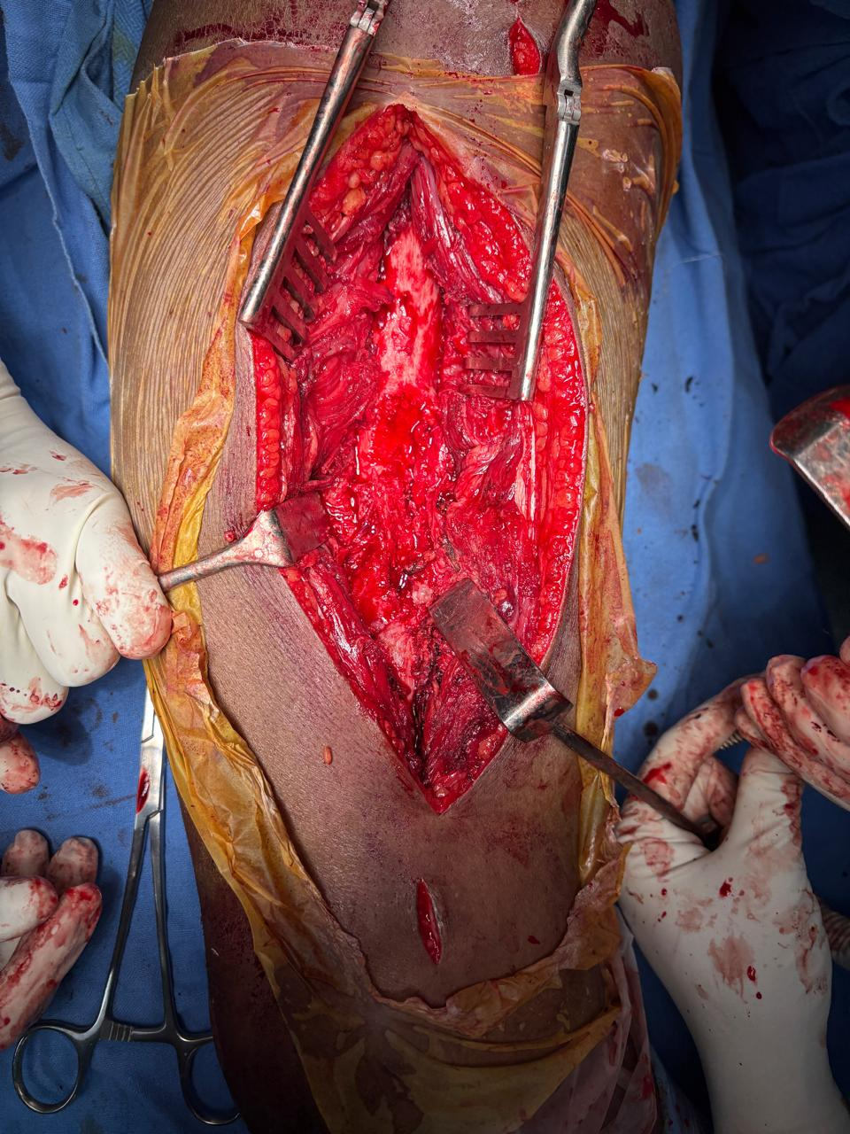
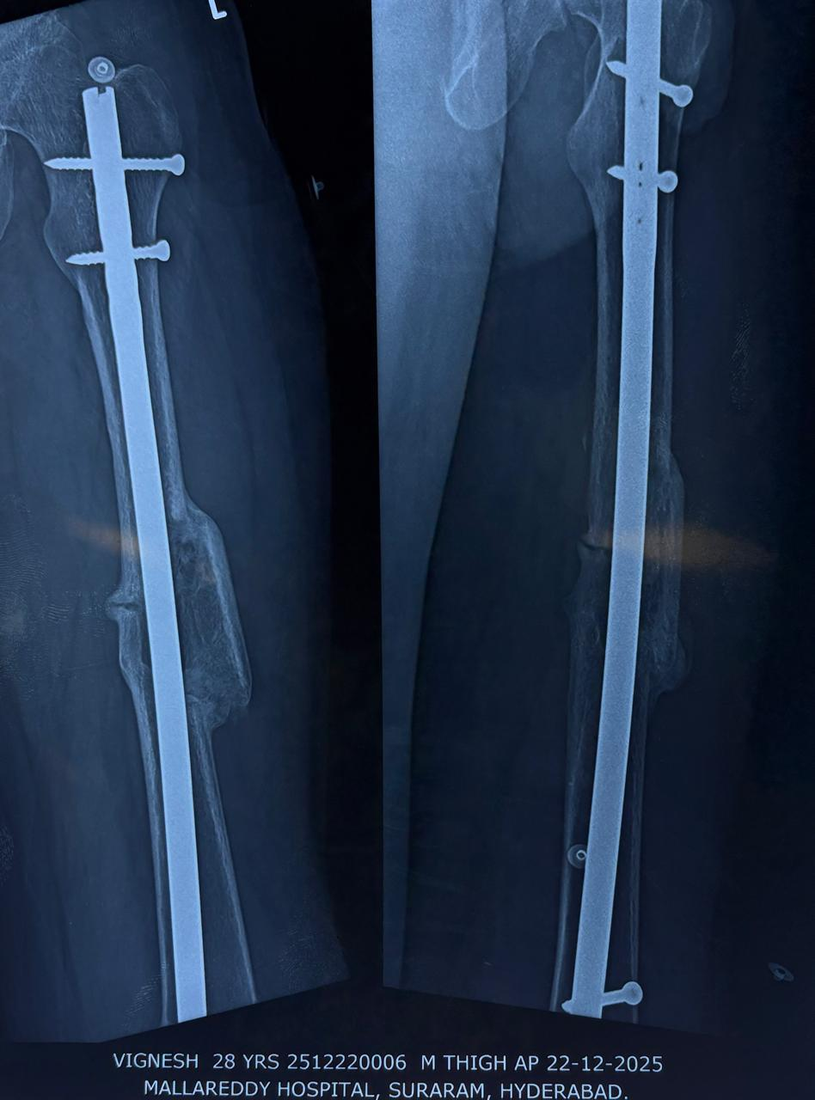
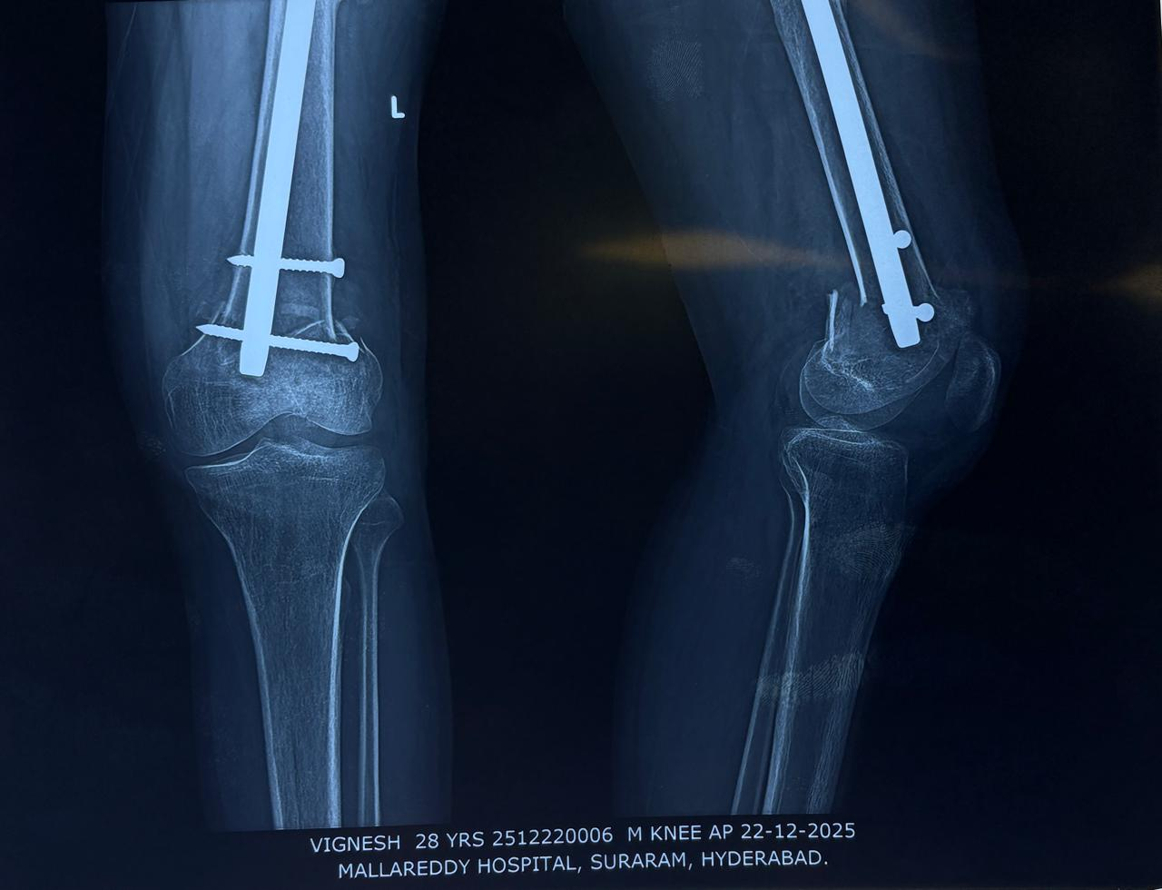
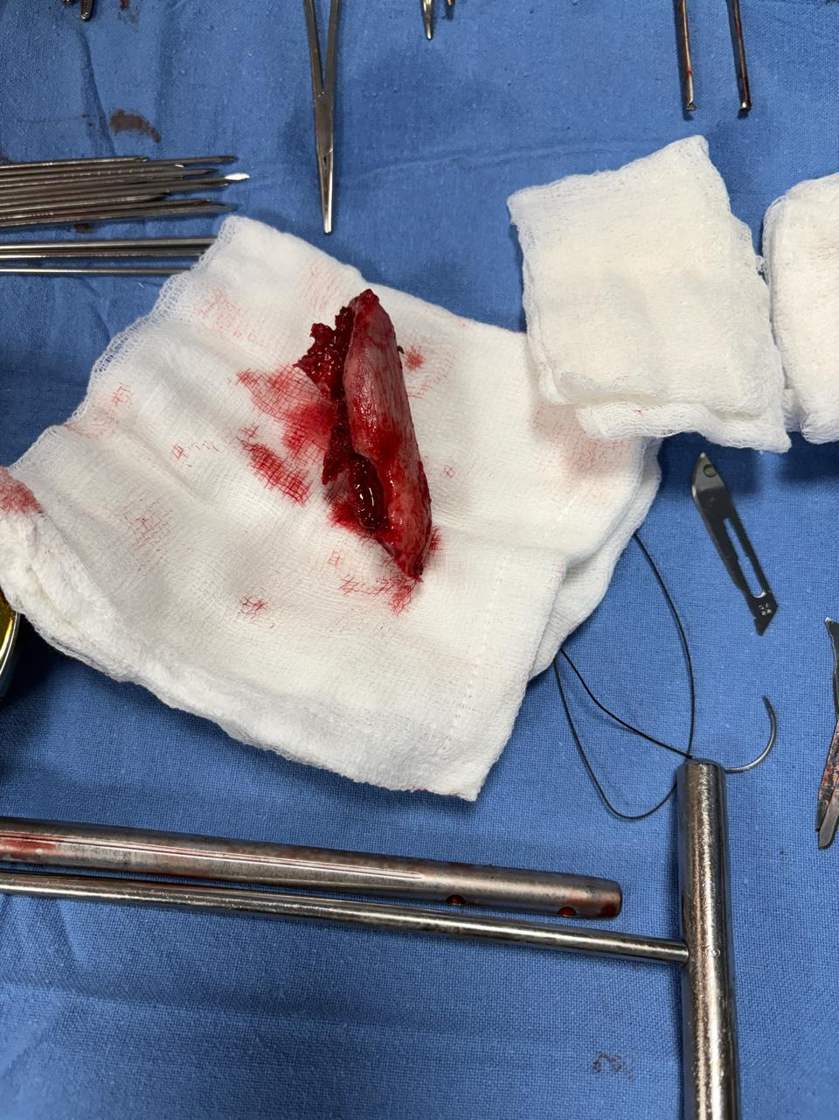
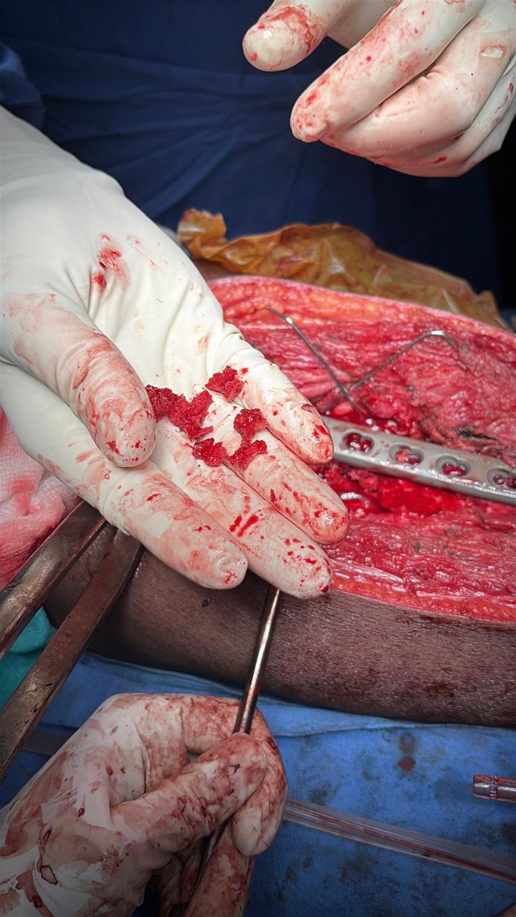
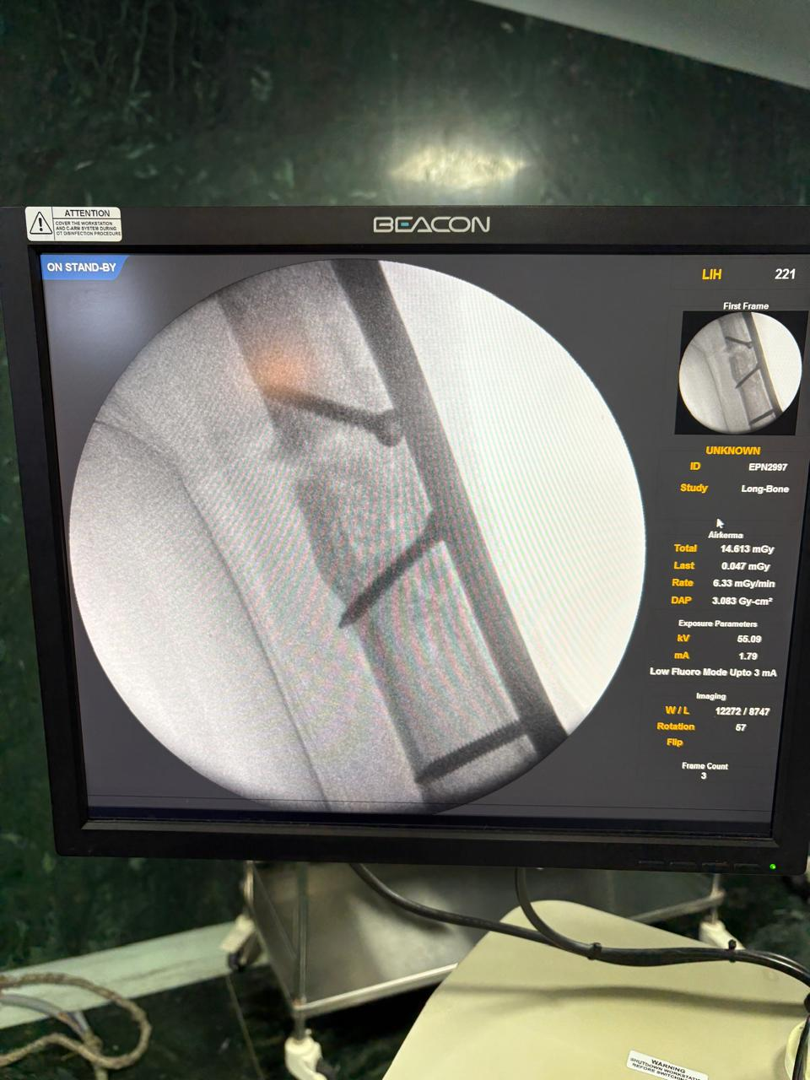
PERI-IMPLANT DISTAL FEMUR FRACTURE WITH IPSILATERAL NON-UNION OF MIDDLE THIRD SHAFT OF FEMUR
Presenter - Dr. Aachi Venkata Sai Anirudh
Guide - Dr. Azeemuddin (Professor of Orthopedics)
MALLA REDDY INSTITUTE OF MEDICAL SCIENCES
REGISTRATION ID- OSSAP-542
INTRODUCTION
OPERATIVE FINDINGS
DISCUSSION
Intraoperatively the intramedullary interlocking nail was found to be intact with clear evidence of fibrous non-union at the femur shaft fracture site.
The nail was removed and thorough debridement of the non-union site was done.
Open reduction of the distal femur fracture was done using 16 holed distal femoral locking compression plate with iliac crest bone grafting.
Adequate alignment,length and rotation was restored.
Peri-implant distal femur fractures with associated non-union are uncommon and pose significant surgical challenges due to altered anatomy,poor bone stock and existing hardware.
Management depends on fracture location,implant type,bone quality and biological status of non-union.
Implant removal followed by stable fixation using a distal femoral locking compression plate allows restoration of alignment,compression at non-union site and early mobilization.
Adequate debridement,preservation of biology and rigid fixation are key factors influencing union and functional outcome.
peri-implant fracture of distal femur are uncommon and challenging injuries.
They occur due to altered biomechanics,stress risers and poor bone quality.
management is complex because of existing hardware and non-union risk.
careful planning and appropriate fixation strategy are essential for good outcomes.
CASE REPORT
A 25 year old male presented with pain and deformity around the left knee following a road traffic accident.
History of middle third femur shaft fracture previously treated with intramedullary nailing.
Radiographs showed peri-implant distal femur fracture with non-union of middle third shaft of femur
CONCLUSION
Careful planning is essential in peri-implant distal femur fractures.
Implant removal and locking plate fixation provides stable fixation and promotes union.
Mechanical stability and biology factors is essential for successful outcomes.
Appropriate surgical management can result in Good union and good functional recovery can be achieved.

