Slide 1


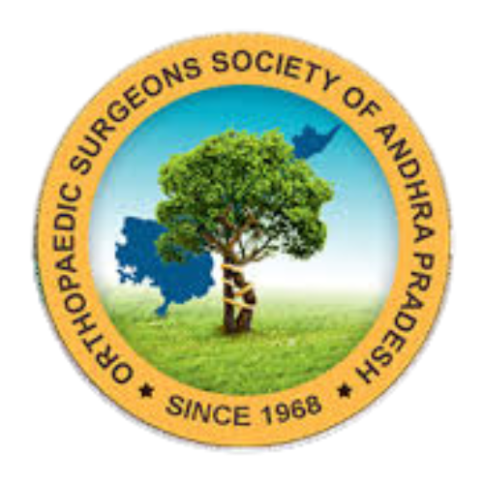

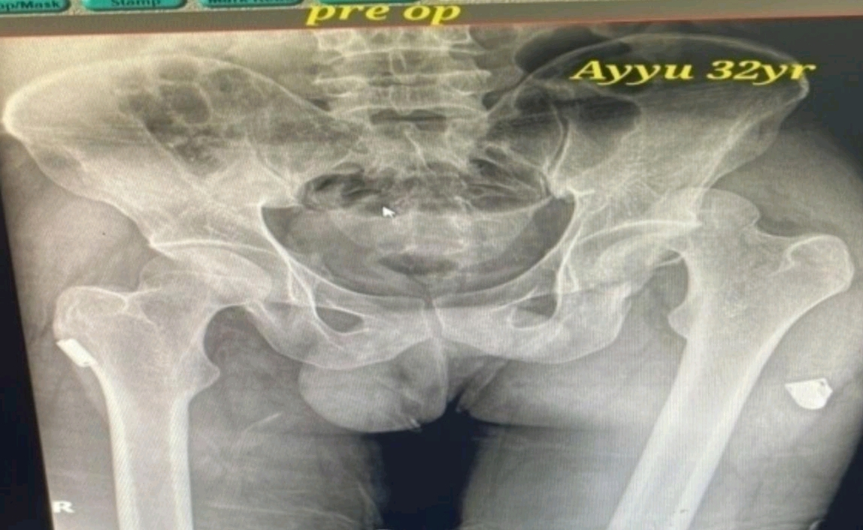
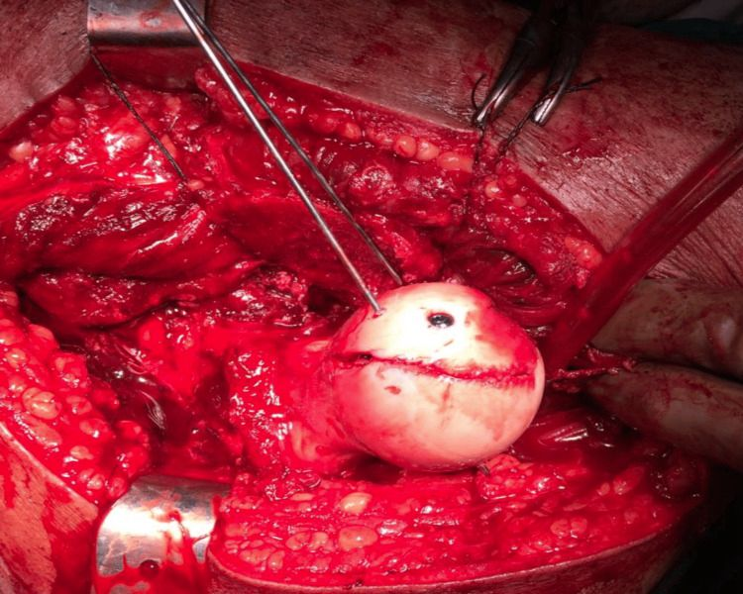
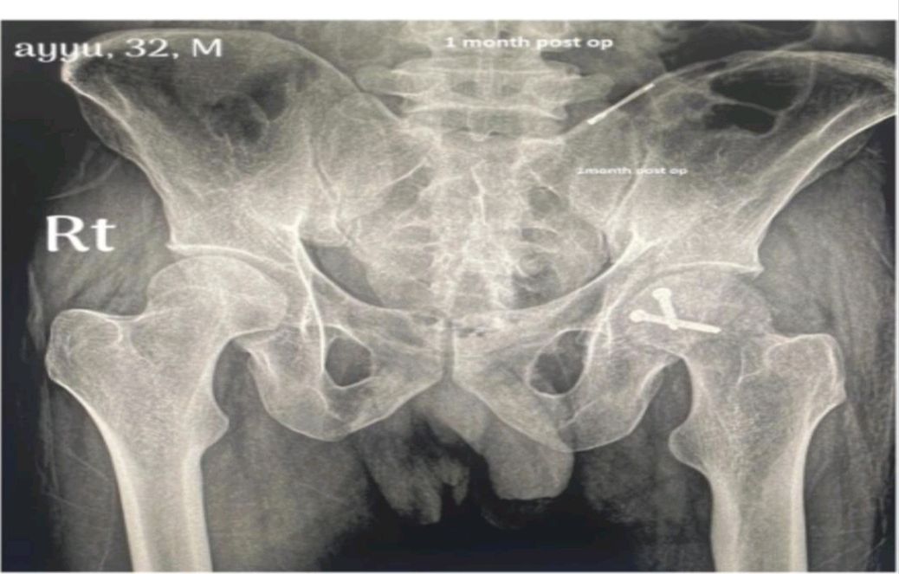
55th Annual Conference of
Orthopedic Surgeon Society of Andhra Pradesh
Organized by : Department of Orthopaedics, Kurnool Medical College Kurnool.
A case of posterior dislocation with fracture of femoral head fixed with open reduction & internal fixation with two cannulated cancellous screws
Presenter - Dr. Ampavathina Krishnasai
Guide - Dr. Y.V.S. Prabhakar (professor and HOD), Department of Orthopaedics
MALLAREDDY INSTITUTE OF MEDICAL SCIENCES
Registration ID: OSSAP - 544
INTRODUCTION
OPERATIVE FINDINGS
DISCUSSION
The patient was taken up for surgery under spinal anesthesia and positioned in lateral decubitus position with the affected limb draped freely.
A posterior approach to the hip was used through the Southern (Moore) approach.
Skin incision was made centered over the posterior aspect of the greater trochanter extending proximally and distally.
Subcutaneous tissue and fascia lata were incised in line with the skin incision.
Gluteus maximus fibers were split along the direction of muscle fibers to expose the deeper structures.
The short external rotators (piriformis, obturator internus, gemelli) were identified and tagged with sutures for later repair.
The sciatic nerve was identified and protected throughout the procedure.
The posterior capsule of the hip joint was exposed and found to be torn due to the dislocation.
Capsulotomy was performed and the hip joint was entered.
The femoral head was found to be dislocated posteriorly with associated fracture fragment.
The femoral head fracture fragment corresponding to Pipkin Type II was visualized within the joint.
There was cartilage damage noted over the femoral head fragment and acetabular surface was inspected for any loose fragments.
The joint was thoroughly irrigated and hematoma/clots were removed.
Anatomical reduction of the femoral head fracture fragment was achieved under direct visualization.
Temporary fixation was done using guide wires to maintain reduction.
Definitive fixation was carried out using two cannulated cancellous screws placed over the guide wires.
Screw placement was done in such a way that the screw heads were countersunk to avoid articular cartilage impingement.
Reduction of the hip joint was achieved and stability of the hip was assessed through gentle range of motion.
Intraoperative fluoroscopy was used to confirm congruent reduction of the hip and proper position of screws.
Posterior capsule and short external rotators were repaired back to their attachment to improve stability and reduce risk of redislocation, followed by wound closure in layers with drain placement.
Posterior hip dislocation with femoral head fracture is a rare orthopedic emergency.
It usually occurs due to high-energy trauma, commonly road traffic accidents.
This injury requires immediate attention to prevent long-term disability.
If not treated early, it may lead to avascular necrosis (AVN) of the femoral head.
It can also cause post-traumatic arthritis of the hip joint.
There is a risk of sciatic nerve injury associated with posterior dislocations.
Early diagnosis is essential for proper management and better outcome.
Urgent reduction is required to restore hip joint alignment and preserve blood supply.
In displaced femoral head fractures, anatomical reduction and stable fixation are necessary.
This poster reports a case managed at Malla Reddy Hospital, treated with ORIF using two cannulated cancellous screws, showing clinical and surgical outcome.
Femoral head fractures are commonly classified by Pipkin classification, which helps in deciding the management protocol. In displaced Pipkin fractures, especially those involving the weight-bearing surface, anatomical reduction and stable fixation are mandatory to restore joint congruity and prevent long-term complications.
The treatment options include closed reduction alone, fragment excision, ORIF, and total hip arthroplasty depending on patient age, fracture type, displacement, and joint stability. In young patients, preservation of the native hip joint is preferred. Hence, open reduction and internal fixation (ORIF) is recommended for displaced fractures where the fragment is large and reconstructable.
In our case, ORIF was done using two cannulated cancellous screws, achieving stable fixation and good restoration of articular congruity. Cannulated screws provide adequate compression, maintain reduction, and allow early mobilization. Surgical fixation also helps in reducing the chances of secondary displacement and improves functional outcome.
Despite successful fixation, complications like AVN, heterotopic ossification, sciatic nerve injury, redislocation, and secondary osteoarthritis remain possible. Therefore, strict postoperative rehabilitation, regular follow-up, and radiological monitoring are necessary.
CASE REPORT
A 32-year-old male presented to casualty with alleged history of road traffic accident sustaining injury to the left hip and inability to bear weight. Clinical examination revealed swelling, warmth, tenderness over the left hip with limb shortening. The left lower limb was positioned in flexion, adduction, and internal rotation with restricted range of movements. Distal neurovascular status was intact with no deficits. X-ray and CT pelvis with both hips showed fracture of head of left femur (Pipkin Type II) with posterior dislocation of left hip (Thompson and Epstein Type V).
CONCLUSION
Posterior hip dislocation with femoral head fracture is a rare high-energy injury and should be treated as an orthopedic emergency. Early reduction of the dislocated hip is crucial to minimize the risk of avascular necrosis. Post-reduction CT scan plays an important role in identifying fracture pattern, fragment displacement, and intra-articular loose bodies, and Pipkin classification helps in guiding treatment. In young patients, preservation of the native hip joint is the primary goal, and displaced reconstructable femoral head fractures are best managed with open reduction and internal fixation. ORIF using two cannulated cancellous screws provides stable fixation, restores articular congruity, and helps achieve good functional recovery with early mobilization. Proper postoperative rehabilitation with protected weight bearing and regular follow-up is essential to detect complications such as AVN, heterotopic ossification, redislocation, and post-traumatic osteoarthritis. Overall, timely reduction and anatomical fixation offer favorable radiological and functional outcomes in such cases.

