Slide 1




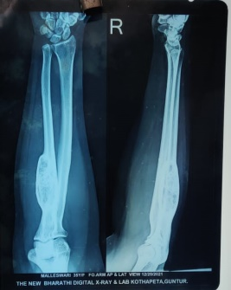
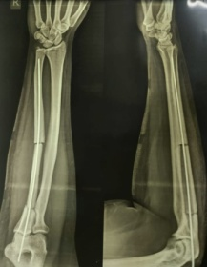
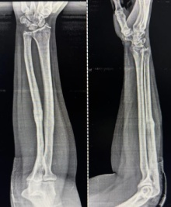
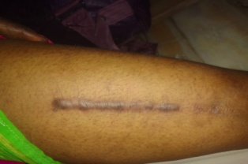
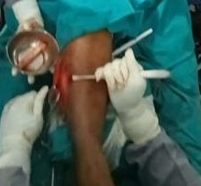
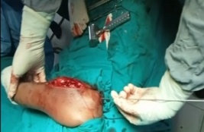
55th Annual Conference of
Orthopedic Surgeon Society of Andhra Pradesh
Date 6 – 8 February,2026, Venue : Kurnool Medical College
Organized by : Department of Orthopaedics, Kurnool Medical College Kurnool
INTRODUCTION
OPERATIVE FINDINGS
DISCUSSION
A benign osteoma is a non-
cancerous bone tumour
characterized by the
overgrowth of normal bone
tissue.
Typically slow-growing and
asymptomatic, these
tumours are often
discovered incidentally.
Though generally harmless,
they may require treatment
if they cause discomfort or
affect surrounding
structures.
      X-ray shows bony swelling with
      sclerotic borders with
      extension into soft tissue and
      medullary cavity with breach in cortex
HPE REPORT:- BENIGN OSTEOMA(no evidence of malignancy)
FOLLOW UP:- After surgery patient was first followed up within 2weeks of surgery and serial follow up at 1, 3, 6 and 12 months.
RESULTS:- After successful en bloc excision and internal fixation
patient was able to return her daily activities within 3 months with relief of pre operative symptoms and there is no recurrence.
DISCUSSION:- Benign osteoma of middle 1/3rd of ulna.Generally the tumour is of no clinical significance except, it may produce visible swelling.
MRI right forearm shows
likely ossifying fibroma
Through a standard dorsal
approach to the ulna, a well-defined,
hard, ivory-white bony mass was
identified involving the middle one-
third of the ulna.
En bloc excision of the tumor was
performed, resulting in a segmental
diaphyseal defect of the ulna.
Reconstruction was done using an
autologous ipsilateral fibular graft,
fixed with internal fixation Rush nail
achieving stable alignment.
CONCLUSION
CASE REPORT
CONCLUSION:
Benign osteoma usually arises in paranasal sinuses and
calvaria and is uncommon in long bones.
Furthermore, En Bloc excision with internal fixation with
autologous ipsilateral fibular autograft of the lesion gave
excellent results with functional ROM in our patient.
Benign osteoma of middle
1/3rd of right ulna after en
bloc excision and internal
fixation with autologous
ipsilateral fibular autograft.

