Slide 1


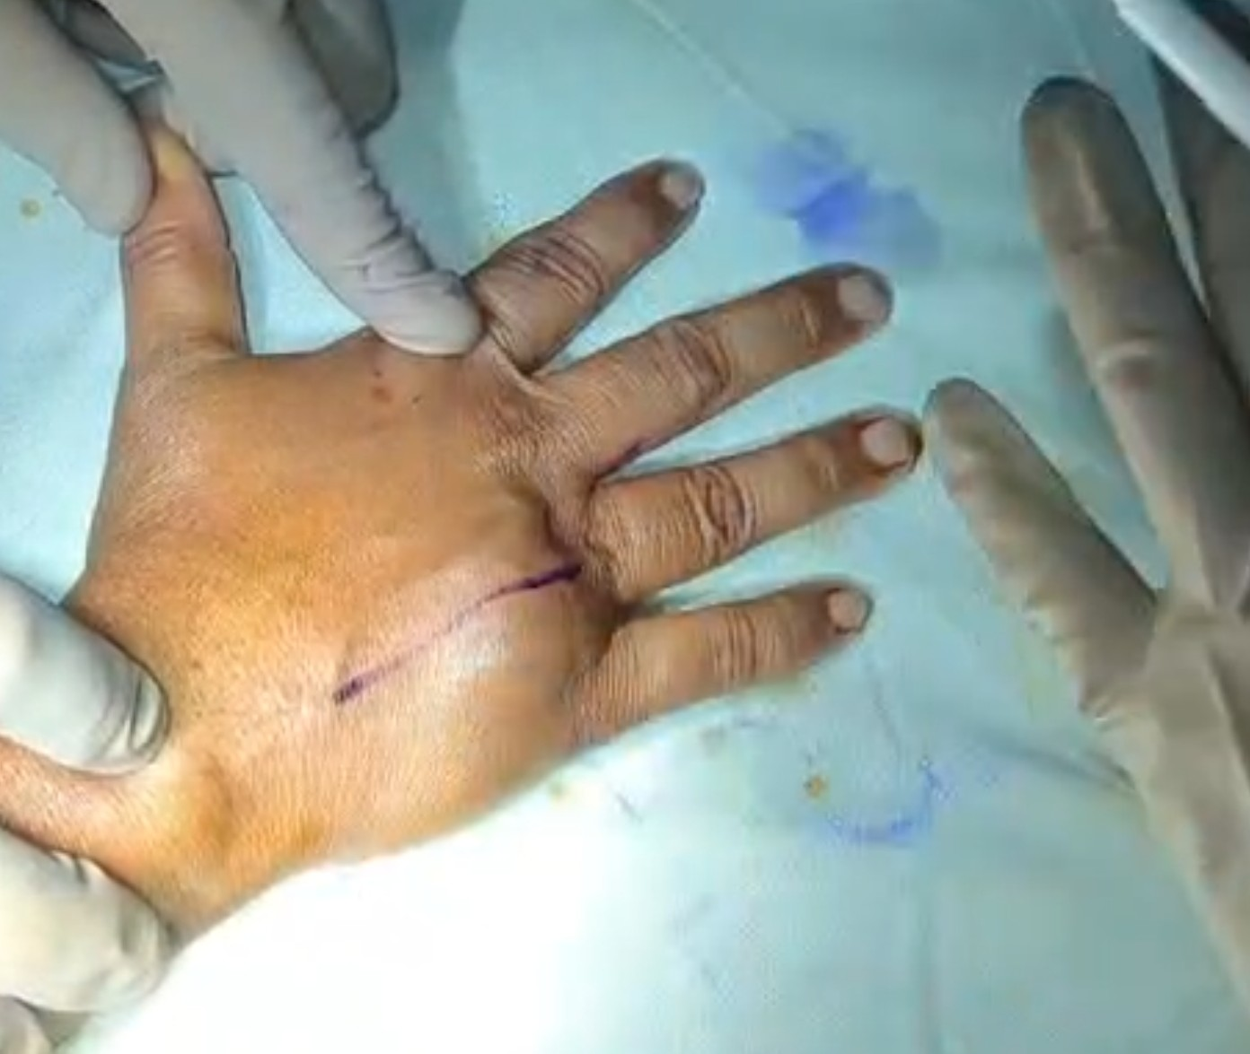
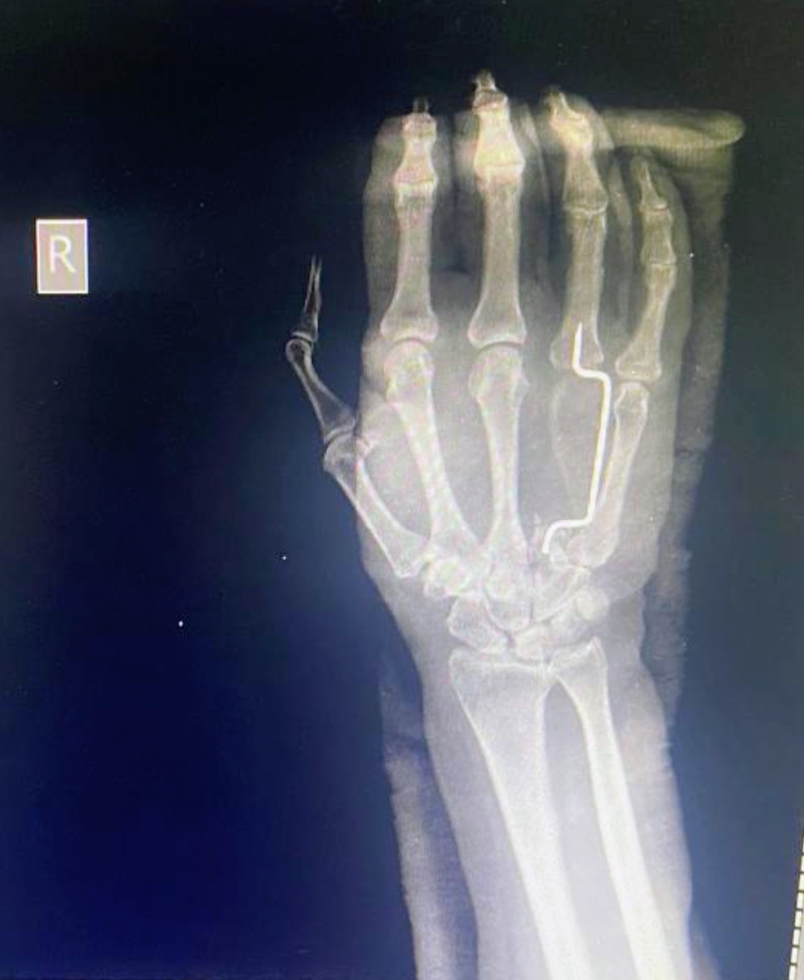
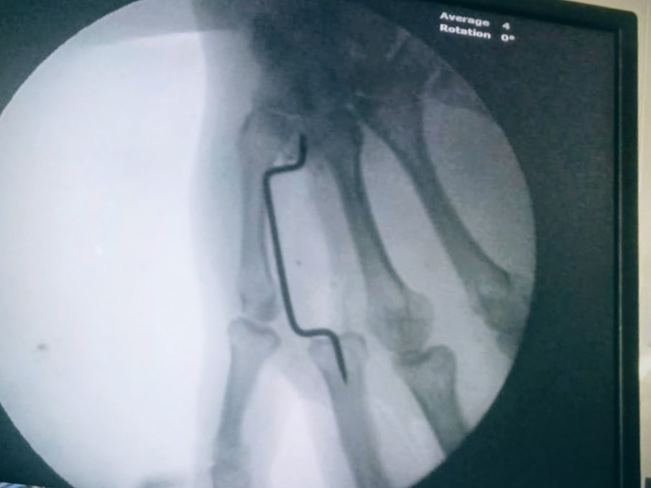
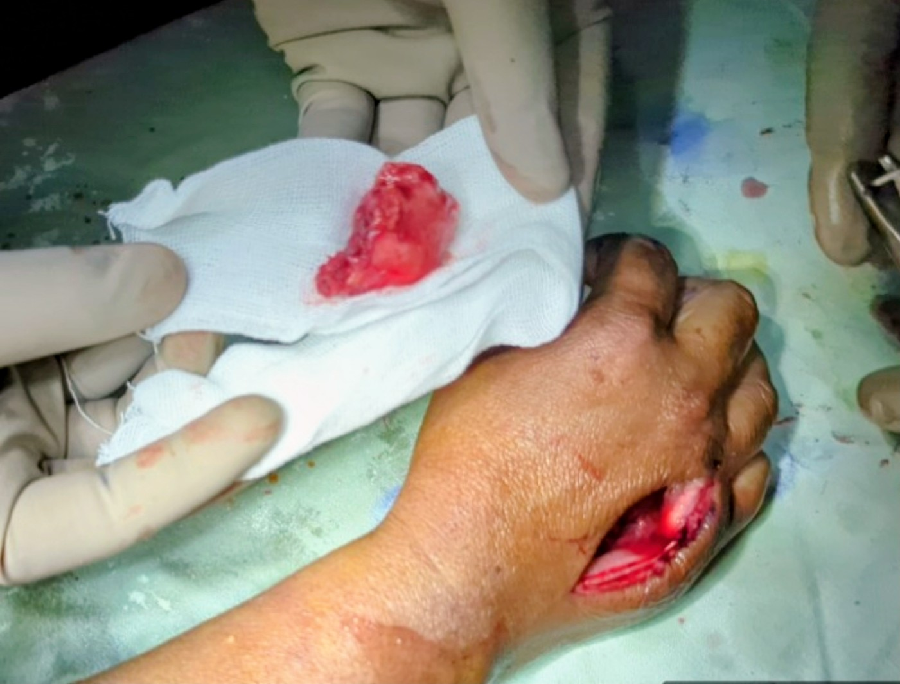
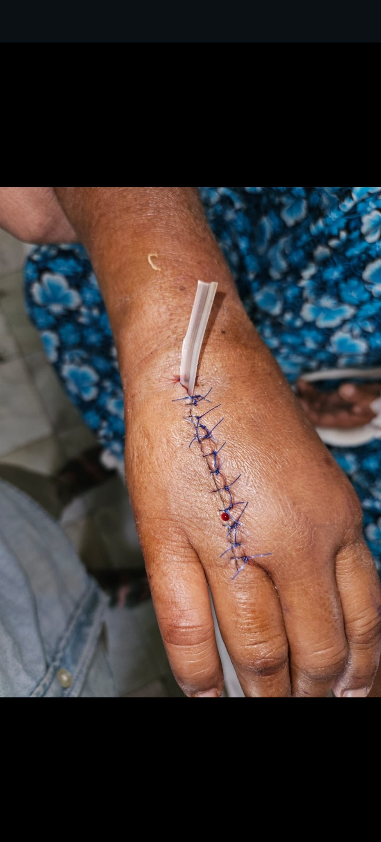
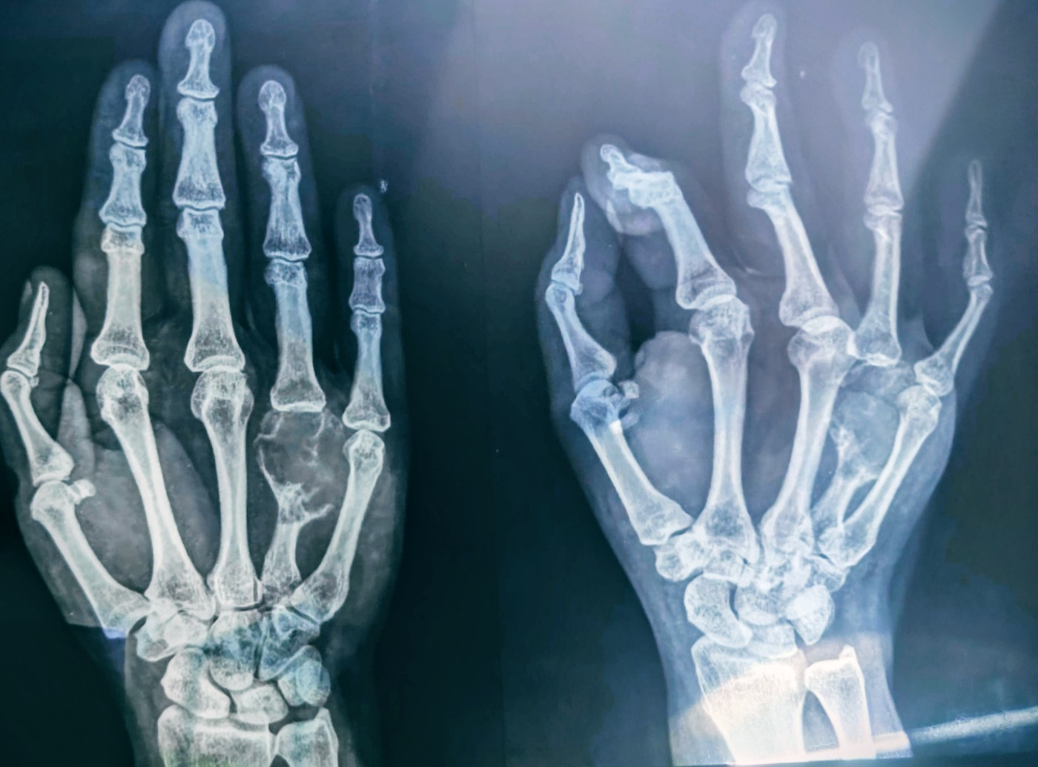
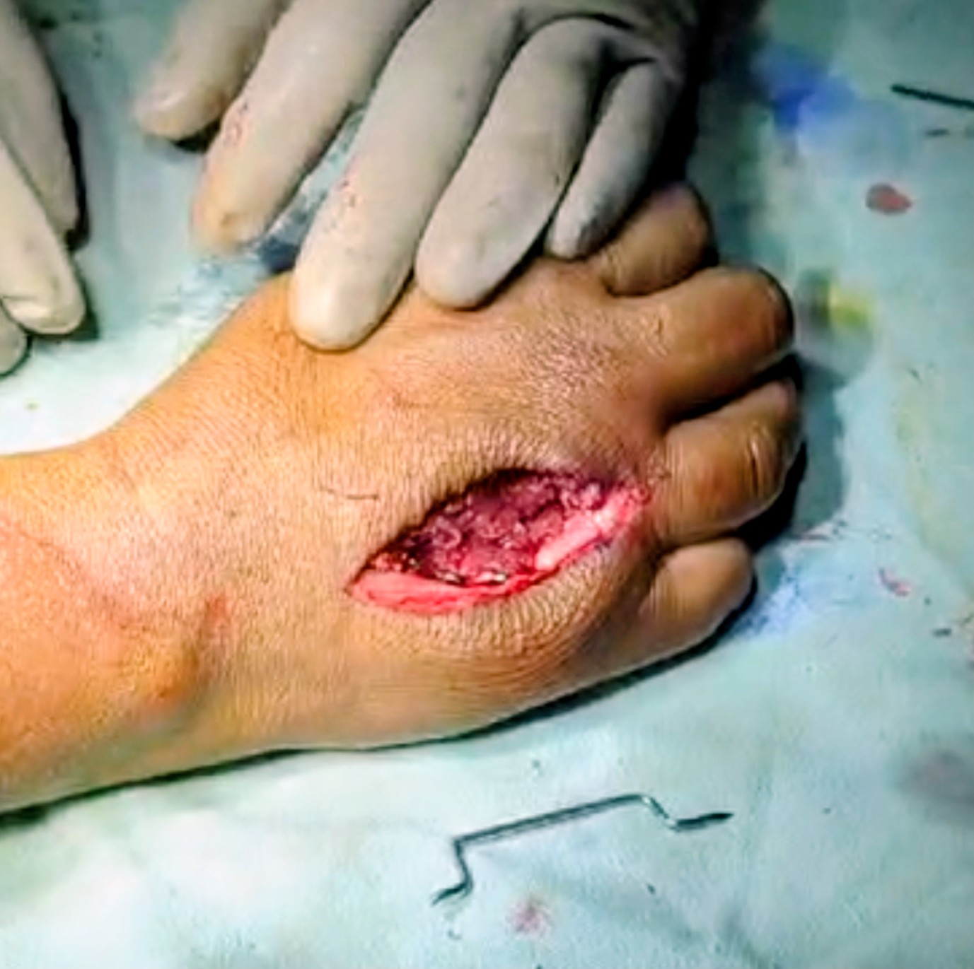
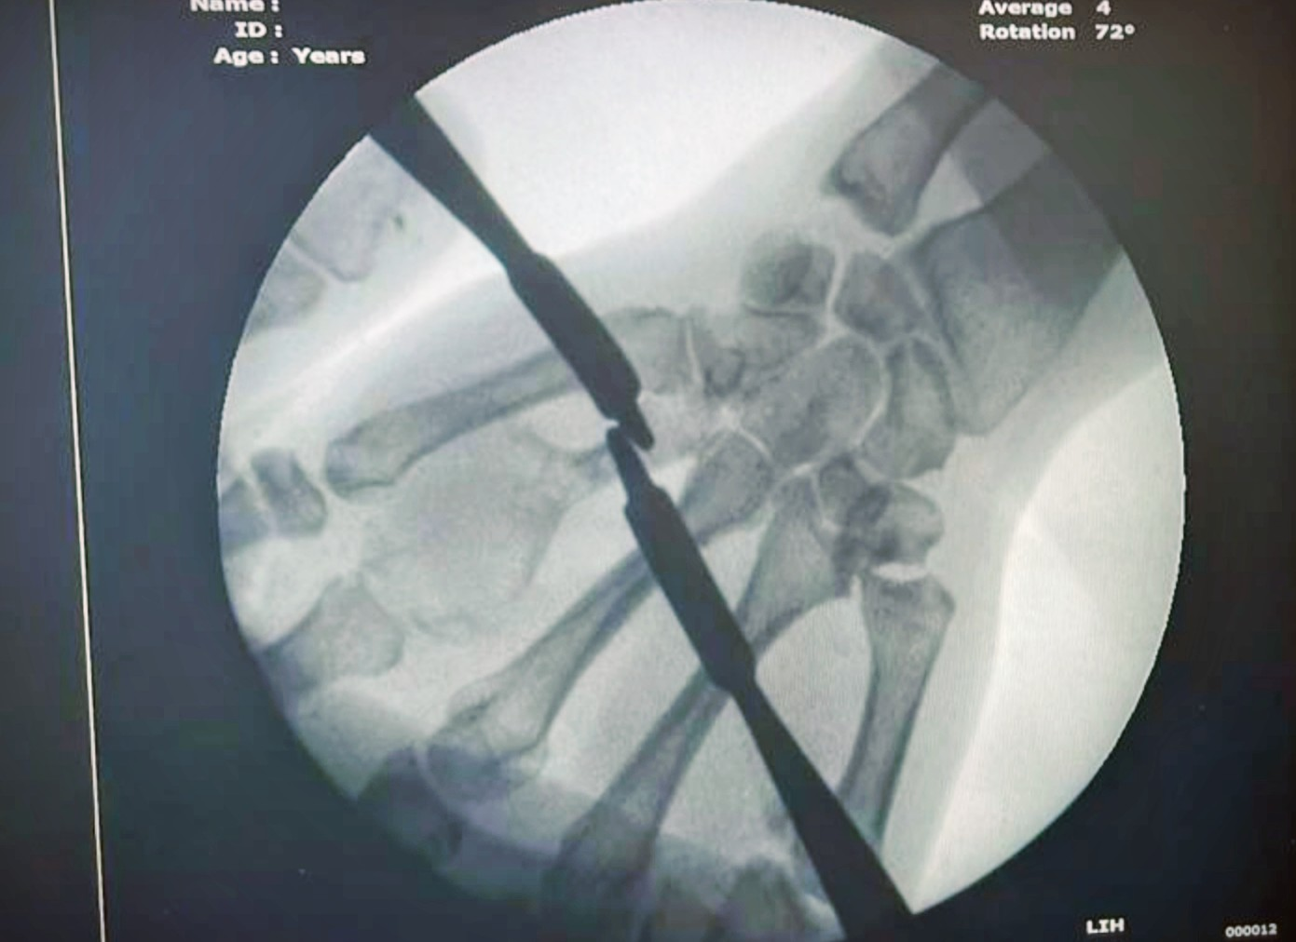
55th Annual Conference of Orthopaedic Surgeons Society of Andhra Pradesh
6–8 February 2026 | Kurnool Medical College, Kurnool
Organised by Department of Orthopaedics, Kurnool Medical College
Giant Cell Tumour of the Head of Fourth Metacarpal – A Rare Case Report
INTRODUCTION
  • GCT is a benign but locally aggressive osteolytic tumor arising from epiphyseal bone.
  • Accounts for ~5% of primary bone tumors; hand involvement <5%.
  • Hand lesions demonstrate higher recurrence and cortical breach.
  • Early diagnosis prevents joint destruction and tendon compromise.
  • Treatment must balance oncologic clearance with hand function preservation.
OPERATIVE FINDINGS
  • Dorsal approach under tourniquet control.
  • Friable brown tumor tissue with cortical breach.
  • Extended intralesional curettage and burring performed.
  • Temporary K-wire fixation for length maintenance.
  • Staged reconstruction planned after histopathology and surveillance.
KEY LEARNING POINTS
  • Metacarpal GCT is rare but biologically aggressive.
  • Imaging guides extent and joint involvement.
  • Staged curettage preserves function while ensuring safety.
  • Temporary fixation maintains length and alignment.
  • Long-term surveillance is essential.
CASE REPORT
  • 51-year-old female with painless progressive swelling over right 4th MCP region.
  • Duration 2 months, insidious onset, gradual progression.
  • No trauma, fever, tuberculosis or constitutional symptoms.
  • Local exam: firm non-fluctuant swelling, egg-shell crackling.
  • Restricted MCP motion; intact skin and neurovascular status.
DISCUSSION
  • Hand GCT shows higher recurrence than long bone counterparts.
  • Joint proximity leads to early articular invasion.
  • En bloc excision reduces recurrence but compromises function.
  • Staged curettage allows biological behavior assessment.
  • Regular radiologic follow-up mandatory for early recurrence detection.
IMAGING
  • X-ray: expansile, well-defined lytic lesion in 4th metacarpal head.
  • Cortical thinning and ballooning without matrix calcification.
  • No periosteal reaction or sclerosis.
  • MRI suggestive of benign aggressive lesion consistent with GCT.
  • Differentials: enchondroma, aneurysmal bone cyst.
Dr ADITHYA SATISH
POST GRADUATE
DEPT OF ORTHOPAEDICS,
GMC/GGH GUNTUR

