Slide 1


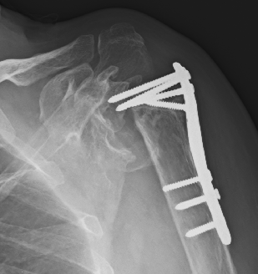
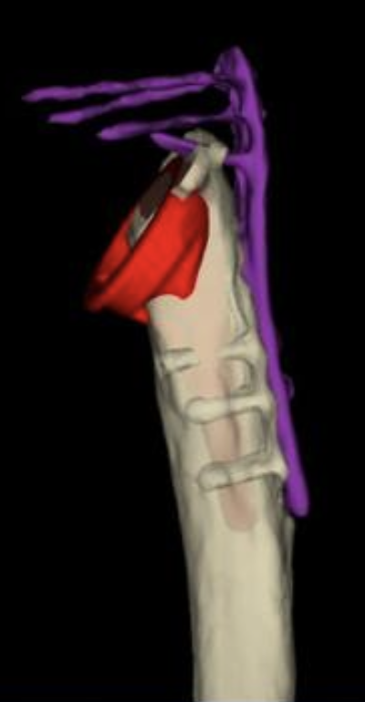
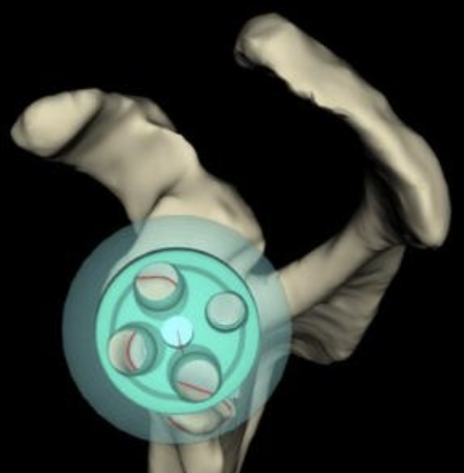
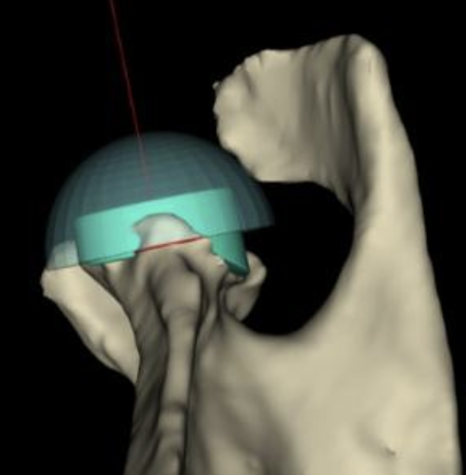
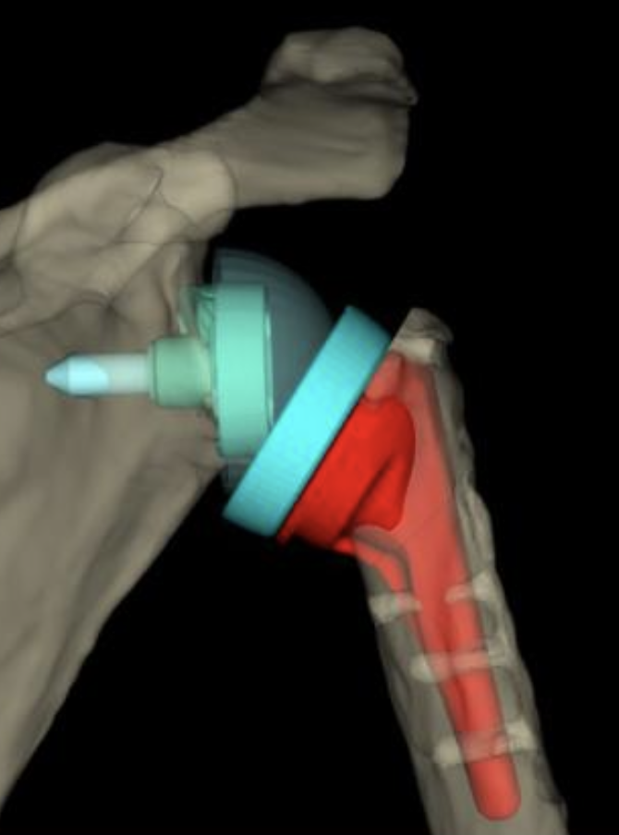
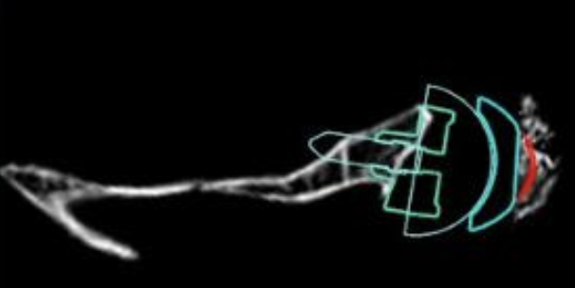
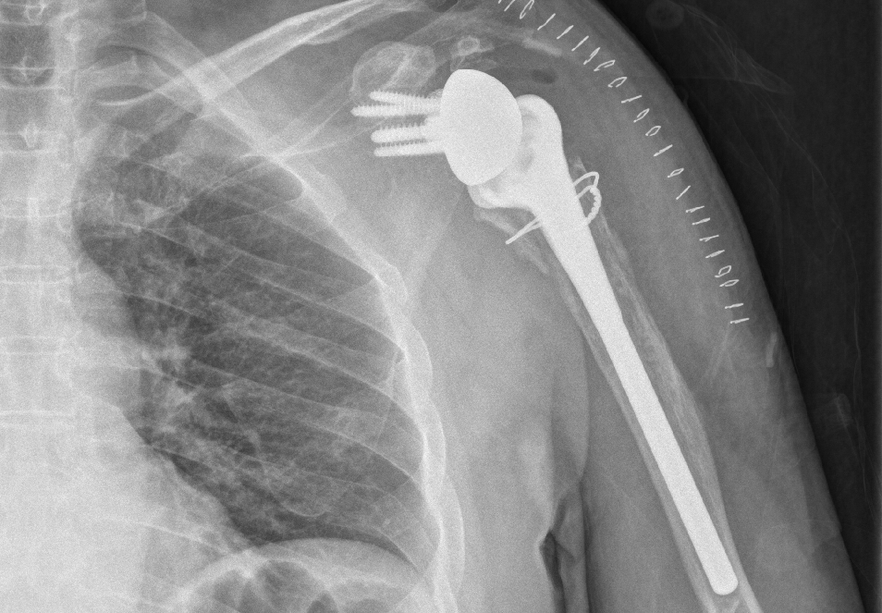
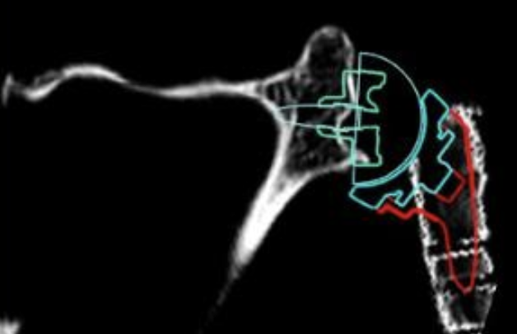
REBUILDING A COMPLEX POST-TRAUMATIC SHOULDER – REVERSE SHOULDER ARTHROPLASTY WITH VIRTUAL IMPLANT PLANNING
DR MAHITH GUDURI, DR THADI MOHAN
INTRODUCTION
EXAMINATION AND OPERATIVE FINDINGS
DISCUSSION
Chronic proximal humeral malunion secondary to implant failure results in distorted anatomy, altered biomechanics and rotator cuff dysfunction, making shoulder arthroplasty challenging.
Reverse shoulder arthroplasty (RSA) provides reliable functional restoration
CT-based Virtual Implant Positioning (VIP) planning allows patient-specific, 3D optimization of implant selection, positioning, and fixation.
O/E
Severely restricted ROM beyond 30°
PLANNING
3D CT was done with 1 mm cuts
Various implant sizes and version simulated
SURGERY
Deltopectoral approach
Subluxed humeral head remnant removed
Glenoid reaming done as per plan
Glenoid bone loss augmented with half wedge and bone graft
Glenosphere size and offset selected per VIP plan
Intra-operative fracture at the surgical neck approximated with cerclage
Subscapularis repair done
Intraop function was full
RSA is effective in proximal humerus implant failure with distorted anatomy with rotator cuff deficiency.
allows the deltoid to function as the primary elevator.
significant postop improvements with consistent gains in rotational movements.
provides a stable construct - reducing instability when compared with anatomic arthroplasty.
3D CT-based VIP planning
improves the accuracy of glenoid component placement .
patient-specific planning
enhanced implant biomechanics, fixation
HISTORY
CONCLUSION
66 y/o male
Had a left proximal humeral intra-articular fracture operated elsewhere 15 years back.
Subsequently, he reported painful restriction of movements not improving with physio.
RSA COMBINED WITH VIP PLANNING IMPROVES SURGICAL ACCURACY AND PRECISION IN IMPLANT POSITIONING LEADING TO PREDICTABLE OUTCOMES IN COMPLEX POST TRAUMATIC SHOULDER.

