Slide 1


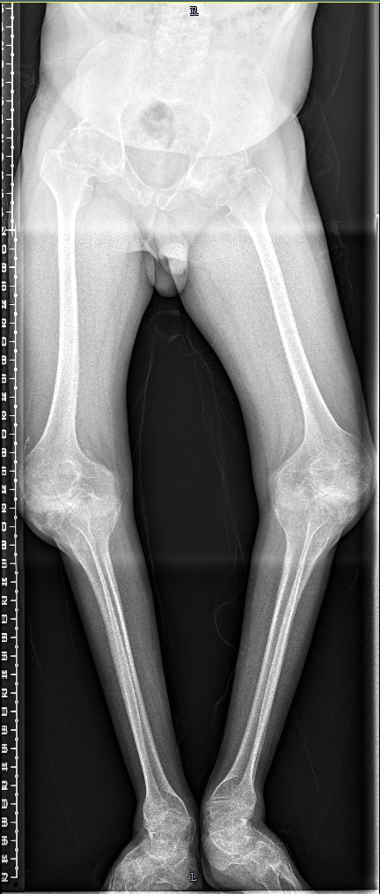
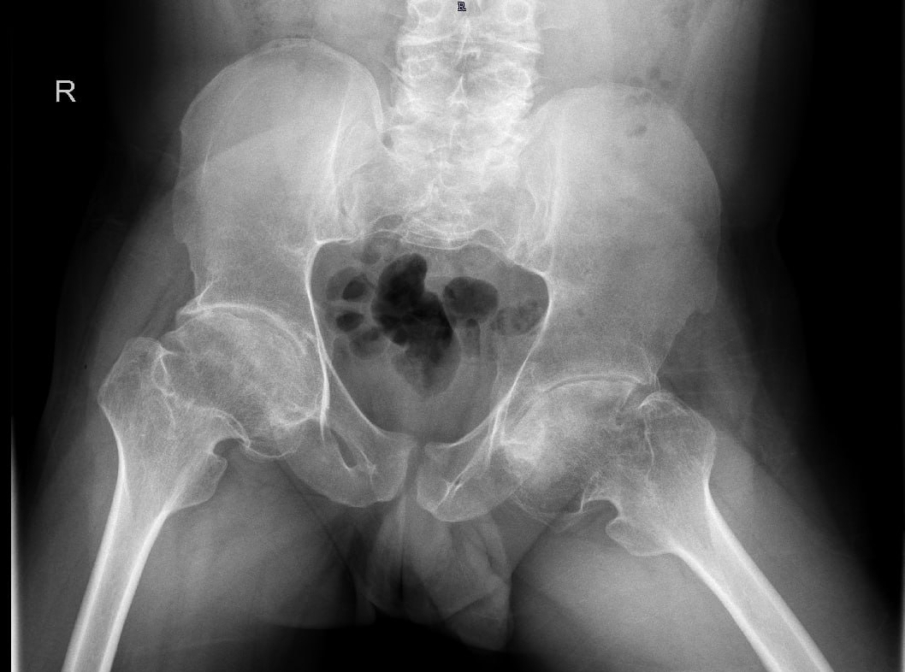
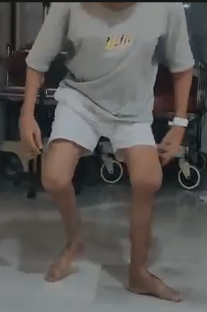
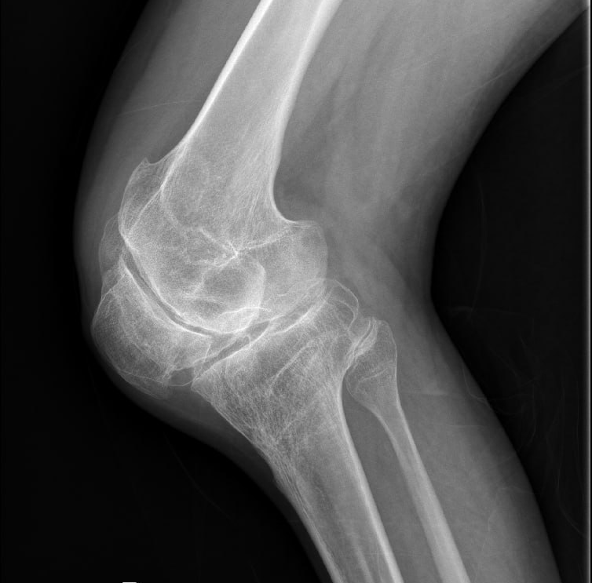
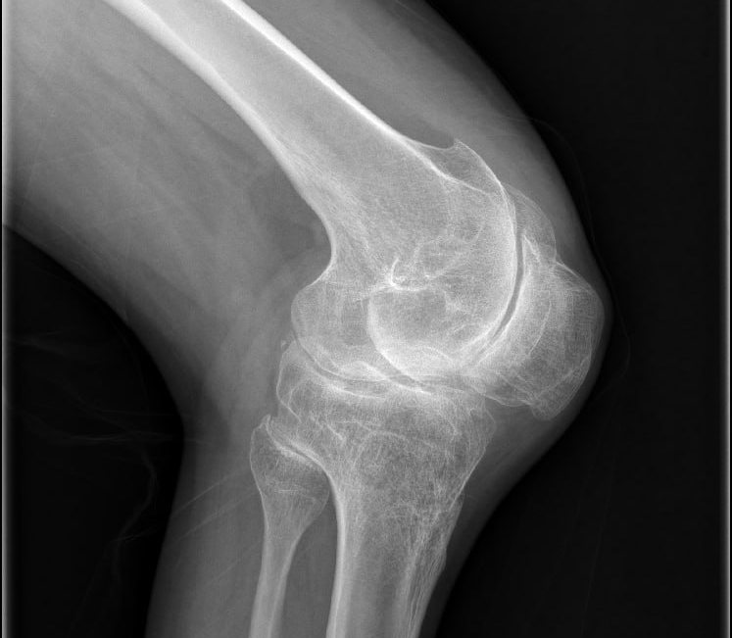
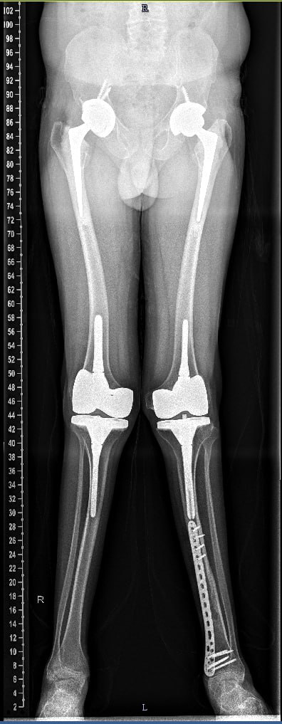
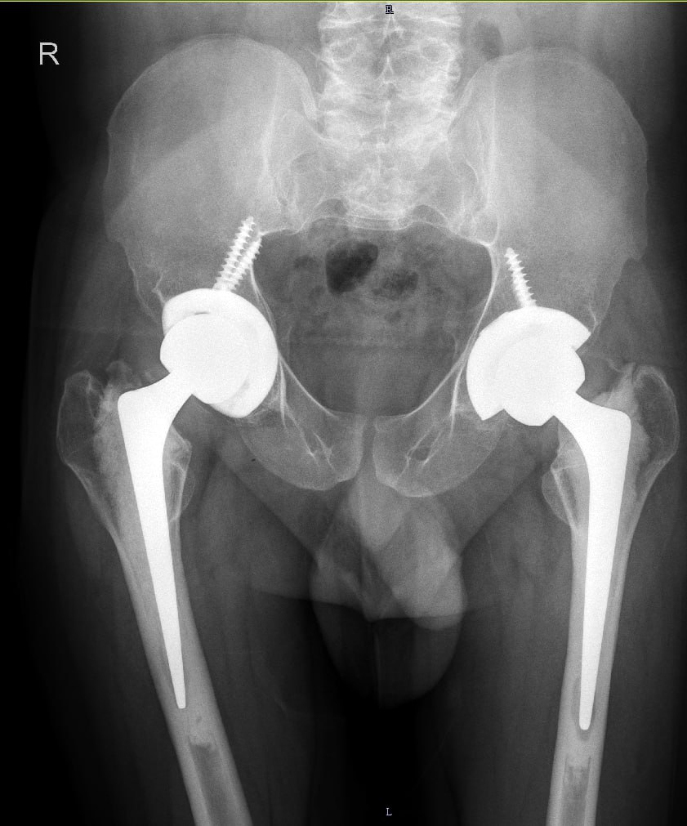
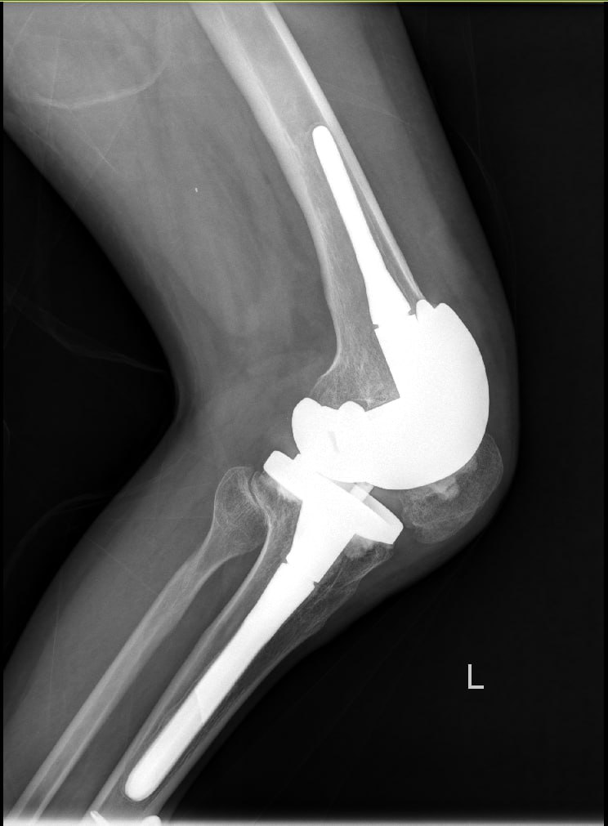
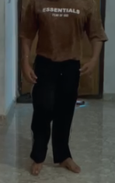
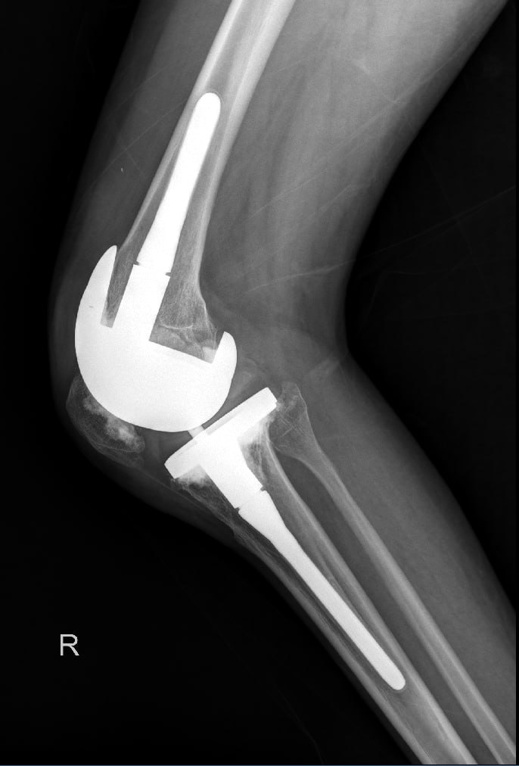
BREAKING THE STIFFNESS BARRIER: Bilateral Hip and Knee Arthroplasty in WISP3-Related PPRD
DR. CHINTA NITISH, DR. THADI MOHAN
INTRODUCTION
CASE REPORT
DISCUSSION
Progressive Pseudo-Rheumatoid Dysplasia (PPRD) is a rare autosomal recessive skeletal dysplasia caused by WISP3 (CCN6) mutations, leading to defective cartilage homeostasis. It presents with progressive cartilage degeneration, epimetaphyseal enlargement, and early joint stiffness without systemic inflammation. Frequently misdiagnosed as juvenile idiopathic arthritis, delayed diagnosis results in advanced joint destruction, posing significant challenges for arthroplasty.
POST-OP
LEFT | RIGHT
HIP FLEXION: 0⁰-90⁰ ABDUCTION: 0⁰-30⁰ ADDUCTION: 0⁰-15⁰ IR: 0⁰-20⁰ ER: 0⁰-30⁰ | HIP FLEXION: 0⁰-90⁰ ABDUCTION: 0⁰-40⁰ ADDUCTION: 0⁰-10⁰ IR: 0⁰-20⁰ ER: 0⁰-30⁰
KNEE FLEXION: 0⁰-110⁰ | KNEE FLEXION: 0⁰-110⁰
Literature on arthroplasty in PPRD is limited, with most reports describing isolated joint replacement. This case demonstrates that:
• Severe stiffness and deformity are not absolute contraindications to arthroplasty
• A staged approach reduces perioperative risk
• Deformity-specific techniques and constrained implants are critical for success
• Multidisciplinary planning and meticulous surgical execution are essential
RESULTS
Marked reduction in pain
Significant improvement in hip and knee range of motion
Correction of severe deformities
Achieved independent ambulation
Improved overall quality of life
HISTORY & PRESENTATION
CONCLUSION
Staged bilateral hip and knee arthroplasty can safely and effectively restore mobility, alignment, and function in advanced WISP3-related PPRD. Individualized surgical planning and tailored implant selection are key determinants of successful outcomes.
A 22-year-old male, a known case of WISP3-related Progressive Pseudo-Rheumatoid Dysplasia (PPRD), presented with bilateral knee and hip pain for the past 2 years. The pain was insidious in onset, gradually progressive, mild to moderate in intensity, non-radiating, and more pronounced on the left side. It was associated with progressive difficulty in walking and deformity of both hips and knees, with inability to achieve full joint extension. He had a long-standing history of polyarthralgia and delayed ambulation, having started walking at 15 months with anterior bowing of both lower limbs. Following childhood conservative management and a prolonged functional plateau, his symptoms worsened over the last 2 years, prompting presentation to our tertiary care Centre for further evaluation and management
PRE-OP
B/L HIPS: NO MOVEMENTS, FFD – 60⁰
B/L KNEES: FFD – 40⁰ ,FLEXION 40-110⁰
TAKE HOME MESSAGE`
“Even extreme stiffness and deformity in PPRD can be overcome with meticulous planning, staged surgery, and appropriate implant choice”
What was done:
Stage 1: Left Total Hip Replacement + Left Total knee Replacement
Stage 2: Right Total Hip Replacement + Right Total Knee Replacement
REFERENCES: Hurvitz JR et al. Nat Genet. 1999; Garcia-Segarra N et al. Am J Med Genet C. 2012; Wang W et al. Medicine (Baltimore). 2023; Outrequin A et al. J Orthop Case Rep. 2024

