Slide 1
A COMPARATIVE STUDY ON RADIAL HEAD FIXATION VERSUS EXCISION
ABSTRACT-
AIM:- Radial head fractures account one third of the fractures around the elbow. Earlier radial head resection was common for comminuted fractures, With advancement of the technology,to know better method of treatment for radial head fractures in Massons II and III , In this study I aim to compare the outcome in radial head open reduction and internal fixation with that of radial head excision
METHODS :- Prospective study consisting of 21 patients of age 18-60 years, Group 1 of 13 patients with internal fixation of radial head and Group 2 of 8 patients with radial head excision.The study was conducted at Guntur Medical College and Hospital, between 2024-2025 after obtaining clearance from the ethical committee and informed consent from all the patients
CONCLUSION:- Radial head fractures of Masson Type II and III have better functional outcome with reduced complications in Open reduction and internal fixation groups than compared to the radial head excision groups

Slide 2
INTRODUCTION:
Radial head and neck fractures constitute up to one third of all fractures around the elbow. They account for approximately 1.5-4% of all the fractures in adults.1,2 It usually involves a fall on the outstretched and with pronation and wrist extension or direct trauma. Elbow forms an essential component of the upper extremity helping in support, grasping, fine movement of hand and wrist. Fracture of the radial head disables the elbow joint in its function. Thus it is utmost necessary to treat the fractures of radius for normal functioning of the elbow.3
Radial head fractures were classified first by Mason3, and later modifies by Johnston4. Type I includes minimally or undisplaced radial head fractures, type II are marginal sector fractures with displacement, type III are communited fractures and type IV involves fractures of radial head with dislocation of elbow. The most of the radial head are isolated fractures but many are also associated with ligamentous injury, fractures of olecranon, capitellum, coronoid and proximal ulna.
There are different treatment options for radial head fractures which includes the radial head fixation, radial head prosthesis and plating.
This study aims at evaluating the outcome of patients treated with internal fixation and excision of radial head

Slide 3
METHODOLOGY
The study comprises of 21 patients of age group 18-60 yrs. with average of 50 years. Patents were randomly allotted in to two groups. Group 1 comprising of 13 patients with internal fixation of radial head and group 2 comprises of 8 patients with radial head excision. The study was conducted at Guntur Medical College and Hospital, between 2024-2025 after obtaining clearance from the ethical committee and informed consent from all the patients. The patients with Mason Type I and Type IV fractures, skeletally immature patients, pathological fractures, patients with associated neurological injury, head injury were excluded from the study.
The patient was taken up for surgery after medical fitness was obtained. Preoperative antibiotics were started 1 hour before the surgery. The patient was positioned in supine position with elbow flexed to 90 degrees and internal rotation of the arm over the arm board after securing regional block or general anesthesia. Kochers approach, the interval between Extensor carpi ulnaris and Anconeous or the Kaplans approach, the interval between the Extensor carpi radialis brevis and Extensor digitorum communis or the plain created due to trauma was extended in the approach to radial head.

Slide 4
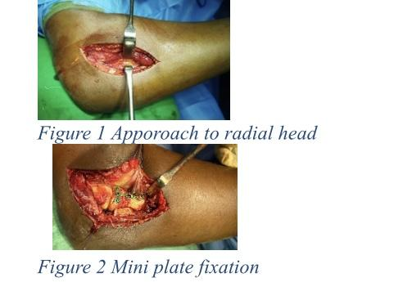

Slide 5
Once the radial head was exposed, the radial head was removed in group II, fragments were provisionally fixed in group I with K-wires. Under C-arm guidance the radial head was fixed with mini fragment plate or Herbert screw or the locking plate in group I patients. The plates were placed in the safe zone of the radius. The stability was checked intra-op by movements and fluoroscopy imaging. Above elbow POP slab was applied to all the patients for 4 weeks followed by mobilization. Intravenous antibiotics was given for 5 days and patients were discharged followed by 5 days of oral antibiotics. Suture removal was done on postop day 10.
Patients were reviewed at 1, 3 and 6 months. X rays were done and were assessed and scored as per Broberg and Morry score5. One way ANOVA test was done for statistical analysis.

Slide 6
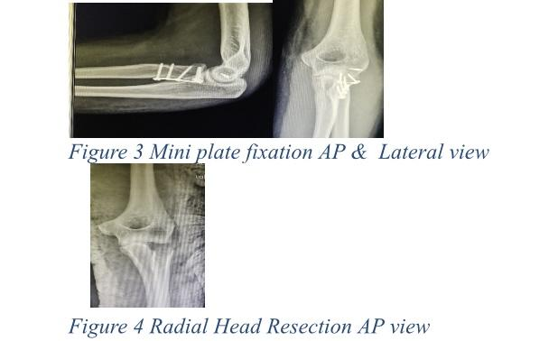

Slide 7
RESULTS
A majority of the patients were in the age group of 28-46 years, Averaged around 35 years. 21 patients underwent open reduction and internal fixation and 8 underwent excision. Majority of fractures were united by 3 months. Average Broberg and Morrey score was 91.071 in the group I while 81 in group II with a significant p-value. Periarticular Occification was noted in 1 patient in group I and proximal migration were noted in Group II.

Slide 8
DISCUSSION
Until 1970s the main modality of treatment in Mason Types II, III and IV was radial head resection. Later in 1980’s the radial head anatomy and the stabilizers of elbow was researched and discussed in great detail. After which the instrumentation and surgical techniques improved and the radial head fixation came to the lime light.
Further the research publications mentioned the importance of the radial head in maintaining the elbow stability and the complication of radial head resections were mentioned in great detail. In later days the radial head prosthesis was also researched and was mostly used in Masson type III and IV, as in severe radial head communition.
Incomplete radial head partial articular fractures show good to excellent results in many retrospective cases.5-8
In a study by Khalfayan et al., they investigated outcomes in patients with radial head incomplete articular fractures. Among these patients, 16 were managed conservatively, while 10 underwent operative treatment. The retrospective analysis, with a mean follow-up of 1.5 years, revealed that 90% of patients treated operatively achieved good-to-excellent results, compared to only 44% in the non-operative group (P<0.01). Notably, X-rays of non-operatively treated patients showed greater displacement, joint surface malalignment, and arthritic changes.9
Additionally, Pearce et al. examined 19 patients with isolated, displaced partial articular fractures who received operative management (open reduction and internal fixation, ORIF). Their study demonstrated comparable functional outcomes across all enrolled participants.10
In a retrospective study conducted by Ring et al., they examined 30 patients divided into two groups, each consisting of 15 patients. One group included patients with comminuted fractures, while the other group comprised patients with a single fragment. Both groups were managed using open reduction and internal fixation (ORIF). Interestingly, satisfactory results were observed in patients with single fragments, whereas the other group experienced unsatisfactory outcomes (approximately 27%).11
Our study of comparison between radial head fixation group and resection group with the evaluation of the elbow function were done at 1,3 and 6 months. We observed that excellent results in Broberg and Morrey score in 8 patients of group I and only 3 patients in Group II. Thus the patients who underwent open reduction and internal fixation were having better results than compared to the radial head resection group, also in terms of elbow function.

Slide 9
LIMITATION
The sample size was small. The follow up was limited to 6 months. Limited study of only 21 patients.
CONCLUSION
Radial head fractures of Masson Type II and III have better functional outcome with reduced complications in Open reduction and internal fixation groups than compared to the radial head excision groups.
Conflict of interest:
There is no conflict of interest to declare

Slide 10
REFERENCES
1. Herbertsson P, Josefsson PO, Hasserius R, Karlsson C, Besjakov J, Karlsson M. Uncomplicated Mason type-II and III fractures of the radial head and neck in adults. A long-term follow-up study. J Bone Joint Surg Am. 2004;86-A:569–574.
2. Herbertsson P, Josefsson PO, Hasserius R, Besjakov J, Nyqvist F, Karlsson MK. Fractures of the radial head and neck treated with radial head excision. J Bone Joint Surg Am. 2004;86-A:1925–1930.
3. Mason ML. Some observations on fractures of the head of the radius with a review of one hundred cases. Br J Surg. 1954;42:123–132.
4. Johnston GW. A followup of one hundred cases of fracture of the head of radius with a review of the literature. Ulster Med J. 1962;31:51-6
5. ] Vannabouathong C, Akhter S, Athwal GS, Moro J, Bhandari M. Interventions for displaced radial head fractures: network meta-analysis of randomized trials. J Shoulder Elbow Surg 2019; 28(3): 578-586.
6. Crönlein M, Zyskowski M, Beirer M, Imhoff FB, Pförringer D, Sandmann GH, et al. Using an anatomically preshaped low-profile locking plate system leads to reliable results in comminuted radial head fractures. Arch Orthop Trauma Surg 2017; 137(6): 789-795.
7. Liu G, Chen E, Xu D, Ma W, Zhou L, Chen J, et al. Open reduction and internal fixation with bone grafts for comminuted mason type II radial head fractures. BMC Musculoskelet Disord 2018; 19(1): 1-7.
8. Kadam R, Sharma C, Pandhare S, Chhallani A, Gupta A, Sawant R. Functional outcome of radial head replacement in isolated radial head fractures. Int J Res Orthop 2017; 3(3): 362.
9. Rochwerger A, Bataille JF, Kelberine F, Curvale G, Groulier P. Retrospective analysis of 78 surgically repaired fractures of the radial head. Acta Orthop Belg 1996; 62(Suppl 1): 87-92.
10. Pearce MS, Gallannaugh SC. Mason type II radial head fractures fixed with Herbert bone screws. J R Soc Med 1996; 89(6): 340P-344P.
11. Ring D, Quintero J, Jupiter JB. Open reduction and internal fixation of fractures of the radial head. JBJS 2002; 84(10): 1811-1815

