Slide 1




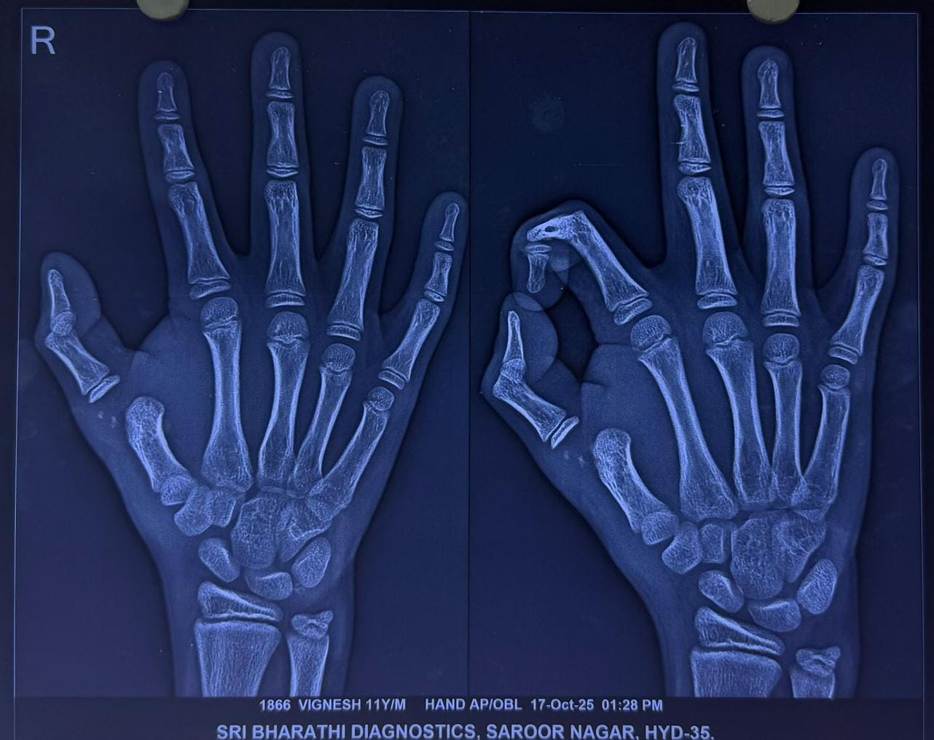
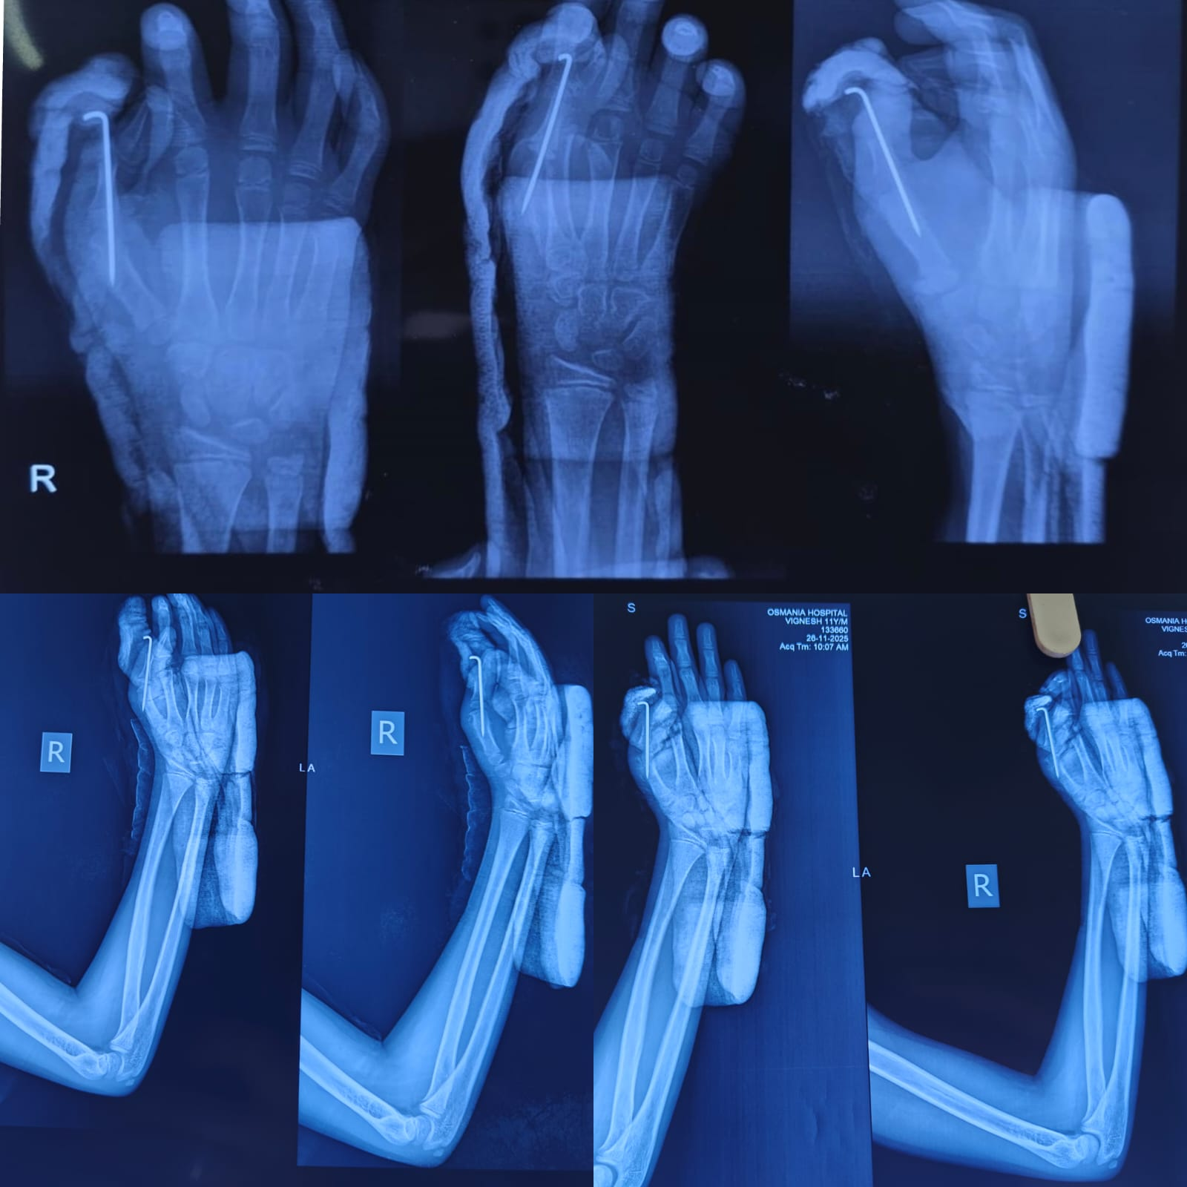
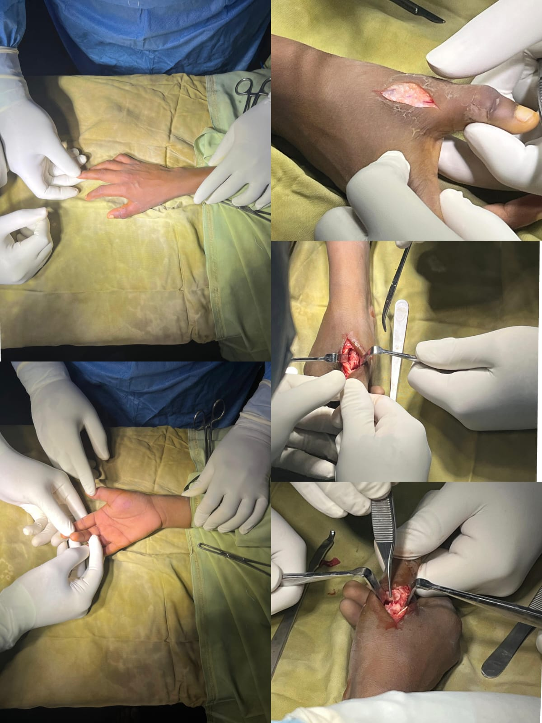
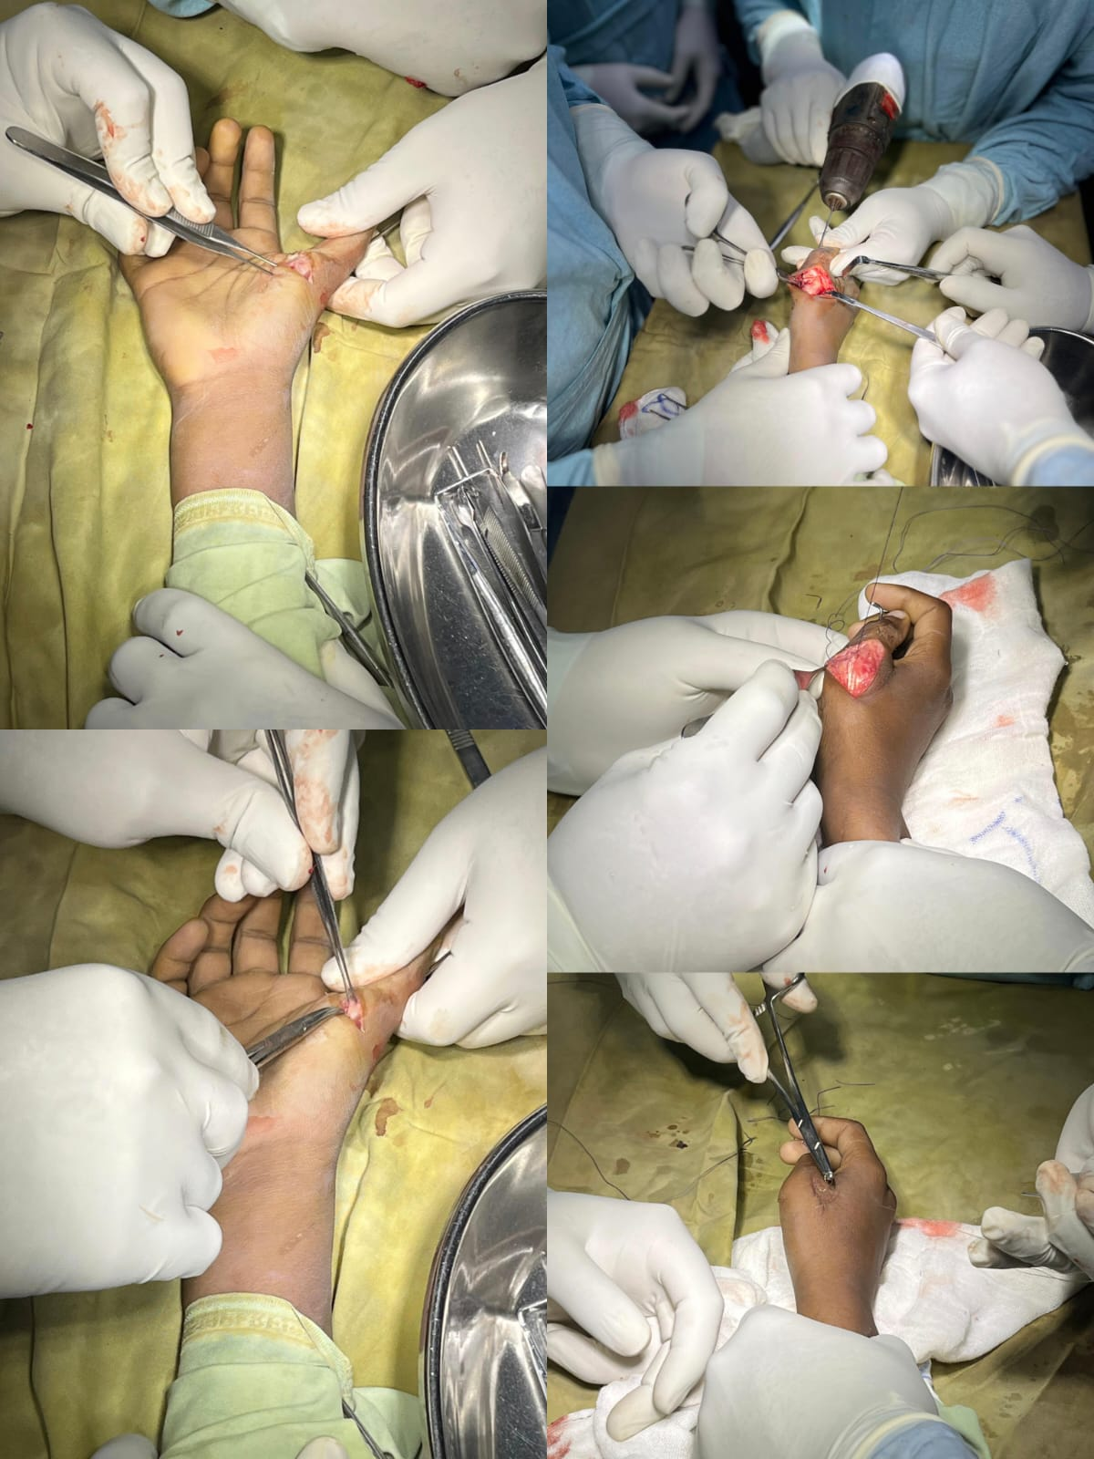
55th Annual Conference of
Orthopedic Surgeon Society of Andhra Pradesh
Date 20– 22 February,2026, Venue : Kurnool Medical College
Organized by : Department of Orthopaedics, Kurnool Medical College Kurnool
A RARE CASE OF KAPLAN DISLOCATION BY COMBINED OPEN DORSAL AND VOLAR APPROACH
AUTHOR: DR ATHUL K – POST GRADUATE
GUIDE: DR J H VIDYASAGAR( ASSISTANT PROFFESOR),DR TANZEEL MUNAWAR ( ASSISTANT PROFFESOR) , OSMANIA MEDICAL COLLEGE
OSSAP ID -588
INTRODUCTION
OPERATIVE FINDINGS
DISCUSSION
Open reduction was performed using a combined dorsal and volar approach. Intra‑operative observations included:
Interposition of the volar plate within the joint
Sesamoid complex entrapped between articular surfaces
Tight flexor pollicis longus tendon acting as a noose
The obstructing structures were carefully released. Reduction was achieved under direct visualization fixed with K wire, restoring joint congruity. Stability of the MCP joint was confirmed intra‑operatively, and immobilization was provided post procedure.
Kaplan’s dislocation differs from simple MCP dislocations due to soft‑tissue interposition that blocks closed reduction. The volar plate, natatory ligament, sesamoids, and flexor tendons form a constricting ring around the metacarpal head
. Key discussion points: • Closed reduction attempts may worsen soft‑tissue interposition
• Delayed presentations are more likely to require open reduction
• Dorsal approach provides good visualization of joint surfaces.
• Volar approach allows safe release of the volar plate and sesamoids.
• A combined approach offers comprehensive exposure facilitating accurate reduction .
Kaplan’s dislocation is a rare and complex form of dorsal dislocation of first MCP Joint.
It is characterized by interposition of volar plate,sesamoids,flexor tendons and surrounding soft tissues which prevent successful closed reduction.
These injuries are uncommon in paediatric population and often require open reduction.
Early recognition and appropriate surgical approach are essential to restore joint congruity,stability and function.
CASE REPORT
CONCLUSION
A 11 year old boy presented 3 weeks following trauma to right hand.
Clinical findings :
Swelling and tenderness over firstMCP
Dorsal deformity of thumb
Painful and restricted ROM.
Radiological Evaluation: AP and oblique radiographs of the right hand confirmed dorsal dislocation of the first MCP joint.
Kaplan dislocation of first MCP Joint is rare and usually complex,particularly in paediatric patients.Closed reduction should be avoided in suspected complex dislocations.A combined dorsal and volar approach provides superior visualization,enables safe release of interposed structures,and ensures stable anatomical reduction,leading to good functional outcomes.

