Slide 1
OUTCOME OF TIGHT ROPE FIXATION IN DISTAL TIBIO- FIBULAR SYNDESMOSIS DISRUPTION IN COMPARISON WITH CONVENTIONAL SYNDESMOTIC SCREW FIXATION
DR ATHUL K
POST GRADUATE
OSMANIA MEDICAL COLLEGE,HYDERABAD

Slide 2
INTRODUCTION
Ankle fractures are frequently associated with disruption of distal tibio fibular syndesmosis.
Restoration of anatomical syndesmosis holds great importance in clinical outcomes post operatively in ankle fractures.
Until now syndesmotic screws were being used for syndesmosis reduction and fixation in ankle fractures.
But it has its own drawbacks like need for screw removal subsequently and too rigid fixation of syndesmosis allowing no micro movements which are normally present at the distal tibiofibular syndesmosis

Slide 3
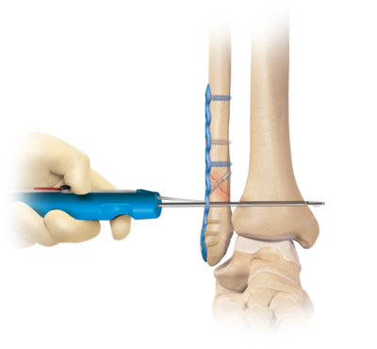
a recent technique of using tight rope to fix ankle syndesmosis has been reported to have shown good clinical outcomes.
Tight rope is a strong thin fibre wire inter connected with 2 metallic buttons.

Slide 4
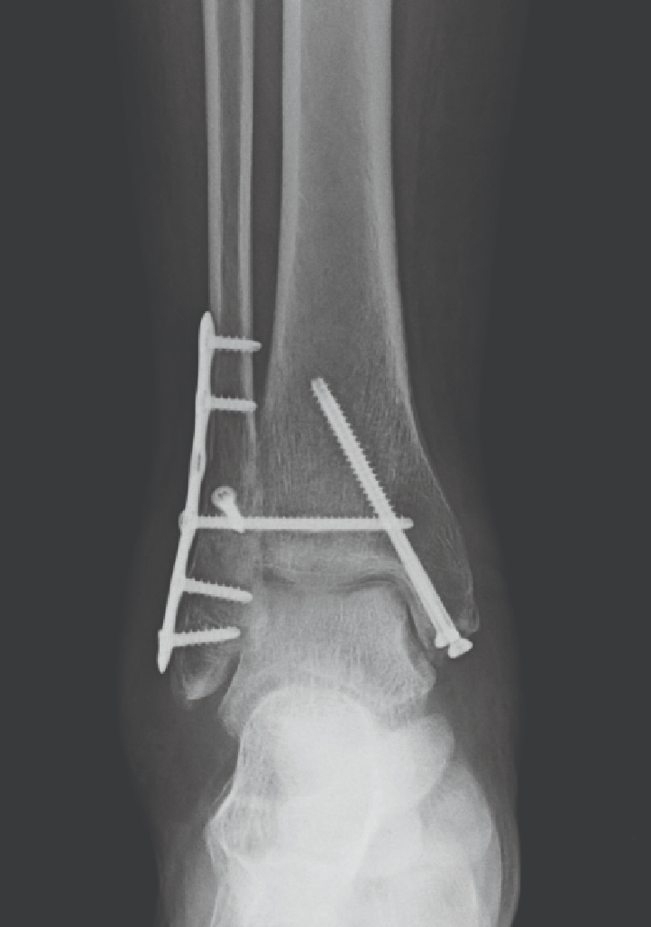
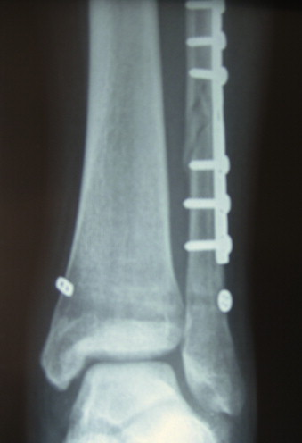

Slide 5
MATERIALS AND METHODS
Here we compare the clinical outcomes of patients operated with a tight rope and patients operated with syndesmotic screw to fix the ankle syndesmosis by a retrospective study.
20 post operative patients operated at OSMANIA General Hospital, Hyderabad between 2023 to 2025 were selected in this study with 10 belonging to the syndesmotic screw group and 10 to the tight rope group.
Patients were selected based on inclusion and exclusion criteria.
This cohort study included all consecutive adult patients treated for acute ankle syndesmotic diastases with either the TightRope or the syndesmotic screw fixation method in our Hospital over a period of 2 years, between 2023 and 2025.
Patients with compound fractures, multiple injuries, neuropathic arthropathy, bilateral injuries, and chronic or missed syndesmotic injuries were excluded.
Average duration of follow up was 22-24 weeks.
The outcome was assessed using American Orthopaedic Foot and Ankle Society (AOFAS) and Foot and Ankle Disability Index (FADI) scores and radiographic parameters for syndesmosis integrity.

Slide 6
SURGICAL TECHNIQUES
All procedures were performed with patients in the supine position under general or spinal anesthesia with antibiotic prophylaxis and tourniquet control.
Standard techniques were used to internally fix fractures of the fibula or tibia requiring fixation, and a large clamp with the ankle in neutral position was used to reduce and maintain syndesmosis.
If a plate was used for fibular stabilization, the drill hole was made through one of the empty plate holes, depending on the location of the plate.
In patients treated with a syndesmotic screw, either a 3.5-mm or a 4.5-mm cortical screw was inserted through the drill hole, engaging all 4 cortices.
In the TightRope group, the needle attached to the leading oblong Button was passed through the holes and out from the intact medial skin along with the pull-through sutures. Once the medial button was passed through the medial tibial cortex (confirmed by imaging), the assembly was tensioned by pulling the free ends of the FiberWire on the lateral side.
Once both the buttons were seated flush with the bone, the free ends of the FiberWire were hand tied on the lateral side and cut 1 cm long and buried.

Slide 7
RESULTS
20 eligible patients were included in the study; 10 patients were in the TightRope group and 10 in the syndesmotic screw group.
The average age was 42 years in the TightRope and 40 years in the syndesmotic screw group, and the mean follow-up time was 24 weeks .
The average width of normal syndesmosis was 4.03 ± 0.89 mm.
In the TightRope group, the mean width of syndesmosis was 4.37 mm (SD, ±1.12 mm) (P = .30, t test) compared with 5.16 mm (SD, ±1.92 mm) in the syndesmotic screw group (P = .01, t test).
Four of 10 ankles (40%) in the syndesmotic screw group had syndesmotic malreduction, whereas none of the TightRope group showed malreduction on CT scans (P = .04, Fisher exact test).
Average time to full weightbearing was 8 weeks in the TightRope group and 9.1 weeks in the syndesmotic screw group.
There was no significant difference between the TightRope and syndesmotic screw groups in mean postoperative AOFAS score (89.56 and 86.52, respectively) or FADI score (82.42 and 81.22, respectively).
Regression analysis confirmed malreduction of syndesmosis as the only independent variable that affected the clinical outcome (regression coefficient, -12.39; t = -2.43; P = .02).

Slide 8
CONCLUSION
The results of this study indicate that fixation with TightRope provides a more accurate method of syndesmotic stabilization compared with screw fixation.
Syndesmotic malreduction is the most important independent predictor of clinical outcomes; therefore, care should be taken to reduce the syndesmosis accurately.
Hence we conclude that tight rope is superior in providing ankle syndesmosis stability along with micro movements at the syndesmosis than compared to the syndesmotic screw.

Slide 9
REFERENCES
1. Arthrex Inc. Surgical technique. www.ankletightrope.com. Accessed March 26, 2011
2. Beumer A, van Hemert WL, Niesing R, et al. Radiographic measurement of the distal tibiofibular syndesmosis has limited use. Clin Orthop Relat Res. 2004;423:227-234.
3. Coetzee JC, Ebeling P. Treatment of syndesmoses disruptions: a prospective, randomized study comparing conventional screw fixation vs TightRope fiber wire fixation–medium term results. South Afr Orthop J. 2009;8(1):32-37.
4. Cottom JM, Hyer CF, Philbin TM, Berlet GC. Transosseous fixation of the distal tibiofibular syndesmosis: comparison of an interosseous suture and Endobutton to traditional screw fixation in 50 cases. J Foot Ankle Surg. 2009;48(6):620-630.
5. Cottom JM, Hyer CF, Philbin TM, Berlet GC. Treatment of syndesmotic disruptions with the Arthrex Tightrope: a report of 25 cases. Foot Ankle Int. 2008;29(8):773-780.
6. Court-Brown CM, McBirnie J, Wilson G. Adult ankle fractures—an increasing problem? Acta Orthop Scand. 1998;69(1):43-47.
7. Dattani R, Patnaik S, Kantak A, Srikanth B, Selvan TP. Injuries to the tibiofibular syndesmosis. J Bone Joint Surg Br. 2008;90(4):405-410.
8. DeGroot H, Al-Qmari A, El Ghazaly SA. Outcomes of suture button repair of the distal tibiofibular syndesmosis. Foot Ankle Int. 2011;32:250-256.
9. Ebraheim NA, Lu J, Yang H, Mekhail AO, Yeasting RA. Radiographic and CT evaluation of tibiofibular syndesmotic diastasis: a cadaver study. Foot Ankle Int. 1997;18(11):693-698.
10. Elgafy H, Semaan HB, Blessinger B, Wassef A, Ebraheim NA. Computed tomography of normal distal tibiofibular syndesmosis. Skeletal Radiol. 2010;39(6):559-564.

