Slide 1





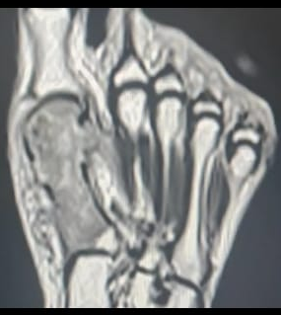
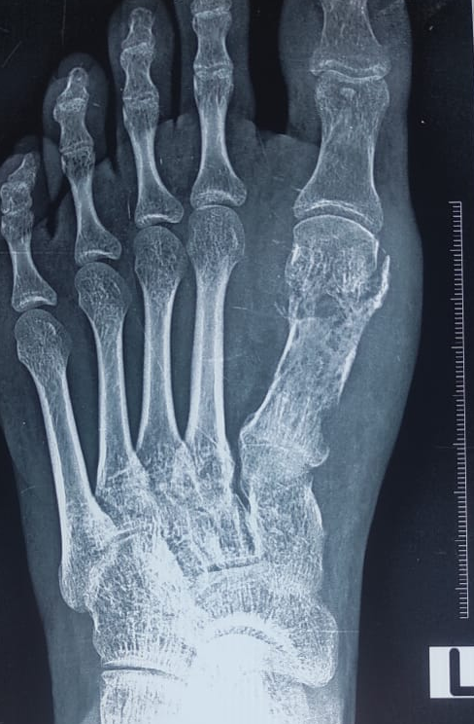
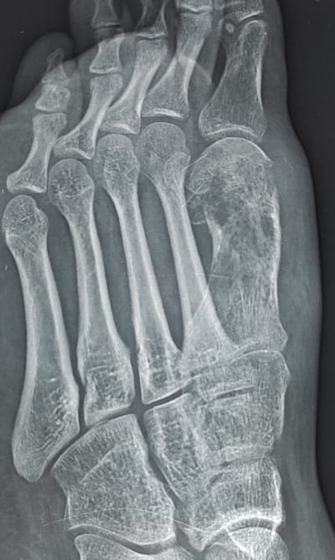
Necrotising Granulomatous Osteomyelitis
—An Underrecognized Entity in Bone Infections
DR. TV RAGHU SRAVAN, DR. ARUN HS, DR AKSHAY P
SRI DEVRAJ URS MEDICAL COLLEGE
55th Annual Conference of
Orthopedic Surgeon Society of Andhra Pradesh
.
INTRODUCTION
CLINICAL COURSE
Non-infectious causes are rare but can seen with foreign body conditions or autoimmune conditions.
Clinical features are often insidious and nonspecific like persistent bone pain, swelling and tenderness over involved bone, possible low-grade fever, sinus tract infection and reduced function.
The diagnosis of this pathology requires inflammatory markers, culture studies which are often nonspecific with radiographical features like lytic lesions, sequestra, periosteal reaction, marrow changes, necrosis and cortical destruction. Histopathology is the gold standard for diagnosis with Tissue biopsy and special stains also useful.
Differential diagnosis include chronic pyogenic osteomyelitis, primary bone tumors or metastases, chronic non-bacterial osteomyelitis, xanthogranulomatous osteomyelitis.
Medical therapy include targeted antibacterial therapy like ATT in tubercular cases or antibacterials or antifungals in other cases.
Surgical treatment include debridement of necrotic tissue with drainage of abscess or sinus tract and stabilisation of structural integrity is compromised.
Early recognition and treatment significantly improve outcomes and reduce chronic disability.
Necrotising granulomatous osteomyelitis represents a diagnostically challenging chronic bone infection characterized by granuloma formation with central necrosis. Its atypical clinical presentation and overlap with other infectious and non-infectious pathologies demand a high index of suspicion and multimodal evaluation. Early histopathologic confirmation and targeted therapy are crucial to preventing structural destruction and long-term disability.
Necrotising granulomatous osteomyelitis is a form of chronic bone infection characterized by granuloma formation with central necrosis.
It is seen in infections like tuberculous osteomyelitis or other atypical infections.
Rare and challenging to diagnose; often requires correlation of clinical, imaging, microbiological, and histopathological data.
MRI Left foot showed ill defined T1 hypointense / T2 heterogeneously hyperintensities noted in the 1st meta tarsal showing restriction of diffusion with adjacent T2/ PDFS hyperintensities noted in the subcutaneous, muscular and intermuscular planes involving dorsum and extending to skin surface. CT showed fracture of neck of first metatarsal with diffuse cortical irregularities and erosion of head and shaft – Suggestive of osteomyelitis.
Bone scan showed Hyperemia noted in the left foot, with delayed images showing increased osteoblastic activity linearly involving the 1st metatarsal bone of left foot and the proximal phalanges of left foot – Consistent with Osteomyelitis
Incisional Biopsy reported necrotic bony fragments with surrounding fibro adipose tissue showing numerous coalescent granulomas made up of epithelioid histiocytes and Langhans giant cells accompanied by lymphocytes and plasma cells with an impression of Necrotising Granulomatous Osteomyelitis.
CASE PRESENTATION
Age - 17 years old, Gender - Female
History
Minor trauma 6 months back
Treated conservatively with Antibiotics – Piptaz and Clavulinic acid and compression bandage
Pain aggravated on weight bearing
History of low grade fever since 3 months
No history of TB or any other comorbidities
No H/O weight loss
Examination:
BP: 110/60 mm of Hg, PULSE: 68 bpm, SP02- 98% RA, TEMP- 98.4°F
On examination, swelling, tenderness and burning type of pain noted over medial aspect of left foot with mild local rise of temperature
Active ankle and toe movements present
Routine Investigations are within the normal limits.
ESR within normal limits
CRP negative
Alkaline phosphatase elevated
CONCLUSION
INVESTIGATIONS
DISCUSSION
Granulomatous osteomyelitis refers to a chronic inflammatory bone infection characterized by the formation of granulomas — organized collections of activated macrophages (epithelioid cells) and giant cells — often with surrounding lymphocytes. When these granulomas show central necrosis, the condition is described as necrotising granulomatous osteomyelitis.
Infectious causes include Mycobacterium tuberculosis, M. chelonae, M. abscessus, Nocardia, Bartonella and fungi like Histoplasma, Coccidioides and Aspergillus in immunocompromised hosts.
REFERENCES
Datta D, Ravichandran T, Kumar R et al. Necrotizing granulomatous inflammation mimicking skeletal metastasis: a possible differential diagnosis. Eur J Hybrid Imaging. 2022
Schmitt SK. Osteomyelitis. Infect Dis Clin North Am. 2017;31(2):325–38
Wu, P. C., Khin, M. M., & Pang, S. W. (1985). Salmonella osteomyelitis. An important differential diagnosis of granulomatous osteomyelitis. The American journal of surgical pathology, 9(7), 531–37
Zwass, A., & Feldman, F. (1994). Case report 875: Multifocal osteomyelitis--a manifestation of chronic brucellosis. Skeletal radiology, 23(8), 660–663

