Slide 1



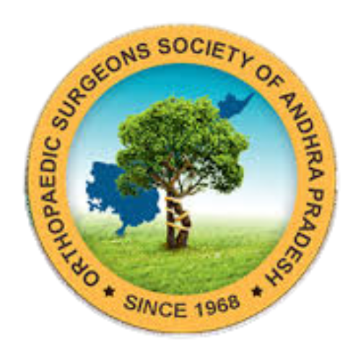
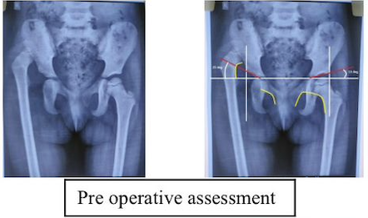
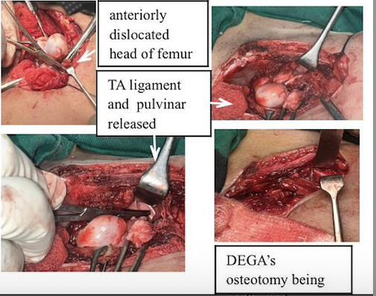
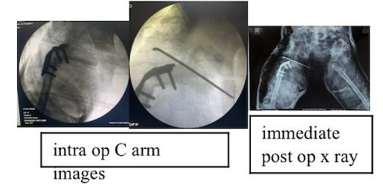
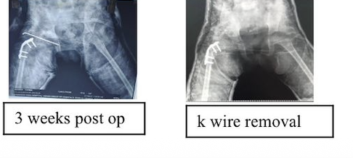
55th Annual Conference of
Orthopedic Surgeon Society of Andhra Pradesh
Short term study of one staged procedure of DDH by opne reduction + Varus deroation osteotomy +pelvic osteotomy by anterior approach.
OSAP-598
AUTHOR : DR NAJMAL ISMAIL ( POST GRADUATE )
INTRODUCTION
OPERATIVE FINDINGS
DISCUSSION
Developmental dysplasia of hip
is a condition characterized by an abnormal shallow acetabulum with resulting subluxation/dislocation of the femoral head in turn causing dysplasia of the same overtime resulting in a malformed and dislocated hip
A single staged procedure was executed.smith peterson approach was taken and soft tissue in the acetabulum released .varus derotation osteotomy was performed.derotation secured with plate and hip reduced,secured with k wire.Degas pelvic osteotomy done and secured with graft.1 and half hip spica applied.
DDH presenting after walking age often require combined procedures to achieve stable reduction.
Important surgical principles
•adequate soft tissue release
•concentric reduction
•correction of femoral anteversion
•improvement of acetabular coverage
In children above 3 yrs open reduction alone is insufficent .combined femoral and pelvic osteotomy improves outcomes.Degas osteotomy provide anterolateral coverage , stable containment , better remodelling potential.femoral shortening reduces pressure on the femoral head and decrease risk of avascular necrosis.early concentric reduction is the most importasnt prognostic factor.
CASE REPORT
CONCLUSION
A 4 yr old female child presesnted with abnormal walking since when she started to walk,unable wt bear on right hip.O/E-right head of femur was palpable anteriorly ,high up with increased internal rotation
.Xray -right dislocated hip with shallow acetabulum
6 weeks follow up showed head of femur still reduced .k wire removed 1and half hip spica reapplied in reduced position of the hip.
Combined approach provide stable reduction,improved acetabular coverage and good radiological outcome.

