Slide 1
COMPARATIVE STUDY OF DYNAMIC COMPRESSION PLATING VS INTERLOCKING NAIL IN FRACTURE SHAFT OF HUMERUS
Dr. Sri chaitanya Ganji (PG)
GUIDE: Dr Soma sekhar ,M.S. ORTHO
PROFESSOR & HOD,GVPIHC and MT, visakhapatnam

Slide 2
INTRODUCTION
Fractures of humerus shaft are very commonly seen now a days of modern World accounting about 3% of all the fractures¹
Treatment methods are also advancing, initially treated with the help of hanging casts, arm cylinders, collar and cuff slings, then functional cast bracing, U casts, shoulder spica improved results but the long duration of treatment results in adverse effect on economy of the patients²
Nonunion, malunion, limitation of joint motion and progressive degenerative arthritis are commonly seen complications in conservative modes.

Slide 3
The present study covers the comparison of results of open reduction and internal fixation by dynamic compression plate with close interlocking nailing in fracture shaft of humerus.

Slide 4
MATERIAL AND METHODS
This was a prospective study conducted in Siddhartha Medical College & Hospital , during the period of May 2022 to Jan 2023, after taking ethical committee approval.
The study consist of 11 cases (group A) of fracture shaft humerus treated with closed intramedullary nailing and 11 cases (group B) treated with dynamic compression plating.

Slide 5
INCLUSION AND EXCLUSION CRITERIA
The inclusion criteria was patients more than 15 years of age of either sex.
All cases of compound fractures, poly trauma patients who were initially managed with external fixator and patients below 15 years age were excluded from the study.
All the fractures were managed and stabilized initially with pop back splint, then fractures were classified and managed accordingly with intramedullary nails or DCP

Slide 6
SURGICAL APPROACH
For interlocking nail under Brachial plexus block via Interscalene approach patient was placed in semi inclined position.
A 2 cm incision was given lateral to acromion in the direction of deltoid fibres. Entry made into the medullary canal just medial to the greater tuberosity.
Guide wire passed into the proximal fragment, passed to distal fragment and confirmed under image intensifier. Sequential reaming done. Then nail of appropriate size placed with jig and guide wire taken out. Distal locking done by free hand technique, fracture compression given by back hammering. Wound closure done and arm sling applied.

Slide 7
For D.C.P patient was placed in supine position under Brachial plexus block with shoulder fully adducted and forearm lying on the chest.
After proper painting and draping incision was given proximally and distally to fracture site through Anterolateral approach. Skin and subcutaneous tissue ,Deep fascia was incised . Biceps muscle identified and retracted medially exposing brachialis and brachioradialis muscle which were retracted medially.
Radial nerve identified and explored wherever required. Muscle were stripped off by periosteal elevator, fracture reduced and plate of appropriate size fixed with screws. Wound wash given and sutured in layers and drain, crepe bandage applied arm sling given.

Slide 8
Physiotherapy of shoulder and elbow advised from the next day.
Radiographic examination done to confirm the fixation of reduction.
Patients were followed up and examined at weekly interval till union.

Slide 9
On every visit radiographs were taken in anteroposterior and lateral view. Radiological sign of union, displacement, angulation were recorded.
Clinically patients were examined for any tenderness, infection, pain. Movements of elbow and shoulder recorded.

Slide 10

RESULTS
The youngest patient in our study had age of 18 years and oldest has age of 59 years. Average age was 35.77 years. 80% of fractures occurred between age group of 21-50 years.
There is male preponderance in our study with male female ratio 7:3 due to more involvement in outdoor activities.
Injury was more common on right arm because of conditioned protective reflex in using right upper limb more often in a bid to avoid trauma.

Slide 11
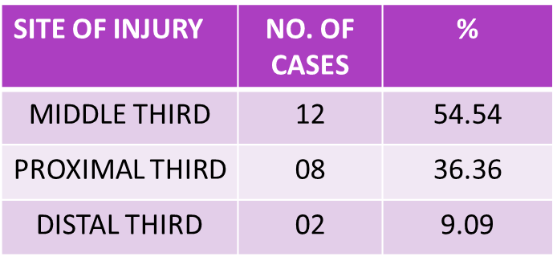
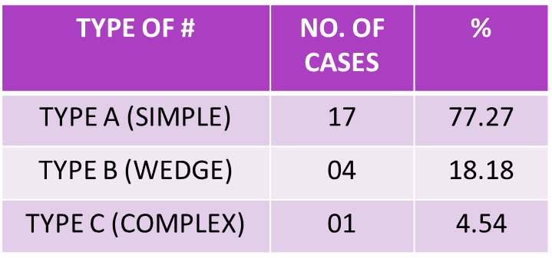
Present study had 90.90% closed fractures and 9.09% (2) compound fractures with grade 1 injury as per Gustilo Anderson classification.

Slide 12
6 (27.27%) patients had associated injuries like fracture both bone forearm, radial nerve involvement, fracture metacarpals, head injury. In this study majority of the patients were operated within three days (80%) in group A and (73.33%) in group B.

Slide 13
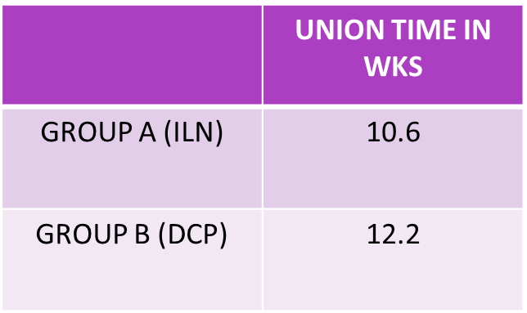
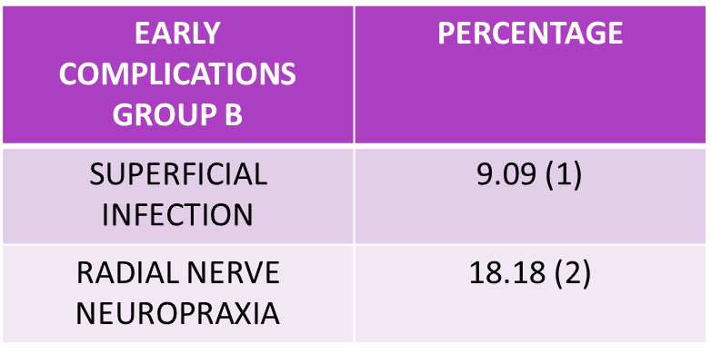
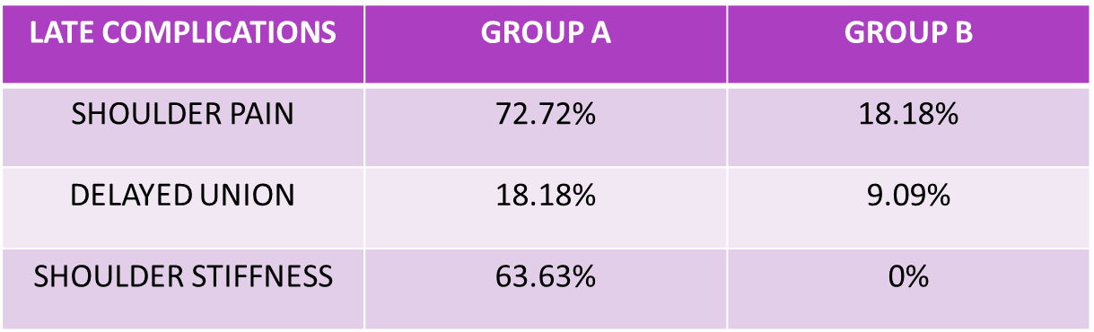

Slide 14
There was decrease in abduction and rotation at shoulder joint at final follow up in group A patients

Slide 15
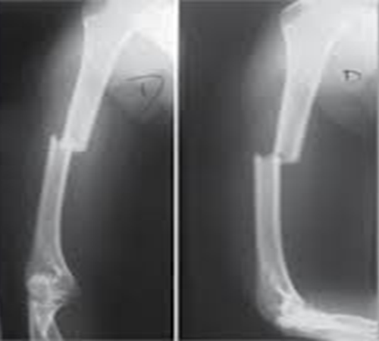
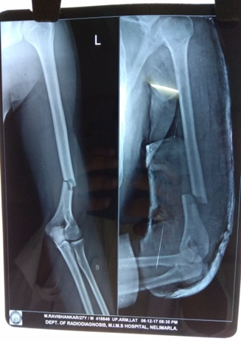
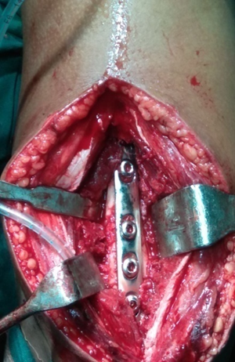
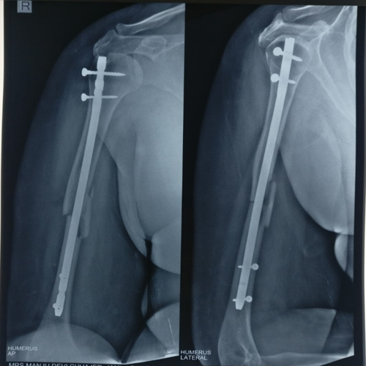
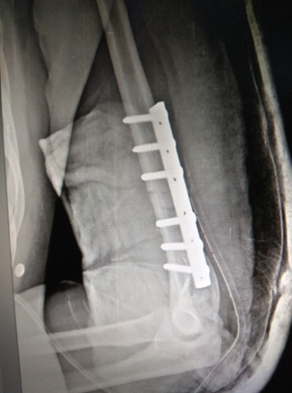
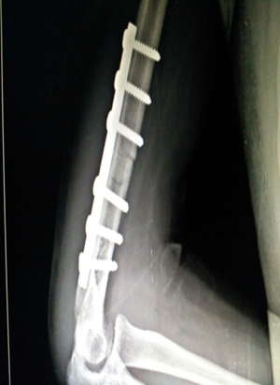
ILN DCP

Slide 16
DISCUSSION
11 of each cases in group A and group B were treated with interlocking nail and dynamic compression plating respectively with age of youngest patient 18 years and oldest 59years with mean age 35.7.
Similar trend was seen in a series of Lal et al³ in which mean was 39.5 years and chacha et al⁴ average being 36.3 years.
In this study male/ female ratio being 7:3 similar to study series of Reddy et al⁵ where also m/f ratio was 7:3.

Slide 17
P.M Rommens⁷ found No patient of group A had superficial infection in comparison with 1 patient in group B; 2 patients in group B has postoperative neurapraxia of radial nerve with no patient in group A.

Slide 18
8 patients in group A had shown pain in shoulder in comparison to 2 in group B. 07 patients of group A has shoulder stiffness in comparison to no patient in group B, two patients in group A had shown delayed union in comparison to 1 in group B.
In this study 63.63% of patients developed shoulder stiffness treated with interlocking nail and same trends were seen in study of Suh JT et al⁸ where 50% of patients shows shoulder stiffness.
No patient in either group shows nonunion, malunion, deep infection and any instability.

Slide 19
In our study 100% cases achieved union.
Ikpeme⁹ noted 100% union of shaft fractures with I.L.N.
Willis MP et al¹⁰ reported union rate of 100% in humerus fractures with plating

Slide 20
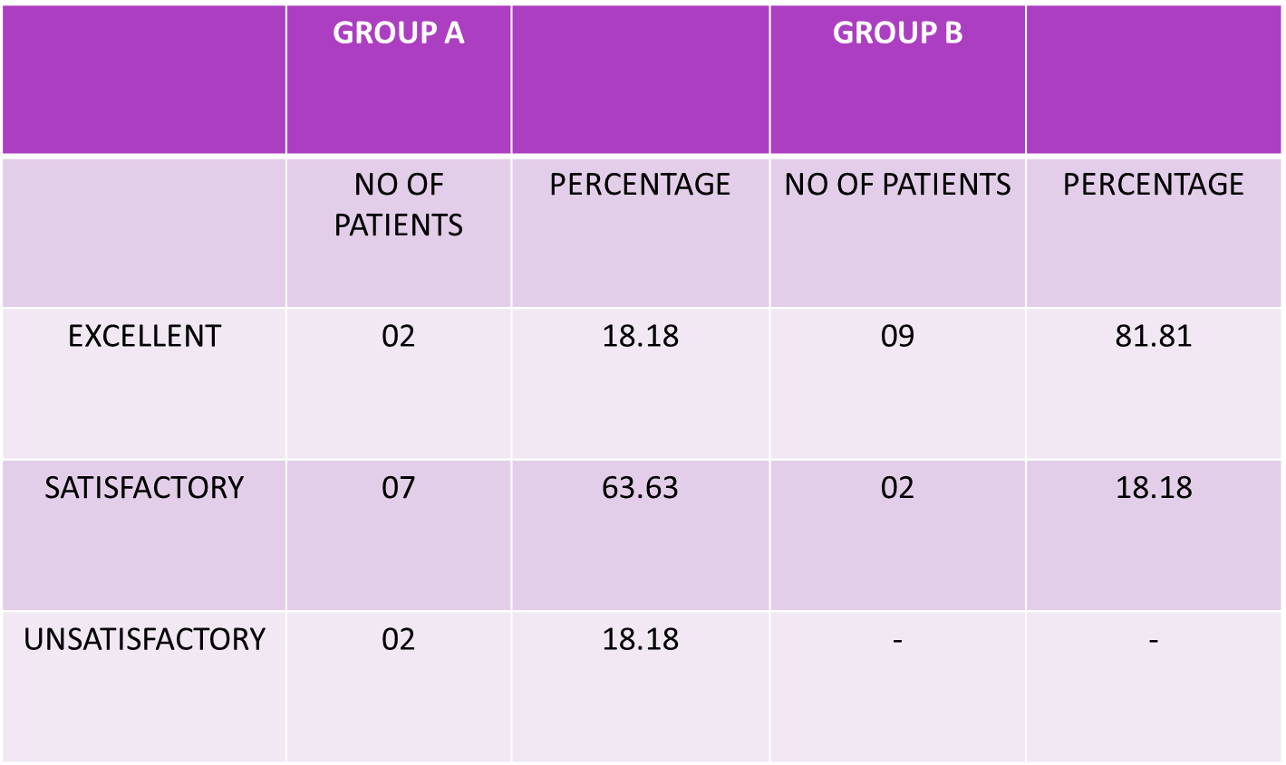
FINAL RESULTS

Slide 21
CONCLUSION
So we concluded that compression plating is gold standard for fracture shaft humerus.
While there is no significant difference in the radiological union in the patients treated with interlocking nail and compression plate.
But there is significant decrease in movements of shoulder joint; shoulder stiffness and persistent shoulder pain in patients treated with interlocking nail.

Slide 22
REFERENCES
1. Corroll EA, Schweppe M, Langfitt M, Miller AN, Halvorson JJ. Management of humeral shaft fractures. J Am Acad Orthop Surg. 2013;20:423-33.
2. Canavese F, Marengo L, Cravino M, Giacometti V, Pereira B, Dimeglio A, Origo C, Andreacchio A. Outcome of Conservative Versus Surgical Treatment of Humeral Shaft Fracture in Children and Adolescents: Comparison Between Nonoperative Treatment (Desault's Bandage), External Fixation and Elastic Stable Intramedullary Nailing. J Pediatr Orthop. 2016 Jul 29.
3. Lal Y, Sharma S, Krishna LG, Ahmed A: Humeral shaft fractures treated by undreamed interlocking nail. Indian journal of Ortho. 1999;33:23-30.
4. Chacha PB: Compression plating without bone grafting for delayed and nonunion of humeral shaft fractures injury. 1974;5:283-85.
5. Reddy BJ, Athmaram M, Swaroop VS. A clinical study of fixation of fracture of shaft of humerus with interlocking nail. JEMDS. 2015;4:2172-9.

Slide 23
6. Changulani M, Jain UK, Keswani T. Comparison of the use of the humerus intramedullary nail and dynamic compression plate for the management of diaphyseal fractures of the humerus. A randomised controlled study. International orthopaedics. 2007;31:391-5.
7. Rommens PM, Verbruggen J, Retrograde locked nailing of humerus shaft fractures. A review of 39 patients JBJS. 1995;77B,84-9.
8. Suh JT, Jung SW, Ku JK, Yoo CI. Operative treatment of the humeral shaft fracture: Comparative study of dynamic compression plate and interlocking intramedullary nail. Journal of the Korean Society of Fractures. 2002;15:391-7.
9. Ikpeme JO, I.M. nailing interlocking of humerus fracture. Experience with Russel Taylor nail. Injury. 1994;25:447- 55.
10. Willis MP, Brooks JP, Badman BL, Gaines RJ, Mighell MA, Sanders RW. Treatment of atrophic diaphyseal humeral nonunions with compressive locked plating and augmented with an intramedullary strut allograft. Journal of orthopaedic trauma. 2013;27:77-81.

Slide 24
THANK YOU

