Slide 1




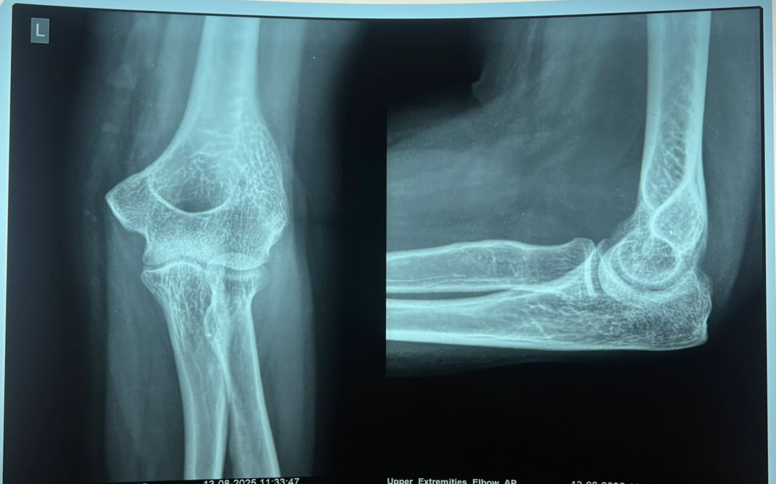
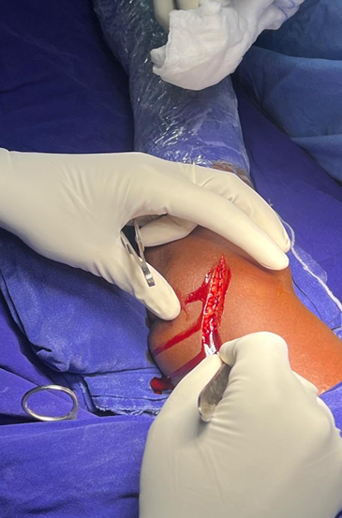
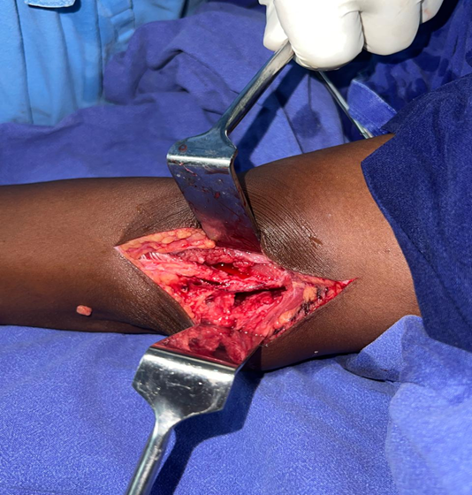
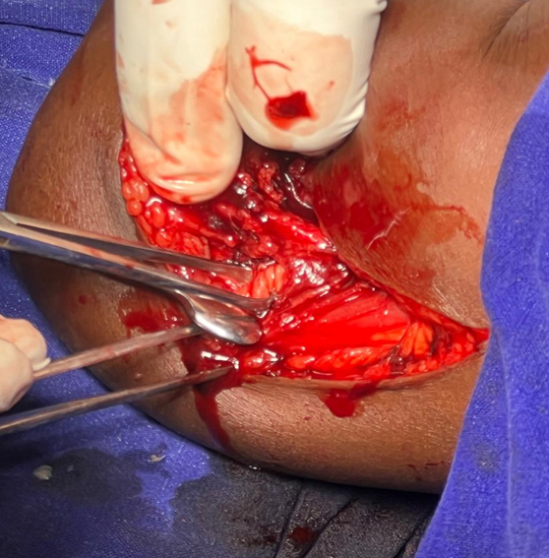
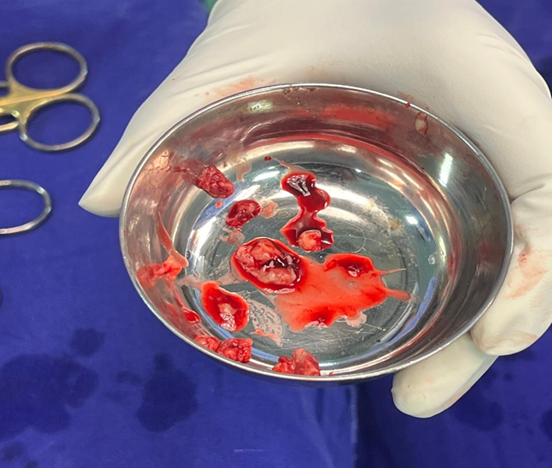
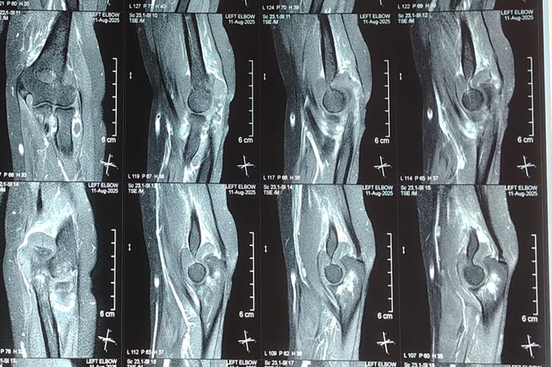
A Rare Case of Tenosynovial Giant Cell Tumor of the Elbow
Presenter : Dr. V.N.V.Gnanadeep
Guide : Dr. S.Sreenivasa Reddy, HOD, Department of Orthopaedics
Institute: Apollo Institute of Medical Sciences and Research
Registration ID : OSSAP-641
INTRODUCTION
INVESTIGATIONS
OPERATIVE FINDINGS
-Teno synovial Giant Cell Tumor (TGCT) is a benign proliferative lesion of the synovium and it is AKA pigmented villonodular synovitis.
-Commonly affects tendon sheaths of fingers, rarely large joints like the elbow.
-Characterized by localized swelling and pain.
-Imaging and histopathology are key for diagnosis.
-Patient underwent excisional biopsy and resection of the lesion.
-Intraoperatively, tumor tissue completely excised.
-Postoperative recovery was uneventful
X-ray: Normal findings.
Histopathology Findings: Report Suggestive of Tenosynovial Giant cell tumour
DISCUSSION AND CONCLUSION
CASE REPORT
-TGCT of elbow is rare, making this case an uncommon clinical presentation.
- Subtle presentation leading to a diagnostic challenge and delayed clinical suspicion.
-Plain radiographs were normal, highlighting their limited role in soft-tissue TGCT
.-MRI was essential in detecting the lesion, defining its extent.
.Complete surgical excision was achieved, which is crucial in preventing recurrence.
Histopathological examination confirmed the diagnosis, and the patient had a good postoperative functional outcome.
-40-year-old female presented to OPD with pain and swelling in the left elbow since 2 months.
-No history of trauma, fever, or systemic illness.
-Pain was persistent despite oral analgesics
MRI Left elbow with contrast was done which was suggestive of TenoSynovial Giant cell tumour.
CBNAAT was Negative.

