Slide 1




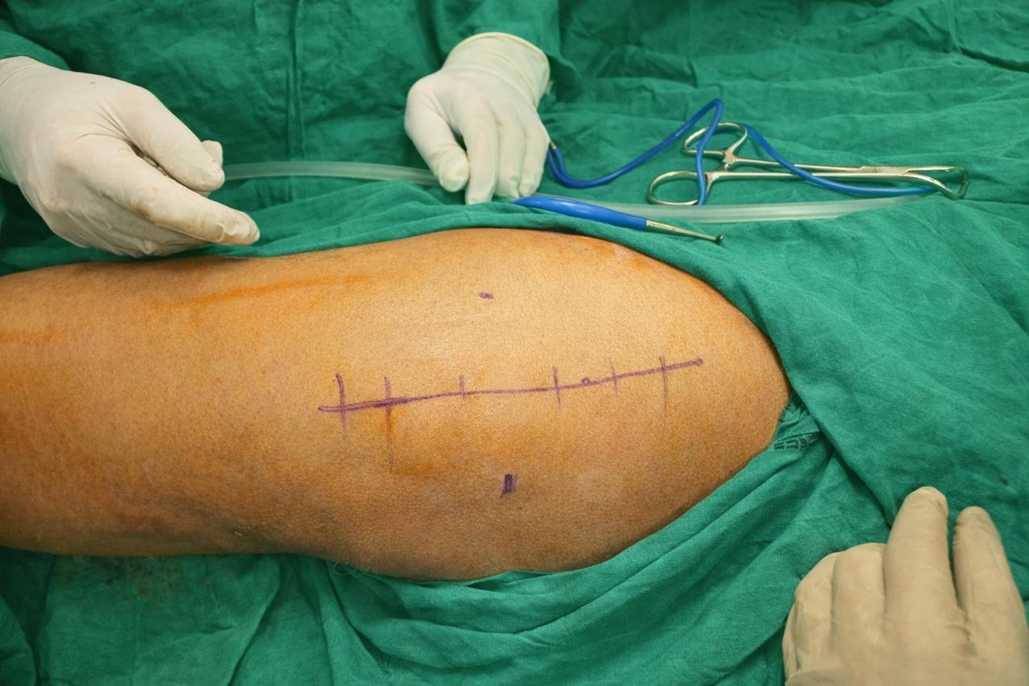
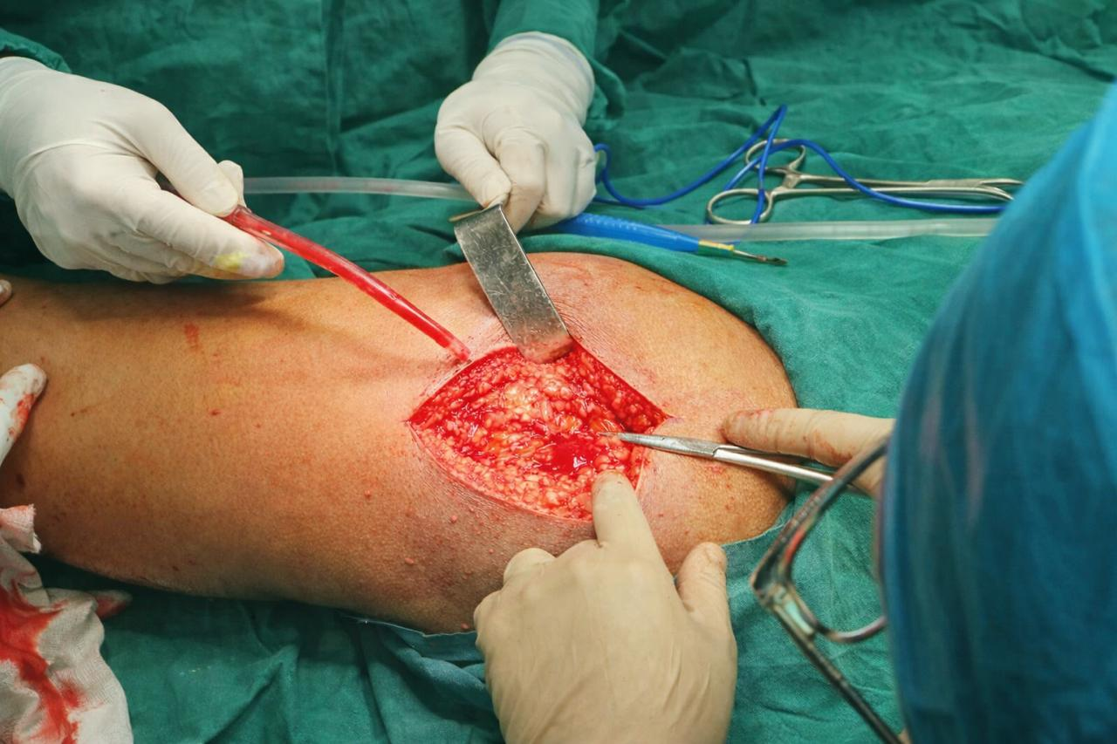
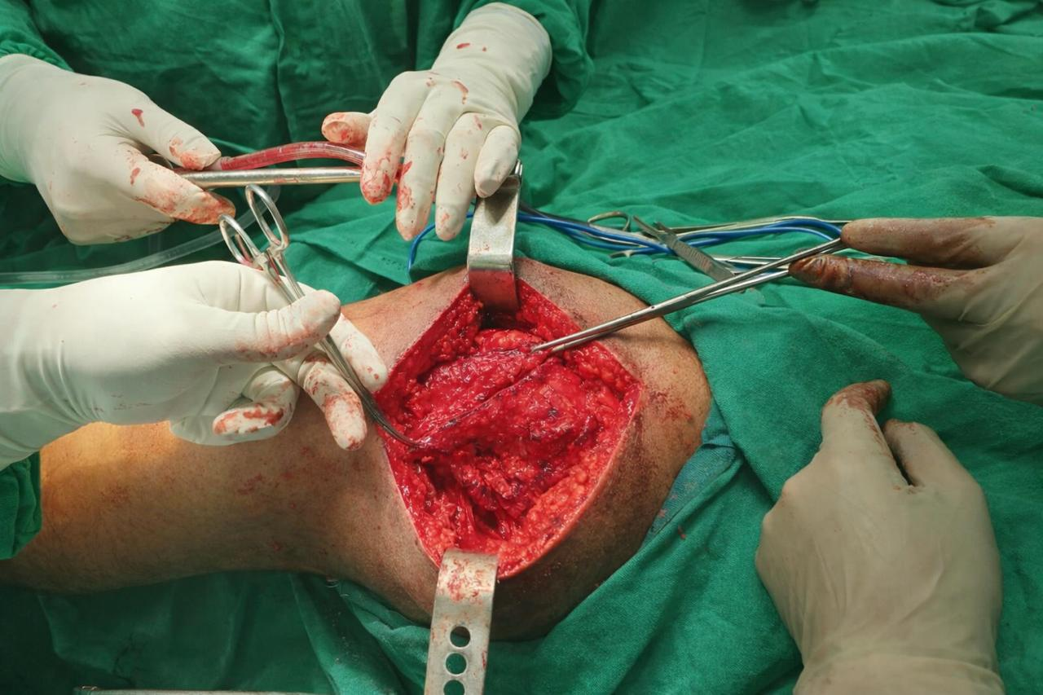
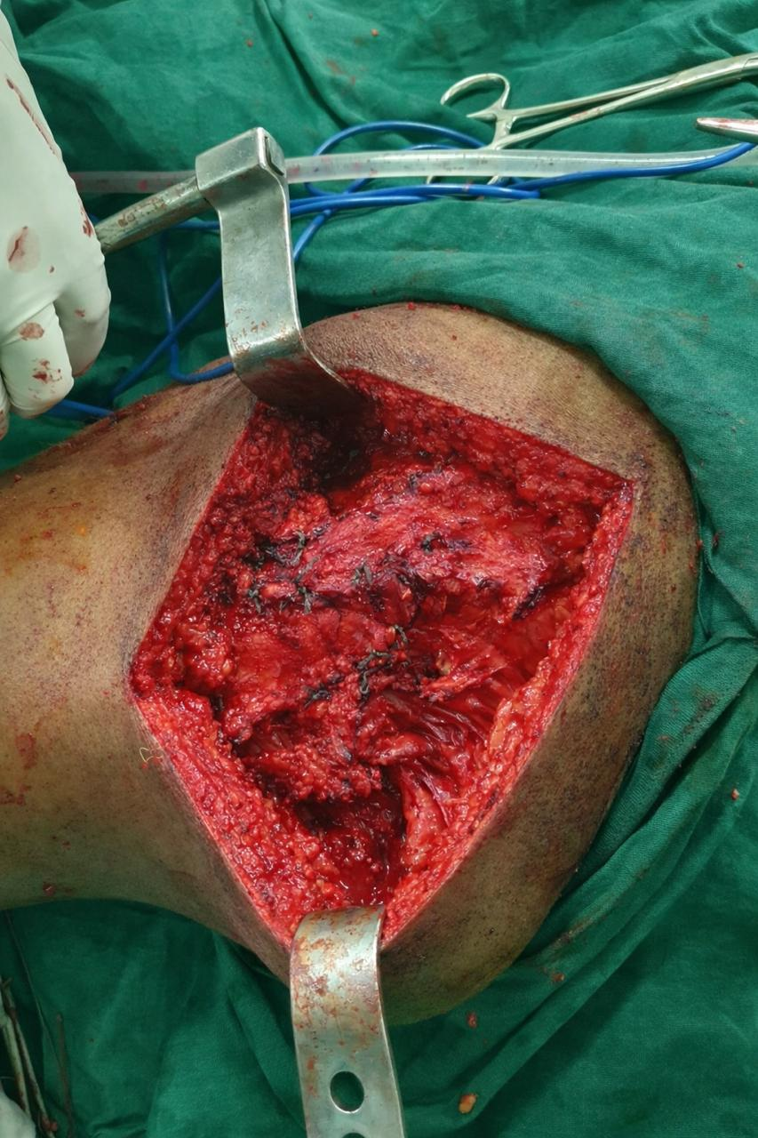
55th Annual Conference of
Orthopedic Surgeon Society of Andhra Pradesh
External Snapping Hip Syndrome: A Rare Case Report
AUTHORS: DR BANDAN VENKAT RAO PG, KAMSRC , HYD
INTRODUCTION
MANAGEMENT
DISCUSSION
Snapping hip, also known as coxa saltans, is a clinical condition characterized by an audible or palpable snapping sensation around the hip joint during movement. It is broadly classified into three distinct types: external snapping hip, internal snapping hip, and intra-articular snapping hip.
External and internal snapping hip are primarily diagnosed clinically through a detailed history and specific physical examination maneuvers that reproduce the snapping phenomenon. In contrast, intra-articular snapping hip often requires advanced imaging modalities for accurate diagnosis, as it typically involves underlying intra-articular pathology.
Management may be either conservative or surgical, depending on the underlying etiology, severity of symptoms, and duration of presentation. Nonoperative treatment is generally the first-line approach, while operative intervention is reserved for refractory or structurally significant cases
Local Examination
Painful hip flexion associated with palpable external snapping of the tensor fascia lata over the greater trochanter
Painful and restricted hip abduction and adduction
Ober’s test: Positive
Investigations
Dynamic ultrasonography of the hip demonstrated snapping of the iliotibial band over the greater trochanter
Findings consistent with external snapping hip syndrome
Management
Initial conservative management was initiated:
  Structured physiotherapy program
  Local corticosteroid infiltration
No significant symptomatic improvement was noted
Intraoperatively, adhesions were identified along the posterior border of the iliotibial band (ITB) and were carefully released.
Additional longitudinal releases were performed to relieve residual tightness of the ITB.
An N-plasty of the iliotibial band was performed, along with excision of the greater trochanteric bursa.
OP IMAGES
CONCLUSION
CASE REPORT
Surgical Procedure
The patient was positioned in the lateral decubitus position under general anesthesia, with the affected limb maintained in adduction.
A 10 cm longitudinal incision was made along the axis of the femur, centered over the greater trochanter, extending approximately one-third proximally and two-thirds distally relative to the tip of the greater trochanter.
External snapping hip syndrome is an important and often under-recognized cause of lateral hip pain. While the majority of cases respond well to conservative management, persistent symptomatic cases require surgical intervention. Iliotibial band release with N-plasty combined with greater trochanteric bursectomy effectively relieves snapping, reduces pain, and restores functional hip movement. Early recognition and appropriate stepwise management are essential to achieve optimal clinical outcomes.
A 45-year-old male patient presented to OPD with chief complaints of pain in left hip since 3months with difficulty in walking, associated with snapping sensation. pt was asymptomatic 3 months back then developed dull aching pain in left hip, radiating along posterior buttock region, aggravated on activity, relieved on rest.

