Slide 1




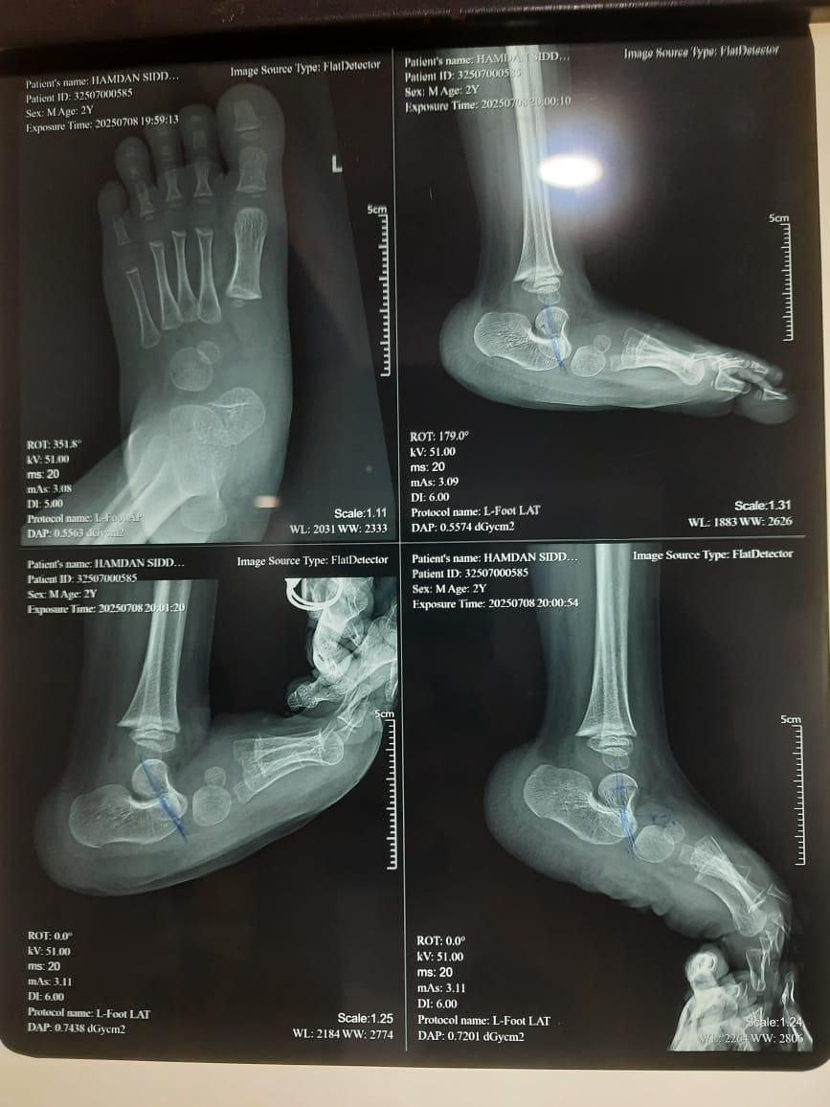
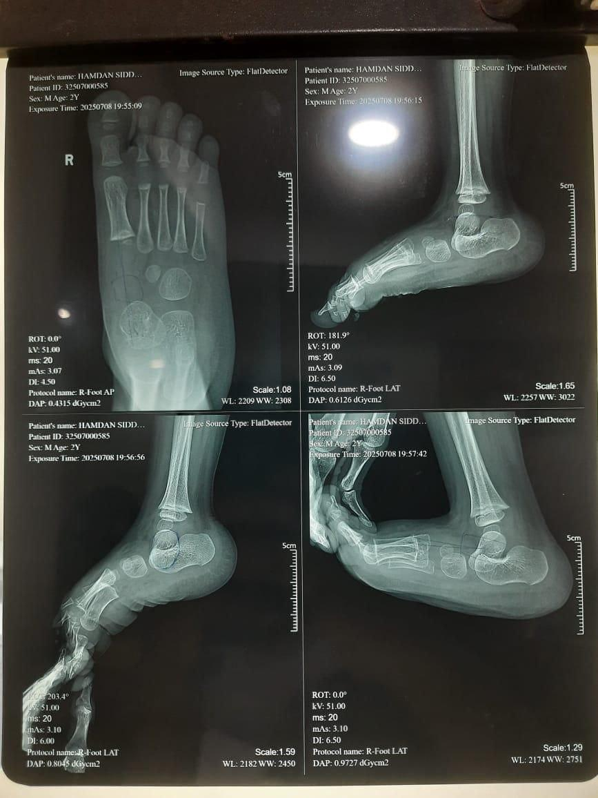
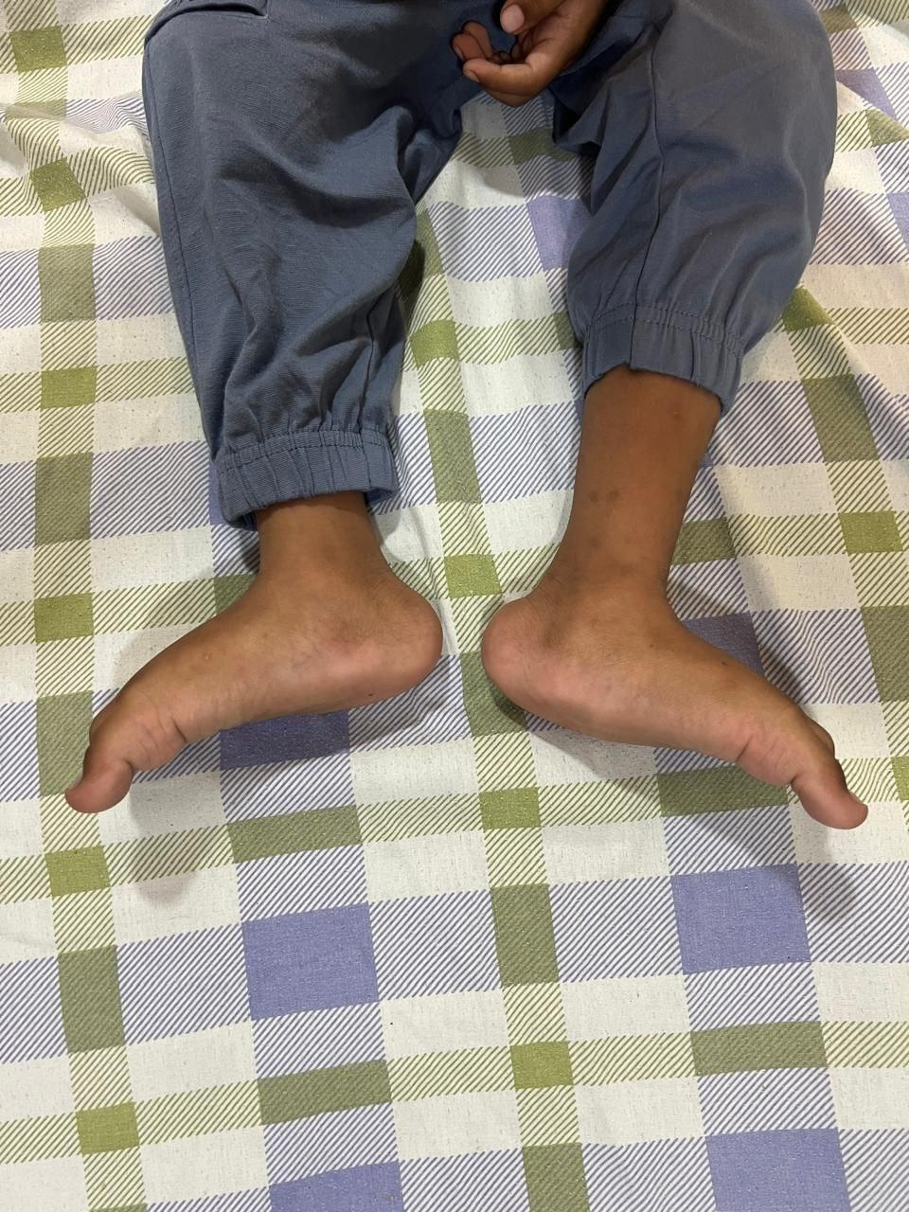
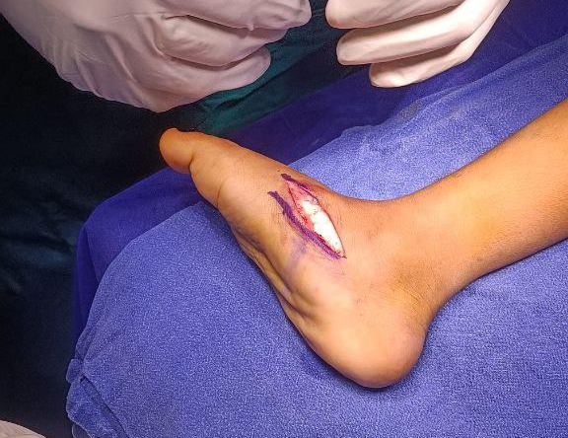
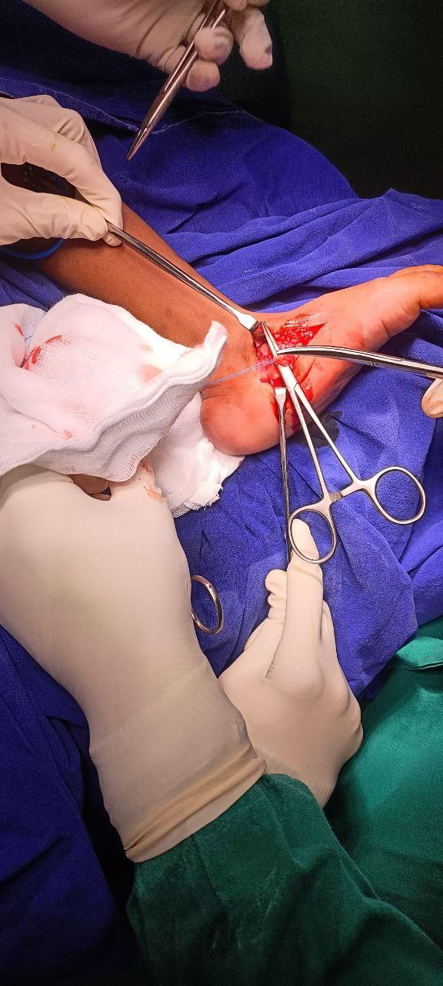
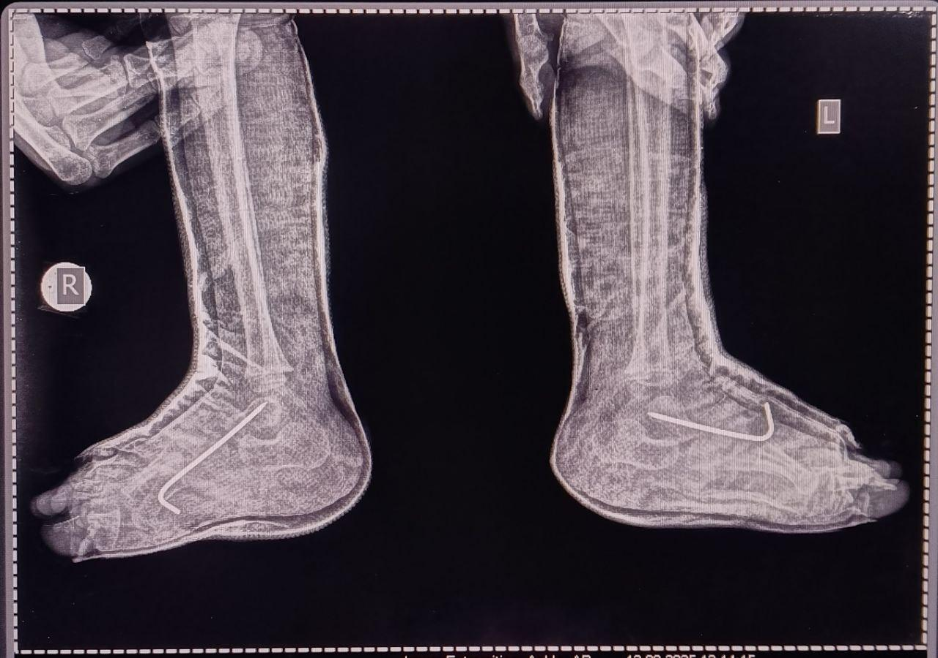
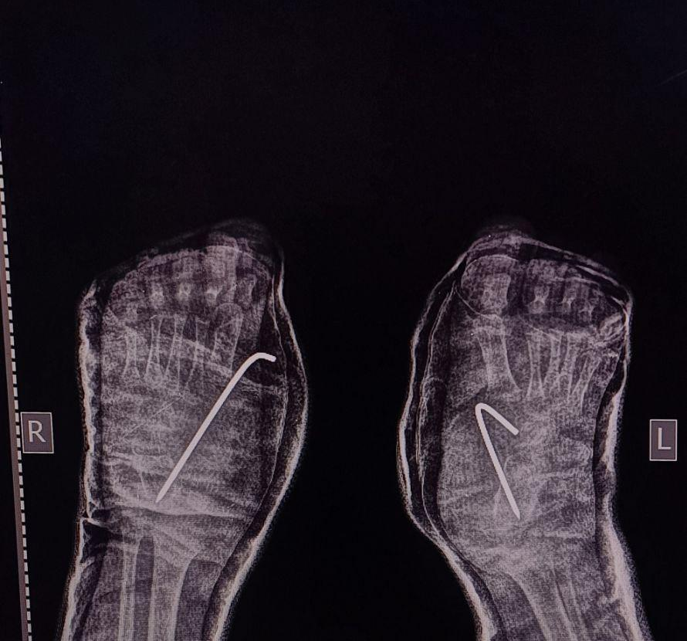
Late-Presenting Bilateral Congenital Vertical Talus: A Case Report
Presenter : Dr.Srinivasa Vishnu Vara Prasad
Guide : Dr. S.Sreenivasa Reddy, HOD, Department of Orthopaedics
Institute: Apollo Institute of Medical Sciences and Research
Registration ID : OSSAP-643
INTRODUCTION
INVESTIGATIONS
PROCEDURE
Congenital vertical talus (CVT) is a rare but severe rigid flatfoot deformity present at birth with 1 in 10,000 births, characterized by fixed dorsal dislocation of the talonavicular joint resulting in a classic rocker-bottom foot. Early recognition is crucial to prevent long-term disability and pain.
Performed under general anesthesia with tourniquet control.
1. Achilles tendon lengthening
– Percutaneous, to correct hindfoot equinus
2. Open reduction of talonavicular joint
– Medial approach
– Release of tight dorsal and medial soft tissues
– Anatomical reduction of talus and navicular bones
3. Soft-tissue releases
– Tibialis anterior lengthening
4. Stabilization
– K-wire fixation across the talonavicular joint
5. Immobilization
– Above-knee cast with foot in plantigrade position
CASE REPORT
This is a 2yr 9 months old patient presented with deformity in his bilateral foot since birth ,There was no history of trauma, fever, or previous treatment. The child was born at term through a normal vaginal delivery, with no significant antenatal or perinatal complications. Family history was non-contributory.On clinical examination, the affected foot showed a rigid rocker-bottom deformity.Radiographic evaluation with lateral foot radiographs in maximum plantarflexion demonstrated a persistently vertical talus with dorsal dislocation of the talonavicular joint, confirming the diagnosis of congenital vertical talus.
DISCUSSION AND CONCLUSION
In children presenting with bilateral CVT more than 2 years of age, open reduction with soft-tissue release and stabilization remains the treatment of choice for congenital vertical talus, yielding satisfactory functional outcomes when performed early and followed by structured rehabilitation.

