Slide 1
Study of Outcome of Ligamentotaxis with External Fixation in Distal Radius Fractures
Presenter: Dr. Kuchana Jayanth.
Department of Orthopaedics
GMC Nizamabad
Aim: To evaluate functional and radiological outcomes of ligamentotaxis with external fixation in unstable distal radius fractures

Slide 2
Background & Rationale
Low-energy extra-articular fractures → casting adequate
High-velocity injuries → comminuted, unstable, intra-articular fractures
Loss of reduction → malunion, poor function, early OA
Ligamentotaxis aligns fragments via intact ligaments
External fixation provides stable, adjustable, reliable reduction

Slide 3
Materials & Methods
Design: Prospective study (2 years)
Sample size: 30 patients
Inclusion:
  Age 20–80 yrs
  Frykman type V–VIII
  Intra-articular comminuted fractures
Exclusion:
  Stable fractures
  Open fractures
  Previous wrist fracture

Slide 4
Procedure & Follow-up
External fixator applied using ligamentotaxis principle
Fixator removed at 6 weeks after radiological union
Active wrist mobilization started
Follow-up at 3 months
Evaluation:
  Radiological parameters
  Functional assessment

Slide 5
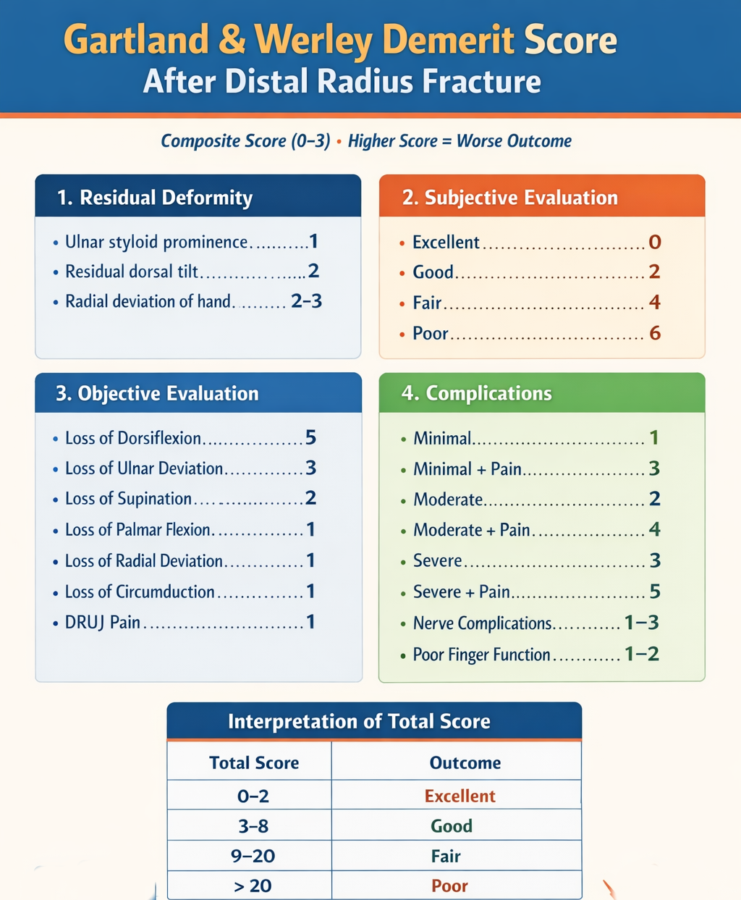
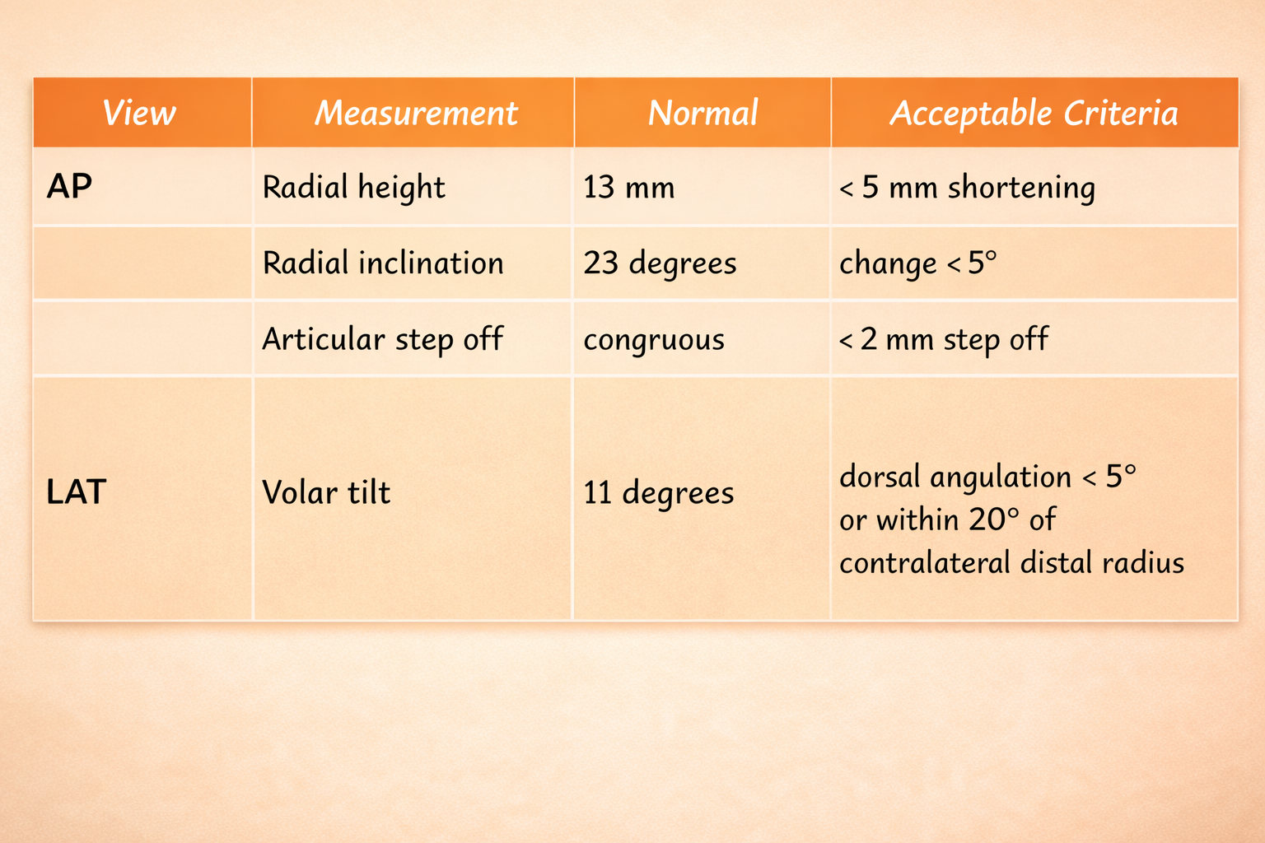
OUTCOME

Slide 6
Results & Complications
Results (Gartland & Werley):
  Excellent – 17%
  Good – 40%
  Fair – 33%
  Poor – 10%
Complications:
  Pin-tract infection – 13%
  DRUJ pain – 10%
  DRUJ instability – 7%

Slide 7
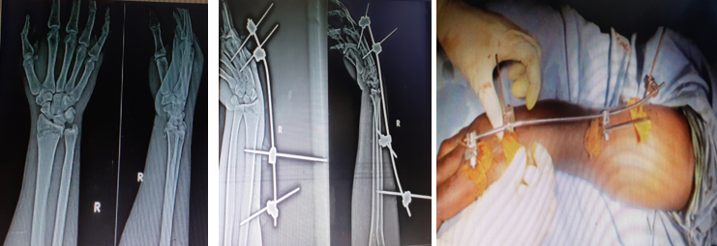
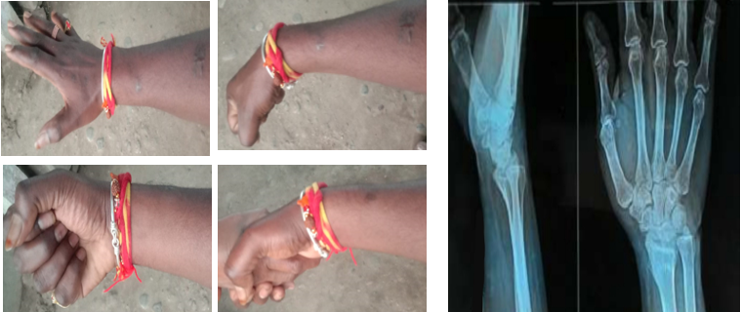
CONCLUSION
External fixation with ligamentotaxis is effective for unstable distal radius fractures
Provides good functional and radiological outcomes
Not a universal solution—fracture pattern dictates treatment
Early anatomical restoration improves long-term wrist function

