Slide 1
COMPARISON BETWEEN CLINICAL EXAMINATION AND MAGNETIC RESONANCE
IMAGING IN ACCURATELY DIAGNOSING MENISCAL TEARS
PRESENTER:DR.SRIKANTH VUYYURU
2nd YEAR POST GRADUATE
GUIDE:DR.CHINTAPETA RAVI
PROFESSOR&HOD,DEPARTMENT OF ORTHOPAEDICS
MAHAVIR INSTITUTE OF MEDICAL SCIENCES

Slide 2
INTRODUCTION:
* Meniscal lesions are one of the most common intraarticular injuries .
* The peak age of occurrence is between 20-29 years in both males and
females(1-3 )
* Meniscal lesions are most often caused by sports related injuries in young patients, particularly those people playing soccer, skiing , baseball , basketball and football.
* Majority of these injuries are caused by actions involving hyperextension , twisting or cutting movements as well as actions involving high amount of force
* In 80% of instances , Meniscal tears during athletic activities are occuring with the anterior cruciate ligament tears . In case of old age people , Meniscal tears are due to gradual wear and tear.

Slide 3
AIM:
* Objective of current study was to evaluate and compare sensitivity , specificity , accuracy, positive predictive value and negative predictive value of clinical examination, and MRI in the diagnosis of Meniscal tears , considering arthroscopic findings as the gold standard .

Slide 4
METHODS:
-This is a prospective study done in patients coming to our hospital OPD with chief complaints of knee pain , locking , instability were taken in to our study.
-Consent was taken from the patient's regarding the study and procedures .
-Thorough clinical examination was done to diagnose medial and lateral Meniscal injuries in suspected cases ( Mc murrays test).
-Radiological investigations like MRI was done in suspected cases of Meniscal tears .
-Finally arthroscopy was done as diagnostic and therapeutic management in required cases .
-Approval was taken from institutional ethical committee regarding this study .

Slide 5
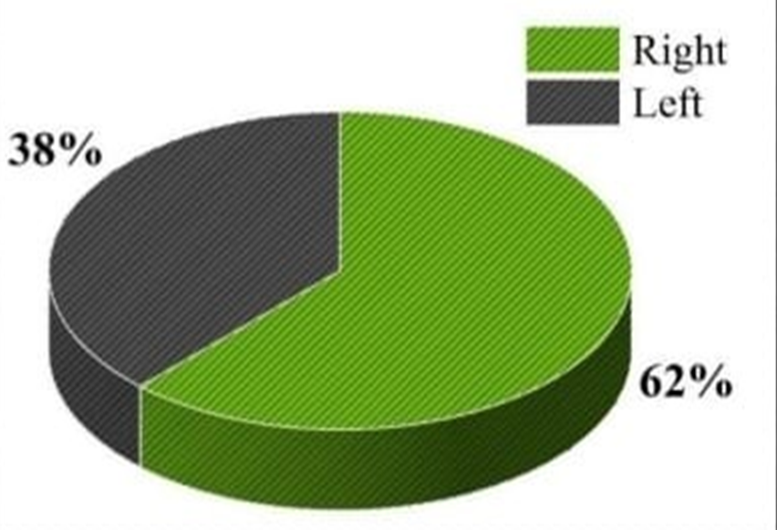
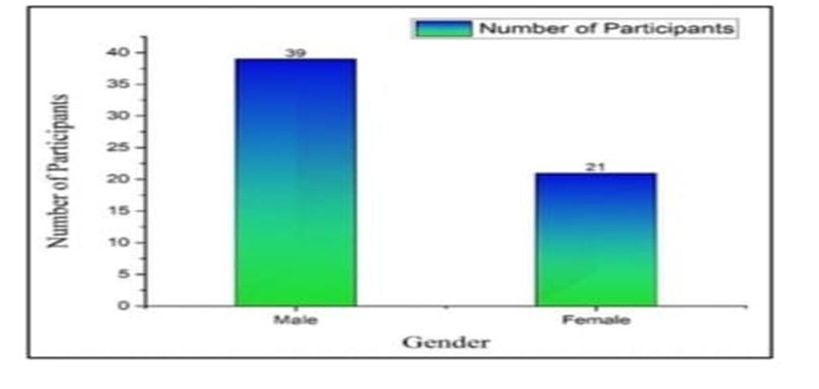
RESULTS:
* Sample size - 60 cases
* Among 60 patients
* Male-39
* Female -21
* Right side involvement is more commonly seen than the left side .
Clinical examination done by well experienced orthopaedic surgeon can accurately diagnose Meniscal injuries correctly .

Slide 6
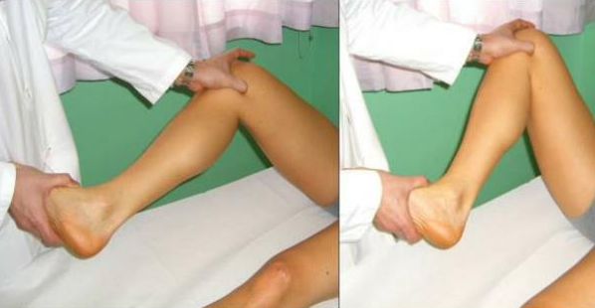
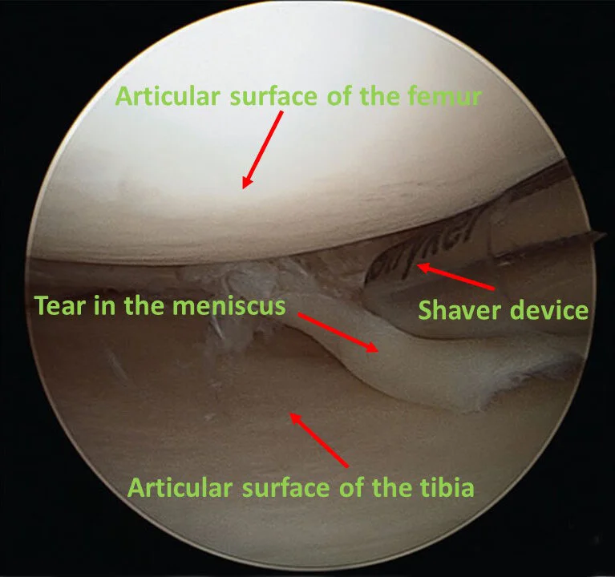
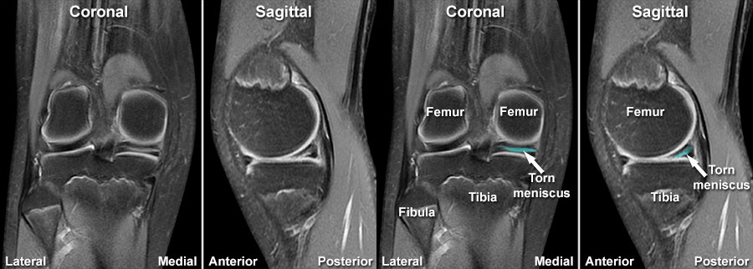
MC MURRAYS TEST
ARTHROSCOPIC CHANGES
MRI

Slide 7
CONCLUSION:
* We can avoid MRI scan if clinical examination findings are accurate.
* Relying on MRI without proper clinical examination will lead the surgeon in
trouble.
* This expensive diagnostic technique should only be utilised in cases of
difficult dubious , equivocal and complicated knee injuries .

Slide 8
REFERENCES:
-Baker BE, Peckham AC, Pupparo F, Sanborn JC.Review of meniscal injury and associated sports. Am J Sports Med, 1985;13:1-4.
-Steinbruck K. Epidemiology of sports injuries-25.year-analysis of sports orthopedic-traumatologic ambulatory care. Sportverletz Sportschaden. 1999;13:38-52.
-Steinbruck K. Epidemiology of sports injuries-A 15year analysis of sports orthopedic ambulatory care. Sportverletz Sportschaden. 1995;11:35-9.
-Salata MJ. Gibbs AE, Sekiya JK. A systematic review of clinical outcomes in patients l undergoing meniscectomy, Am J Sports Med, 2010;38:1907-16.
-Noble J，Hamblen DL.The pathology of the degenerate meniscus lesion. J Bone Jt Surg Br, 1975;57:180-6.

