Slide 1
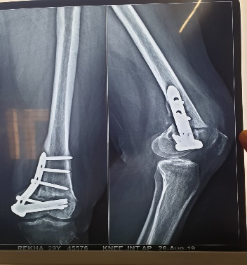
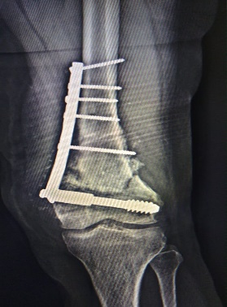
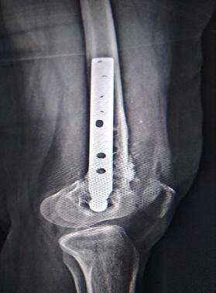
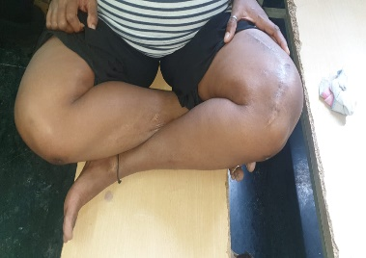
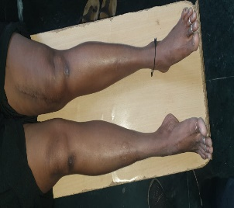
NON UNION IN VALGUS CORRECTIOVE OSTEOTOMY WITH DISTAL FEMUR PLATING TREATED
WITH REVISION OSTEOTOMY FIXED WITH DISTAL FEMUR DCS PLATING AND BONE GRAFTING
ABSTRACT:
TITLE:
Non union in valgus corrective osteotomy with distal femur plating treated with implant removal + revision osteotomy fixed with distal femur DCS plating and bone grafting
BACKGROUND:
Presenting a case of 29 year old female patient having complaint of pain and swelling at Left knee and difficulty in climbing stairs. patient is o/c/o genu valgum correction osteotomy with plating 1 year ago. In further investigation radiographs and ct plates shows Non union and effusion of knee joint. patient is Anti-CCP positive but RA negative.
TREATMENT:
Patient is treated with implant removal followed by revision osteotomy with fixation of DCS plate and bone grafting
OUTCOME:
Patient remained has asymptomatic with regain adequate range of movement and remarkable pain relief in left knee.
CONCLUSION:
valgus deformity can treated with DCS plate after a corrective osteotomy which provides good strength during weight bearing bone grafts facilitates union.
CLINICAL PICTURE:
29 yr old female patient came with complaint of difficulty in walking and Left knee pain since 10 days. Patient is o/c/o ORIF with PLATTING for corrective osteotomy of GENU VALGUM deformity of knee in private hospital on October 2018.on examination pain and tenderness present at Left knee. Swelling of Left knee was present which reflects effusion of knee . Range of movement of Left knee was painful and restricted patient had complaint of pain after walking few distance. Blood investigation of patient shows anti-CCP positive while RA factor negative
RADIOLOGICAL FINDING:
Preoperative HKA axis shows 9/171 left valgus of Left knee. Postoperative xray shows allees plate fixation at lateral condyle of femur after osteotomy. Postop ct plates evaluates metallic fixation device in lower part of femur with marginal osteophytes in the tibia femur and patella with subchondral cysts. And intercondylar two small calcific intraarticular loose bodies present. Mild joint effusion with fluid in suprapatellar bursa. And evidence of gross osteopenia.
TREATMENT:
Operative limb was paint draped in usual sterile fashion , utilizing a tourniquet preset to 320mmhg and an extremity drape. An
Anteromedial swashbuckler approach was taken over left knee, soft tissue was dissected.
Debridement was done for collection in knee joint. Implant removal done of previous corrective osteotomy in which 1 allees plate and 7 screws removed. distal femur osteotomy was practised Richard screw fixed through from medial condyle of femur. DCS plate fixed from medial side of femur in up side down fashion. Subsequently bone graft taken from same side of iliac crest which fills the gap between osteotomised bone and plate ,another bioactive bone ceramic granules was also used to facilitates union. closure done layer wise. Cylindrical slab given for immobilisation. On 2nd postop day long knee brace given and weight bearing was advised under supervision.
Pre-op xray
Post-op xray

