Slide 1




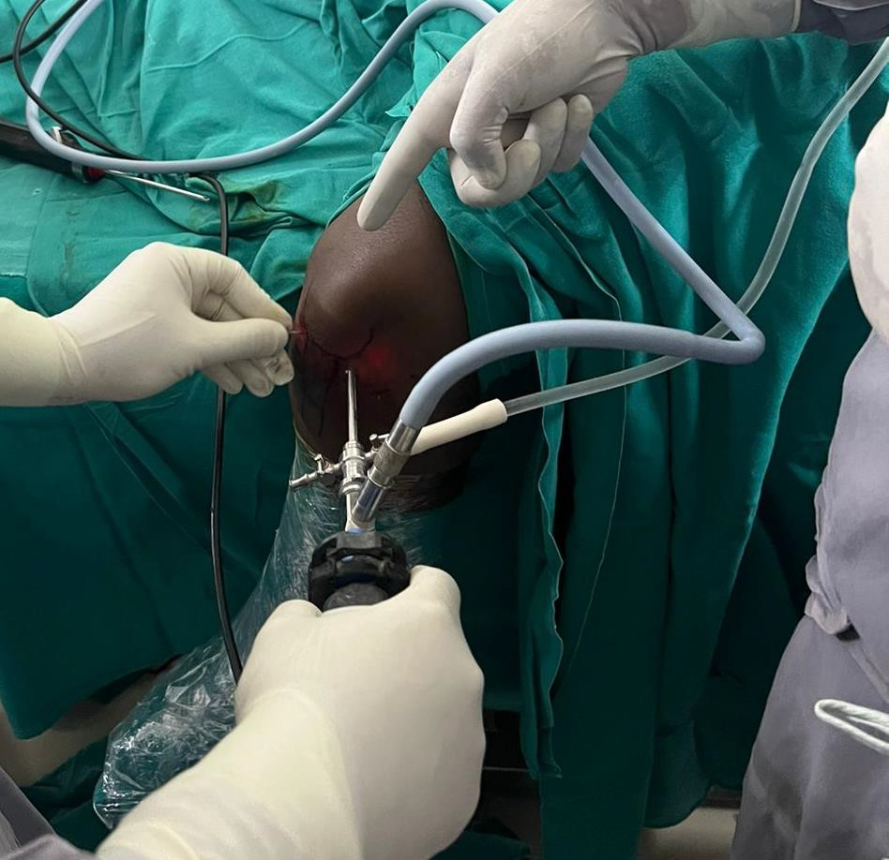
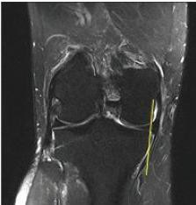
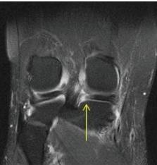
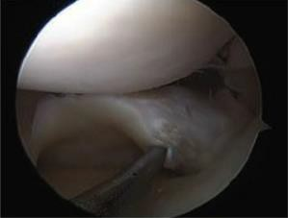
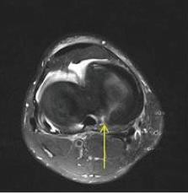
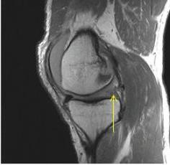
A CASE REPORT OF 40 YEAR MALE WITH POST TRAUMATIC ROOT TEAR OF POSTERIOR HORN OF MEDIAL MENISCUS OF LEFT KNEE MANAGED WITH ARTHROSCOPIC REPAIR
PRESENTING AUTHOR: Dr. AMMARALA SAI CHANDRA SEKHAR
CO-AUTHOR: Dr. I.ROHIT , ASRAM MEDICAL COLLEGE, ELURU. OSSAP ID -725
INTRODUCTION
OPERATIVE FINDINGS
DISCUSSION
Meniscal root tears or avulsions compromise the biomechanical function of the menisci to a greater extent than simple meniscal tears do.
As such, if left untreated, root injuries render the menisci incapable of properly distributing axial load and resisting rotation and translation.
The clinical diagnosis of meniscal root abnormalities may be difficult as the signs and symptoms typically associated with meniscal body injuries, such as mechanical locking and catching, may not be present in patients with root injury and there may not be a history of an acute traumatic event.
The treatment is aimed at restoring the root attachment through transtibial bone tunnels.
Transosseus repair techniques, such as the transtibial pullout repair has been our preferred practice.
Standard medial and lateral parapatellar arthroscopic portals are created and the torn meniscus stump is debrided down to a bleeding bone trough with an arthroscopic shaver
If access into the medial joint space is limited, pie crusting the femoral side of the MCL from outside-in with a spinal needle can help to enhance the working space.
No. 2 non-absorbable suture is then passed through the meniscus root using a suture passing device
Alternatively, a retrograde reaming device may be used to drill a socket for which the root may be dunked within.
Sutures are then retrieved through the tunnel and shuttled exteriorly where they are secured over a suture button. Wound closure done.
Post op xray was taken on the next day following surgery.
He was made non weight bearing for 6 weeks, with restrictions in motion to 90 degrees.
Weight bearing and range of motion were progressed thereafter and he returned to all activities by 6 months post op.
CONCLUSION
CASE REPORT
With an improved understanding of the important role that an intact meniscal root has on proper meniscal function, the recent attention paid to the identification and treatment of meniscal root tears is appropriate and necessary
A 40 year old male patient presented with complaints of Left knee pain and difficulty in squatting since 10 months following a self fall from bike. The patient was able to get up soon after the fall but had difficulty in walking and developed swelling which subsided gradually.

