Slide 1


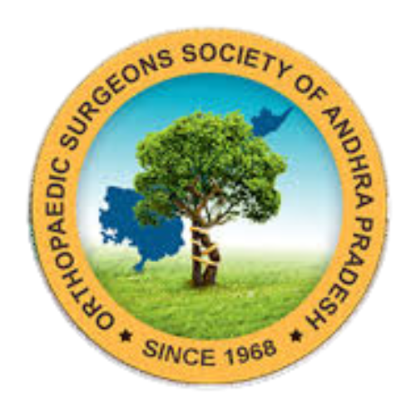

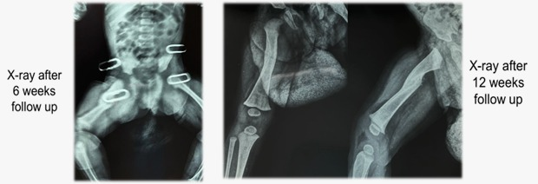
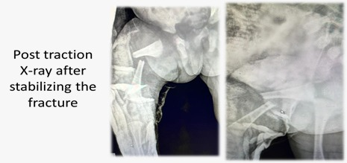
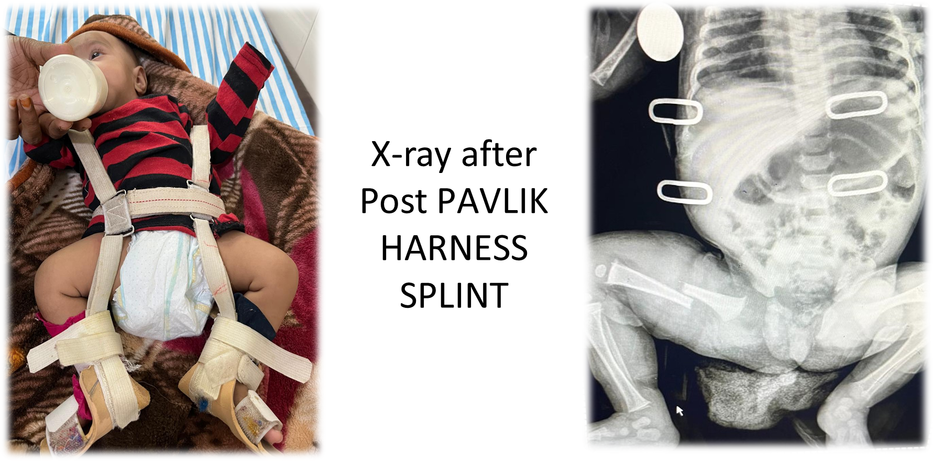
55th Annual Conference of Orthopedic Surgeon Society of Andhra Pradesh
Date 20 – 22 February,2026, Venue : Kurnool Medical College
Organized by : Department of Orthopaedics, Kurnool Medical College Kurnool
CONSERVATIVE MANAGEMENT OF FEMUR SHAFT FRACTURE IN 4MONTH OLD INFANT WITH PAVLIK HARNESS SPLINT
DR.BALAGONI VIKRAM GOUD,JUNIOR RESIDENT,MIMS: DR.RAM KALYAN,HOD,MIMS
INTRODUCTION
Under fluoroscopic guidance,
satisfactory alignment was achieved using a Pavlik harness splint after failure of traction.
No surgery was required; serial X-rays showed callus formation with maintained alignment. The splint was removed at six weeks, with union at twelve weeks.
MANAGEMENT
DISCUSSION
Management of femoral shaft fractures in infants favors conservative methods
because of rapid bone
healing and excellent
remodeling capacity.
Pavlik harness splinting
offers stable immobilization
while allowing comfort and ease of nursing care. Previous studies have shown high union rates with minimal complications in children under six months. This case further supports Pavlik harness splinting as a reliable alternative to surgical fixation in appropriately selected infants.
Femoral shaft fractures in infants are uncommon and constitute about 0.7–1.7% of all paediatric fractures. Due to the excellent remodeling potential in this age group, conservative treatment is usually preferred to avoid surgical risks. Pavlik harness splinting is a well-established non-operative method for femoral fractures in children below six months. We present a case of a four-month-old infant with a mid-shaft femoral fracture managed successfully with conservative treatment.
CONCLUSION
CASE REPORT
A four-month-old infant presented with right thigh pain following trauma. Radiographs showed a closed mid-shaft femoral fracture. Traction failed, so a Pavlik harness was applied. Follow-up X-rays showed callus formation and alignment, with union at twelve weeks.
Conservative management with Pavlik harness splinting is an effective and safe option for femoral shaft fractures in infants. It provides satisfactory fracture alignment, promotes timely union, and avoids operative risks. Early diagnosis, proper application, and close radiological follow-up are essential for optimal outcomes.

