Slide 1




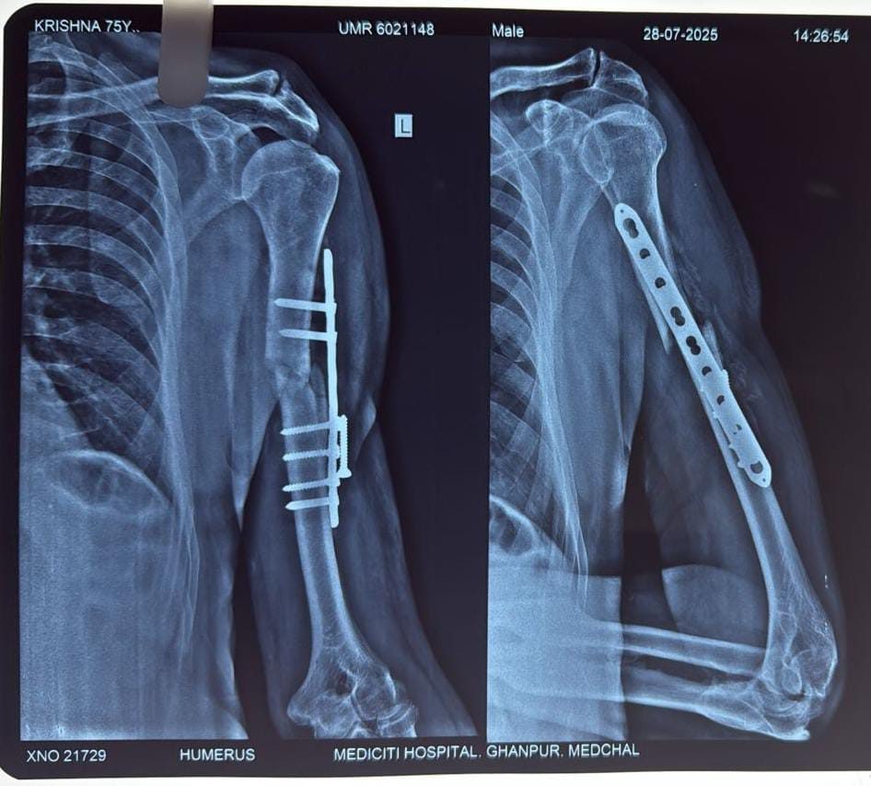
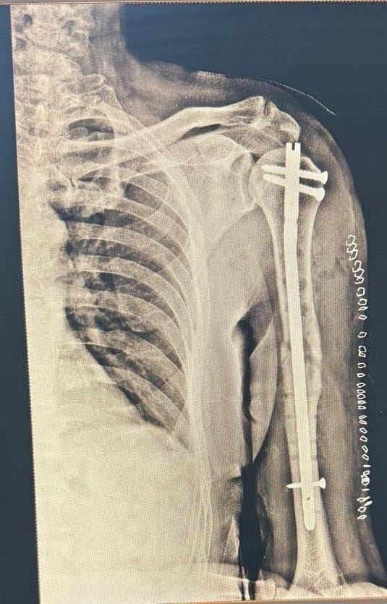
55th Annual Conference of Orthopedic Surgeon Society of AndhraPradesh
Date 20– 22 February,2026, Venue : Kurnool Medical College
Organized by : Department of Orthopaedics, Kurnool Medical College Kurnool
REVISION SURGERY FOR HUMERUS SHAFT FRACTURE
DR.TANNERU AJAY JUNIOR RESIDENT,MIMS. DR.RAM KALYAN,HOD,MIMS
INTRODUCTION
Intra-operatively, implant failure with loosening of screws was
noted at the
fracture site.
The previously applied plate
and screws were removed, and the fracture ends were refreshed.Intramedullary interlocking nailing was performed under fluoroscopic guidance, achieving satisfactory
alignment and
stable fixation.
OPERATIVE FINDINGS
DISCUSSION
Humeral shaft fractures treated with plating may fail due to poor bone quality, inadequate medial support, malreduction, or repeat trauma. In this case, a second fall and probable osteoporotic bone contributed to implant failure. Revision fixation using intramedullary interlocking nailing provided stable load-sharing fixation with minimal soft-tissue disruption and allowed early rehabilitation. This technique is particularly useful in revision settings and in patients with compromised bone quality, offering reliable union and satisfactory functional outcomes.
Implant failure rates can be as high as 22% in humerus plate fixation, particularly in humeral shaft fractures. Failure may occur due to mechanical, biological, or infective causes. Common modes of failure include plate bending or breakage, screw loosening and intra-articular screw penetration.Contributing factors include mechanical overload and bending forces on the implant, improper screw positioning, varus malreduction, lack of medial calcar support, osteoporotic or poor-quality bone, and early or secondary trauma.
CASE REPORT
CONCLUSION
A 75-year-old male with a previously plated for humeral shaft fracture sustained a
second fall leading to implant failure. Revision fixation was done using intramedullary interlocking nailing after plate removal. Recovery was uneventful with immobilisation followed by physiotherapy, and three-month follow-up showed good functional outcome.
Intramedullary interlocking nailing is an effective option for revision of failed humeral shaft plating, particularly in osteoporotic bone, providing stable fixation, good union rates, and satisfactory functional recovery.

