Slide 1




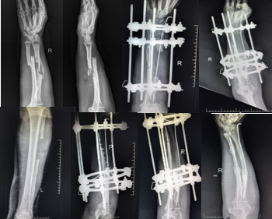
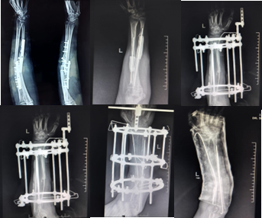
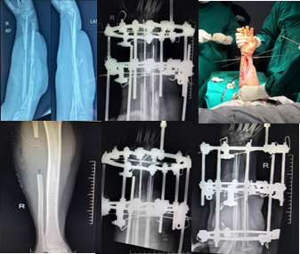
55th Annual Conference of
Orthopedic Surgeon Society of Andhra Pradesh
Date 20 – 22 February,2026, Venue : Kurnool Medical College
Organized by : Department of Orthopaedics, Kurnool Medical College Kurnool
INTRODUCTION
OPERATIVE FINDINGS
DISCUSSION
Management of infected both-bone forearm fractures presents a significant challenge, requiring eradication of infection, restoration of skeletal integrity, and functional recovery. Traditional techniques often result in prolonged treatment durations with variable outcomes. This case series evaluates the efficacy of a combined approach utilizing Ilizarov lengthening for the radius and free fibular grafting for the ulna, focusing on achieving optimal results within a reduced treatment timeline.
The first patient, a 56-year-old male, had a history of a road traffic accident with a bilateral forearm fracture. He was treated somewhere else, but presented to us 5 months later with a discharging sinus at the surgical site.
All patients underwent multiple procedures, including wound debridement, implant removal, and the insertion of antibiotic spacers or Stimulan beads until the infection subsided, as confirmed by laboratory investigations. Following infection resolution, the patients proceeded with Ilizarov fixation and corticotomy of the radius. Once the desired radial length was achieved through primary bone transport, free fibular bone grafting was performed.
The second patient, a 47-year-old female, arrived at our center with similar complications within 2 months of her initial surgery.
CONCLUSION
The combined use of Ilizarov lengthening for the radius and free fibular grafting for the ulna is a promising strategy for managing infected both-bone forearm fractures. This approach effectively addresses infection, bone defects, and functional restoration within a shorter period, offering patients a reliable and efficient pathway to recovery. Further studies with larger cohorts are warranted to validate these findings and refine the protocol for broader application.
CASE REPORT
The third patient, a 24-year-old male, experienced a workplace accident resulting in a bilateral forearm fracture. After undergoing surgery elsewhere, he developed signs of infection during postoperative follow-up, prompting his referral to us.
This case series presents 3 patients who suffered infected fractures of both bone forearm and were referred to our facility. All individuals had chronic osteomyelitis, previous unsuccessful internal fixation, and significant bone loss.

