Slide 1



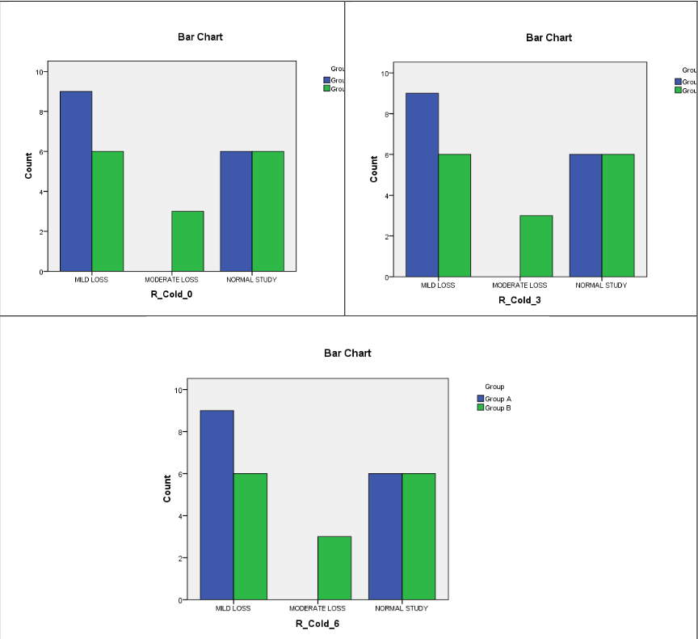
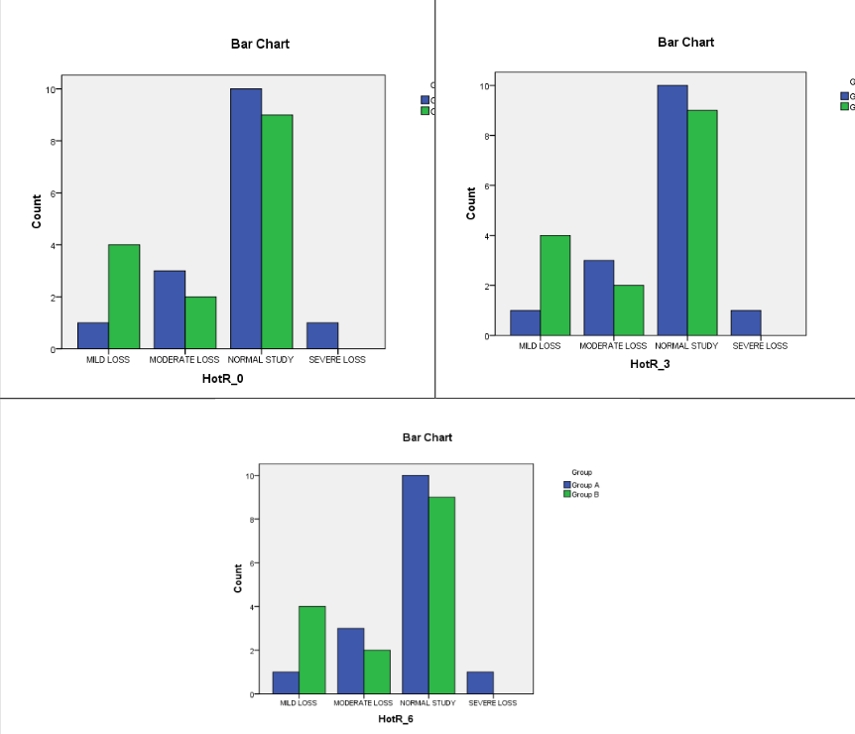
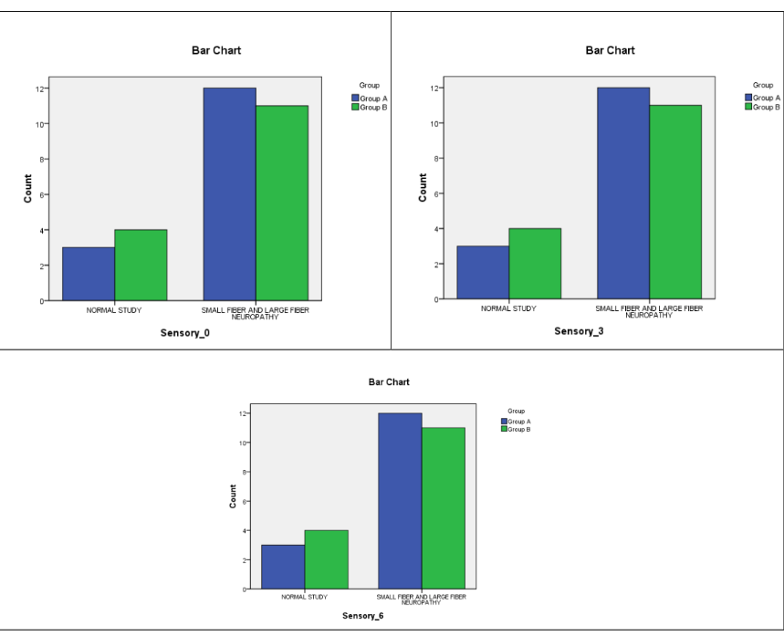
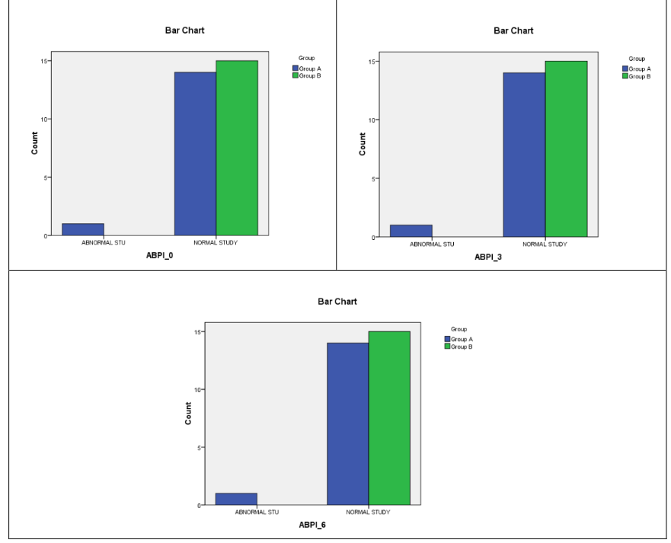
“EFFICACY OF FOOT AND ANKLE EXERCISES(MODIFIED BUERGER’S
EXCERCISES) ON PREVENTON OF FOOT AND ANKLE
COMPLICATIONS ASSOCIATED WITH DIABETES – A PROSPECTIVE
COMPARATIVE STUDY”
Screenshot 2025-08-25 at 10.06.53 AM
Dr Abhijith C
Post Graduate student
Introduction
Results
Conclusions
Diabetes mellitus is a chronic metabolic disorder characterized by persistent hyperglycemiadue to impaired insulin secretion, action, or both. Its global prevalence is rising at an alarming rate, with projections suggesting 700 million cases by 2045 (International Diabetes Federation, 2021)¹. Among its complications, foot and ankle pathologies are particularly debilitating, often leading to ulcers, infections, and even lower-limb amputations. Peripheral neuropathy, peripheral arterial disease (PAD), and impaired wound healing are major contributors, with diabetic foot ulcers preceding approximately 85% of non-traumatic amputations². Preventive strategies are therefore essential.
Given the high burden of diabetic foot complications, especially in resource-limited settings, simple, low-cost, non-invasive interventions such as modified Buerger’s exercises could have significant impact. These require minimal equipment, can be self-administered, and are adaptable for varying functional levels. This study aims to evaluate the preventive efficacy of such exercises in reducing diabetic foot risks, bridging the gap between clinical recommendations and practical community-level implementation.
The study involved 30 participants, predominantly females (66.7%), with over
half (53.3%) aged 50 years and above. Both Group A (intervention) and Group B (control)
had equal allocation (n=15). Ankle Brachial Pressure Index (ABPI) remained within
normal range for 96.7% of participants at baseline, 3 months, and 6 months in both groups,
with no significant differences (p > 0.05). Similarly, sensory neuropathy involving small
and large fibers persisted in 76.7% of participants throughout the study period, with no
significant intergroup variation. Thermal sensation assessment (hot and cold) in both feet
also showed consistent results over time, with most participants exhibiting mild to
moderate loss and no statistical difference between groups. Although clinical
improvements were observed in the intervention group, these did not reach statistical
significance.
Future studies should consider larger, multicentric cohorts with stratification based on
disease severity, duration of diabetes, and glycemic control. Incorporating additional
interventions such as resistance or balance training, nutritional supplementation (e.g.,
alpha-lipoic acid or B vitamins), and structured foot care education may yield synergistic
effects. Longer-term follow-up is also warranted to assess whether modified Buerger’s
exercises confer sustained benefits or help delay the onset of more serious complications
like foot ulcers or gangrene.
Objectives Of The Study
Primary objective:- To evaluate the efficacy of foot and ankle
exercises(modified buerger’s excercises) on prevention of diabetic foot
disease.
• Secondary objective:- Evaluation of the comorbidities associated with
diabetes
SENSATION OF COLD
SENASATION OF HEAT
NEUROPATHY
ABPI
Materials and Methods
References
Recommendations
Study design: This was a prospective comparative interventional study conducted over 18months, using purposive sampling to enroll 30 participants with type 2 diabetes mellitus (duration >5 years). Participants were divided into two groups: Group A received modified Buerger’s foot and ankle exercises along with footwear modifications and foot care education, while Group B received only foot care education. Podiatric was performed at baseline, 3 months, and 6 months. Data were collected using standardized
instruments, and informed consent was obtained from all participants.
Inclusion Criteria:
• Patients diagnosed with type 2 diabetes mellitus for more than 5 years.
Exclusion Criteria:
• Patients with chronic diabetic foot ulcers
• Amputees with diabetes
• Patients with joint dislocations
• Patients presenting with gangrene in the foot
1. International Diabetes Federation. IDF Diabetes Atlas. 10th ed. Brussels, Belgium:International Diabetes Federation; 2021.
2. Armstrong DG, Boulton AJM, Bus SA. Diabetic foot ulcers and their recurrence.N Engl J Med. 2017 Jun 15;376(24):2367–75. doi: 10.1056/NEJMra1615439.
3. Allet L, Armand S, Golay A, Monnin D, de Bie RA, de Bruin ED. Gaitcharacteristics of diabetic patients: a systematic review. Diabetes Metab Res Rev.2008 May-Jun;24(3):173–91. doi: 10.1002/dmrr.809.
4. Iversen MM, Tell GS, Riise T, Hanestad BR, Østbye T, Graue M, Midthjell K.History of foot ulcer increases mortality among individuals with diabetes: ten-year follow-up of the Nord-Trøndelag Health Study, Norway. Diabetes Care. 2009 Dec;32(12):2193–9. doi: 10.2337/dc09-0651.
5. Francis D, Kandaswami K, Padinhare Veedu P, Ponniah Subramanian A. Effect of exercises for strengthening the intrinsic muscles of the foot and improving ankle mobility on patients of diabetic peripheral neuropathy. Cureus. 2024 Mar 20;16(3):e56553. doi: 10.7759/cureus.56553. PMID: 38646253; PMCID: PMC11027948.
6. Fernando M, Crowther R, Lazzarini P, Sangla K, Cunningham M, Buttner P, Golledge J. Biomechanical characteristics of peripheral diabetic neuropathy: a systematic review and meta-analysis of findings from the gait cycle, muscle activity and dynamic barefoot plantar pressure. Clin Biomech (Bristol, Avon). 2013Oct;28(8):831–45. doi: 10.1016/j.clinbiomech.2013.08.004.
Future studies should consider larger, multicentric cohorts with stratification based on
disease severity, duration of diabetes, and glycemic control. Incorporating additional
interventions such as resistance or balance training, nutritional supplementation (e.g.,
alpha-lipoic acid or B vitamins), and structured foot care education may yield synergistic
effects. Longer-term follow-up is also warranted to assess whether modified Buerger’s
exercises confer sustained benefits or help delay the onset of more serious complications
like foot ulcers or gangrene.

