Slide 1
IPL ANALYTICS
AKASH MEGHANI

Slide 2
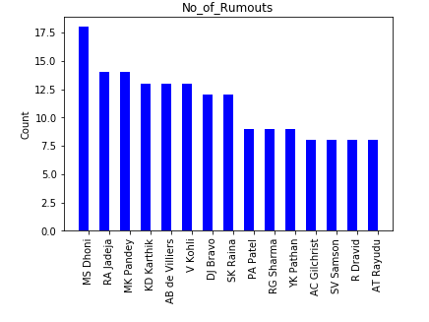
Fielding ANALYSIS

Slide 3
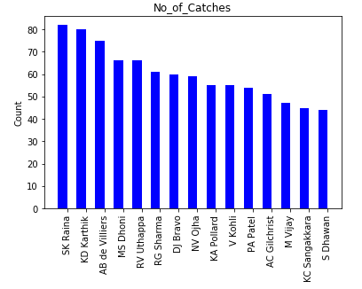
Fielding ANALYSIS
Number of catches by the fielders:-

Slide 4
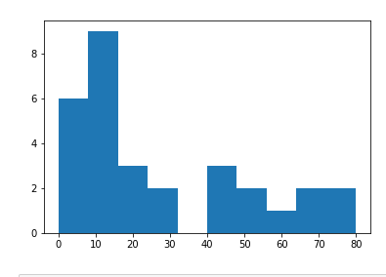
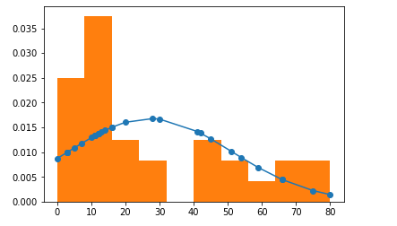
frequency distribution for wicketkeepers

