Slide 1
MEAN STACK
Which is the most effective technology to build E-commerce and Open Source platform today and the enhancements you visualise it will need to retain its position as No. 1 in the next three or more than three years.

Slide 2
MEAN STACK
Project Presented & Submitted By:-
Akash Mishra.
Registration No.:- R171107500138
NIIT, DECCAN,
PUNE.

Slide 3
What is MEAN STACK?
MEAN STACK is latest and high end technology widely used in IT industry for developing the web application / sites
It is combine technology with different different frameworks of JavaScript.
Meaning of MEAN is :-
M:- Mongo DB - the data base which is used.
E :- Express JS.
A :- Angular JS- use for front-end development with
HTML-5, CSS-3, and Twitter-Bootstrap.
N :- Node JS – which is single threaded server and it is
comparatively faster than other servers.
At the end it is JavaScript only

Slide 4
Why MEAN STACK ?
At the current stage of industry no one can afford the heavy and time consuming web-applications/sites.
MEAN STACK is best solution for this as it is easy and open source technology.
Web applications /sites those are built in this technology are much faster than other than technology as they are light-weighted.
The cost of web apps /sites those are built in this technology is cheap as compare to other

Slide 5
System and Environment Pre-Requisite for development:
Computer/ laptop with Windows 7/8/10 (64 bit recommended) and 4 GB RAM.
Atom/ Sublime/ Notepad ++ (Text Editor).
Node.js.
Mongo DB.
Internet Connection.

Slide 6
My MEAN STACK Project:-
Type of project :- E-Commerce : Movie Ticket booking site.
Name of site :-Entertainment.com
Technology used in project:-
Front-end: HTML 5, CSS 3 , Bootstrap, Angular JS.
Database: Mongo DB.
Server: Node Server.
Testing Frameworks: Chai, Mocha, Jasmin.

Slide 7
Small intro of tech…
Angular JS:
It is JavaScript's framework, actually it is library written in JavaScript and distributed as a javascript file , can added to web or HTML page with <script> tag.
It extends the HTML attribute with directive and binds data to HTML with {{expression}} tag and use for front-end development
<script src =“http://ajax.googleapis.com/ ajax/libs/ angular/1.4.8/angular.min.js”></script>

Slide 8
Continued…
Mongo DB:-
MongoDB is an open-source document database and leading NoSQL database. MongoDB is written in C++. This tutorial will give you great understanding on MongoDB concepts needed to create and deploy a highly scalable and performance-oriented database.

Slide 9
Continued…
Node JS or Node server:-
Node.js is a very powerful JavaScript-based framework / platform built on Google Chrome's JavaScript V8 Engine. It is used to develop I/O intensive web applications like video streaming sites, single-page applications, and other web applications. Node.js is open source, completely free, and used by thousands of developers around the world.

Slide 10
Implementation
Implementation starts with the creating the package.json which is starting point
Then need to create the server.js . We can consider it as heart of application or site. Whatever we need to execute we need to describe it inside this file.
App.js is file which is use for register modules part we need to add controller and views for implementing.
appRoutes.js we need to register all controller in this file which help for execution

Slide 11
For User :-

Slide 12
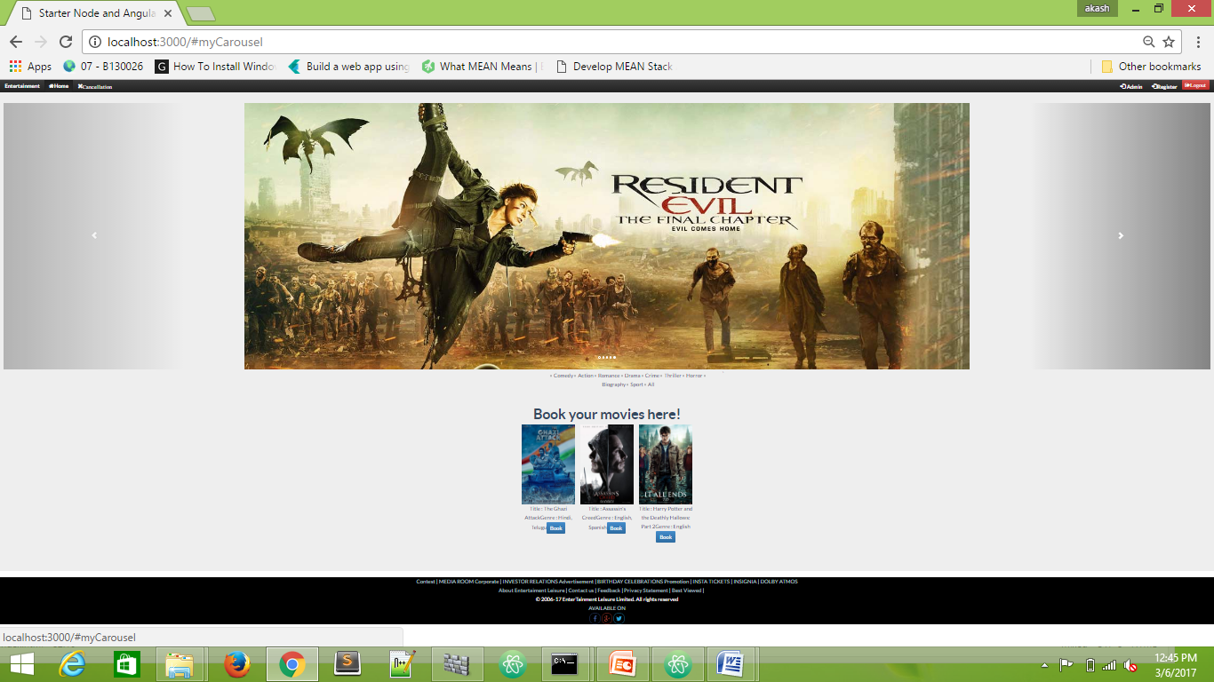
Home page

Slide 13
Continued…
User need to register for booking the movie

Slide 14
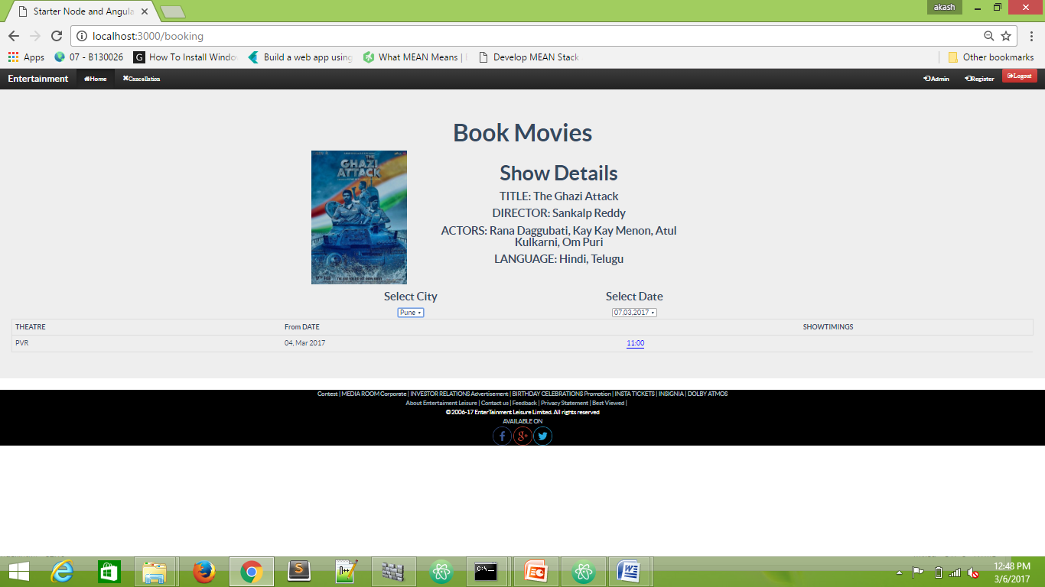
Booking page
Booking page look like

Slide 15
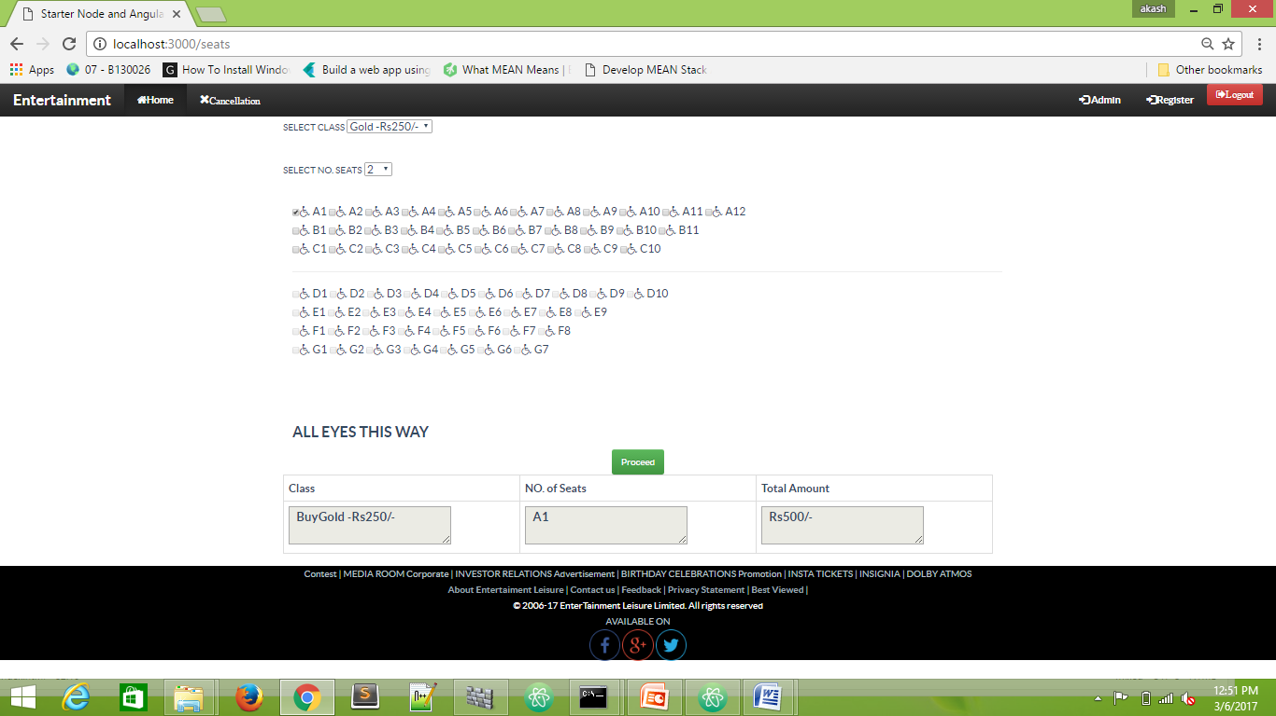
Seat booking page
Seat booking page look like:-

Slide 16
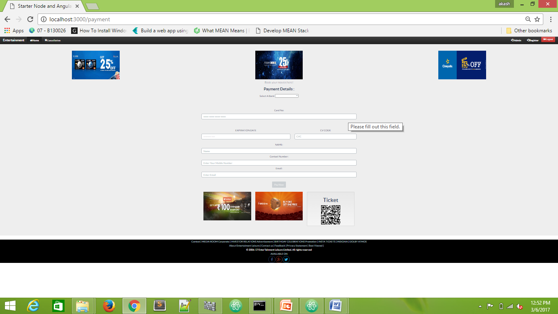
Payment page
Payment page looks like:-

Slide 17
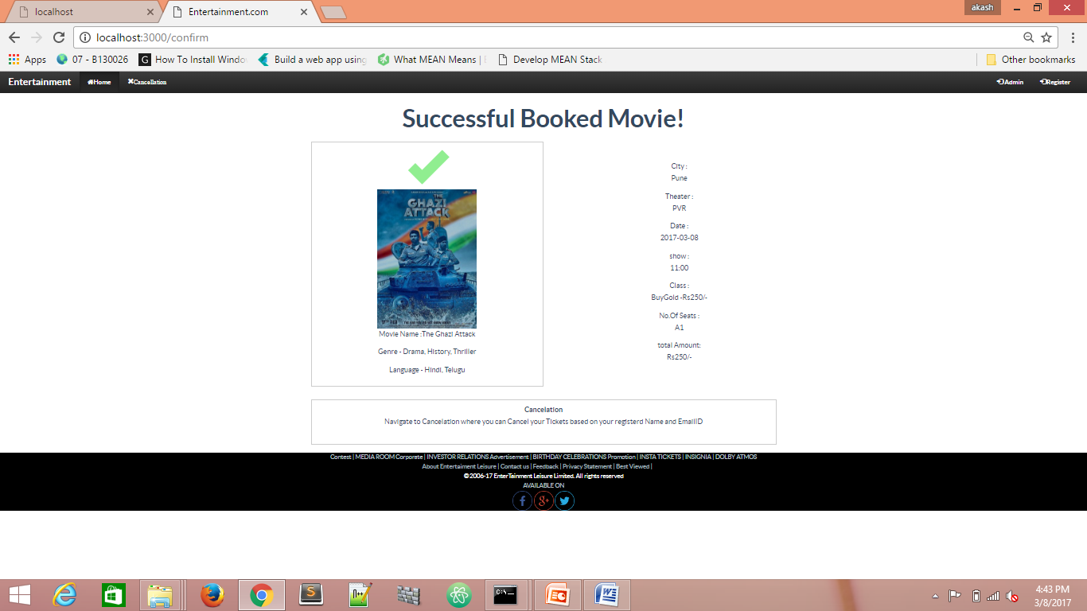
Confirmation Booked Movie Page :-

Slide 18
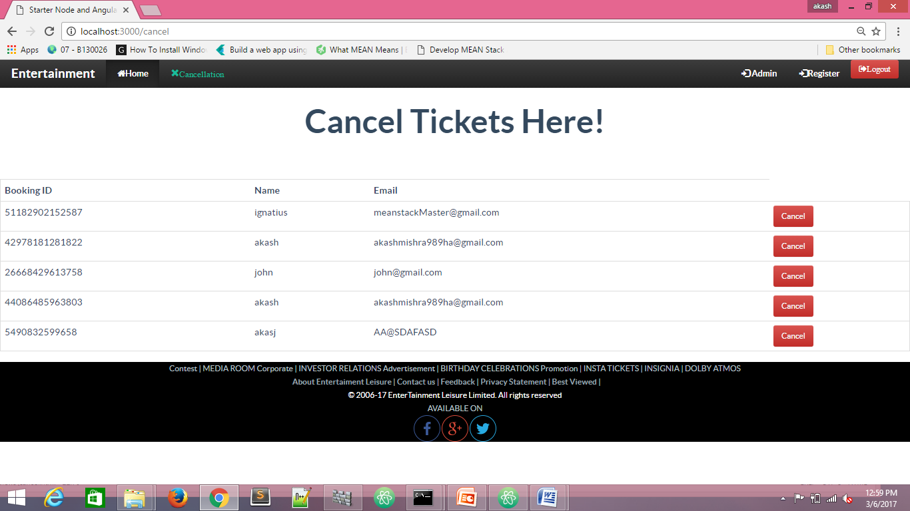
Cancel Ticket :-

Slide 19
Admin
admin have all right or authority to control the each and every part of site or application
Admin controls the adding movie, City , Theatre, Location of theatre , movie display In theatre, show timing, payment options, advertisement and offers

Slide 20
Any Questions???

Slide 21
Thank You

