Slide 1


Physics Informed Neural Network (PINN) using pytorch
Incompressible Lid Driven Cavity
Akash Kumar Mittal

Slide 2
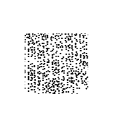
































PINN
Lid-Driven Cavity (Incompressible)
Objective: to approximate the solution of the incompressible Navier-Stokes equations for the lid-driven cavity flow by Multi Layer Perceptron (MLP) (Fully Connected Neural Network).
Governing Equation losses
Boundary Condition losses
u=1, v=0, $\frac{∂p}{∂y}=0$
(0,1)
(1,1)
$$l_{b_{1}}=u_{top}−1$$
$$l_{b_{2}}=v_{top}$$
$$l_{b_{3}}={\left(\frac{∂p}{∂y}\right)}_{top}$$
$$l1=\frac{∂(ρu)}{∂x}+\frac{∂(ρv)}{∂x}$$
u=0
v=0
$\frac{∂p}{∂x}=0$
u=0
v=0
$\frac{∂p}{∂x}=0$
$$l2=\frac{∂(ρu^{2})}{∂x}+\frac{∂(ρuv)}{∂y}+\frac{∂p}{∂x}−\frac{μ}{{Re}_{r}}\left(\frac{∂^{2}u}{{∂x}^{2}}+\frac{∂^{2}u}{{∂y}^{2}}\right)$$
$$l_{b_{7}}=u_{bot}$$
$$l_{b_{8}}=v_{bot}$$
$$l_{b_{9}}={\left(\frac{∂p}{∂y}\right)}_{bot}$$
y
$$l3=\frac{∂(ρuv)}{∂x}+\frac{∂(ρv^{2})}{∂y}+\frac{∂p}{∂y}−\frac{μ}{{Re}_{r}}\left(\frac{∂^{2}v}{{∂x}^{2}}+\frac{∂^{2}v}{{∂y}^{2}}\right)$$
$$l_{b_{4}}=u_{right}$$
$$l_{b_{5}}=v_{right}$$
$$l_{b_{6}}={\left(\frac{∂p}{∂x}\right)}_{right}$$
x
(0,0)
u=0, v=0, $\frac{∂p}{∂y}=0$
(1,0)
$μ=1, ρ=1$ (constants and non-dimensionalized)
$$l_{b_{10}}=u_{left}$$
$$l_{b_{11}}=v_{left}$$
$$l_{b_{12}}={\left(\frac{∂p}{∂x}\right)}_{left}$$
$$[u]$$
$$[v]$$
$$[p]$$
$$l1, l2, l3$$
NN model
$$[u]$$
$$[v]$$
$$[p]$$
$$l_{b_{1}}, l_{b_{2}}, l_{b_{3}}$$
$$loss=mean\left(\begin{aligned}l1^{2}+l2^{2}+l3^{2}+lb1^{2} \\ +lb2^{2}+…+lb{12}^{2}\end{aligned}\right)$$
$$⋮$$
$$⋮$$
$$⋮$$
$$[u]$$
$$[v]$$
$$[p]$$
$$l_{b_{10}}, l_{b_{11}}, l_{b_{12}}$$
With backpropagation (automatic differentiation)
20000 collocation points
500+500+500+500 boundary points

Slide 3
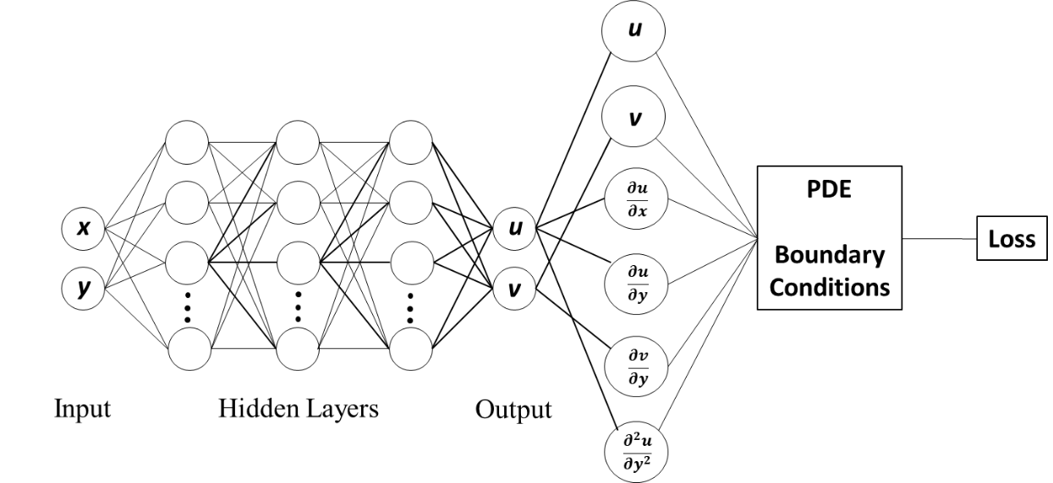
PINN
Lid-Driven Cavity (Incompressible)
Optimizer: Adam
learning_rate = 1e-3
optimizer = torch.optim.Adam(model.parameters(), lr = learning_rate)
u
v
Mini-batch training for 20 epochs
Batch size: 2000 (collocation) + 50+50+50+50 (boundary points)
p
Optimizer: LBFGS
Multi-Layer Perceptron
optimizer = torch.optim.LBFGS(model.parameters(),
lr = 1.0,
max_iter = 50000,
max_eval = 50000,
history_size = 50,
tolerance_grad = 1e-05,
tolerance_change = 0.5*numpy.finfo(float).eps,
line_search_fn = "strong_wolfe")
Width = 30 units
Depth = 4 hidden layers
Activation: tanh (including for the last layer)
LBFGS requires the entire dataset.

Slide 4
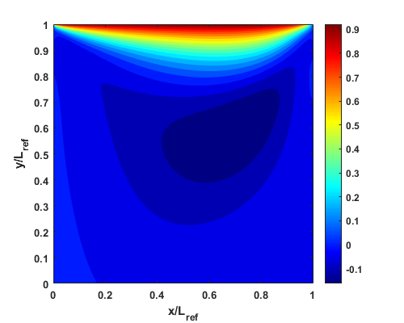
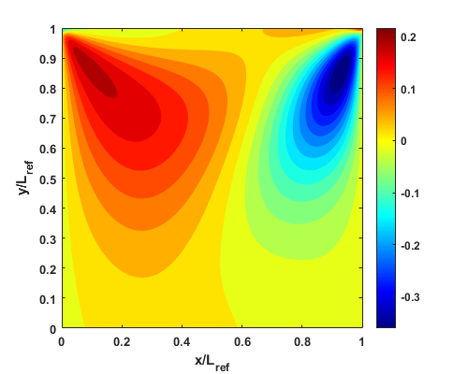
PINN
Lid-Driven Cavity (Incompressible)
Loss history
u-velocity
v-velocity
Pressure

