Slide 1

Physics Informed Neural Network (PINN)
Session 1: Tensorflow Basics
By Akash Kumar Mittal

Slide 2
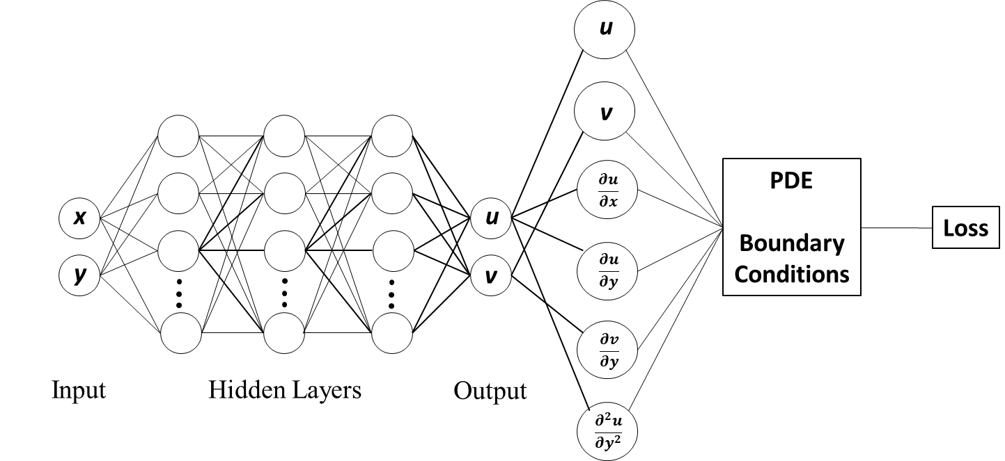


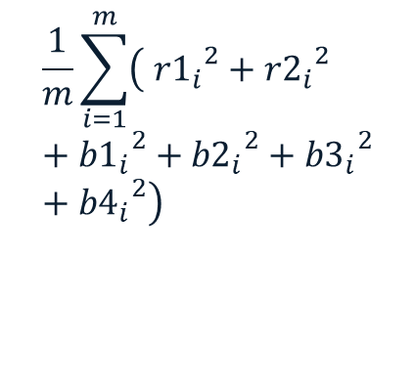











Typical Physics-Informed Neural Network Architecture
$$a_{1}^{1}=f\left({b^{0}+w}_{11}^{0}x+w_{21}^{0}y \right)$$
$$w_{21}^{0}$$
$$w_{31}^{1}$$
$$w_{11}^{0}$$
$$a_{1}^{1}$$
$$a_{1}^{2}$$
$(i$→ $ith$collocation point)
$$a_{2}^{1}$$
$$a_{2}^{2}$$
$$\frac{1}{m}\sum_{i=1}^{m}{\left({{ r1}_{i}}^{2}+{{r2}_{i}}^{2}+{{b1}_{i}}^{2}+{{b2}_{i}}^{2}+{{b3}_{i}}^{2}+{{b4}_{i}}^{2}\right)}$$
$$a_{1}^{0}$$
$$a_{3}^{1}$$
$$a_{3}^{2}$$
$$a_{2}^{0}$$
r1, r2
b1, b2
b3, b4
Feed-forward
Optimized PINN model
Gradients are calculated using Automatic Differentiation
Loss
<ϵ
Yes
No
Update weights, w
Optimizer to minimize loss

Slide 3
Session 1: Tensorflow Basics
import tensorflow as tf
import numpy as np
…
Few Tensorflow functions/operations
tf.cast()
tf.rank()
tf.reshape()
tf.transpose()
tf.concat([x,y],axis=0)
tf.convert_to_tensor()
tf.add()
tf.pow()
tf.multiply()
tf.matmul()
tf.ones()
tf.zeros()
tf.reduce_sum()
tf.reduce_max()
tf.reduce_mean()
tf_object.dtype (property)
tf_object.shape (property)
Tensorflow building blocks
- tf.constant
- tf.Variable
tf.placeholder
Tensors of various ranks
Tensor properties
Indexing in Tensors
Manipulating shapes
Datatype casting
Broadcasting

Slide 4
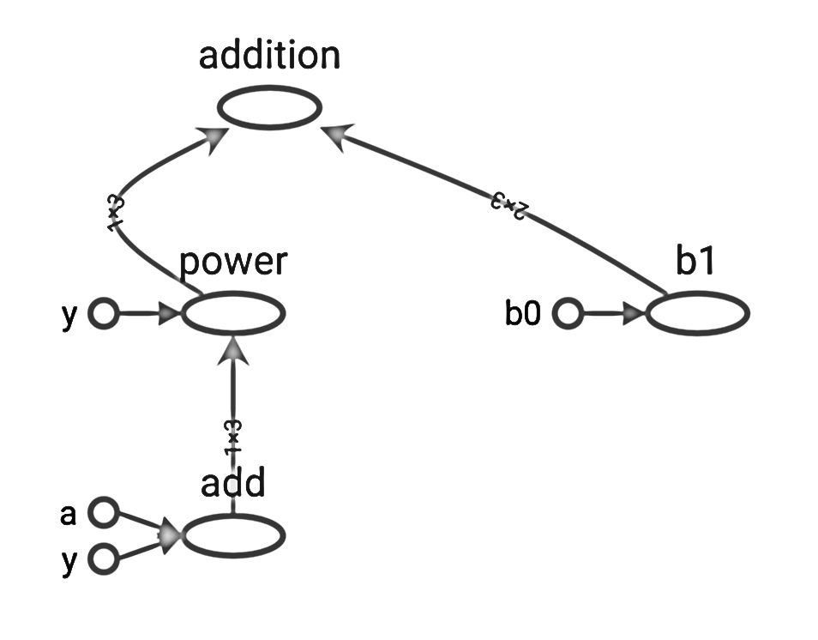
Session 1: Tensorflow Basics
Example of
Computation graph
(visualization in Tensorboard)
Tensorflow computation can be executed in
- Eager mode
- Non-Eager mode (graph mode)
Operation
Computation Graph
Static execution, Optimized, Similar to statically typed, languages (such as C++, Fortran)
Hence, faster computation
Constant/Variable/Placeholder

Slide 5
Session 1: Tensorflow Basics
Tensorflow Constants
a=tf.constant([1,2,3], dtype=tf.float64, name='a', shape=(1,3));
Tensorflow Variables
var=tf.Variable([1,2], dtype=tf.float64, name='var’, trainable=False);
# Default: trainable is True
# Initlization of the variables required before graph execution
init = tf.compat.v1.global_variables_initializer()
Tensorflow Placeholders (can not be assigned, only to feed data)
x = tf.compat.v1.placeholder(dtype=tf.float16, shape=(None,1), name='x’)
# placeholder is NOT compatible with eager execution
# feed_dict is needed to input data, ex. sess.run(y,feed_dict={x:a})

Slide 6

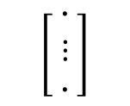
Session 1: Tensorflow Basics
Automatic Gradient/Algorithmic Gradient
# Importing Libraries
import tensorflow as tf
import numpy as np
$$\left[\begin{matrix}∙ \\ ⋮ \\ ∙ \end{matrix}\right]$$
x
y
$$\left[3\right]$$
(None,1)
(1,)
# Executing in graph mode & creating session
tf.compat.v1.disable_eager_execution();
sess = tf.compat.v1.Session();
# Defining data and its type
x = tf.compat.v1.placeholder(shape=(None,1),
dtype=tf.float16,
name='x’);
y = tf.Variable([3], dtype=tf.float16
name='y’,
trainable=False);

Slide 7


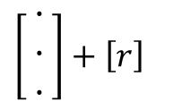
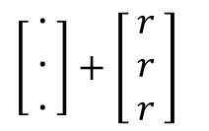
Session 1: Tensorflow Basics
Automatic Gradient/Algorithmic Gradient
# Arithmatic expression and taping
with tf.GradientTape(persistent=True) as tape_1:
tape_1.watch([x,y]);
z = x**3+y**2
$$\left[\begin{matrix}∙ \\ ⋮ \\ ∙ \end{matrix}\right]$$
x
y
$$\left[3\right]$$
(None,1)
(1,)
# Evaluating gradient
dz_dy = tape_1.gradient(z,y);
dz_dx = tape_1.gradient(z,x);
**
3
2
**
(Broadcasting)
$\left[\begin{matrix}∙ \\ ∙ \\ ∙ \end{matrix}\right]+$ $\left[r\right]$
$\left[\begin{matrix}∙ \\ ∙ \\ ∙ \end{matrix}\right]+$ $\left[\begin{matrix}r \\ r \\ r \end{matrix}\right]$
+
# Running the session
init=tf.compat.v1.global_variables_initializer();
sess.run(init); # required for variables
z
(None,1)
$$∇$$
$$∇$$
dz_dx
dz_dy
(None,1)
(1,)

Slide 8

Session 1: Tensorflow Basics
Automatic Gradient/Algorithmic Gradient
# Running the session (continued)
a = np.linspace(1,3,3); # shape: (3,): 1 dimension
a = np.reshape(a,(a.size,1));
# converting to shape (3,1) compatible with the
placeholder (None,1)
$$\left[\begin{aligned}1. \\ 2. \\ 3.\end{aligned}\right]$$
x
y
$$\left[\begin{matrix}∙ \\ ⋮ \\ ∙ \end{matrix}\right]$$
$$\left[3\right]$$
(None,1)
(1,)
(3,1)
**
3
2
**
grad_z_y = sess.run(dz_dy,feed_dict={x:a});
print(grad_z_y)
grad_z_x = sess.run(dz_dx,feed_dict={x:a});
print(grad_z_x)
+
z
Output
(3,1)
[18.]
[[ 3.]
[12.]
[27.]]
$$∇$$
$$∇$$
dz_dx
dz_dy
(None,1)
(3,1)
(1,)

Slide 9





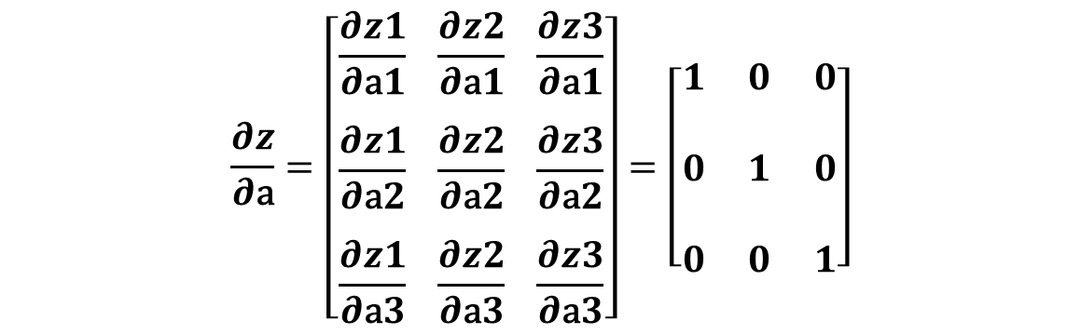
Session 1: Tensorflow Basics
Automatic Gradient/Algorithmic Gradient
Understanding output
$$\left[\begin{aligned}1. \\ 2. \\ 3.\end{aligned}\right]$$
x
y
a
b
z
a
b (broadcasting)
$$\left[3\right]$$
(3,1)
(1,)
(1,)
+
$$\left[\begin{aligned}z1 \\ z2 \\ z3\end{aligned}\right]$$
$$\left[\begin{aligned}a1 \\ a2 \\ a3\end{aligned}\right]$$
$$\left[\begin{aligned}b \\ b \\ b\end{aligned}\right]$$
(3,1)
=
+
z
(3,1)
**
3
2
**
a
b
$$\frac{∂z}{∂\text{a}}=\left[\begin{aligned}\frac{∂z1}{∂\text{a}1} \frac{∂z2}{∂\text{a}1} \frac{∂z3}{∂\text{a}1} \\ \\ \frac{∂z1}{∂\text{a}2} \frac{∂z2}{∂\text{a}2} \frac{∂z3}{∂\text{a}2} \\ \\ \frac{∂z1}{∂\text{a}3} \frac{∂z2}{∂\text{a}3} \frac{∂z3}{∂\text{a}3}\end{aligned}\right]=\left[\begin{aligned}1 0 0 \\ \\ 0 1 0 \\ \\ 0 0 1\end{aligned}\right]$$
(3,1)
(1,)
+
z
(3,1)
$$∇$$
$$∇$$
The Jacobian matrix
dz_dx
dz_dy
(3,1)
(1,)

Slide 10
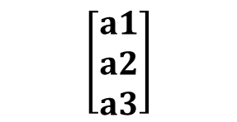
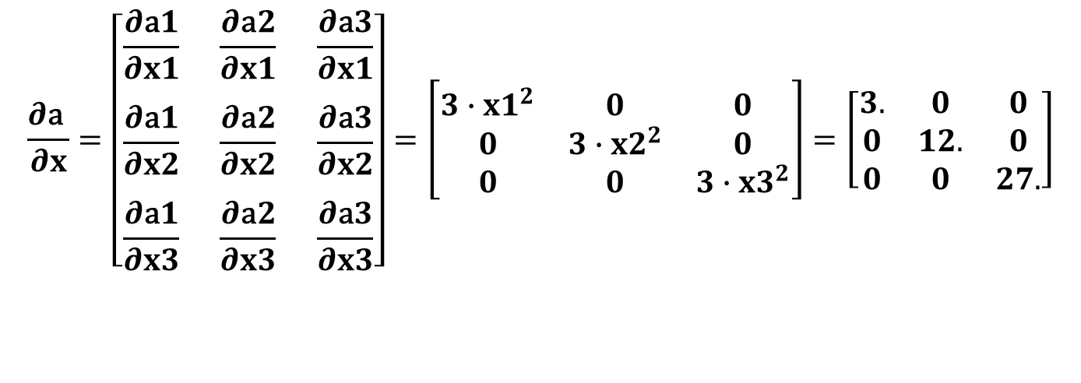
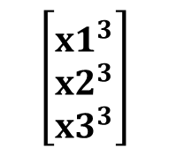
Session 1: Tensorflow Basics
x
Automatic Gradient/Algorithmic Gradient
(3,1)
Understanding output
$$\left[\begin{aligned}1. \\ 2. \\ 3.\end{aligned}\right]$$
x
y
a
x**3
$$\left[3\right]$$
**
3
$$\left[\begin{aligned}a1 \\ a2 \\ a3\end{aligned}\right]$$
$$\left[\begin{aligned}{x1}^{3} \\ {x2}^{3} \\ {x3}^{3}\end{aligned}\right]$$
(1,)
(3,1)
a
=
(3,1)
**
3
2
**
$$\frac{∂\text{a} }{∂x}=\left[\begin{aligned}\frac{∂\text{a}1}{∂x1} \frac{∂\text{a}2}{∂x1} \frac{∂\text{a}3}{∂x1} \\ \\ \frac{∂\text{a}1}{∂x2} \frac{∂\text{a}2}{∂x2} \frac{∂\text{a}3}{∂x2} \\ \\ \frac{∂\text{a}1}{∂x3} \frac{∂\text{a}2}{∂x3} \frac{∂\text{a}3}{∂x3}\end{aligned}\right]=\left[\begin{matrix}3{∙x1}^{2} & 0 & 0 \\ 0 & 3∙{x2}^{2} & 0 \\ 0 & 0 & 3{∙x3}^{2}\end{matrix}\right]=\left[\begin{matrix}3. & 0 & 0 \\ 0 & 12. & 0 \\ 0 & 0 & 27.\end{matrix}\right]$$
a
b
(3,1)
(1,)
+
z
(3,1)
The Jacobian matrix
$$∇$$
$$∇$$
dz_dx
dz_dy
(3,1)
(1,)

Slide 11



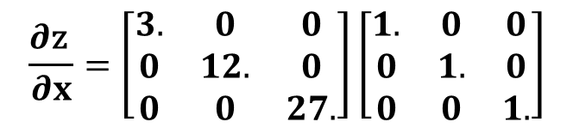




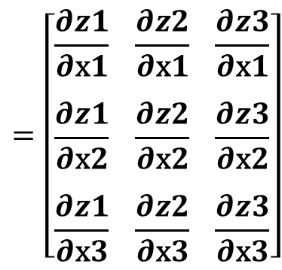




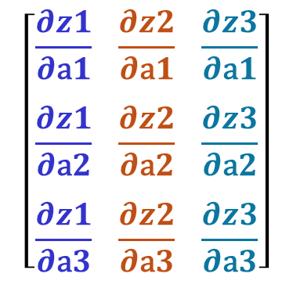


Session 1: Tensorflow Basics
Automatic Gradient/Algorithmic Gradient
Understanding output
$$\left[\begin{aligned}1. \\ 2. \\ 3.\end{aligned}\right]$$
x
y
$$\left[3\right]$$
$$\frac{∂\text{a} }{∂x}\frac{∂z}{∂\text{a}}=\left[\begin{aligned}\frac{∂\text{a}1}{∂x1} \frac{∂\text{a}2}{∂x1} \frac{∂\text{a}3}{∂x1} \\ \\ \frac{∂\text{a}1}{∂x2} \frac{∂\text{a}2}{∂x2} \frac{∂\text{a}3}{∂x2} \\ \\ \frac{∂\text{a}1}{∂x3} \frac{∂\text{a}2}{∂x3} \frac{∂\text{a}3}{∂x3}\end{aligned}\right]$$
$$\left[\begin{aligned}\frac{∂z1}{∂\text{a}1} \frac{∂z2}{∂\text{a}1} \frac{∂z3}{∂\text{a}1} \\ \\ \frac{∂z1}{∂\text{a}2} \frac{∂z2}{∂\text{a}2} \frac{∂z3}{∂\text{a}2} \\ \\ \frac{∂z1}{∂\text{a}3} \frac{∂z2}{∂\text{a}3} \frac{∂z3}{∂\text{a}3}\end{aligned}\right]$$
$$=\left[\begin{aligned}\frac{∂z1}{∂\text{x}1} \frac{∂z2}{∂\text{x}1} \frac{∂z3}{∂\text{x}1} \\ \\ \frac{∂z1}{∂\text{x}2} \frac{∂z2}{∂\text{x}2} \frac{∂z3}{∂\text{x}2} \\ \\ \frac{∂z1}{∂\text{x}3} \frac{∂z2}{∂\text{x}3} \frac{∂z3}{∂\text{x}3}\end{aligned}\right]$$
(3,1)
(1,)
$$\frac{∂\text{z} }{∂x}=\left[\begin{aligned}\frac{∂z1}{∂\text{x}1}+\frac{∂z2}{∂\text{x}1}+\frac{∂z3}{∂\text{x}1} \\ \\ \frac{∂z1}{∂\text{x}2}+\frac{∂z2}{∂\text{x}2}+\frac{∂z3}{∂\text{x}2} \\ \\ \frac{∂z1}{∂\text{x}3}+\frac{∂z2}{∂\text{x}3}+\frac{∂z3}{∂\text{x}3}\end{aligned}\right]=\left[\begin{aligned}3. \\ 12. \\ 27.\end{aligned}\right]$$
**
3
2
**
a
b
(3,1)
(1,)
$$\frac{∂\text{z} }{∂x}=\left[\begin{matrix}3. & 0 & 0 \\ 0 & 12. & 0 \\ 0 & 0 & 27.\end{matrix}\right]\left[\begin{matrix}1. & 0 & 0 \\ 0 & 1. & 0 \\ 0 & 0 & 1.\end{matrix}\right]$$
$$=\left[\begin{matrix}3. & 0 & 0 \\ 0 & 12. & 0 \\ 0 & 0 & 27.\end{matrix}\right]$$
+
$$\frac{∂\text{a}1}{∂x1}\frac{∂z1}{∂\text{a}1}+\frac{∂\text{a}2}{∂x1}\frac{∂z1}{∂\text{a}2}+\frac{∂\text{a}3}{∂x1}\frac{∂z1}{∂\text{a}3}$$
$$\frac{∂\text{a}1}{∂x1}\frac{∂z2}{∂\text{a}1}+\frac{∂\text{a}2}{∂x1}\frac{∂z2}{∂\text{a}2}+\frac{∂\text{a}3}{∂x1}\frac{∂z2}{∂\text{a}3}$$
$$\frac{∂\text{a}1}{∂x1}\frac{∂z3}{∂\text{a}1}+\frac{∂\text{a}2}{∂x1}\frac{∂z3}{∂\text{a}2}+\frac{∂\text{a}3}{∂x1}\frac{∂z3}{∂\text{a}3}$$
z
$$\frac{∂\text{a}1}{∂x2}\frac{∂z1}{∂\text{a}1}+\frac{∂\text{a}2}{∂x2}\frac{∂z1}{∂\text{a}2}+\frac{∂\text{a}3}{∂x2}\frac{∂z1}{∂\text{a}3}$$
$$\frac{∂\text{a}1}{∂x2}\frac{∂z2}{∂\text{a}1}+\frac{∂\text{a}2}{∂x2}\frac{∂z2}{∂\text{a}2}+\frac{∂\text{a}3}{∂x2}\frac{∂z2}{∂\text{a}3}$$
$$\frac{∂\text{a}1}{∂x2}\frac{∂z3}{∂\text{a}1}+\frac{∂\text{a}2}{∂x2}\frac{∂z3}{∂\text{a}2}+\frac{∂\text{a}3}{∂x2}\frac{∂z3}{∂\text{a}3}$$
(3,1)
$$=$$
The change in output with respect to an input element is taken as the sum of the changes in all output elements
$$∇$$
$$∇$$
$$\frac{∂\text{a}1}{∂x3}\frac{∂z1}{∂\text{a}1}+\frac{∂\text{a}2}{∂x3}\frac{∂z1}{∂\text{a}2}+\frac{∂\text{a}3}{∂x3}\frac{∂z1}{∂\text{a}3}$$
$$\frac{∂\text{a}1}{∂x3}\frac{∂z2}{∂\text{a}1}+\frac{∂\text{a}2}{∂x3}\frac{∂z2}{∂\text{a}2}+\frac{∂\text{a}3}{∂x3}\frac{∂z2}{∂\text{a}3}$$
$$\frac{∂\text{a}1}{∂x3}\frac{∂z3}{∂\text{a}1}+\frac{∂\text{a}2}{∂x3}\frac{∂z3}{∂\text{a}2}+\frac{∂\text{a}3}{∂x3}\frac{∂z3}{∂\text{a}3}$$
dz_dx
dz_dy
(3,1)
(1,)

Slide 12

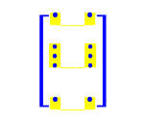
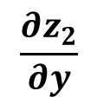



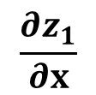




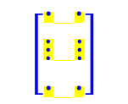




Session 1: Tensorflow Basics
Automatic Gradient: Keras Model Example
Bias
$$b_{1}$$
$$b_{2}$$
$$z_{1}=\left(b_{1}+w_{11}x+w_{21}y \right)$$
$$x$$
$$w_{11}$$
$$x y$$
(None,1)
1
1
$z_{1}$ $z_{2}$
$$\left[\begin{aligned}∙ \\ ⋮ \\ ∙\end{aligned}\begin{aligned} ∙ \\ ⋮ \\ ∙\end{aligned}\right]$$
$$w_{12}$$
$$\left[\begin{aligned}∙ \\ ⋮ \\ ∙\end{aligned}\begin{aligned} ∙ \\ ⋮ \\ ∙\end{aligned}\right]$$
$$w_{21}$$
$$y$$
(None,1)
2
2
$$w_{22}$$
$$z_{2}=\left(b_{2}+w_{12}x+w_{22}y \right)$$
$$\frac{∂z_{1}}{∂x}$$
$$\frac{∂z_{2}}{∂y}$$
Objective: To compute
and

Slide 13
Session 1: Tensorflow Basics
Automatic Gradient: Keras Model Example
# Importing Libraries
import numpy
import keras
from keras import layers, Input
from keras.models import Model
import tensorflow as tf
from keras import backend
# Executing in graph mode
tf.compat.v1.disable_eager_execution();
sess = tf.compat.v1.Session();
backend.set_session(sess); # Required to tell Keras to use this session.
# Setting precision for Tensorflow (used as backend by Keras)
# Default: float32
tf.keras.backend.set_floatx('float64')

Slide 14












Session 1: Tensorflow Basics
Automatic Gradient: Keras Model Example
# Creating a Keras model
input_tensor=Input(shape=(2,)); # input:(None, 2): a placeholder
out1=layers.Dense(2,activation='linear')(input_tensor); # (None,2)
model1 = Model(inputs=[input_tensor], outputs=[out1]);
# We can not directly tape these commands because input_tensor, out1 are Keras-tensors (objects of Keras) not tensorflow tensors.
model1
Bias
$$b_{1}$$
(None,1)
$$b_{2}$$
$$x$$
$$w_{11}$$
$$z_{1}$$
1
1
(None,2)
(None,2)
$$w_{12}$$
(None,1)
$$w_{21}$$
$$y$$
2
2
$$z_{2}$$
$$w_{22}$$
$$z_{1}=\left(b_{1}+w_{11}x+w_{21}y \right)$$
$$z_{2}=\left(b_{2}+w_{12}x+w_{22}y \right)$$

Slide 15
Session 1: Tensorflow Basics
Automatic Gradient: Keras Model Example
# Creating second Keras model to compute gradients
# Defining custom Keras layer
class cust_layer_grad(keras.layers.Layer):
def __init__(self, units=1, **kwargs):
super().__init__(**kwargs);
self.units=units;
def get_config(self):
config=super().get_config();
config ["units"]=self.units;
return config;
...

Slide 16


Session 1: Tensorflow Basics
Automatic Gradient: Keras Model Example
$$\frac{∂z_{1}}{∂x}$$
$$\frac{∂z_{2}}{∂y}$$
class cust_layer_grad(keras.layers.Layer):
...
Objective: To compute
def call(self, xy, model_passed):
# xy:(None,2), model_passed: input:(None,2), output:(None,2)
with tf.GradientTape(persistent=True) as tape:
tape.watch([xy]);
z = model_passed(xy);
z1 = z[:,0:1]; # 0:1 -> to preserve dimension
z2 = z[:,1:2];
dz1_dxy = tape.gradient(z1,xy);
dz2_dxy = tape.gradient(z2,xy);
dz1_dx = dz1_dxy[:,0:1];
dz2_dy = dz2_dxy[:,1:2];
result=tf.concat([z1, z2, dz1_dx, dz2_dy], axis=1);
return result;

Slide 17
Session 1: Tensorflow Basics
Automatic Gradient: Keras Model Example
# Defining second Keras model
out2=cust_layer_grad(1)(input_tensor, model1);
model=Model(inputs=[input_tensor],outputs=[out2]);
model.summary();
input_tensor is input to model and model1.
To feed the placeholder (input data to the graph)
model
Output
Model: "model_1"
________________________________________________
Layer (type) Output Shape Param #
=========================================
input_1 (InputLayer) [(None, 2)] 0
cust_layer_grad (cust_layer (None, 4) 0
_grad)
=========================================
Total params: 0
Trainable params: 0
Non-trainable params: 0
________________________________________________
cust_layer_grad
(None,4)
input_tensor
(None,2)
model1
Gradients
z1,z2,dz1_dx,dz2_dy
(None,2)

Slide 18













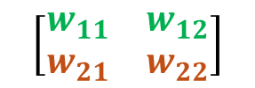


Session 1: Tensorflow Basics
Automatic Gradient: Keras Model Example
# Prediction
a=numpy.array([[1,2],[3,4]],dtype=numpy.float64)
z_out=model.predict(a)
print(z_out)
print(sess.run(model1.weights))
$$\frac{∂z_{1}}{∂x}$$
$$\frac{∂z_{2}}{∂y}$$
Objective: To compute
model
(None,2)
(None,4)
z1,z2,dz1_dx,dz2_dy
$$z_{1}=\left(b_{1}+w_{11}x+w_{21}y \right)$$
Output
$$z_{2}=\left(b_{2}+w_{12}x+w_{22}y \right)$$
[[ 1.66207651 -0.97649089 -0.64192205 -0.53772128]
[ 2.68223098 -1.8540301 -0.64192205 -0.53772128]]
Bias
$$b_{1}$$
[array([[-0.64192205, 0.09895167],
[ 1.15199928, -0.53772128]]), array([0., 0.])]
$$b_{2}$$
$$x$$
$$w_{11}$$
$$z_{1}$$
(None,1)
1
1
$$w_{12}$$
$$\left[\begin{matrix}w_{11} & w_{12} \\ w_{21} & w_{22}\end{matrix}\right]$$
$$w_{21}$$
$$\left[b_{1}{ b}_{2}\right]$$
$$y$$
(None,1)
2
2
$$z_{2}$$
$$w_{22}$$

Slide 19
Session 1: Tensorflow Basics
Automatic Gradient: Keras Model Example

Slide 20



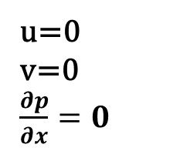



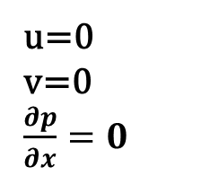

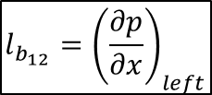

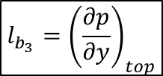






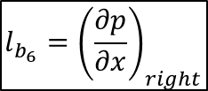
Session 2: PINN
Lid-Driven Cavity (Incompressible)
u=1, v=0, $\frac{∂p}{∂y}=0$
Objective: to approximate the solution of the incompressible Navier-Stokes equations for the lid-driven cavity flow by Multi Layer Perceptron (MLP) (Fully Connected Neural Network).
u=0
v=0
$\frac{∂p}{∂x}=0$
u=0
v=0
$\frac{∂p}{∂x}=0$
Governing Equation losses
$$l1=\frac{∂(ρu)}{∂x}+\frac{∂(ρv)}{∂x}$$
y
$$l2=\frac{∂(ρu^{2})}{∂x}+\frac{∂(ρuv)}{∂y}+\frac{∂p}{∂x}−\frac{μ}{{Re}_{r}}\left(\frac{∂^{2}u}{{∂x}^{2}}+\frac{∂^{2}u}{{∂y}^{2}}\right)$$
x
u=0, v=0, $\frac{∂p}{∂y}=0$
$$l3=\frac{∂(ρuv)}{∂x}+\frac{∂(ρv^{2})}{∂y}+\frac{∂p}{∂y}−\frac{μ}{{Re}_{r}}\left(\frac{∂^{2}v}{{∂x}^{2}}+\frac{∂^{2}v}{{∂y}^{2}}\right)$$
Boundary Condition losses
$$l_{b_{3}}={\left(\frac{∂p}{∂y}\right)}_{top}$$
$$l_{b_{6}}={\left(\frac{∂p}{∂x}\right)}_{right}$$
$$l_{b_{1}}=u_{top}−1$$
$$l_{b_{2}}=v_{top}$$
$$l_{b_{4}}=u_{right}$$
$$l_{b_{5}}=v_{right}$$
$$l_{b_{7}}=u_{bot}$$
$$l_{b_{8}}=v_{bot}$$
$$l_{b_{9}}={\left(\frac{∂p}{∂y}\right)}_{bot}$$
$$l_{b_{12}}={\left(\frac{∂p}{∂x}\right)}_{left}$$
$$l_{b_{10}}=u_{left}$$
$$l_{b_{11}}=v_{left}$$

Slide 21


Session 2: PINN
Lid-Driven Cavity (Incompressible)
#%% Base model definition to approximate flow field (Instantiating the model)
input_tensor=Input(shape=(2,)); # input: x,y (None, 2)
out1=layers.Dense(60,activation='tanh')(input_tensor);
out1=layers.Dense(60,activation='tanh')(out1);
out1=layers.Dense(60,activation='tanh')(out1);
out2=layers.Dense(3,activation='linear')(out1); # output: u,v,p
model_field=Model(inputs=[input_tensor], outputs=[out2]);
model_field.summary();
MLP (Base Model)
Loss = ${l1}^{2}+{l2}^{2}+…+{l_{b_{12}}}^{2}$
Data generation (Input): Collocation points for interior and boundary (random)
Custom loss: requires to separate boundary points
Model compilation (model.compile())
Model training
Tuning the model
Derivatives using Algorithmic gradient
u
v
p
$l1, l2,…,$ $l_{b_{12}}$

Slide 22
Session 2: PINN
Lid-Driven Cavity (Incompressible)

