Slide 1

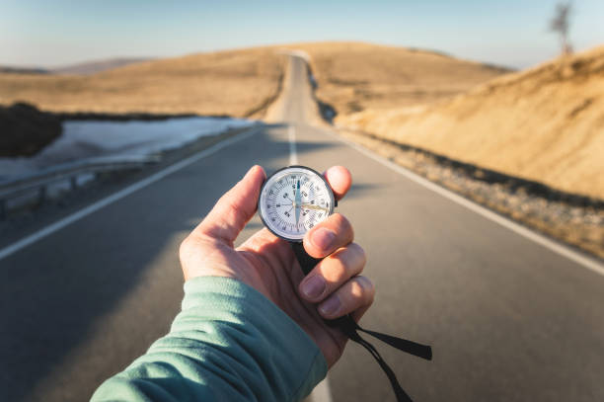
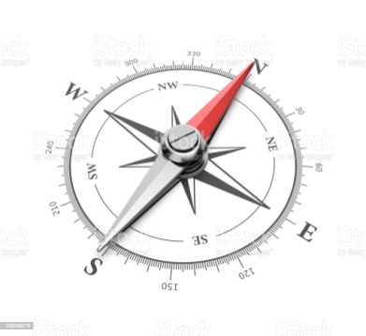
5
DIRECTIONS

Slide 2


Introduction
There are four main directions - East, West, North and South as shown below:

Slide 3
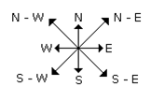
Introduction
There are four cardinal directions - North-East (N-E), North-West (N-W), South-East (S-E), and South-West (S-W) as shown below:

Slide 4
Introduction
At the time of sunrise(Dawn) if a man stands facing the east, his shadow will be towards west.
At the time of sunset(Dusk) the shadow of an object is always in the east.
If a man stands facing the North, at the time of sunrise his shadow will be towards his left and at the time of sunset it will be towards his right.
At 12:00 noon, the rays of the sun are vertically downward hence there will be no shadow.

Slide 5
Introduction
For solving direction reasoning questions, it is critical that we have a direction sense after movement. Keep in mind the change in direction when a person takes right or left.
Direction before taking the time | Direction in which person will be moving after taking time.
 | Right | Left
North | East | West
South | West | East
East | South | North
West | North | South

Slide 6

Type 1: Siva starting from his house, goes 5 km in the East, then he turns to his left and goes 4 km. Finally he turns to his left and goes 5 km. Now how far is he from his house and in what direction?

Slide 7
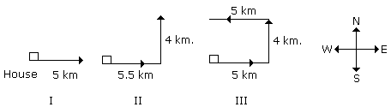
Type 1: Siva starting from his house, goes 5 km in the East, then he turns to his left and goes 4 km. Finally he turns to his left and goes 5 km. Now how far is he from his house and in what direction?
From third position it is clear he is 4 km from his house and
is in North direction.

Slide 8
Type 2: Suresh starting from his house, goes 4 km in the East, then he turns to his right and goes 3 km. What minimum distance will be covered by him to come back to his house?

Slide 9
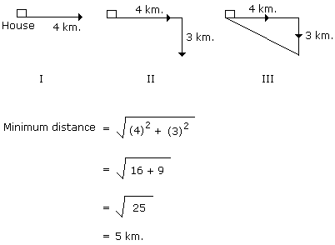
Type 2: Suresh starting from his house, goes 4 km in the East, then he turns to his right and goes 3 km. What minimum distance will be covered by him to come back to his house?

Slide 10
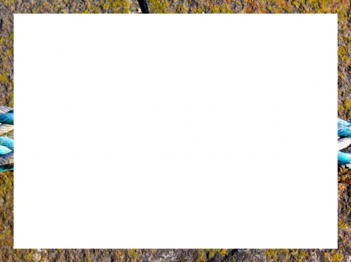
Reena walked from A to B in the East 10 feet. Then she turned to the right and walked 3 feet. Again she turned to the right and walked 14 feet. How far is she from A? a) 4 feet b) 5 feet c) 24 feet d) 27 feet

Slide 11
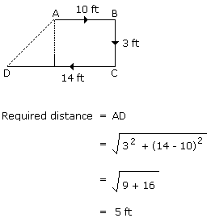
Reena walked from A to B in the East 10 feet. Then she turned to the right and walked 3 feet. Again she turned to the right and walked 14 feet. How far is she from A? a) 4 feet b) 5 feet c) 24 feet d) 27 feet

Slide 12
A man walks 5 km toward south and then turns to the right. After walking 3 km he turns to the left and walks 5 km. Now in which direction is he from the starting place? a)West b)South c)North-East d)South-West

Slide 13
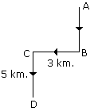
A man walks 5 km toward south and then turns to the right. After walking 3 km he turns to the left and walks 5 km. Now in which direction is he from the starting place? a)West b)South c)North-East d)South-West
Hence required direction is South-West.

Slide 14
Mani walks 2 km towards North. Then he turns to East and walks 10 km. After this he turns to North and walks 3 km. Again he turns towards East and walks 2 km. How far is he from the starting point? a) 14 km b) 13 km c) 15 km d) 10 km

Slide 15
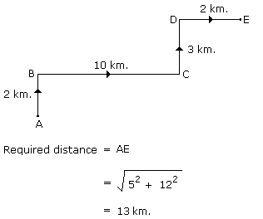
Mani walks 2 km towards North. Then he turns to East and walks 10 km. After this he turns to North and walks 3 km. Again he turns towards East and walks 2 km. How far is he from the starting point? a) 14 km b) 13 km c) 15 km d) 10 km

Slide 16
Type 3 : A man is facing north-west. He turns 90 degrees in the clockwise direction, then 180 degrees in the anticlockwise direction and then another 90degrees in the same direction. Which direction is he facing now?

Slide 17
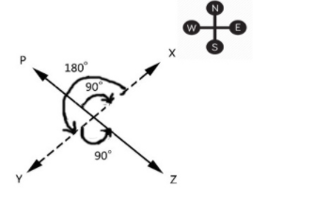
Type 3 : A man is facing north-west. He turns 90 degrees in the clockwise direction, then 180 degrees in the anticlockwise direction and then another 90degrees in the same direction. Which direction is he facing now? Ans: South-East

Slide 18
A man is facing towards the west and turns through 45° clockwise, again 180° clockwise and then turns through 270° anti-clockwise. In which direction is he facing now? a)South-west b)North-west c)west d)South

Slide 19
A man is facing towards the west and turns through 45° clockwise, again 180° clockwise and then turns through 270° anti-clockwise. In which direction is he facing now? a)South-west b)North-west c)west d)South

Slide 20
A girl facing north rotates 100(degree) clockwise then 190(degree) anticlockwise. what is new direction of the girl ? a) North-East b) West c) South-East d) South

Slide 21
A girl facing north rotates 100(degree) clockwise then 190(degree) anticlockwise. what is new direction of the girl ? a) North-East b) West c) South-East d) South

Slide 22
P started from his house towards west. After walking a distance of 25 m. He turned to the right and walked 10 m. He then again turned to the right and walked 15 m. After this he is to turn right at 135º and to cover 30 m. In which direction should he go? a) West b) South c) South-West d) South-East

Slide 23
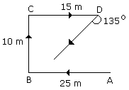
P started from his house towards west. After walking a distance of 25 m. He turned to the right and walked 10 m. He then again turned to the right and walked 15 m. After this he is to turn right at 135º and to cover 30 m. In which direction should he go? a) West b) South c) South-West d) South-East
Hence he should go in the South-West direction.

Slide 24
Type 4 : If South-East becomes North, North-East becomes West and so on. What will West become?

Slide 25
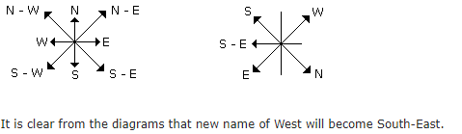
Type 4 : If South-East becomes North, North-East becomes West and so on. What will West become?

Slide 26
A compass was damaged and its needle turned in such a manner that the pointer, which was showing East, now showed north. One person went towards west as per the above mentioned compass. In which direction did he actually go? a) North b) South c) South-west d) North- east

Slide 27
A compass was damaged and its needle turned in such a manner that the pointer, which was showing East, now showed north. One person went towards west as per the above mentioned compass. In which direction did he actually go? a) North b) South c) South-west d) North- east

Slide 28
Rahul put his timepiece on the table in such a way that at 6 P.M. hour hand points to North. In which direction the minute hand will point at 9.15 P.M. ? a) South-East b) South c) North d) West

Slide 29
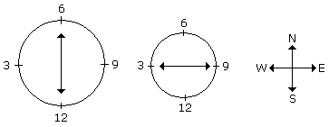
Rahul put his timepiece on the table in such a way that at 6 P.M. hour hand points to North. In which direction the minute hand will point at 9.15 P.M. ? a) South-East b) South c) North d) West
At 9.15 P.M., the minute hand will point towards west.

Slide 30
Type 5: Hema starting from her house walked 5 km to reach the crossing of Palace. In which direction she was going, a road opposite to this direction goes to Hospital. The road to the right goes to station. If the road which goes to station is just opposite to the road which IT-Park, then in which direction to Hema is the road which goes to IT-Park?

Slide 31
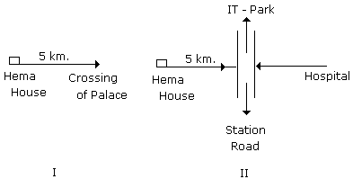
Type 5: Hema starting from her house walked 5 km to reach the crossing of Palace. In which direction she was going, a road opposite to this direction goes to Hospital. The road to the right goes to station. If the road which goes to station is just opposite to the road which IT-Park, then in which direction to Hema is the road which goes to IT-Park?
From II it is clear that the road which goes to IT-Park is left to Hema.

Slide 32
Hemant in order to go to university started from his house in the east and came to a crossing. The road to the left ends in a theatre, straight ahead is the hospital. In which direction is the university? a) North b) South c) East d) West

Slide 33
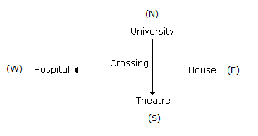
Hemant in order to go to university started from his house in the east and came to a crossing. The road to the left ends in a theatre, straight ahead is the hospital. In which direction is the university? a) North b) South c) East d) West
Therefore university is in North.

Slide 34
Type 6: One evening at the time of sunset Juhi while returning from school met Lalli at Boring road crossing. Lalli's shadow was exactly to the right of Juhi. If they were face to face, which direction was Juhi facing?

Slide 35
Type 6: One evening at the time of sunset Juhi while returning from school met Lalli at Boring road crossing. Lalli's shadow was exactly to the right of Juhi. If they were face to face, which direction was Juhi facing?
In the evening sunsets in the west.
So in evening the shadow falls towards the East.
Now Lalli's shadow falls to the right of the Juhi.
Hence Juhi is facing North .

Slide 36
One morning after sunrise, Suresh was standing facing a pole. The shadow of the pole fell exactly to his right. To which direction was he facing? a) East b) West c) South d) Data is inadequate

Slide 37
One morning after sunrise, Suresh was standing facing a pole. The shadow of the pole fell exactly to his right. To which direction was he facing? a) East b) West c) South d) Data is inadequate

Slide 38
Village Q is to the North of the village P. The village R is in the East of Village Q. The village S is to the left of the village P. In which direction is the village S with respect to village R? a) West b) South-West c) South d) North-West

Slide 39

Village Q is to the North of the village P. The village R is in the East of Village Q. The village S is to the left of the village P. In which direction is the village S with respect to village R? a) West b) South-West c) South d) North-West
S is to the South-West of R.

Slide 40
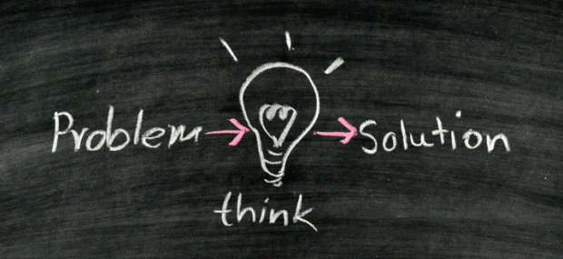

Slide 41
1) A man went 10 kms towards South. Then turned East and covered 10 kms and turned to the right. Again after 10 kms, he turned to left and covered 10 kms to reach the destination. How far is he from his starting point? a) 18.8 km b) 28.28 km c) 16 km d) 20 km

Slide 42
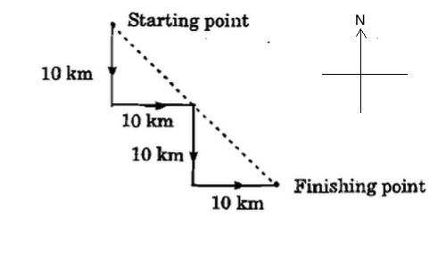

1) A man went 10 kms towards South. Then turned East and covered 10 kms and turned to the right. Again after 10 kms, he turned to left and covered 10 kms to reach the destination. How far is he from his starting point? a) 18.8 km b) 28.28 km c) 16 km d) 20 km
By Pythagoras theorem, the required distance is √(20²+20²)
= √800 = 20 √2 = 28.28 Km

Slide 43
2) Anil wants to go the university. He starts from his house which is in the East and comes to a crossing. The road to his left ends in a theatre, straight ahead is the hospital. In which direction is the University? a) East b) North c) South d) West

Slide 44
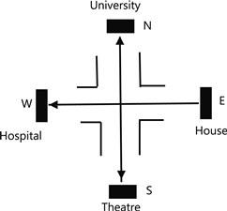
2) Anil wants to go the university. He starts from his house which is in the East and comes to a crossing. The road to his left ends in a theatre, straight ahead is the hospital. In which direction is the University? a) East b) North c) South d) West
Starting from his house in the East, Anil moves westwards. Then, the theatre, which is to the left, will be in the south. The Hospital, which is straight ahead, will be to the West. So, the University will be to the North.

Slide 45
3) If South-East becomes North, North-East becomes West and so on, what will West become? a) North b) East c) South-East d) North-West

Slide 46
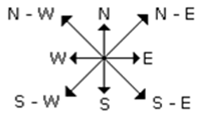
3) If South-East becomes North, North-East becomes West and so on, what will West become? a) North b) East c) South-East d) North-West

Slide 47
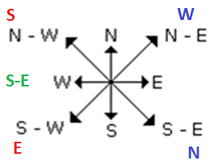
3) If South-East becomes North, North-East becomes West and so on, what will West become? a) North b) East c) South-East d) North-West

Slide 48
4) A man walks 1 km towards East and then he turns to South and walks 5 km. Again he turns to East and walks 2 km, after this he turns to North and walks 9 km .Now, how far is he from his starting point? a) 10 km b) 9 km c) 5 km d) 4 km

Slide 49
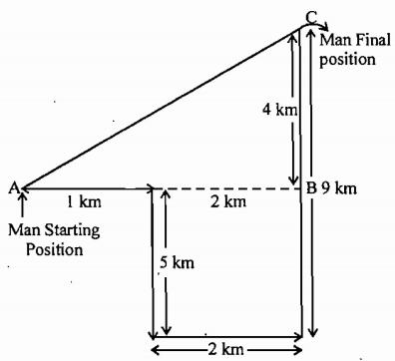
4) A man walks 1 km towards East and then he turns to South and walks 5 km. Again he turns to East and walks 2 km, after this he turns to North and walks 9 km .Now, how far is he from his starting point? a) 10 km b) 9 km c) 5 km d) 4 km
By Pythagoras theorem, the required distance is √(3²+4²)
= √25 = 5 Km

Slide 50
5) I am facing South. I turn right and walk 20m .Then I turn right again and walk 10m .Then I turn left and walk 10 m and then turning right walk 20 m. Then, I turn right again and walks 60 m. In which direction am I from the starting point? a) North-East b) North-West c) North d) West

Slide 51
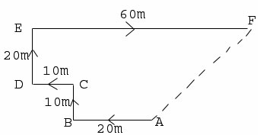
5) I am facing South. I turn right and walk 20m .Then I turn right again and walk 10m .Then I turn left and walk 10 m and then turning right walk 20 m. Then, I turn right again and walks 60 m. In which direction am I from the starting point? a) North-East b) North-West c) North d) West

Slide 52
6) One day, Raviraj left home and cycled 20 Km southwards, turned right and cycled 10 km and turned right and cycled 20 Km and turned left and cycled 20 Km. How many kilometers will he have to cycle to reach his home straight ? a) 50 Km b)30 Km c) 40 Km d) 60 Km

Slide 53
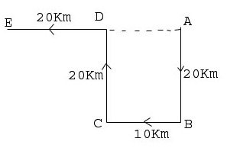
6) One day, Raviraj left home and cycled 20 Km southwards, turned right and cycled 10 km and turned right and cycled 20 Km and turned left and cycled 20 Km. How many kilometers will he have to cycle to reach his home straight ? a) 50 Km b)30 Km c) 40 Km d) 60 Km
Distance = ED + DA = 20 + 10 = 30 Km

Slide 54
7) Kunal walks 10 km towards North. From there he walks 6 Km towards South. Then, he walks 3 Km towards east. How far and in which direction is he with reference to his starting point ? a) 5 Km North b) 5 Km South c) 5 Km East d) 5 Km North-East

Slide 55
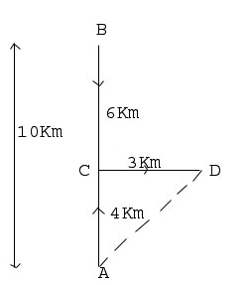
7) Kunal walks 10 km towards North. From there he walks 6 Km towards South. Then, he walks 3 Km towards east. How far and in which direction is he with reference to his starting point ? a) 5 Km North b) 5 Km South c) 5 Km East d) 5 Km North-East
By Pythagoras theorem, the required distance is √(3²+4²)
= √25 = 5 Km
Direction = North - East

Slide 56
8) If East becomes South, west becomes North and so on, What will be the direction for South-West? a)North-west b)South-East c)East d)North

Slide 57
8) If East becomes South, west becomes North and so on, What will be the direction for South-West? a)North-west b)South-East c)East d)North

Slide 58
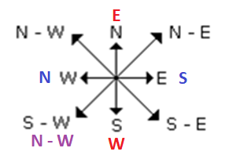
8) If East becomes South, west becomes North and so on, What will be the direction for South-West? a)North-west b)South-East c)East d)North

Slide 59
9) Joe is walking towards North for 15 miles, turns left and walks another 10 miles. He then turns right and walks 10 miles. Now, he again turns right and walks 30 miles. Which direction is he from Starting point? a) South-East b) North-East c) North-West d) South-West e) None of these

Slide 60
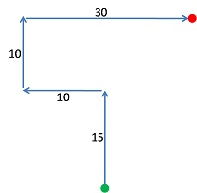
9) Joe is walking towards North for 15 miles, turns left and walks another 10 miles. He then turns right and walks 10 miles. Now, he again turns right and walks 30 miles. Which direction is he from Starting point? a) South-East b) North-East c) North-West d) South-West e) None of these

Slide 61
10) There are four towns P, Q, R and T. Q is to the South-west of P, R is to the east of Q and south-east of P, and T is to the north of R in line with QP. In which direction of P is T located? a) South–east b)South c)North–east d)East

Slide 62
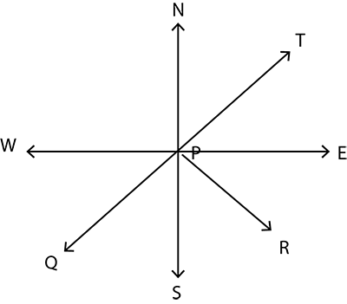
10) There are four towns P, Q, R and T. Q is to the South-west of P, R is to the east of Q and south-east of P, and T is to the north of R in line with QP. In which direction of P is T located? a) South–east b) South c) North–east d) East

Slide 63
11) Harry walks 25 meters towards North from his friend’s house. Then he turns left and walks 32 meters. He again turns left and walks 25 meters. Further, he moves 25 meters after turning to his right. How far is he from his friend’s house? a) 50 b) 7 c) 57 d) 0

Slide 64
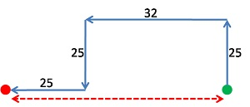
11) Harry walks 25 meters towards North from his friend’s house. Then he turns left and walks 32 meters. He again turns left and walks 25 meters. Further, he moves 25 meters after turning to his right. How far is he from his friend’s house? a) 50 b) 7 c) 57 d) 0

Slide 65
12) A car travels 25 kms towards south from garage. It turns left and travels 30 kms, then turns right and travels 15 kms. how far is car from the garage and in which direction? a) 40 North-East b) 70 South-East c) 60 North-East d) 50 South-East

Slide 66
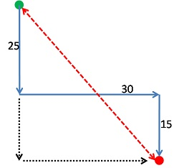
12) A car travels 25 kms towards south from garage. It turns left and travels 30 kms, then turns right and travels 15 kms. How far is car from the garage and in which direction? a) 40 North-East b) 70 South-East c) 60 North-East d) 50 South-East
By Pythagoras theorem, the required distance is √(40²+30²)
= √2500 = 50 Km
Direction = South - East

Slide 67
13) Jerry starts walking towards South from his house. After travelling 10 meters, he turns left and walks 6 meters. He turns left and walks 26 meters and then he turns right and walks 4 meters. Finally, he turns right and walks for 16 meters. How far is he from his house and in which direction? a) 10 East b) 20 West c) 16 East d) 26 West

Slide 68
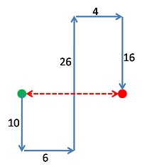
13) Jerry starts walking towards South from his house. After travelling 10 meters, he turns left and walks 6 meters. He turns left and walks 26 meters and then he turns right and walks 4 meters. Finally, he turns right and walks for 16 meters. How far is he from his house and in which direction? a) 10 East b) 20 West c) 16 East d) 26 West

Slide 69
14) A tourist drives 10 Km towards East and turns to the right hand and drives 3 Km. Then, he drives towards West (turning to his right) 3 Km. He, then turns to his left and drives 2 Km. Finally he turns to his right and travels 7 Km. How far is he from his starting point and in which direction would he be? a) 10 Km, East b) 9 Km, North c) 8 Km, West d) 5 Km, South

Slide 70
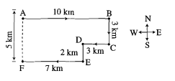
14) A tourist drives 10 Km towards East and turns to the right hand and drives 3 Km. Then, he drives towards West (turning to his right) 3 Km. He, then turns to his left and drives 2 Km. Finally he turns to his right and travels 7 Km. How far is he from his starting point and in which direction would he be? a) 10 Km, East b) 9 Km, North c) 8 Km, West d) 5 Km, South

Slide 71
15) Maddy starts from his house towards West. After walking a distance of 30 metres, he turned towards right and walked 20 metres. He then turned left and moving a distance of 10 metres, turned to his left again and walked 40 metres. He now turns to the left and walks 6 metres. Finally he turns to his left. In which direction is he walking now? a) East b)South c)North d)South west

Slide 72
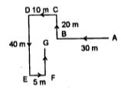
15) Maddy starts from his house towards West. After walking a distance of 30 metres, he turned towards right and walked 20 metres. He then turned left and moving a distance of 10 metres, turned to his left again and walked 40 metres. He now turns to the left and walks 5 metres. Finally he turns to his left. In which direction is he walking now? a) East b)South c)North d)South west

Slide 73
16) P, Q, R and S are playing a game of carrom. P,R and S, Q are partners. S is to the right of R who is facing west. Then, Q is facing
a) East b)West c)South d)North

Slide 74
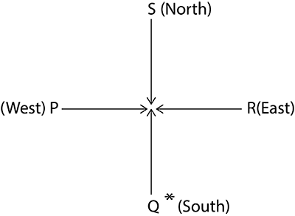
16) P, Q, R and S are playing a game of carrom. P,R and S, Q are partners. S is to the right of R who is facing west. Then, Q is facing
a) East b)West c)South d)North

Slide 75
17) A girl leaves from her home. She first walks 30 metres in North–west direction and then 30 metres in South–west direction. Next, she walks 30 metres in South-east direction. Finally, she turns towards her house. In which direction is she moving?
a) North–East b) North–West c) South–East d)South–East

Slide 76

17) A girl leaves from her home. She first walks 30 metres in North–west direction and then 30 metres in South–west direction. Next, she walks 30 metres in South-east direction. Finally, she turns towards her house. In which direction is she moving?
a) North–East b) North–West c) South–East d)South–East

Slide 77


