Slide 1
Uniduino
Akanksha Makkar
Akarsh Shekhar
Akash Mishra
Akash N Somasalle
Akash Singh
MP Project
Batch- 5

Slide 2
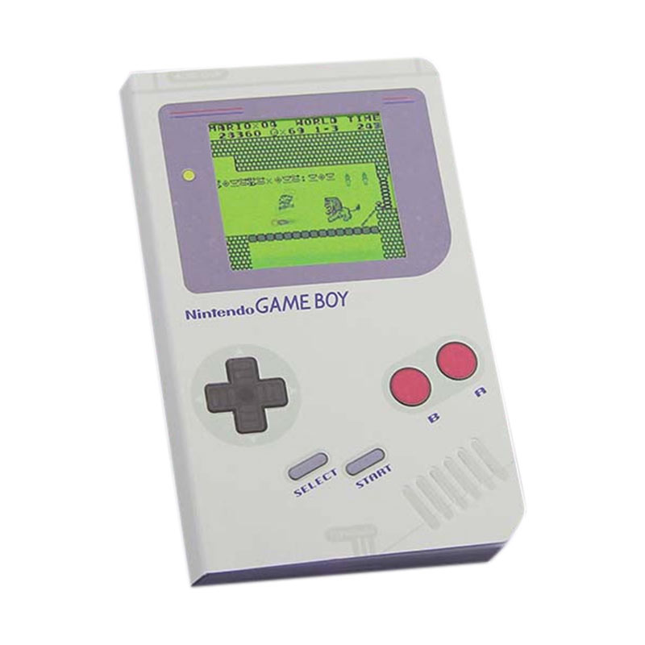
Project Idea
The aim of out project is to implement a simple game prototype using an Arduino Uno and Unity.
The project shows how a simple game console can be made using Arduino-Uno. The console made would be very much similar to those made in the early days.

Slide 3
Introduction
Components Used
Arduino Uno
Unity
Working
Flowchart
Circuit Connection
Code
Demonstration

Slide 4
Components used
Arduino Uno (Atmega 328P microcontroller)
Breadboard
Wires
2 buttons
Processing involves use of software:
Arduino 1.8.8
Unity Game Engine
Language used: C#

Slide 5
Arduino-Uno
Arduino Uno is a microcontroller board based on the ATmega328P (datasheet). It has 14 digital input/output pins (of which 6 can be used as PWM outputs), 6 analog inputs, a 16 MHz quartz crystal, a USB connection, a power jack, an ICSP header and a reset button.
It requires an operating voltage of 5V and an input voltage of 7-12V
Flash Memory 32 KB (ATmega328P) of which 0.5 KB used by bootloader
SRAM 2 KB (ATmega328P)
EEPROM 1 KB (ATmega328P)
Clock Speed 16 MHz

Slide 6
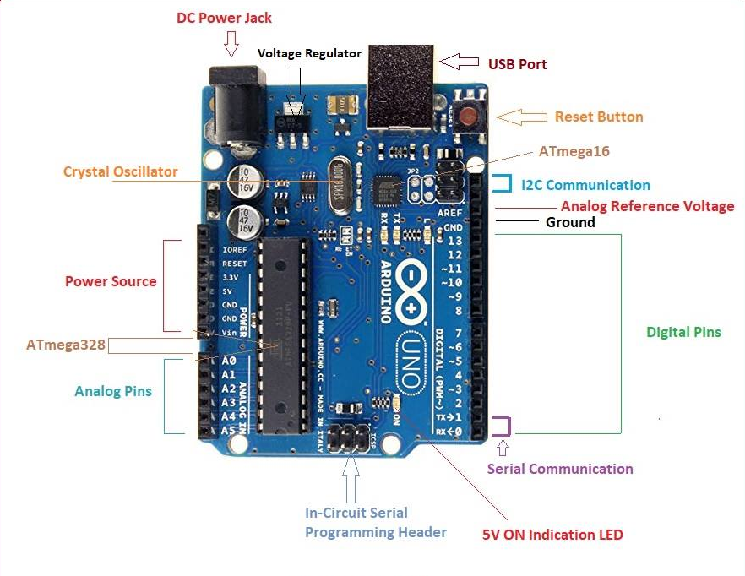

Slide 7
Unity
Unity is a cross-platform, real-time engine developed by Unity Technologies which as an OS X-exclusive game engine.
The engine can be used to create both three-dimensional and two-dimensional games as well as simulations for its many platforms.
Famous games made with unity are assasin creed and temple run.
The engine offers a primary scripting API in C#, for both the Unity editor in the form of plugins, and games themselves, as well as drag and drop functionality.

Slide 8
Working
The project shows how a simple game console can be made using Arduino-Uno.
We’ve included multiple game scenes made in unity game engine, where the player of the game can be controlled (given input) via Arduino. The game is played and operated significantly using the external controls provided with the aid of the Arduino.
This project can also be taken up in the future with other applications added to it thus, making it work effectively. It is a simple controlling mechanism which is easy to understand and use.
The purpose of showing it being used as a game is basic, but its simplicity could be used where efficient implementation of a system is required in practical applications.

Slide 9
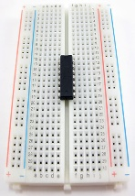
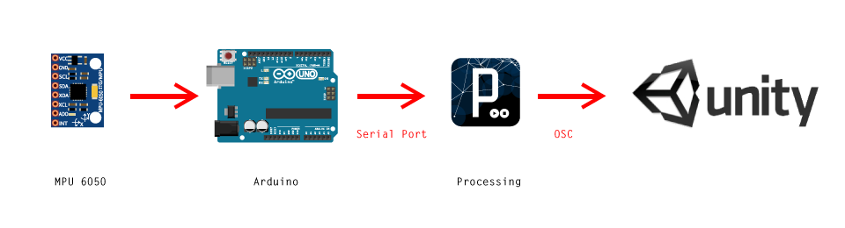
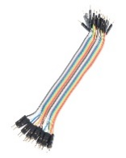
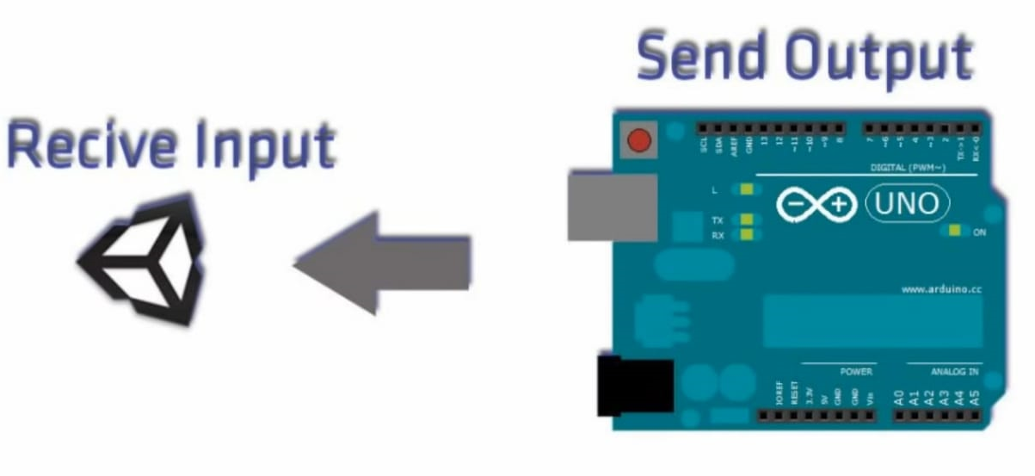
Flowchart
Bread board +wires
Breadboard +Wires

Slide 10
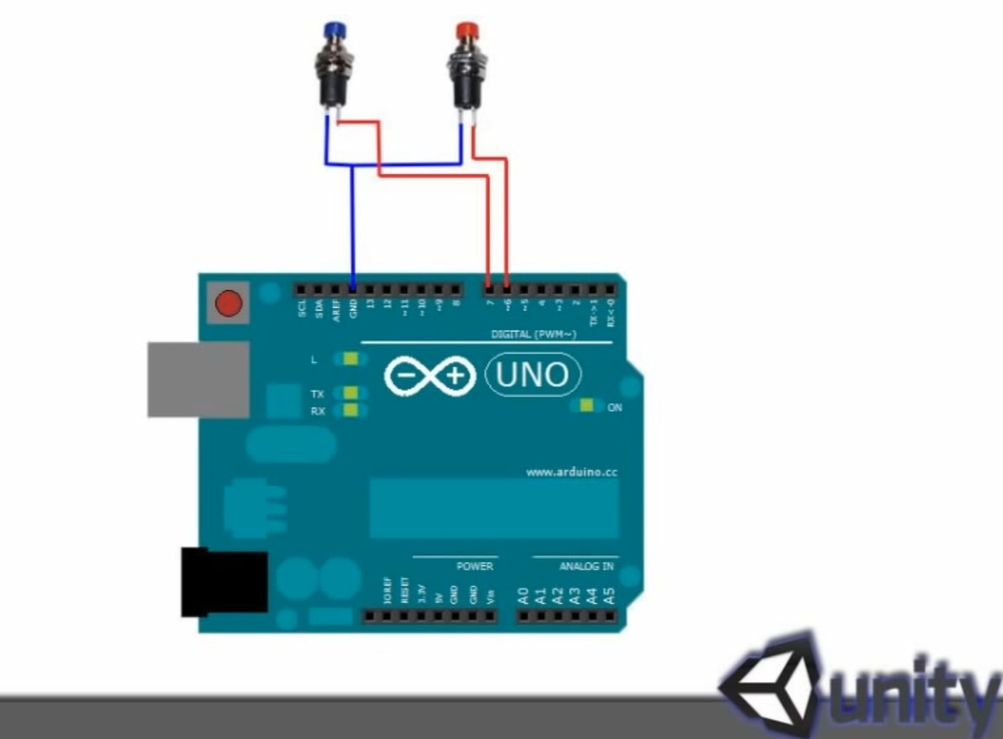
Circuit Connection

Slide 11
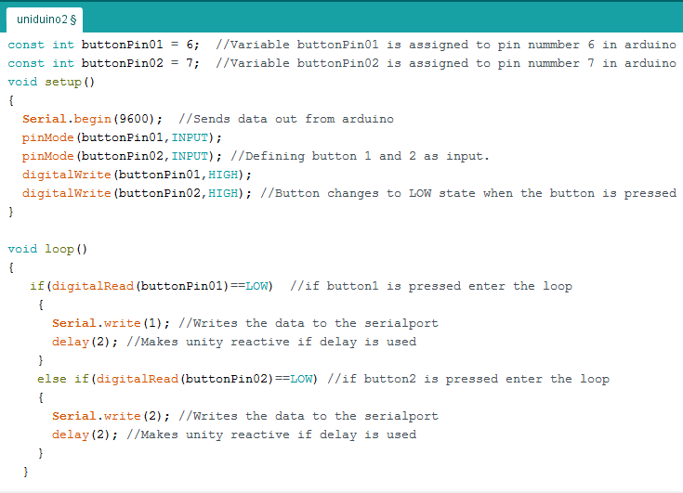
Code

Slide 12
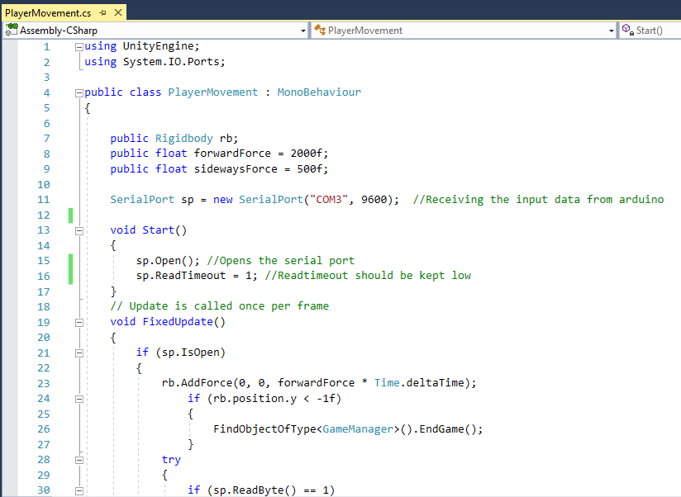

Slide 13
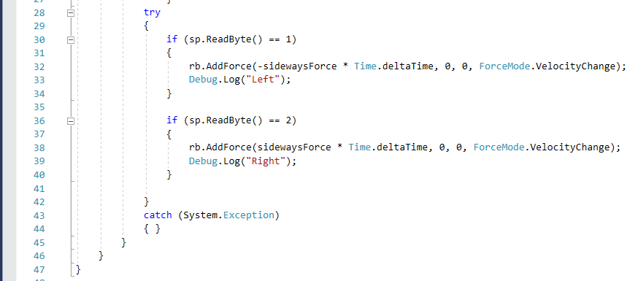

Slide 14
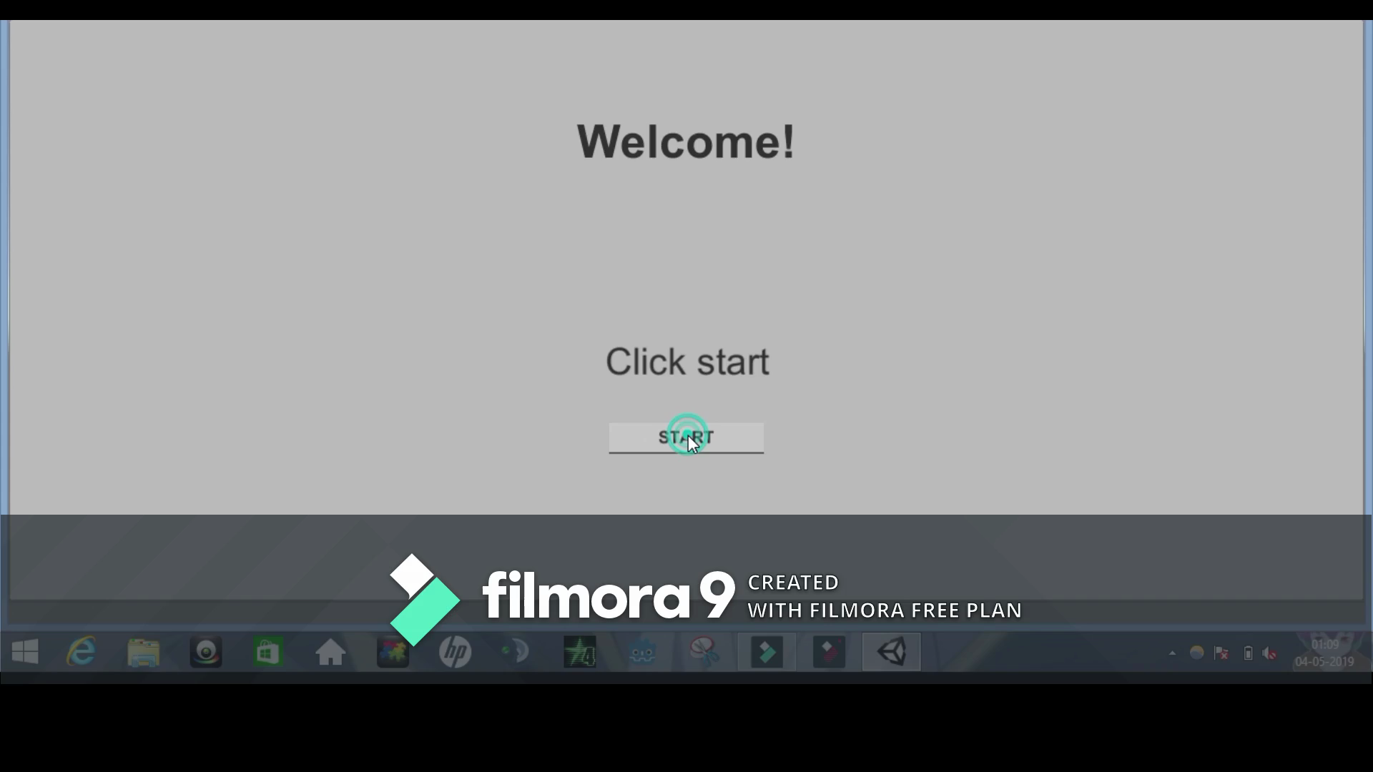
Demonstration

Slide 15
THANK YOU

