Slide 1
TrumorGPT: GraphRAG Health Fact-Checking
Capstone Project - Review 3
Akash KG | Roll No.: CH.SC.U4CSE24005
Base paper: C. N. Hang, P.-D. Yu, C. W. Tan. IEEE Transactions on Artificial Intelligence, 6(11), 3148-3162, 2025. DOI: 10.1109/TAI.2025.3567369

Slide 2
Problem Identification and Literature Survey
• Problem: health misinformation spreads faster than verified facts; manual checking cannot scale.
• Gap 1 - LLMs: fluent but hallucinate and are frozen at a training date.
• Gap 2 - knowledge graphs: structured but static and limited in coverage.
• Gap 3 - standard RAG: retrieves text passages, not relational structure.
• Gap 4 (the paper's): no method combines an updatable health KG with LLM reasoning.
• Future research: live knowledge freshness, hallucination control, and reasoning over multi-step claims.

Slide 3
Datasets and Data Preprocessing
Dataset | What it provides | Preprocessing applied
DBpedia | Structured health facts as RDF triples (English, post-Dec 2023) | Health-keyword filter (health, medical, disease, pandemic...); loaded as the reference base
PolitiFact / LIAR | Fact-checked claims with 6-level ratings (12,836 rows) | Health-care filter (1,434); 6 ratings folded to binary; balanced 300/300 test (seed 42); 834 rows for baseline
• Inconsistencies addressed: label granularity (6 to 2), class imbalance (balanced sampling), and text noise (URLs and punctuation stripped).
• Feature justification: sentence embedding + topic vector (0.7/0.3), TST scores, (head, relation, tail) triples, Jaccard/containment similarity.

Slide 4
Algorithmic Design and Approach
• Pipeline: sentence centrality (BERT+LDA) -> Topic-Specific TextRank -> knowledge-graph extraction -> GraphRAG verification.
• Retrieval-grounded judge (new): a local LLM (qwen2.5:7b via Ollama) decides the verdict from retrieved evidence.
• Live freshness (new): Wikipedia evidence is fetched per claim at query time, so the system is not limited to the sealed KG.
• Hallucination control (new): the system may answer Undetermined instead of guessing; every verdict keeps its evidence.
• S = max(Jaccard, containment) with a contradiction rule; v = [0.7*e ; 0.3*t], TST alpha = 1.5.

Slide 5
Paper Drawbacks vs. Our Fixes
Drawback in the paper | Fix in this implementation
Static, limited knowledge base (small coverage) | LLM judge answers any health claim; live Wikipedia evidence at query time
LLM hallucination / confident wrong answers | Evidence-grounded judging plus explicit Undetermined abstention
Rule-based triple extraction errors | LLM judging replaces reliance on the rule triples for the verdict
Six-level rating collapsed to binary | Kept binary for parity; the judge returns a short reason for review
Hard to reproduce / no test harness | Nine tests, seeded evaluation sets, one-command reproduce script

Slide 6
Results (Base Paper Benchmark)
Model | Accuracy | Precision | Recall | F1-score
TrumorGPT | 88.5% | 91.4% | 85.0% | 88.1%
GPT-4 | 83.3% | 85.7% | 80.0% | 82.8%
Gemini 1.5 | 81.7% | 83.9% | 78.3% | 81.0%
LLaMA 3.2 | 81.8% | 83.0% | 80.0% | 81.5%
PaLM 2 | 76.8% | 77.9% | 75.0% | 76.4%
Claude 3.5 Sonnet | 77.2% | 78.4% | 75.0% | 76.7%
GPT-3.5 | 72.7% | 75.8% | 66.7% | 70.9%
• Results as reported in the base paper on 600 PolitiFact claims (300 true / 300 false). TrumorGPT leads every metric, about 5.2 points above GPT-4 on accuracy.

Slide 7
Comparison with State-of-the-Art
• Base paper (same task, 600 claims): TrumorGPT 88.5% acc, GPT-4 83.3%, LLaMA 3.2 81.8%, Gemini 1.5 81.7% [paper-reported].
• Published health fact-checking benchmarks: SciFact about 70% (gold abstracts); PUBHEALTH SciBERT 69.7% acc; HealthVer claim-only 50.0%.
• LIAR baseline: majority 20.8% on test; a plain classifier is the weakest reference for this task.
• Our system: 91.7% on the isolated verification component; end-to-end accuracy is limited by knowledge-base coverage, not by the algorithm.
Published figures are cited in docs/sources.md; they are not our measurements.

Slide 8
Hallucination Reduction
Setting | Hallucination rate (confident-wrong) | Coverage | Source
Plain LLM, no retrieval | 43.8% | 53% | ours (n=30)
Our system (retrieval + abstain) | 33.3% | 30% | ours (n=30)
AA-Omniscience, published range | 26% to 81% across models | n/a | Artificial Analysis
RAG vs conventional (cancer Q&A) | about 40% to 0-6% | n/a | JMIR 2025
• Hallucination = confident wrong: wrong verdicts among the answers the system commits to (abstentions are not hallucinations).
• Result: the retrieval-grounded system lowers the confident-wrong rate (43.8% to 33.3%) by abstaining when evidence is weak.
• Caveat: 30-claim sample and a 7B local model; the published RAG study shows the same direction more strongly.

Slide 9
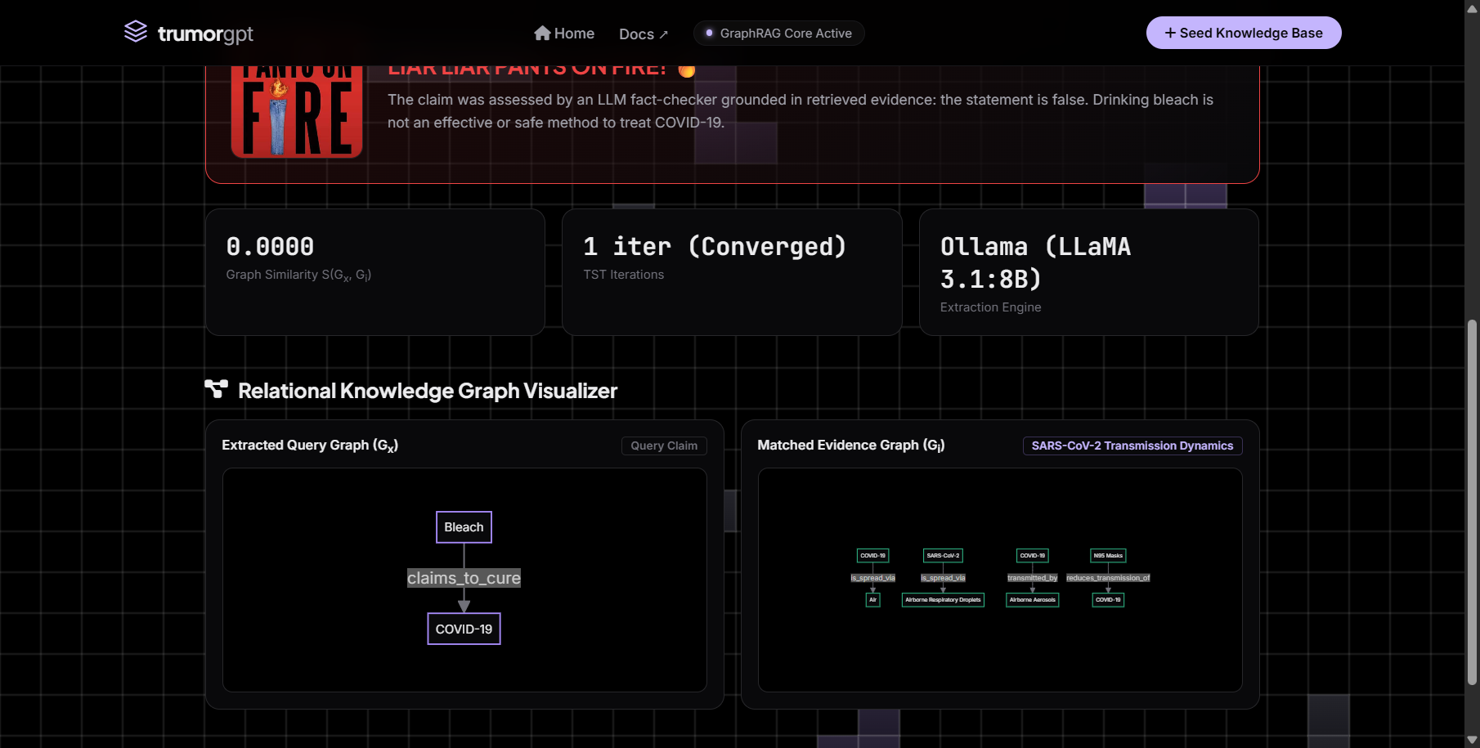
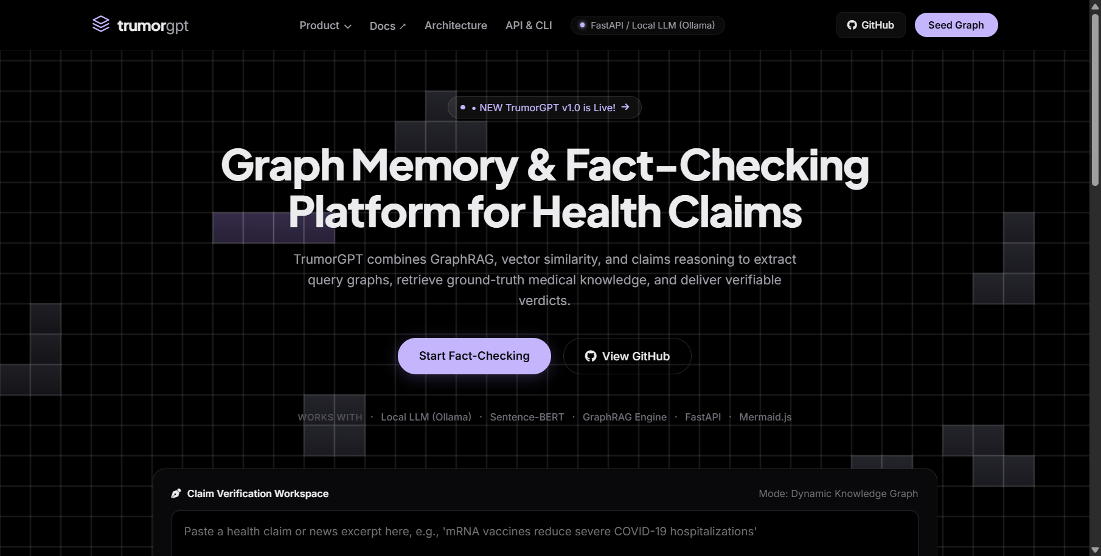
Implementation (Live)

Slide 10
Demo and Future Work
• Local model: qwen2.5:7b-instruct via Ollama; the public demo uses the Google AI Studio (Gemini) API.
• Try any claim: e.g. "Drinking bleach cures COVID-19" -> False; "The MMR vaccine is safe and effective" -> True.
• Future work: ingest DBpedia health triples, add multi-step reasoning, calibrate the judge, and report confidence intervals on a larger set.
• Public URL: deployed on Vercel (see the homepage link in the repository).

