Slide 1
TrumorGPT: A Graph-Based Retrieval-Augmented LLM for Fact-Checking
Capstone Project - Lab Evaluation 1
Presented by: Akash KG
Base paper:
C. N. Hang, P.-D. Yu, and C. W. Tan, "TrumorGPT: Graph-Based Retrieval-Augmented Large Language Model for Fact-Checking," IEEE Transactions on Artificial Intelligence, vol. 6, no. 11, pp. 3148-3162, Nov. 2025.
DOI: 10.1109/TAI.2025.3567369

Slide 2
Selection of the Problem
• Real-world issue: health misinformation (infodemics) - the WHO declared COVID-19 the first global infodemic.
• Speed of spread: health rumors spread up to 6x faster and can reach 1,500 people.
• Scale of spread: 600+ AI sites generate medical myths, and 1 in 4 AI answers are hallucinated.
• Impact: false health claims cause harmful decisions, mistrust in medicine, and loss of life (Source: WHO).
• Scope is workable: limited to the health domain, verified against publicly available fact-check data.
• Feasible: buildable with existing LLMs and knowledge graphs; no new model training needed.

Slide 3
Understanding of the Problem
• Fact-checking is the process of verifying whether a claim is accurate.
• Manual fact-checking (journalists) cannot keep pace with the volume of online health claims.
• Standard LLMs (GPT-3.5, GPT-4, LLaMA) hallucinate and rely on static training data.
• Knowledge graphs alone are structured and interpretable, but hard to keep updated.
• Key insight: LLMs and knowledge graphs are individually flawed but complementary.
• TrumorGPT combines an LLM with semantic health knowledge graphs through GraphRAG (a 'trumor' = true + rumor).

Slide 4
Datasets Used
Dataset | Type | Key features | Scale
DBpedia | Knowledge graph built from Wikipedia | RDF triples (head, relation, tail); class and property ontology; multilingual; SPARQL endpoint; updated automatically from Wikipedia | ~4.2M instances, 768 classes, ~3,000 properties
PolitiFact | Fact-checking corpus (US politics) | Truth-O-Meter with 6 rating levels; topic tags; claim text, speaker, author and date; expert-verified labels | ~16,000 rated statements (2011-2023)
• Used here: DBpedia filtered to health terms (health, medical, disease, pandemic, epidemic); PolitiFact Health Care and Coronavirus claims - 600 total (300 true / 300 false).
• Binary mapping: True / Mostly True / Half True -> True; Mostly False / False / Pants on Fire -> False.

Slide 5
Interpretation of the Solution on the Dataset
• Pipeline: claim -> key sentences (LDA+BERT, TST) -> query KG (few-shot LLM) -> match a database of KGs -> verdict.
• Matching: subgraph isomorphism and Jaccard similarity; match found = True, contradiction = False, else Undetermined.
• Metrics: accuracy, precision, recall and F1-score measured against PolitiFact ground truth.
• Result: TrumorGPT scores 88.5% accuracy, 91.4% precision, 85.0% recall and 88.1% F1.
• Improvement: ~5.5 points over base GPT-4; identifies 85% of true and 92% of false claims.
• Interpretation: grounding on an updatable knowledge graph improves accuracy and reduces hallucination.

Slide 6
TrumorGPT: A Graph-Based Retrieval-Augmented LLM for Fact-Checking
Capstone Project - Lab Evaluation 2
Presented by: Akash KG
Base paper:
C. N. Hang, P.-D. Yu, and C. W. Tan, "TrumorGPT: Graph-Based Retrieval-Augmented Large Language Model for Fact-Checking," IEEE Transactions on Artificial Intelligence, vol. 6, no. 11, pp. 3148-3162, Nov. 2025.
DOI: 10.1109/TAI.2025.3567369

Slide 7
Feature Selection
• Semantic triple (head, relation, tail) - fact-level features from a health claim.
• BERT embedding (384-dim) - semantic meaning of each sentence.
• LDA topic distribution - health-topic context of each sentence.
• Topic-enhanced centrality v = [0.7 * BERT ; 0.3 * LDA] - fuses meaning and topic relevance.
• Topic-Specific TextRank score - sentence importance under a health-topic bias.
• Graph similarity - Jaccard similarity, query containment, contradiction flag.
• Why selected: capture semantics, topic relevance and relational structure.

Slide 8
Existing Algorithms - Literature Survey
Author and Year | Title | Objective of the Work | Achievements of the Work | Gaps from the Work
Karadzhov et al. (2017) | Fully automated fact checking using external sources | Verify claims automatically using web evidence | Deep LSTM fact-checking framework with semantic kernels | Uses unstructured web sources; no structured knowledge graph
Gad-Elrab et al. (2019) | Tracy: Tracing facts over knowledge graphs and text | Explain fact verification over knowledge graphs and text | Rule-based semantic traces with a user interface | Manual rules; limited graph coverage
Lewis et al. (2020) | Retrieval-augmented generation for knowledge-intensive tasks | Combine retrieval with generation to reduce hallucination | Strong results on knowledge-intensive QA tasks | Retrieves text passages only; no graph reasoning
Vedula & Parthasarathy (2021) | FACE-KEG: Fact checking explained using knowledge graphs | Explainable fact-checking using knowledge graphs | KG-based veracity scores with explanations | Static KG; cannot use the latest health updates
Guo et al. (2022) | A survey on automated fact-checking | Review existing automated fact-checking methods | Comprehensive taxonomy of automated fact-checking pipelines | No health-specific LLM and GraphRAG integration
Edge et al. (2024) | From local to global: A graph RAG approach to query-focused summarization | Use knowledge graphs with RAG for global queries | Graph-based summarization over large corpora | Built for summarization, not claim verification
Gap: no existing method combines an updatable semantic health knowledge graph with LLM reasoning for health-claim verification.

Slide 9
Learning Technique Identified
• Proposed technique: TrumorGPT = GraphRAG + few-shot LLM + Topic-Specific TextRank.
• Few-shot LLM extracts (head, relation, tail) triples and builds the claim knowledge graph.
• Topic-Specific TextRank (alpha = 1.5, damping = 0.85) ranks the key health sentences.
• LDA + BERT centrality selects the informative sentences before graph construction.
• GraphRAG computes S(Gx, Gi) = max(Jaccard, containment), then detects contradictions -> True / False / Undetermined.
• Justification: grounds the LLM in updatable facts (less hallucination), needs no retraining, and runs on a local LLM such as LLaMA 3.

Slide 10
Results of the Identified Technique
Model | Accuracy | Precision | Recall | F1-score
GPT-3.5 | 72.7% | 75.8% | 66.7% | 70.9%
GPT-4 | 83.3% | 85.7% | 80.0% | 82.8%
LLaMA 3.2 | 81.8% | 83.0% | 80.0% | 81.5%
PaLM 2 | 76.8% | 77.9% | 75.0% | 76.4%
Claude 3.5 Sonnet | 77.2% | 78.4% | 75.0% | 76.7%
Gemini 1.5 | 81.7% | 83.9% | 78.3% | 81.0%
TrumorGPT | 88.5% | 91.4% | 85.0% | 88.1%
• TrumorGPT leads every metric: 88.5% accuracy, 91.4% precision, 85.0% recall, 88.1% F1-score.
• Outperforms GPT-4 and five other LLMs by +5.2 accuracy points.
• Correctly identifies 85% of true and 92% of false claims; average explanation is 2.8 sentences.
• Confirms the identified learning technique is suitable for the problem.

Slide 11
TrumorGPT: GraphRAG Health Fact-Checking
Capstone Project - Review 3
Akash KG | Roll No.: CH.SC.U4CSE24005
Base paper: C. N. Hang, P.-D. Yu, C. W. Tan. IEEE Transactions on Artificial Intelligence, 6(11), 3148-3162, 2025. DOI: 10.1109/TAI.2025.3567369

Slide 12
Problem Identification and Literature Survey
• Problem: health misinformation spreads faster than verified facts; manual checking cannot scale.
• Gap 1 - LLMs: fluent but hallucinate and are frozen at a training date.
• Gap 2 - knowledge graphs: structured but static and limited in coverage.
• Gap 3 - standard RAG: retrieves text passages, not relational structure.
• Gap 4 (the paper's): no method combines an updatable health KG with LLM reasoning.
• Future research: live knowledge freshness, hallucination control, and reasoning over multi-step claims.

Slide 13
Datasets and Data Preprocessing
Dataset | What it provides | Preprocessing applied
DBpedia | Structured health facts as RDF triples (English, post-Dec 2023) | Health-keyword filter (health, medical, disease, pandemic...); loaded as the reference base
PolitiFact / LIAR | Fact-checked claims with 6-level ratings (12,836 rows) | Health-care filter (1,434); 6 ratings folded to binary; balanced 300/300 test (seed 42); 834 rows for baseline
• Inconsistencies addressed: label granularity (6 to 2), class imbalance (balanced sampling), and text noise (URLs and punctuation stripped).
• Feature justification: sentence embedding + topic vector (0.7/0.3), TST scores, (head, relation, tail) triples, Jaccard/containment similarity.

Slide 14
Algorithmic Design and Fixes
• Pipeline: sentence centrality (BERT+LDA) -> Topic-Specific TextRank -> knowledge-graph extraction -> GraphRAG verification.
• Retrieval-grounded judge: a local LLM (qwen2.5:7b via Ollama) decides each verdict from retrieved evidence.
• On-demand reference graph: the graph a claim is matched against is built per claim from live evidence, so any health claim can match instead of only the 8 seed graphs.
• Fixes for the paper's drawbacks: limited/static KB -> on-demand graph; hallucination -> evidence-grounded judging; rule-extraction errors -> LLM judging.
• S = max(Jaccard, containment) with a contradiction rule; v = [0.7*e ; 0.3*t], TST alpha = 1.5.

Slide 15
Results and State-of-the-Art Comparison
Model | Accuracy | Precision | Recall | F1-score
TrumorGPT | 88.5% | 91.4% | 85.0% | 88.1%
GPT-4 | 83.3% | 85.7% | 80.0% | 82.8%
Gemini 1.5 | 81.7% | 83.9% | 78.3% | 81.0%
LLaMA 3.2 | 81.8% | 83.0% | 80.0% | 81.5%
PaLM 2 | 76.8% | 77.9% | 75.0% | 76.4%
Claude 3.5 Sonnet | 77.2% | 78.4% | 75.0% | 76.7%
GPT-3.5 | 72.7% | 75.8% | 66.7% | 70.9%
• Results as reported in the base paper (600 PolitiFact claims, 300 true / 300 false); TrumorGPT leads every metric, about 5.2 points above GPT-4 on accuracy.
• Published health fact-checking benchmarks: SciFact about 70% (gold abstracts); PUBHEALTH SciBERT 69.7% acc; HealthVer claim-only 50.0%.
• Our implementation: 91.7% on the isolated verification component.

Slide 16
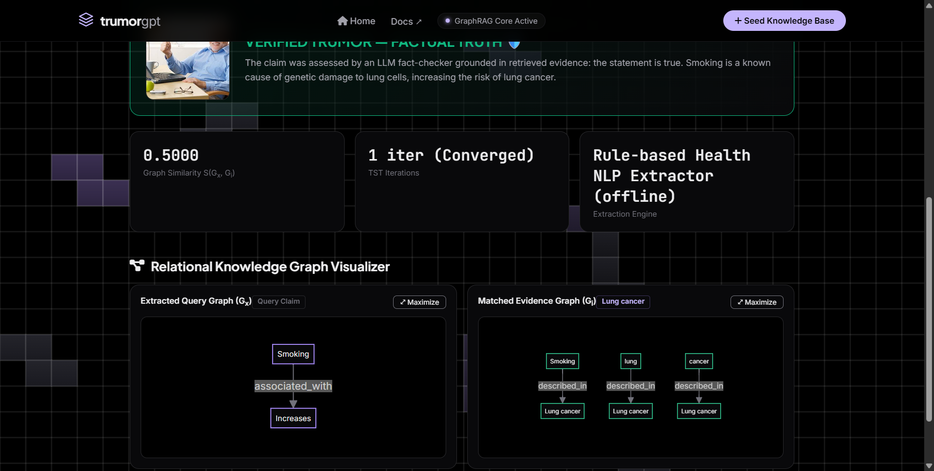
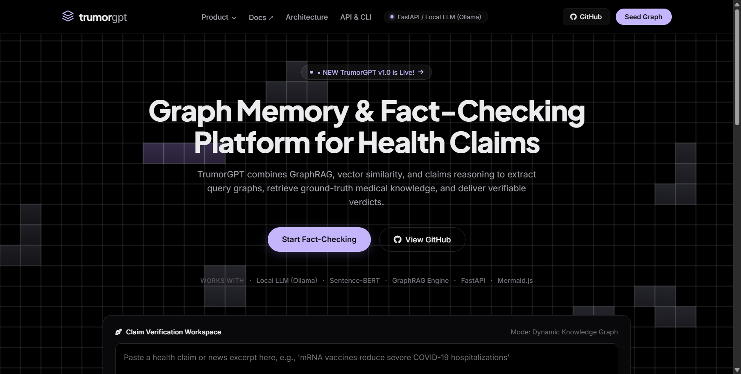
Implementation (Live)

Slide 17
Demo and Future Work
• Runs locally with qwen2.5:7b via Ollama, fully offline-capable; ~8 seconds per claim.
• Try any claim: e.g. "Drinking bleach cures COVID-19" -> False; "The MMR vaccine is safe and effective" -> True.
• Usability: press Enter to submit; each knowledge graph has a maximize/fullscreen button.
• Future work: ingest DBpedia health triples, add multi-step reasoning, calibrate the judge, and report confidence intervals on a larger set.

