Slide 1


Data Understanding & Preparation
Source:
The dataset includes historical data on "Packs" and "Value" metrics.
Focused on time series data for these variables.
Data Segmentation:
Training Data: Rows 1 to 4259, used to train the forecasting model.
Forecasting Range: Rows 4261 to 5599, where the model predicts future values.
Data Characteristics:
Seasonal patterns in both "Packs" and "Value" columns.
Missing or incomplete data was handled to ensure accurate forecasting.

Slide 2
Model Development and Implementation
Model Selection:
Exponential Smoothing:
Chose this model for its effectiveness in capturing seasonality in time series data.
Model Fitting:
Applied the model separately to the "Packs" and "Value" columns.
Utilized historical data (rows 1 to 4259) to fit the model and capture underlying trends.
Excel Integration:
Used OpenPyXL to insert the forecasted values directly into the Excel file.
Ensured the forecasts aligned with the specified cell range (“G4261:H5599”)

Slide 3
Forecasting Methodology
Exponential Smoothing Model:
Logic: Chose Exponential Smoothing for its ability to handle seasonality.
Implementation
Fit the model to the "Packs" and "Value" data.
Forecasted future values for the specified range.
Challenges:
Faced convergence warnings, which indicate optimization issues but forecasts were still generated.

Slide 4
Writing Forecasted Data to Excel
Step 1: Integration with Excel
Used OpenPyXL to write the forecasted values back into the dataset.
Step 2: Accuracy Check
Verified that the forecasted values were placed correctly in the G4261 range.
Apply the model to other time series data within the organization.
Integrate the forecasting approach into automated reporting systems for continuous updates.

Slide 5
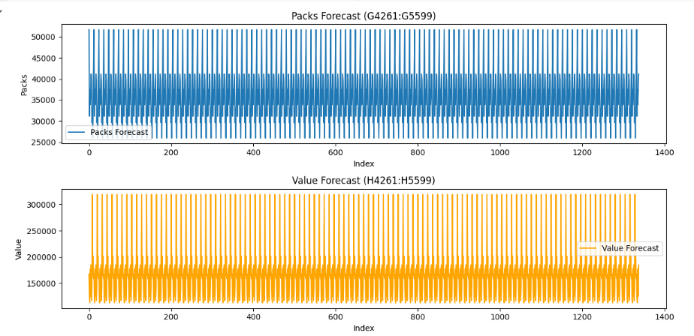
Visualization
Objective: Visualize the forecasted data for better understanding and analysis.
Tools Used:
Matplotlib in Python for creating line plots.
Colab environment for easy code execution.
Results:

