Slide 1
DG INTERNS HUB / CYBERSECURITY INTERNSHIP / WEEK 09
SOC INTRODUCTION & SNORT IDS
Week 9 • Practical monitoring and intrusion detection
CYBERSECURITY INTERNSHIP
Submitted by Akash Sanuria
Intern ID: DG/SEPTEMBER/CYBER/171
05 November 2026
AKASH SANURIA • SOC & SNORT IDS
1

Slide 2
DG INTERNS HUB / CYBERSECURITY INTERNSHIP / WEEK 09
Project at a glance
From virtual lab setup to verified live alerts
ENVIRONMENT
CONFIGURATION
RESULTS
VirtualBox
Ubuntu 24.04.5 LTS
Snort 2.9.20 GRE
Interface: enp0s3
HOME_NET: 10.0.2.0/24
Custom local rules
ICMP detection: PASS
HTTP detection: PASS
Live console evidence
AKASH SANURIA • SOC & SNORT IDS
2

Slide 3
DG INTERNS HUB / CYBERSECURITY INTERNSHIP / WEEK 09
What is a SOC?
Security Operations Center: monitor, investigate, respond
CORE ACTIVITIES
SOC WORKFLOW
Monitor security telemetry
Triage suspicious alerts
Investigate incidents
Escalate and document findings
Collect → Detect → Triage
Investigate → Respond
Snort provides network IDS alerts.
AKASH SANURIA • SOC & SNORT IDS
3

Slide 4
DG INTERNS HUB / CYBERSECURITY INTERNSHIP / WEEK 09
SOC analyst responsibilities
Escalation from initial triage to advanced detection
L1 ANALYST
L2 ANALYST
L3 ANALYST
Alert monitoring
Initial triage
False-positive checks
Correlate evidence
Deep investigation
Coordinate containment
Threat hunting
Malware analysis
Detection engineering
AKASH SANURIA • SOC & SNORT IDS
4

Slide 5
DG INTERNS HUB / CYBERSECURITY INTERNSHIP / WEEK 09
SIEM vs IDS vs IPS
Three complementary security technologies
SIEM
IDS
IPS
Centralizes logs
Correlates events
Supports reporting
Monitors traffic
Matches signatures
Generates alerts
Inline inspection
Can block traffic
Enforces policy
AKASH SANURIA • SOC & SNORT IDS
5

Slide 6
DG INTERNS HUB / CYBERSECURITY INTERNSHIP / WEEK 09
Virtual lab architecture
VirtualBox → Ubuntu VM → Snort IDS → SOC alerts
VIRTUALBOX
UBUNTU VM
SNORT IDS
CONSOLE
→
→
→
VM host
enp0s3 / 10.0.2.5
Rule matching
Detection alerts
Lab scope: passive signature-based intrusion detection on monitored interface.
AKASH SANURIA • SOC & SNORT IDS
6

Slide 7
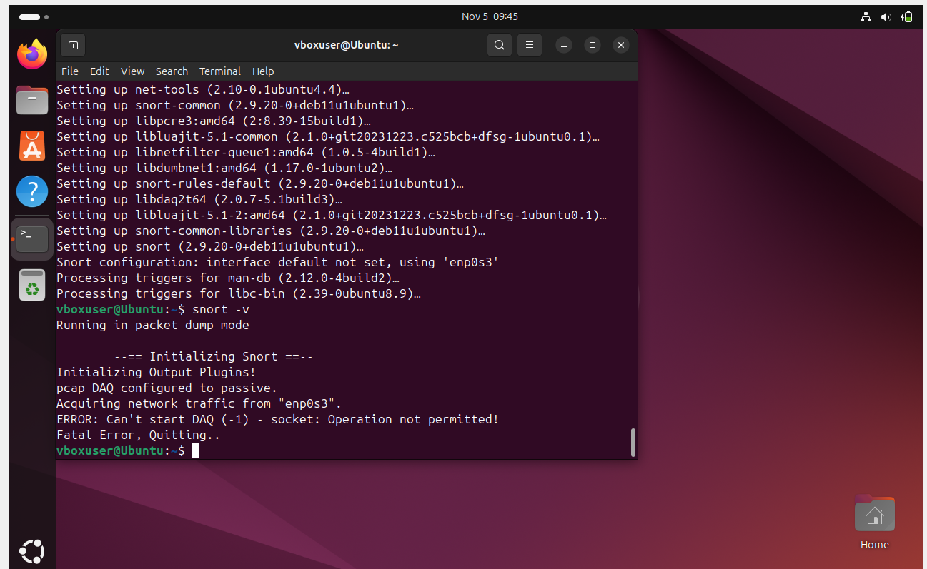
DG INTERNS HUB / CYBERSECURITY INTERNSHIP / WEEK 09
Installation and environment
Verified Snort package and Ubuntu networking
sudo apt update
sudo apt install snort -y
snort -V
Installed: Snort 2.9.20 GRE (Build 82)
AKASH SANURIA • SOC & SNORT IDS
7

Slide 8
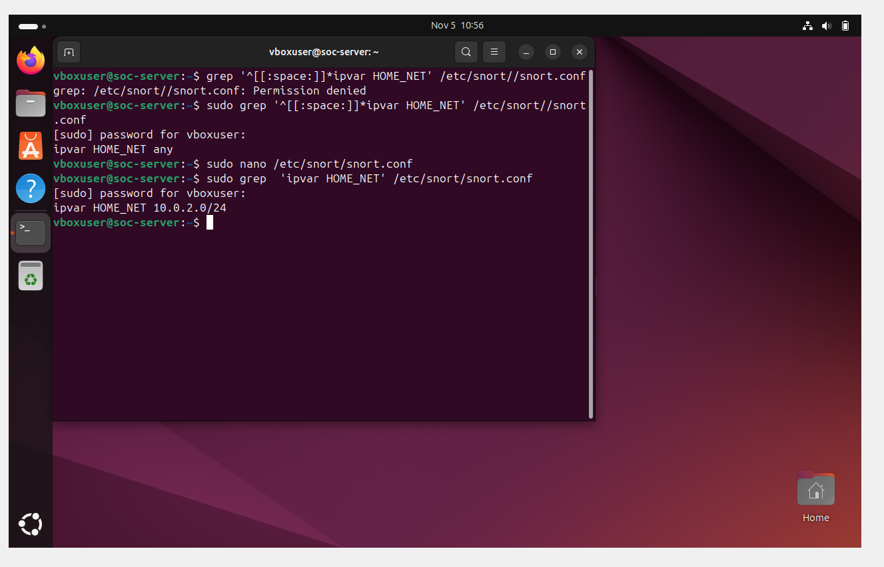
DG INTERNS HUB / CYBERSECURITY INTERNSHIP / WEEK 09
Network configuration
HOME_NET set to the observed VM subnet
ipvar HOME_NET 10.0.2.0/24
ipvar EXTERNAL_NET any
Network interface: enp0s3
Ubuntu VM address: 10.0.2.5
AKASH SANURIA • SOC & SNORT IDS
8

Slide 9
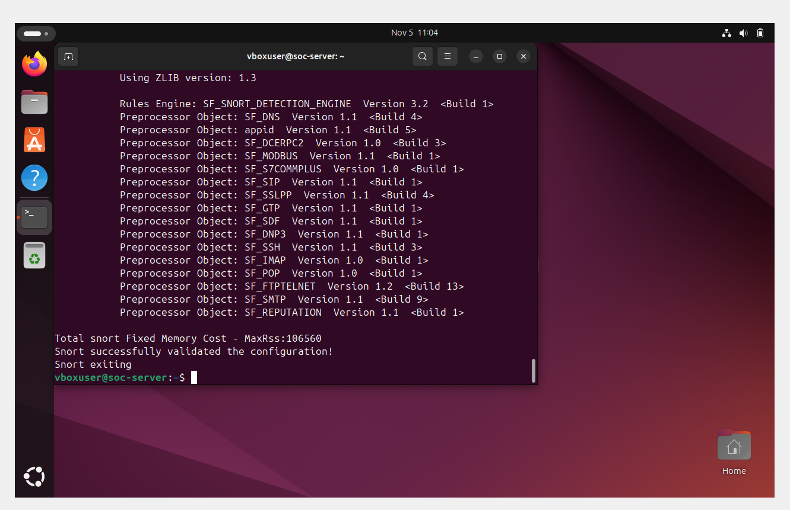
DG INTERNS HUB / CYBERSECURITY INTERNSHIP / WEEK 09
Configuration validation
Snort configuration parsed successfully
sudo snort -T -c /etc/snort/snort.conf -i enp0s3
RESULT: PASS
“Snort successfully validated the configuration!”
AKASH SANURIA • SOC & SNORT IDS
9

Slide 10
DG INTERNS HUB / CYBERSECURITY INTERNSHIP / WEEK 09
Custom detection rules
Local rules included by snort.conf
ICMP / SID 1000001
HTTP / SID 1000002
alert icmp any any -> any any
msg: SOC ICMP Ping Detected
Detects observed ICMP packets
alert tcp any any -> any 80
flow: to_server, established
Detects matching TCP port 80 traffic
AKASH SANURIA • SOC & SNORT IDS
10

Slide 11
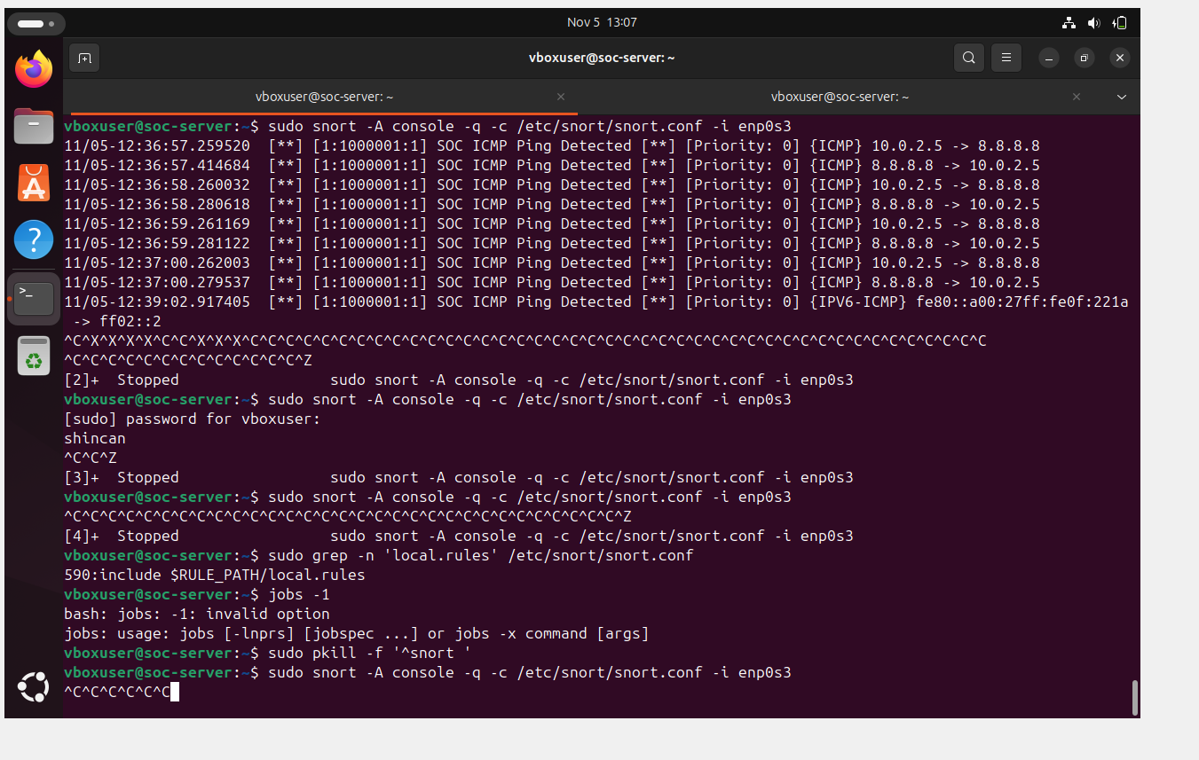
DG INTERNS HUB / CYBERSECURITY INTERNSHIP / WEEK 09
ICMP detection — VERIFIED
Live console evidence after ping to 8.8.8.8
Test: ping -c 4 8.8.8.8
Alert: SOC ICMP Ping Detected
SID: 1000001
10.0.2.5 ↔ 8.8.8.8
RESULT: PASS
AKASH SANURIA • SOC & SNORT IDS
11

Slide 12
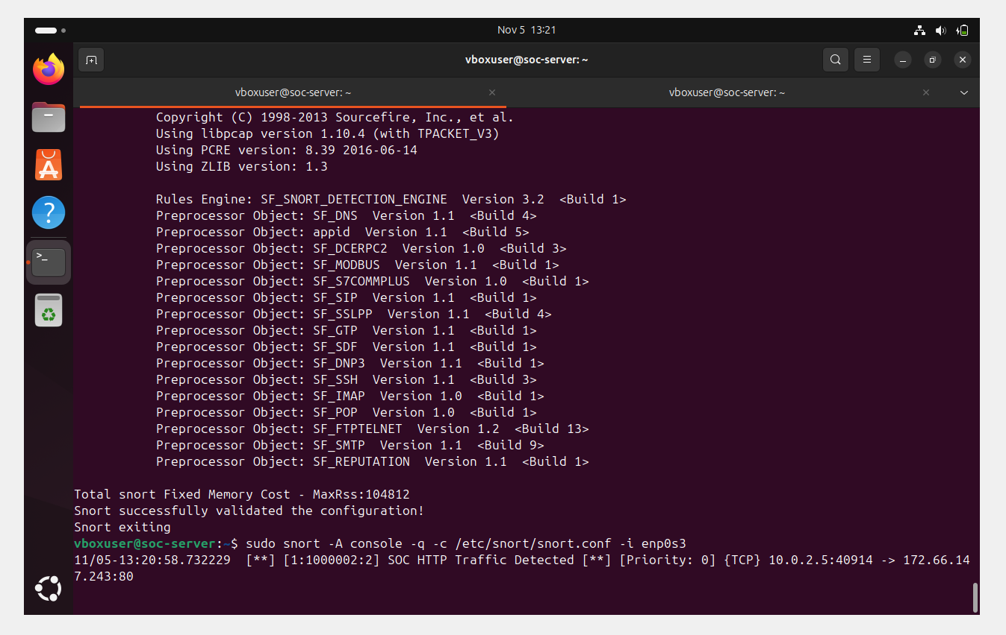
DG INTERNS HUB / CYBERSECURITY INTERNSHIP / WEEK 09
HTTP detection — VERIFIED
Live alert generated for established TCP port 80 traffic
Test: curl -v --max-time 15 http://example.com/
Alert: SOC HTTP Traffic Detected
SID: 1000002
10.0.2.5:40914 → 172.66.147.243:80
RESULT: PASS
AKASH SANURIA • SOC & SNORT IDS
12

Slide 13
DG INTERNS HUB / CYBERSECURITY INTERNSHIP / WEEK 09
How the monitoring workflow operates
Corrected end-to-end detection sequence
GENERATE TRAFFIC
CAPTURE PACKETS
INSPECT TRAFFIC
GENERATE ALERT
→
→
→
ICMP ping / HTTP GET
Network: enp0s3
Snort IDS / local rules
SOC console / SID
Traffic source → enp0s3 → Snort rule matching → SOC alert
AKASH SANURIA • SOC & SNORT IDS
13

Slide 14
DG INTERNS HUB / CYBERSECURITY INTERNSHIP / WEEK 09
Validation matrix
Evidence-based project outcomes
Ubuntu virtual lab
PASS
Snort installation
PASS
HOME_NET configuration
PASS
Configuration validation
PASS
local.rules inclusion
PASS
ICMP detection / SID 1000001
PASS
HTTP detection / SID 1000002
PASS
AKASH SANURIA • SOC & SNORT IDS
14

Slide 15
DG INTERNS HUB / CYBERSECURITY INTERNSHIP / WEEK 09
Conclusion & next steps
Working signature-based intrusion detection demonstrated
COMPLETED
FUTURE IMPROVEMENTS
Snort installed and validated
Two custom detection rules
ICMP and HTTP alerts verified
Real console screenshots captured
Centralized logging
SOC dashboards
Alert triage and enrichment
Broader detection coverage
References: snort.org/documents • documentation.ubuntu.com
AKASH SANURIA • SOC & SNORT IDS
15

