Slide 1
CYBERSECURITY INTERNSHIP / WEEK 6
Web Security & Vulnerability Testing
DVWA • Burp Suite • OWASP ZAP
Practical testing and basic vulnerability assessment
14 October 2026
DG Interns Hub • Akash Sanuria • DG/SEPTEMBER/CYBER/171

Slide 2
WEEK 6 / VAPT BASICS
Aim and tools
My aim was to understand common web security issues and practice testing in a local lab.
DVWA — intentionally vulnerable web application
Burp Suite Community — inspecting HTTP requests and responses
OWASP ZAP — automated security scanning
DG Interns Hub • Akash Sanuria • DG/SEPTEMBER/CYBER/171

Slide 3
WEEK 6 / VAPT BASICS
OWASP topics I studied
SQL Injection — unsafe database input can change queries.
XSS — untrusted input can run JavaScript in a browser.
Broken Authentication — weak login and session controls can expose accounts.
Security Misconfiguration — missing headers or insecure defaults increase risk.
DG Interns Hub • Akash Sanuria • DG/SEPTEMBER/CYBER/171

Slide 4
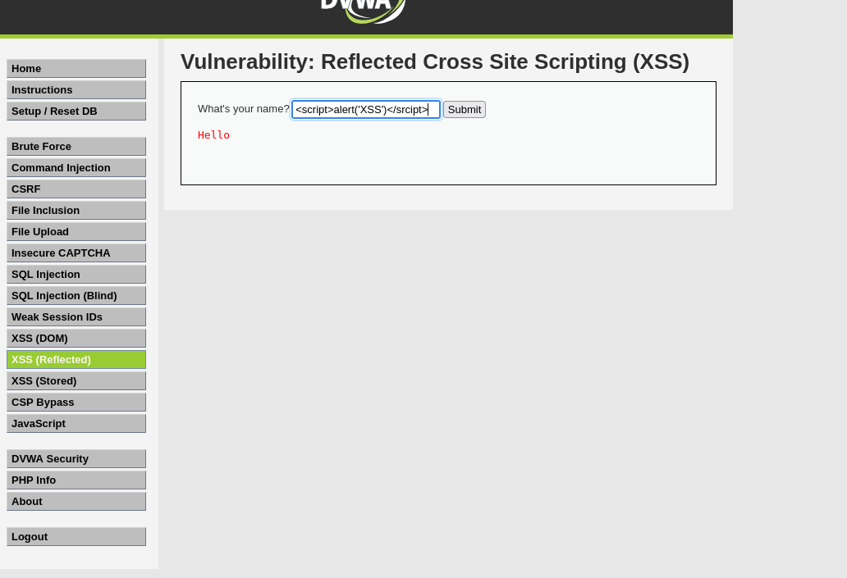
WEEK 6 / VAPT BASICS
My DVWA lab and SQL Injection
I used DVWA in my local lab and opened its SQL Injection page.
I entered test input and checked how the page responded.
Prevention: parameterized queries and input validation.
DG Interns Hub • Akash Sanuria • DG/SEPTEMBER/CYBER/171

Slide 5
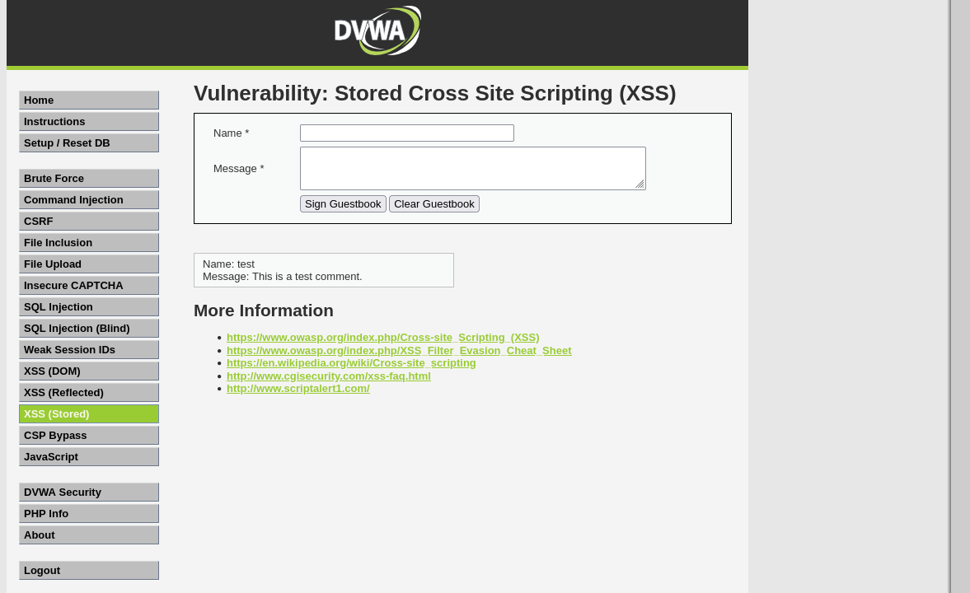
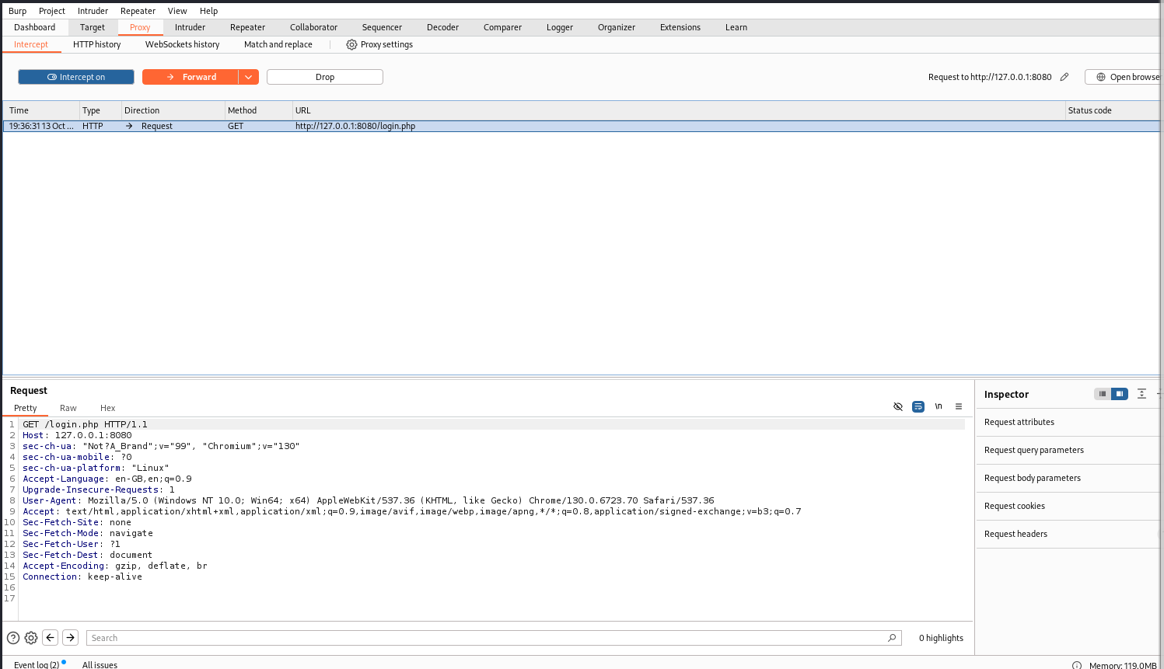
WEEK 6 / VAPT BASICS
Reflected and Stored XSS
Reflected XSS: I submitted a test input and checked the immediate page response.
Stored XSS: I entered test data into a field and checked whether it appeared again.
Prevention: output encoding and safe input handling.
DG Interns Hub • Akash Sanuria • DG/SEPTEMBER/CYBER/171

Slide 6
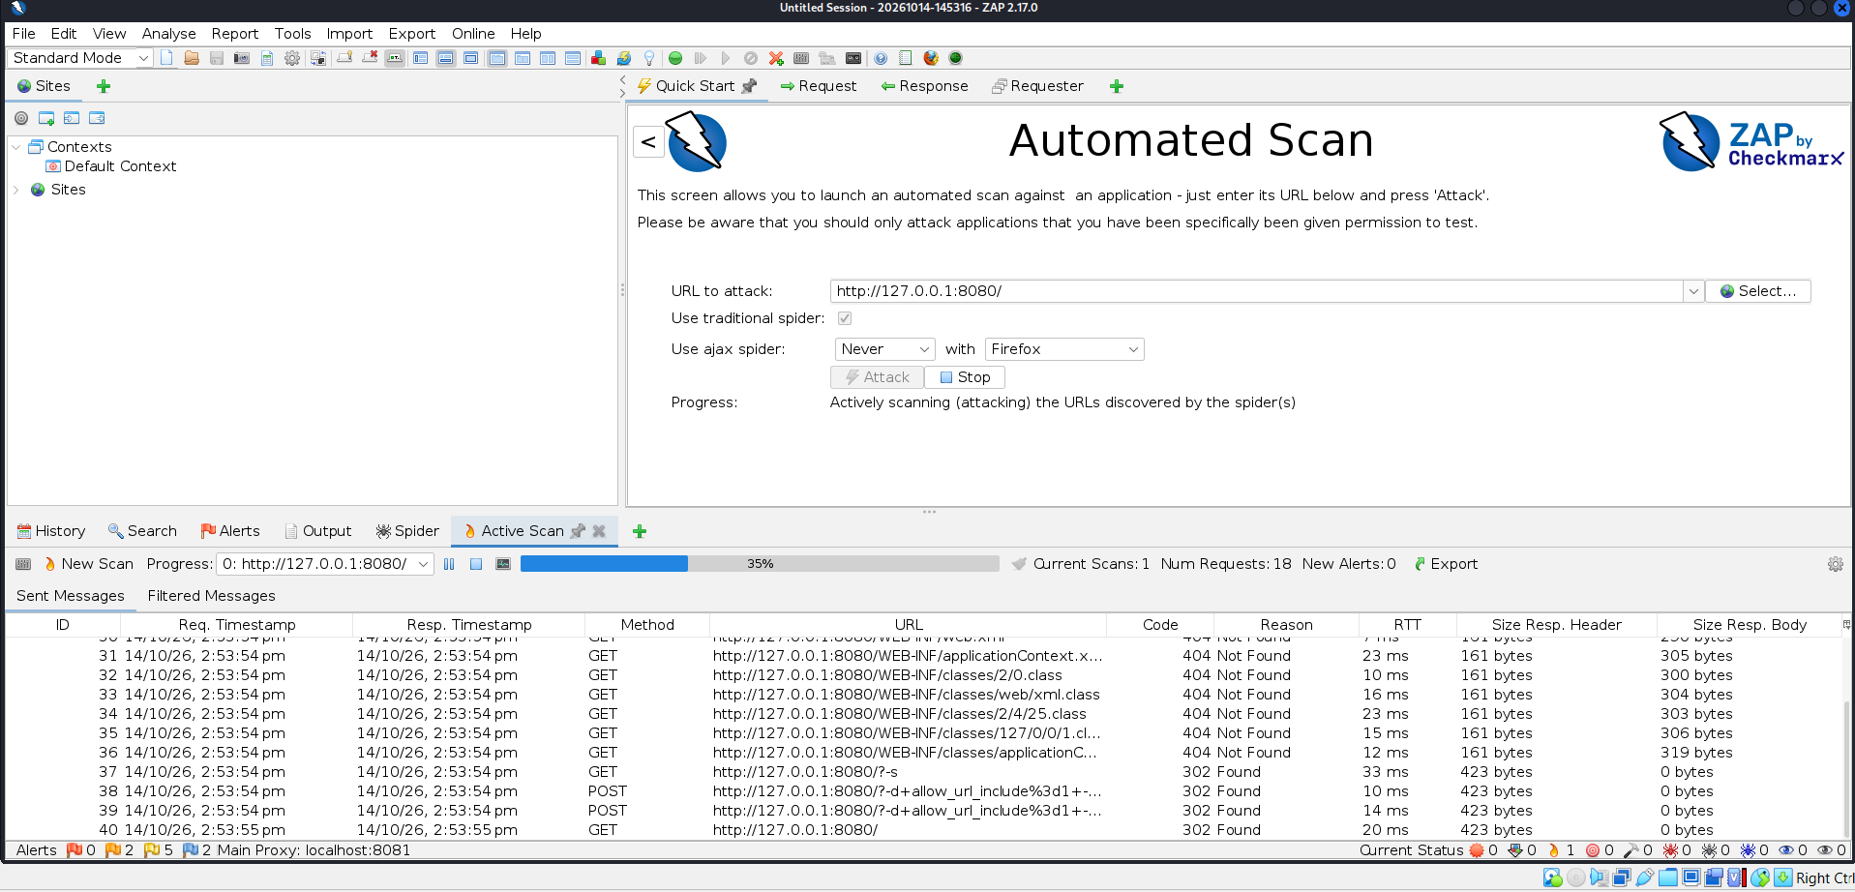
WEEK 6 / VAPT BASICS
Checking HTTP traffic with Burp Suite
I used Burp Suite Community to inspect web traffic from the lab.
I reviewed a request and its response to understand how the browser communicates with the application.
This helped connect the web pages to HTTP behavior.
DG Interns Hub • Akash Sanuria • DG/SEPTEMBER/CYBER/171

Slide 7
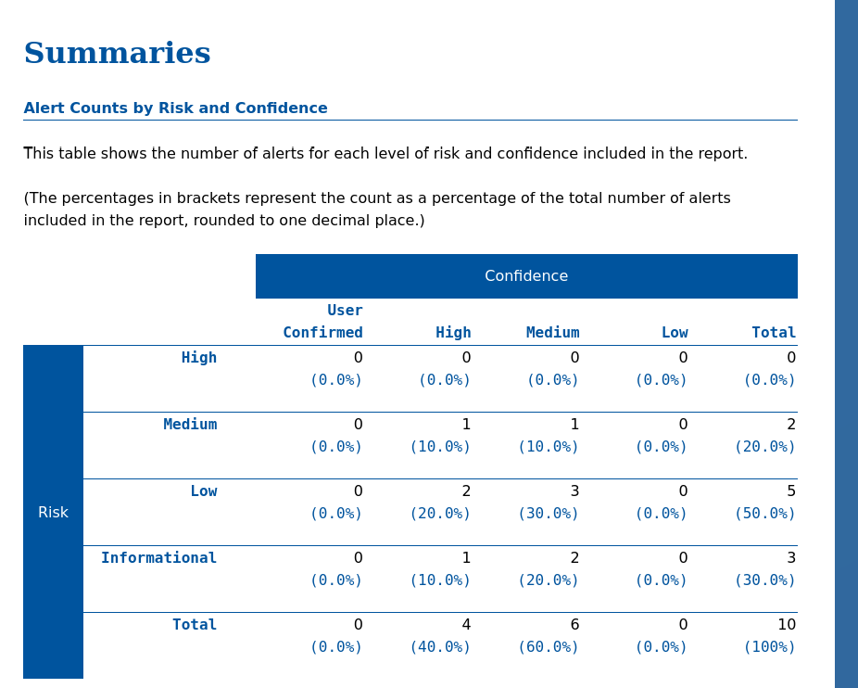
WEEK 6 / VAPT BASICS
OWASP ZAP automated scan
I ran an automated ZAP scan against my local DVWA instance.
The scan produced alerts that I reviewed by risk level.
ZAP results need manual review; an alert is not automatically a confirmed exploit.
DG Interns Hub • Akash Sanuria • DG/SEPTEMBER/CYBER/171

Slide 8
WEEK 6 / VAPT BASICS
Scan findings and fixes
ZAP reported 10 alert types: 0 High, 2 Medium, 5 Low, 3 Informational.
Examples: Content Security Policy header not set; anti-clickjacking header missing; cookie flags not configured; server version information exposed.
Recommended fixes: add suitable security headers, protect cookies with HttpOnly and SameSite, reduce unnecessary server details, and retest.
DG Interns Hub • Akash Sanuria • DG/SEPTEMBER/CYBER/171

Slide 9
WEEK 6 / VAPT BASICS
What I learned
During Week 6, I practiced SQL Injection and XSS testing in DVWA, checked HTTP traffic using Burp Suite, and reviewed OWASP ZAP scan alerts.
I learned that automated tools help identify possible issues, but results still need to be understood and verified.
Testing scope: my local intentionally vulnerable lab. These results do not describe a real production website.
DG Interns Hub • Akash Sanuria • DG/SEPTEMBER/CYBER/171

