Slide 1
DG INTERNS HUB
LAB SNAPSHOT
CYBERSECURITY INTERNSHIP
WEEK 4
10.0.2.0/24
Virtual subnet
Basic Network Setup &
Initial Security Testing
80/TCP
Open HTTP service
A practical virtual-lab assessment covering network setup, service discovery and packet analysis.
3
Protocols analyzed
Kali Linux → Ubuntu Linux
VirtualBox • Apache2 • Nmap • Wireshark
Akash Sanuria
Intern ID DG/SEPTEMBER/CYBER/171 | 30 Sep 2026

Slide 2
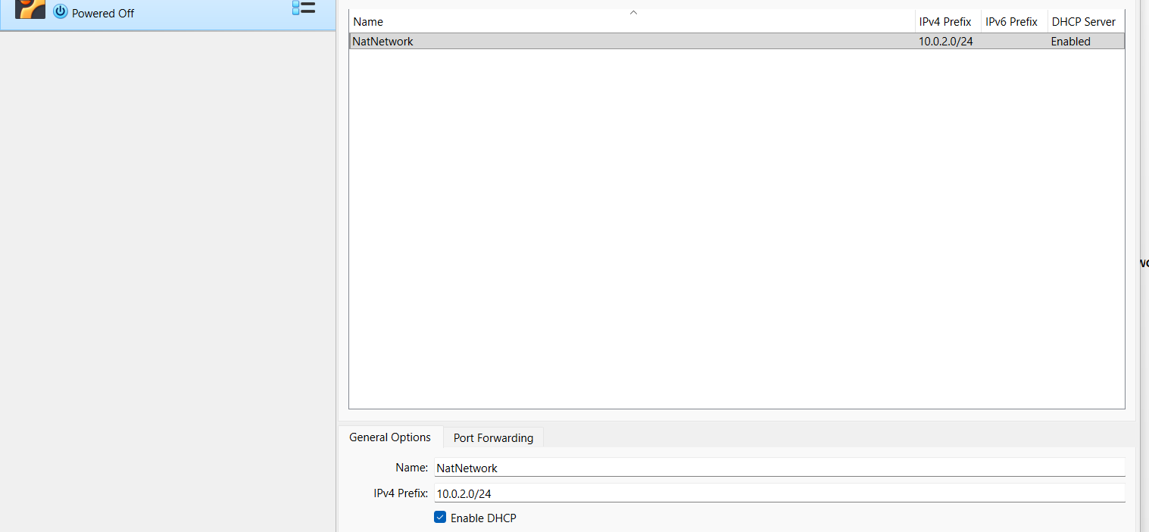
DG INTERNS HUB
LAB ARCHITECTURE
02
01 / ENVIRONMENT
Project Overview & Lab Architecture
A controlled two-VM security lab on a VirtualBox NAT Network.
ARCHITECTURE
KALI
→
NAT
→
10.0.2.15
10.0.2.0/24
↘
UBUNTU
10.0.2.5
VirtualBox NAT Network with DHCP enabled
2
DHCP
Authorized
Akash Sanuria • DG/SEPTEMBER/CYBER/171 • Cybersecurity Internship
WEEK 4
Virtual machines
Address assignment
Lab scope

Slide 3
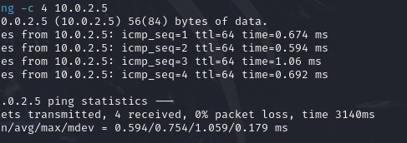
DG INTERNS HUB
NETWORK VALIDATION
03
02 / CONNECTIVITY
Task 1 — Basic Network Setup
Connectivity was validated before moving to service discovery.
VALIDATION RESULT
4 / 4
Packets received
0%
Packet loss
ICMP connectivity verification
DHCP addresses were rechecked after restart because the VM leases changed.
Akash Sanuria • DG/SEPTEMBER/CYBER/171 • Cybersecurity Internship
WEEK 4

Slide 4
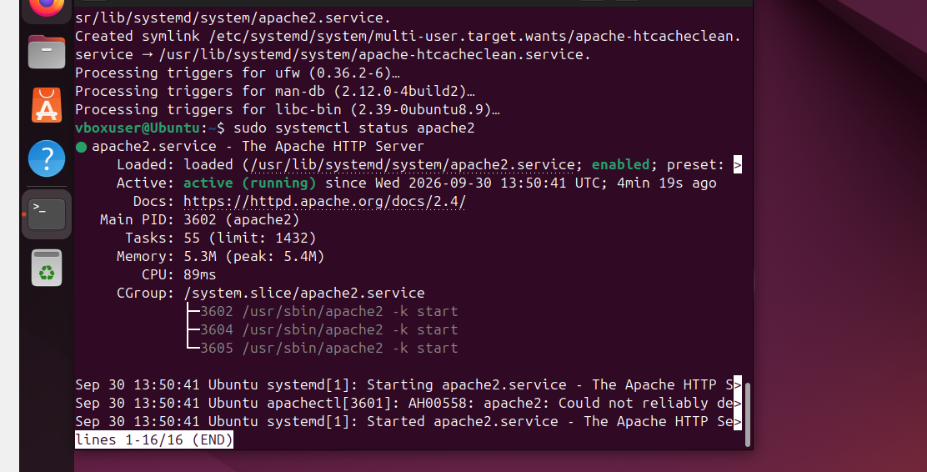
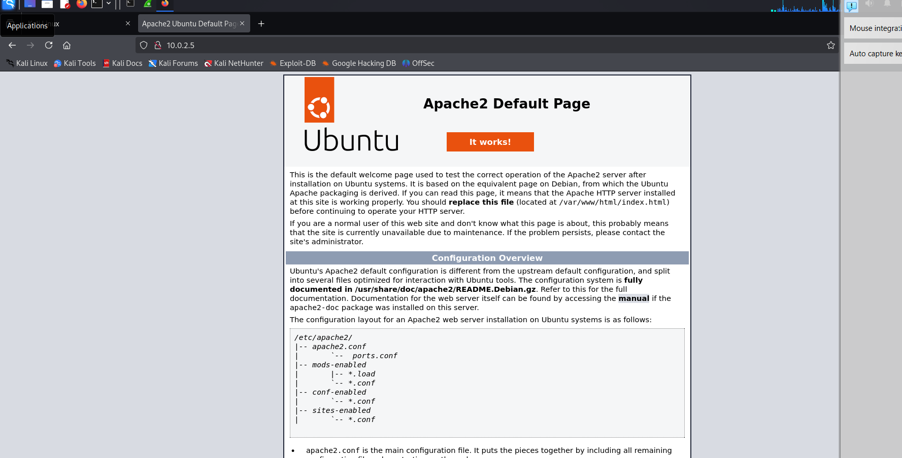
DG INTERNS HUB
SERVICE CONFIGURATION
04
03 / WEB SERVICE
Task 2 — Apache2 on Ubuntu
The target service was installed, verified and accessed from Kali.
Service state: active (running)
HTTP page successfully reached from Kali
80/TCP
Apache2
HTTP
Akash Sanuria • DG/SEPTEMBER/CYBER/171 • Cybersecurity Internship
WEEK 4
Web service
Server
Protocol

Slide 5
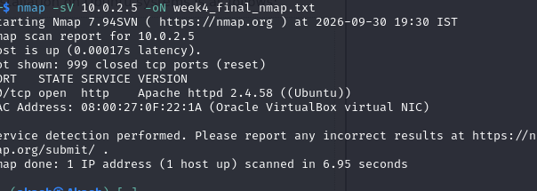
DG INTERNS HUB
SERVICE DISCOVERY
05
04 / NMAP
Task 3 — Scan Analysis
Service/version detection confirmed the exposed web service.
SCAN FINDINGS
Host status • UP
Open port • 80/tcp
Service • HTTP
Version • Apache httpd 2.4.58 (Ubuntu)
Output • week4_final_nmap.txt
nmap -sV 10.0.2.5 -oN week4_final_nmap.txt
999 default-scanned TCP ports were closed.
Akash Sanuria • DG/SEPTEMBER/CYBER/171 • Cybersecurity Internship
WEEK 4

Slide 6
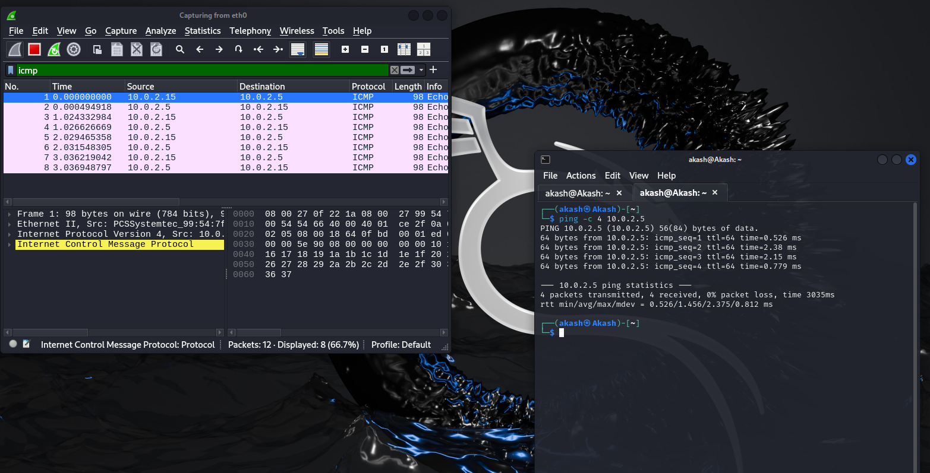
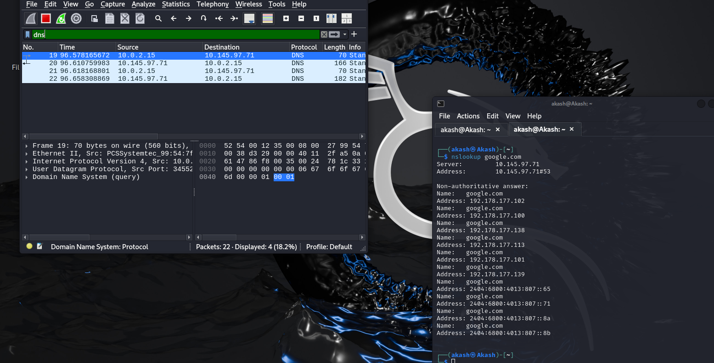
DG INTERNS HUB
TRAFFIC ANALYSIS
06
05 / WIRESHARK
Task 4 — ICMP & DNS
Packet captures validated reachability and name-resolution traffic.
ICMP • Echo Request / Echo Reply
DNS • Query / Response via nslookup
Key takeaway: direct IP connectivity and DNS resolution are separate layers of troubleshooting.
Akash Sanuria • DG/SEPTEMBER/CYBER/171 • Cybersecurity Internship
WEEK 4

Slide 7
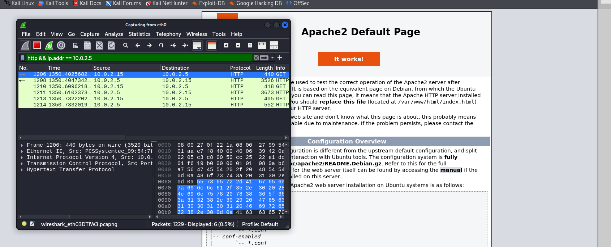
DG INTERNS HUB
HTTP ANALYSIS
07
06 / WIRESHARK
HTTP Request & Response Analysis
Target-specific filtering isolated traffic between Kali and the Ubuntu web server.
OBSERVED
● HTTP GET requests from Kali
● HTTP responses from Ubuntu
● Apache2 page confirmed end-to-end communication
● Plain HTTP traffic is not encrypted
Filter: http && ip.addr == 10.0.2.5
Security note
HTTPS/TLS is preferred for sensitive real-world services.
Akash Sanuria • DG/SEPTEMBER/CYBER/171 • Cybersecurity Internship
WEEK 4

Slide 8
DG INTERNS HUB
OUTCOME
08
07 / COMPLETION
Key Findings & Learning Outcomes
Week 4 practical workflow completed successfully with real lab evidence.
01
NETWORK
→
02
PING
→
03
APACHE
→
04
NMAP
→
05
WIRESHARK
● Built and validated a two-VM VirtualBox lab.
● Configured Apache2 and identified TCP/80 with Nmap.
● Analyzed ICMP, DNS and HTTP traffic in Wireshark.
● Resolved DNS, DHCP/IP and service-state issues systematically.
● Strengthened foundational network-security and SOC analysis skills.
WEEK 4 PRACTICAL • COMPLETED
Akash Sanuria • DG/SEPTEMBER/CYBER/171 • Cybersecurity Internship
WEEK 4

