Slide 1
WEEK 7 / DVWA LAB
Web Application Vulnerability Assessment
DVWA local lab • Burp Suite Community Edition • OWASP ZAP
Submitted by: Akash Sanuria
Intern ID: DG/SEPTEMBER/CYBER/171
Internship: DG Interns Hub – Cybersecurity Internship
Training-only assessment | http://127.0.0.1:4280
Akash Sanuria | DG/SEPTEMBER/CYBER/171 • 01

Slide 2
WEEK 7 / DVWA LAB
Objectives & Assessment Scope
• Map DVWA endpoints and request parameters
• Demonstrate SQL injection, reflected XSS and stored XSS
• Observe invalid-login handling and request modification
• Discover paths using ZAP Spider
• Document evidence and remediation
Akash Sanuria | DG/SEPTEMBER/CYBER/171 • 02

Slide 3
WEEK 7 / DVWA LAB
Lab Setup & Testing Workflow
Kali Linux (VirtualBox) → Burp Proxy / Repeater → DVWA Docker
OWASP ZAP Manual Explore → Spider Discovery → Findings Review
Target: http://127.0.0.1:4280
DVWA Security: Low
Akash Sanuria | DG/SEPTEMBER/CYBER/171 • 03

Slide 4
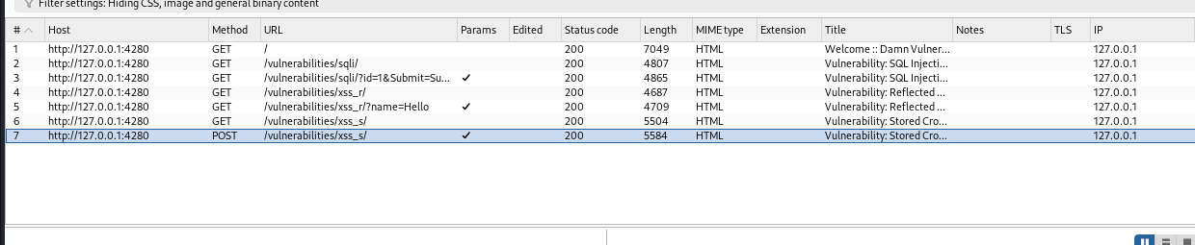
WEEK 7 / DVWA LAB
Burp Suite: Request Mapping
Captured GET requests and guestbook POST /vulnerabilities/xss_s/.
Akash Sanuria | DG/SEPTEMBER/CYBER/171 • 04

Slide 5
WEEK 7 / DVWA LAB
Finding 1 | SQL Injection
Observation: A crafted input on /vulnerabilities/sqli/ returned multiple sample user records.
Impact: Potential exposure of database records in similarly vulnerable applications.
Fix: Parameterized queries, least-privilege database access, input type validation.
Akash Sanuria | DG/SEPTEMBER/CYBER/171 • 05

Slide 6
WEEK 7 / DVWA LAB
Finding 2 | Reflected XSS
Observation: Untrusted name parameter content was reflected and executed in the browser, triggering a JavaScript alert.
Impact: Script execution in the application origin if exploited in a real-world context.
Fix: Context-aware output encoding, safe DOM APIs, defense-in-depth CSP.
Akash Sanuria | DG/SEPTEMBER/CYBER/171 • 06

Slide 7
WEEK 7 / DVWA LAB
Finding 3 | Stored XSS
Observation: A guestbook script was stored and executed when content was rendered.
Evidence: Burp captured POST fields txtName, mtxMessage and btnSign.
Fix: Safe output encoding for stored user content; retest after remediation.
Akash Sanuria | DG/SEPTEMBER/CYBER/171 • 07

Slide 8
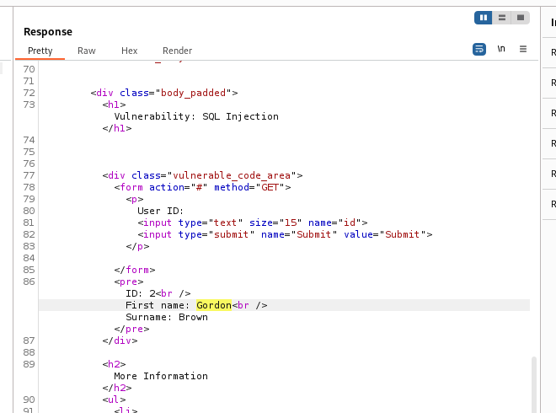
WEEK 7 / DVWA LAB
Authentication & Parameter Tampering
• Incorrect password: “Login failed”
• Burp Repeater changed id=1 to id=2
• Response: Gordon Brown
• This alone does not prove IDOR.
Akash Sanuria | DG/SEPTEMBER/CYBER/171 • 08

Slide 9
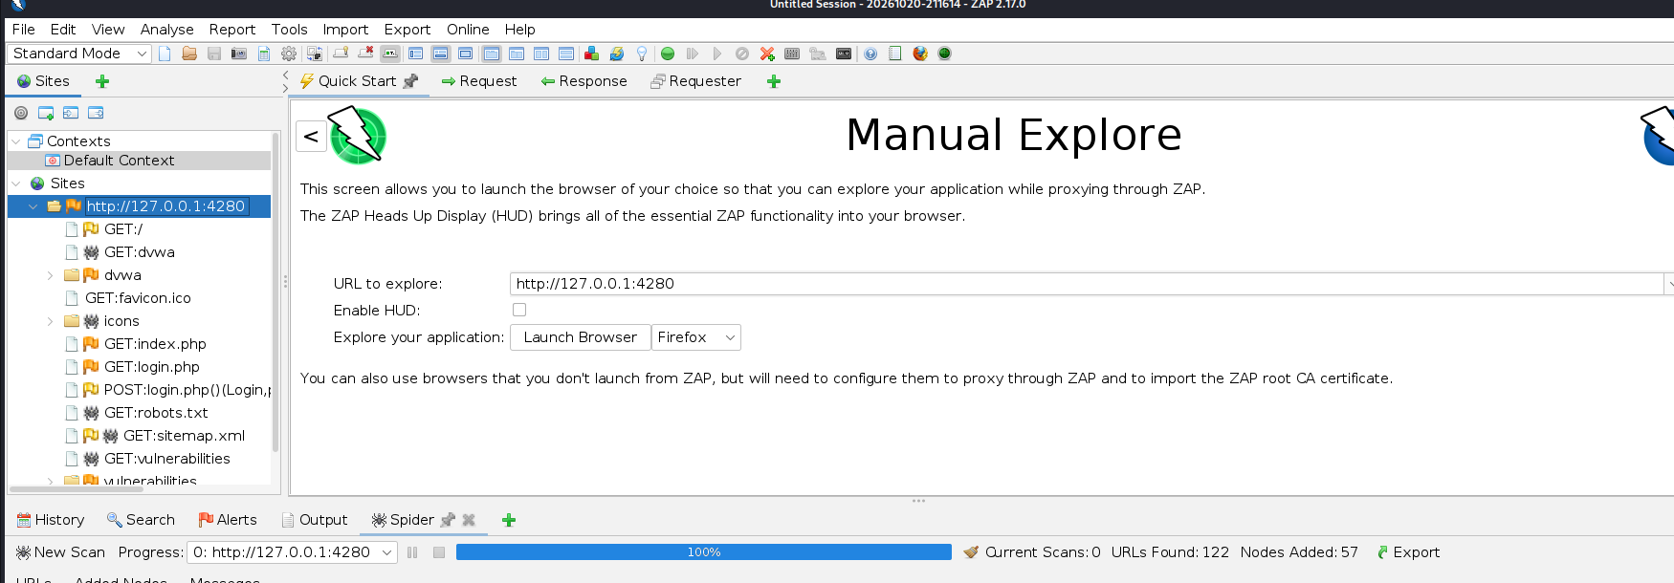
WEEK 7 / DVWA LAB
OWASP ZAP | Spider Discovery
100% complete • 122 URLs found • 57 nodes added • 0 active scans running
Akash Sanuria | DG/SEPTEMBER/CYBER/171 • 09

Slide 10
WEEK 7 / DVWA LAB
Recommendations & Final Status
1. Use parameterized SQL statements.
2. Encode untrusted data in HTML output contexts.
3. Review cookies, headers and directory exposure.
4. Retest fixes with the same request and expected behavior.
Tasks 22–26: Complete | Three manually demonstrated vulnerability types.
ZAP passive alerts are observations, not automatically confirmed findings.
Akash Sanuria | DG/SEPTEMBER/CYBER/171 • 10

