Slide 1

DG INTERNS HUB
Cybersecurity Internship
WEEK 3 ASSIGNMENT
ADVANCED CYBERSECURITY
PRACTICAL TASK
Submitted By: Akash Sanuria
Intern ID: DG/SEPTEMBER/CYBER/171
Week: Week 3

Slide 2
Objectives
Discover active hosts in the authorized virtual lab
Perform Nmap port and service scanning
Capture and analyze ICMP, DNS and TCP traffic
Apply firewall hardening using UFW
Verify the security posture after hardening
DG Interns Hub | Cybersecurity Internship | Week 3 • 2

Slide 3
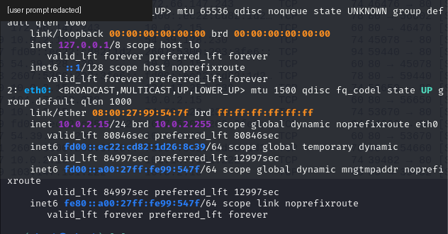
Lab Environment
Kali Linux virtual machine in VirtualBox
Active interface: eth0
Kali VM address: 10.0.2.15/24
Observed lab hosts: 10.0.2.2, 10.0.2.3 and 10.0.2.15
Tools: Nmap, Wireshark and UFW
DG Interns Hub | Cybersecurity Internship | Week 3 • 3

Slide 4
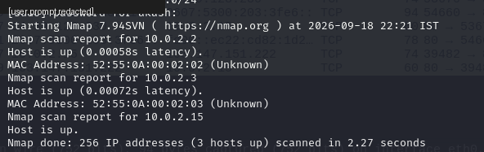
Network Discovery with Nmap
Command: sudo nmap -sn 10.0.2.0/24
Three active lab hosts were discovered
Discovery establishes which systems respond before deeper scanning
DG Interns Hub | Cybersecurity Internship | Week 3 • 4

Slide 5
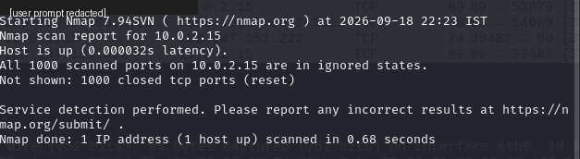
Service / Version Scan
Command: sudo nmap -sV 10.0.2.15
Target host was up
All 1000 commonly scanned TCP ports were closed
No listening TCP service/version was identified in this scan
DG Interns Hub | Cybersecurity Internship | Week 3 • 5

Slide 6
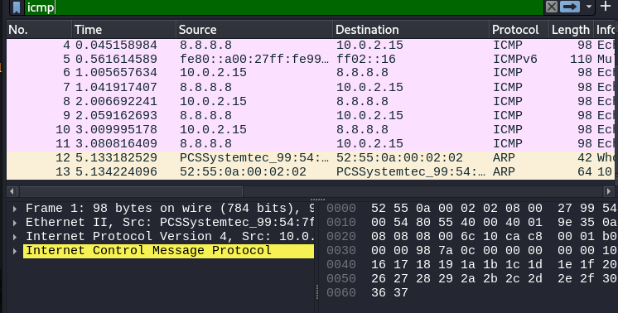
Wireshark: ICMP Analysis
Display filter: icmp
Echo requests and replies were captured
Traffic between 10.0.2.15 and 8.8.8.8 demonstrated successful reachability
ICMP capture provides a simple connectivity baseline
DG Interns Hub | Cybersecurity Internship | Week 3 • 6

Slide 7
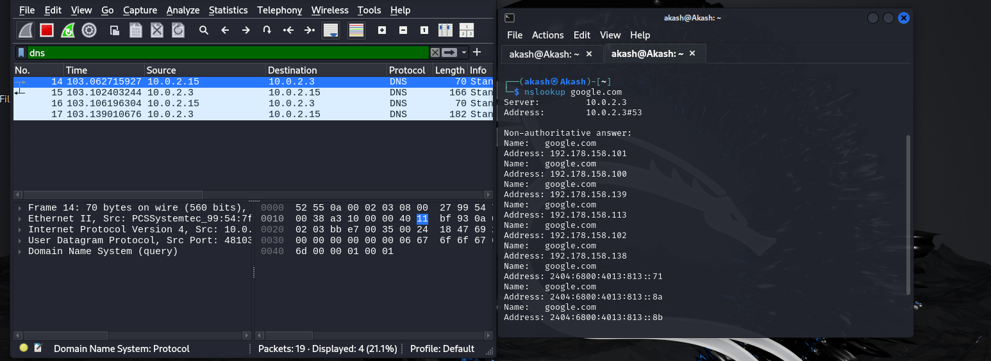
Wireshark: DNS Analysis
Display filter: dns
Queries from 10.0.2.15 were sent to DNS service 10.0.2.3
A and AAAA records were visible in responses
This was normal name-resolution traffic
DG Interns Hub | Cybersecurity Internship | Week 3 • 7

Slide 8
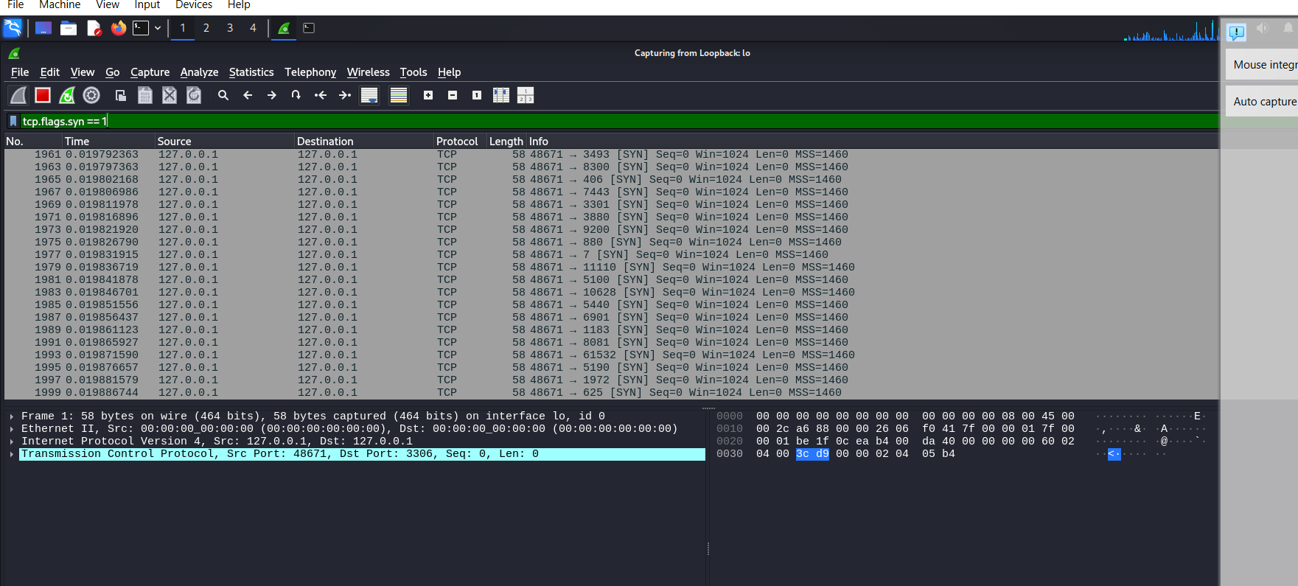
TCP SYN Analysis
Display filter: tcp.flags.syn == 1
SYN and SYN/ACK packets help visualize TCP connection establishment
Wireshark packet evidence can be correlated with Nmap scan results
DG Interns Hub | Cybersecurity Internship | Week 3 • 8

Slide 9
Security Assessment
No confirmed exploitable vulnerability was demonstrated by the available evidence
Initial UFW state was inactive
Legacy FTP (21/tcp) and Telnet (23/tcp) were selected for explicit blocking
Findings were documented as configuration/exposure observations, not overstated vulnerability claims
DG Interns Hub | Cybersecurity Internship | Week 3 • 9

Slide 10
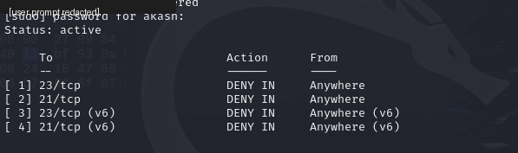
Security Hardening with UFW
Enabled the UFW host firewall
Default posture: deny incoming, allow outgoing
Added explicit deny rule for 23/tcp (Telnet)
Added explicit deny rule for 21/tcp (FTP)
Rules were created for both IPv4 and IPv6
DG Interns Hub | Cybersecurity Internship | Week 3 • 10

Slide 11
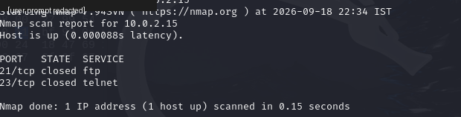
Post-Hardening Verification
Targeted command: sudo nmap -p 21,23 10.0.2.15
Ports 21/tcp and 23/tcp were reported closed
Final UFW status remained active
The improvement demonstrated is stronger firewall policy and explicit deny rules
DG Interns Hub | Cybersecurity Internship | Week 3 • 11

Slide 12
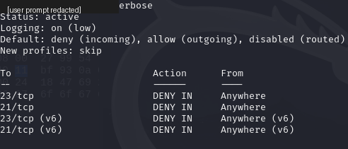
Final Firewall Status
UFW status: active
Logging: on (low)
Default incoming: deny
Default outgoing: allow
Explicit deny rules retained for TCP 21 and TCP 23
DG Interns Hub | Cybersecurity Internship | Week 3 • 12

Slide 13
Recommendations & Conclusion
Keep UFW enabled and review rules periodically
Avoid legacy plaintext services such as Telnet and traditional FTP
Use encrypted alternatives such as SSH/SFTP when required
Perform periodic authorized Nmap scans and monitor packet anomalies
Week 3 practical successfully combined scanning, packet analysis, hardening and verification
DG Interns Hub | Cybersecurity Internship | Week 3 • 13

