Slide 1
CYBERSECURITY INTERNSHIP • DG INTERNS HUB
Advanced VAPT — Attack Chain & Full Exploitation
WEEK 8 ASSIGNMENT
OWASP Juice Shop | Local Training Lab
Submitted by: Akash Sanuria
Intern ID: DG/SEPTEMBER/CYBER/171
28 October 2026
Akash Sanuria • DG/SEPTEMBER/CYBER/171
01

Slide 2
DG INTERNS HUB | WEEK 8 ADVANCED VAPT
Project Overview
• Objective: assess authentication and object-level access controls in a controlled lab.
• Target: OWASP Juice Shop at http://localhost:3000.
• Method: inspect and replay HTTP requests, verify account identity, preserve evidence.
• Results: confirmed login bypass; admin access impact; conditional IDOR finding.
Akash Sanuria • DG/SEPTEMBER/CYBER/171
02

Slide 3
DG INTERNS HUB | WEEK 8 ADVANCED VAPT
Scope & Rules of Engagement
• In scope: local Juice Shop application, login and basket APIs, admin interface.
• Tools: Kali Linux VM, browser, Burp Suite Community Edition / Repeater.
• Read-only evidence collection; no production systems or destructive actions.
• Redact passwords, session cookies and bearer tokens before sharing.
Akash Sanuria • DG/SEPTEMBER/CYBER/171
03

Slide 4
DG INTERNS HUB | WEEK 8 ADVANCED VAPT
Attack Surface Mapping
• POST /rest/user/login — authentication entry point.
• GET /rest/user/whoami — authenticated identity check.
• GET /rest/basket/{id} — object-level basket lookup.
• /#/administration — privileged interface after administrator authentication.
Akash Sanuria • DG/SEPTEMBER/CYBER/171
04

Slide 5
DG INTERNS HUB | WEEK 8 ADVANCED VAPT
Finding A — SQL Injection Login Bypass
• Affected endpoint: POST /rest/user/login.
• Observed: HTTP 200 and administrator identity (user ID 1).
• Severity: Critical within this intentionally vulnerable local lab.
• Likely cause: unsafe SQL query construction; source review needed for exact root cause.
Akash Sanuria • DG/SEPTEMBER/CYBER/171
05

Slide 6
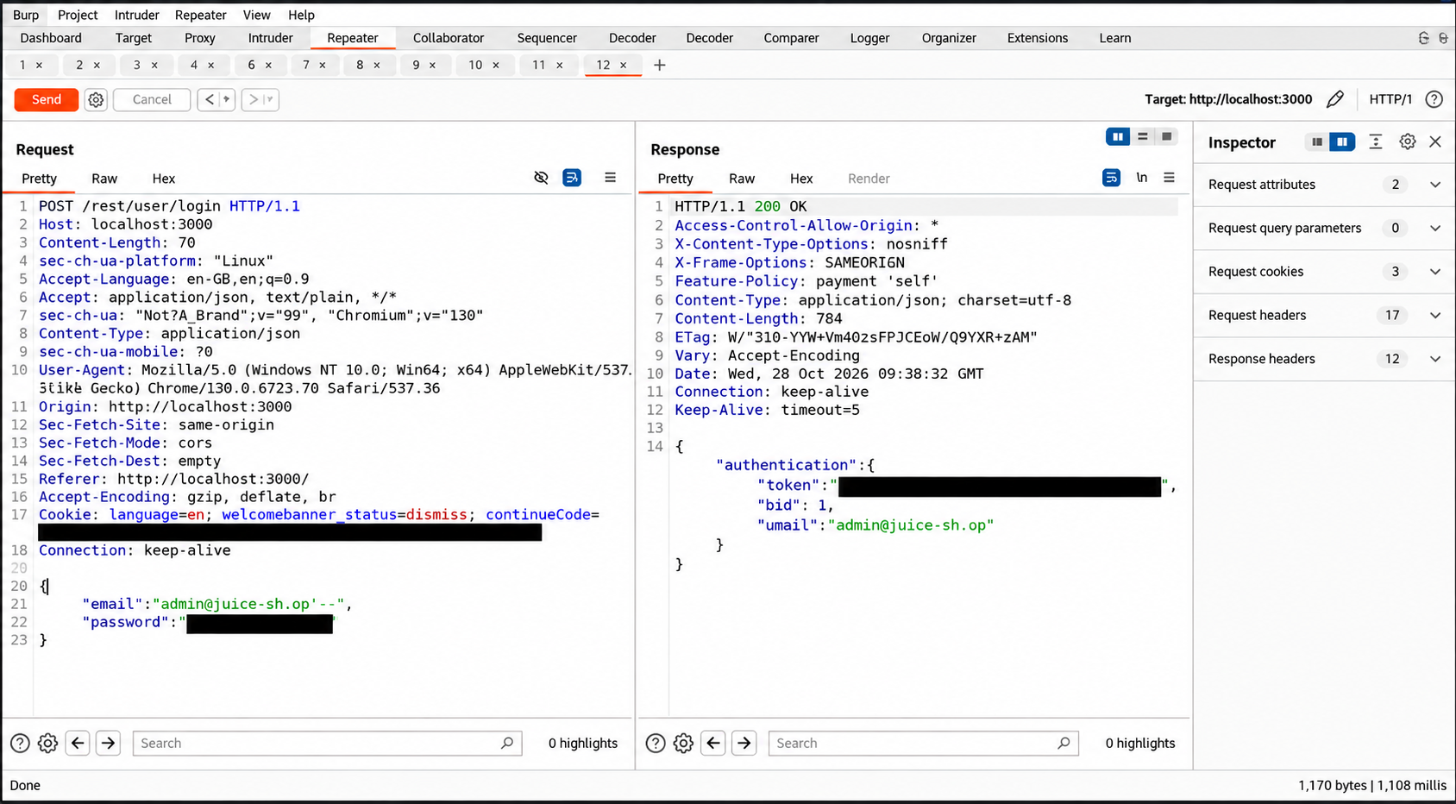
DG INTERNS HUB | WEEK 8 ADVANCED VAPT
Evidence E01 — Login Bypass
Original screenshot: successful administrator authentication; secrets redacted.
Akash Sanuria • DG/SEPTEMBER/CYBER/171
06

Slide 7
DG INTERNS HUB | WEEK 8 ADVANCED VAPT
Finding B — Administrative Access
• After login bypass, the Administration page was accessible.
• The interface displayed registered users and customer feedback.
• This is demonstrated impact of admin account access.
• It is NOT independent proof of an authorization bypass on the admin route.
Akash Sanuria • DG/SEPTEMBER/CYBER/171
07

Slide 8
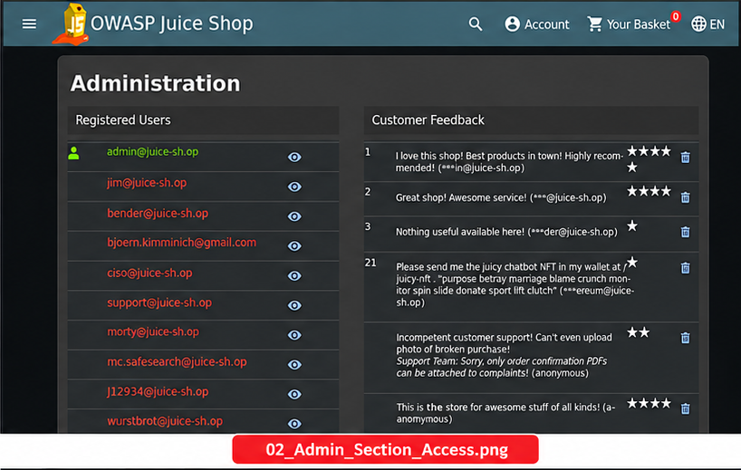
DG INTERNS HUB | WEEK 8 ADVANCED VAPT
Evidence E02 — Admin Section
Akash Sanuria • DG/SEPTEMBER/CYBER/171
08

Slide 9
DG INTERNS HUB | WEEK 8 ADVANCED VAPT
Finding C — Potential IDOR / BOLA
• Identity check: Zara account returned user ID 25.
• Basket request: GET /rest/basket/1 returned HTTP 200 and UserId 1.
• Different caller and owner IDs suggest cross-user object access.
• Confirmation requires matching the same Zara session token in both original requests.
Akash Sanuria • DG/SEPTEMBER/CYBER/171
09

Slide 10
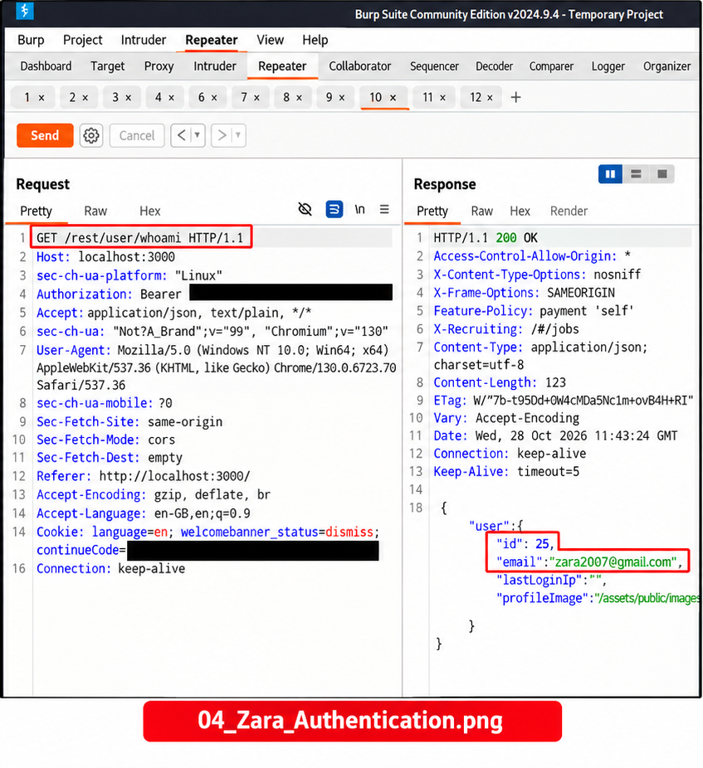
DG INTERNS HUB | WEEK 8 ADVANCED VAPT
Evidence E03 — Regular User Identity
User ID 25 • Authorization values redacted
Akash Sanuria • DG/SEPTEMBER/CYBER/171
10

Slide 11
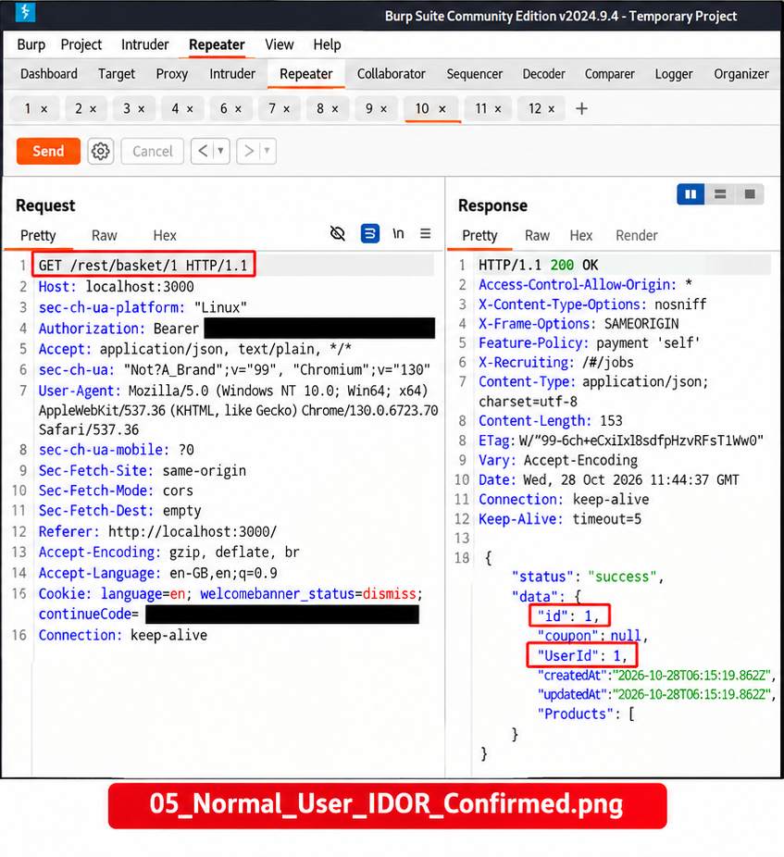
DG INTERNS HUB | WEEK 8 ADVANCED VAPT
Evidence E04 — Basket Response
Basket ID 1 / UserId 1 • No product data disclosed in this capture
Akash Sanuria • DG/SEPTEMBER/CYBER/171
11

Slide 12
DG INTERNS HUB | WEEK 8 ADVANCED VAPT
Attack Chain, Risks & Remediation
• Confirmed chain: SQL injection → admin authentication → administration access.
• Separate test: Zara identity → basket ID 1 request → owner ID 1 response.
• Mitigate SQLi with parameterized queries and authentication regression tests.
• Mitigate IDOR with backend owner checks and two-user authorization tests.
• Limitation: screenshots do not independently establish identical Zara tokens.
Akash Sanuria • DG/SEPTEMBER/CYBER/171
12

