Slide 1
WEEK 5 ASSIGNMENT
VAPT Tools – Practical Learning
Submitted By: Akash Sanuria
Intern ID: DG/SEPTEMBER/CYBER/171
Internship: Cybersecurity Internship
Week: Week 5 Assignment
Submission Date: 07 October 2026
DG Interns Hub | Week 5 | 1

Slide 2
VAPT Overview & Objectives
• VAPT identifies security weaknesses and validates security controls in authorized environments.
• Week 5 tools: Nmap, Nikto and Burp Suite Community Edition.
• Goal: scan the authorized target, inspect web traffic, understand results and document evidence.
• Testing was limited to the internship-provided target: testphp.vulnweb.com.
DG Interns Hub | Week 5 | 2

Slide 3
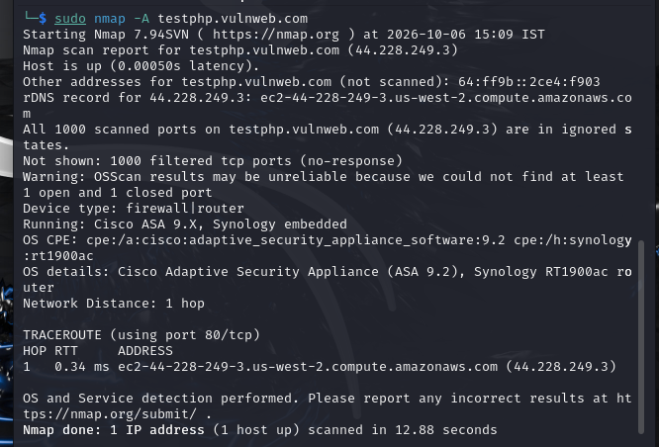
Nmap – Network Scanning
Commands: -sV, -sS and -A
• `nmap -sV` attempted service/version detection.
• `sudo nmap -sS` performed a SYN scan.
• `sudo nmap -A` attempted advanced detection and traceroute.
• Result: target was reachable, but 1000 default TCP ports appeared filtered/no-response.
• OS/device detection was treated as unreliable because Nmap displayed a warning.
DG Interns Hub | Week 5 | 3

Slide 4
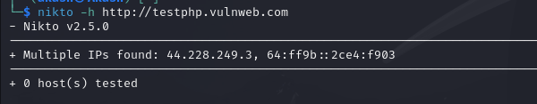
Nikto – Scan Attempt & Troubleshooting
• Nikto v2.5.0 was installed and executed against the authorized target.
• Result: `0 host(s) tested`; therefore no Nikto vulnerability was claimed.
• cURL HTTP/HTTPS checks timed out.
• Netcat connection to TCP port 80 also timed out.
• Conclusion: the web service was not reachable from the current network path during testing.
DG Interns Hub | Week 5 | 4

Slide 5
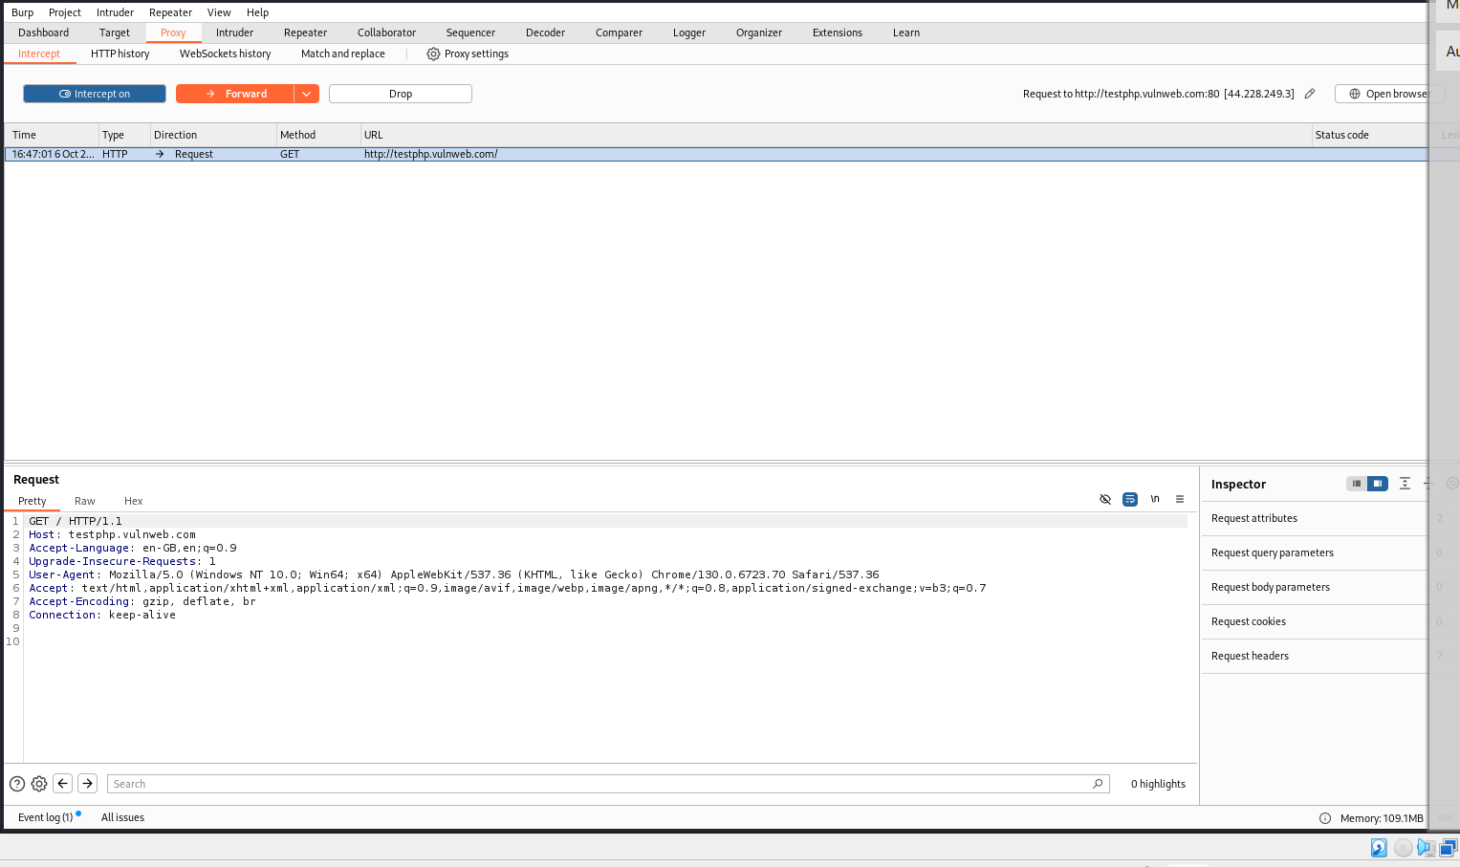
Burp Suite – Intercepting HTTP Requests
• Burp Suite Community Edition was configured using a temporary project.
• Proxy Intercept was enabled and the built-in browser was used.
• Request 1 captured: GET /
• Headers visible included Host, User-Agent, Accept, Accept-Encoding and Connection.
• The practical demonstrated how an intercepting proxy inspects browser-to-server requests.
DG Interns Hub | Week 5 | 5

Slide 6
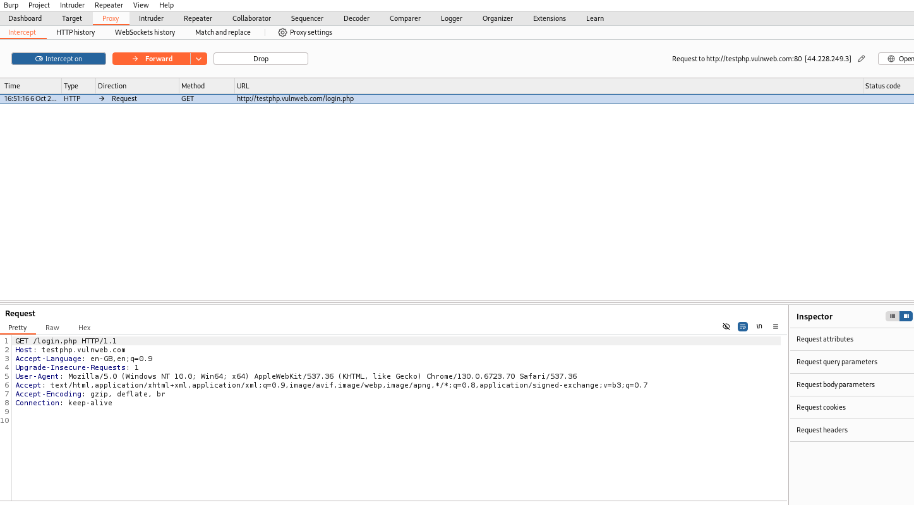
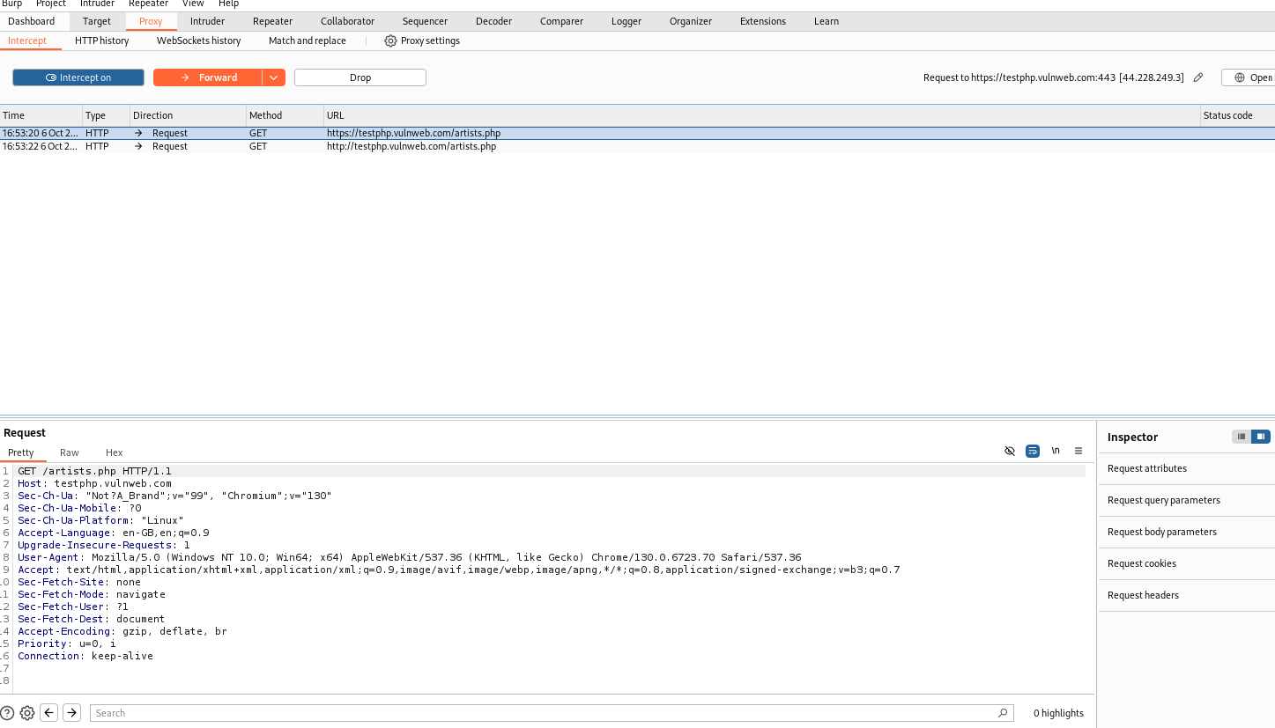
Burp Suite – Additional Requests
Captured: GET /login.php | GET /artists.php | Total practical evidence: 3 intercepted requests
DG Interns Hub | Week 5 | 6

Slide 7
Findings & Observations
• Finding 1: Nmap showed all 1000 default TCP ports as filtered/no-response.
• Finding 2: The target web service was unreachable during Nikto testing; cURL and Netcat independently confirmed timeouts.
• Finding 3: Burp Suite successfully exposed request paths and client HTTP headers through proxy interception.
• No confirmed exploitable vulnerability was claimed from the available evidence.
• Key lesson: scanner output must be validated before it is reported as a vulnerability.
DG Interns Hub | Week 5 | 7

Slide 8
Conclusion & Learning Outcomes
• Nmap practical completed successfully.
• Nikto was correctly attempted, with connectivity limitation documented using evidence.
• Burp Suite practical completed with three captured HTTP requests.
• Learned port/service scanning, web-scan troubleshooting, proxy interception and HTTP header analysis.
• All testing was performed only on the internship-provided authorized target.
Thank You
DG Interns Hub | Week 5 | 8

