Slide 1
DG INTERNS HUB | CYBERSECURITY INTERNSHIP
WEEK 2
TECHNICAL PRESENTATION
Advanced Networking, Analysis & Security Concepts
NETWORK ANALYSIS
SECURITY
SAFE LABS
Wireshark
MITM / DoS / Sniffing
Nmap + Packet Tracer
Prepared by: Akash Sanuria
Week 2 Assignment | September 2026
DG Interns Hub | Cybersecurity Internship | Week 2
01

Slide 2
OVERVIEW
Assignment Scope
• Understand advanced networking concepts
• Analyze live traffic using Wireshark
• Perform authorized scanning using Nmap
• Build and test a LAN in Packet Tracer
• Understand MITM safely at concept level
TOOLS USED
Wireshark | Nmap | Cisco Packet Tracer
SAFETY & ETHICS
Only safe/allowed targets and local simulations were used. No real MITM interception attack was performed.
REPORT COVERAGE
Tasks 1-7: theory + practical evidence
DG Interns Hub | Cybersecurity Internship | Week 2
02

Slide 3
TASKS 01-03
Core Networking & Security Theory
PORTS & SERVICES
NETWORK DEVICES
SECURITY BASICS
Common TCP/UDP ports including SSH 22, DNS 53, HTTP 80, HTTPS 443, SMB 445 and other essential services.
Switch: same-LAN connectivity
Router: connects different networks
Firewall: enforces traffic security rules
MITM
DoS
Packet Sniffing
Prevention: HTTPS/TLS, secure networks, VPN, monitoring and access controls
DG Interns Hub | Cybersecurity Internship | Week 2
03

Slide 4
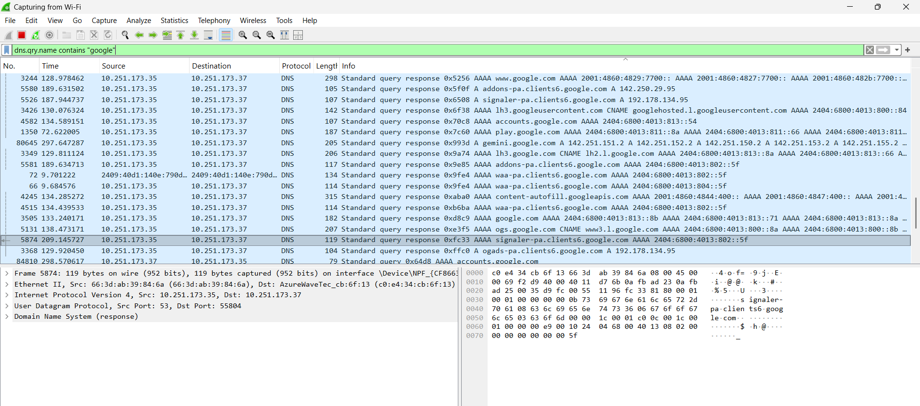
TASK 04
Packet Analysis with Wireshark
Live Wi-Fi traffic capture and protocol filtering
DNS ANALYSIS
Filtered Google-related DNS query/response traffic.
WHAT I IDENTIFIED
DNS traffic, source/destination IPs and protocol details.
LEARNING
Display filters help isolate relevant network conversations.
DG Interns Hub | Cybersecurity Internship | Week 2
04

Slide 5
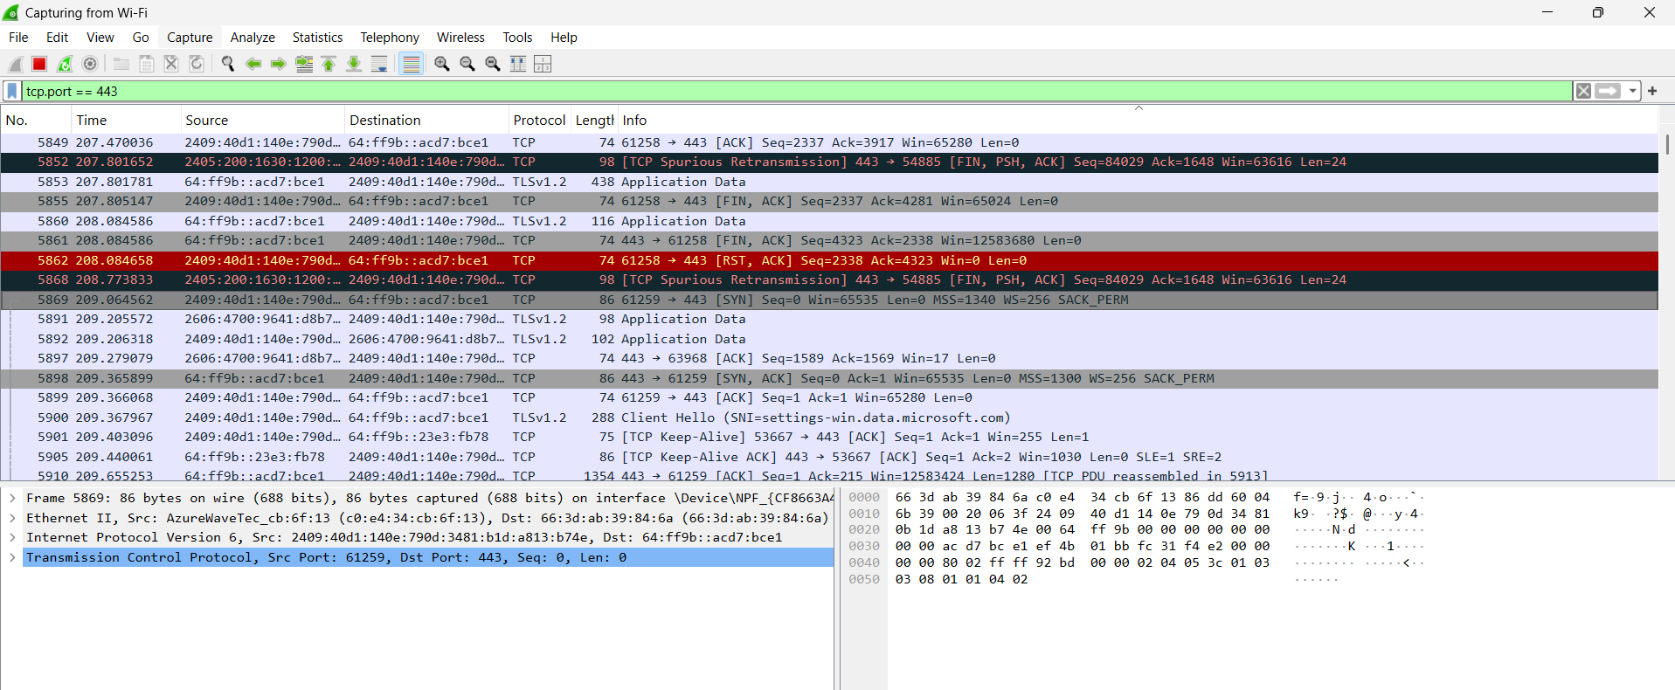
TASK 04
HTTPS / TLS Analysis
Filtering secure web traffic on TCP port 443
FILTER
tcp.port == 443
OBSERVED
TLSv1.2 application data and TCP connections using port 443.
RESULT
Source and destination addressing was visible at packet level.
DG Interns Hub | Cybersecurity Internship | Week 2
05

Slide 6
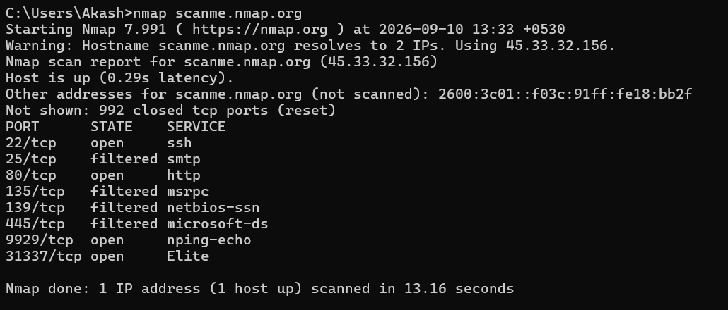
TASK 05
Nmap - Basic Network Scan
Safe target: scanme.nmap.org
COMMAND
nmap scanme.nmap.org
OPEN PORTS
22/tcp - SSH
80/tcp - HTTP
9929/tcp - nping-echo
31337/tcp - open
HOST STATUS
Host was up and reachable.
DG Interns Hub | Cybersecurity Internship | Week 2
06

Slide 7
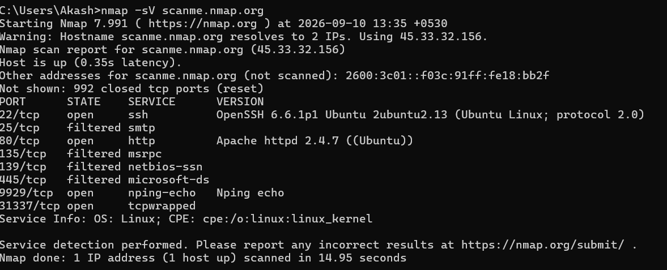
TASK 05
Nmap - Service & Version Detection
COMMAND
nmap -sV scanme.nmap.org
DETECTED
OpenSSH 6.6.1p1
Apache httpd 2.4.7
Nping echo
tcpwrapped
Linux service info
DG Interns Hub | Cybersecurity Internship | Week 2
07

Slide 8
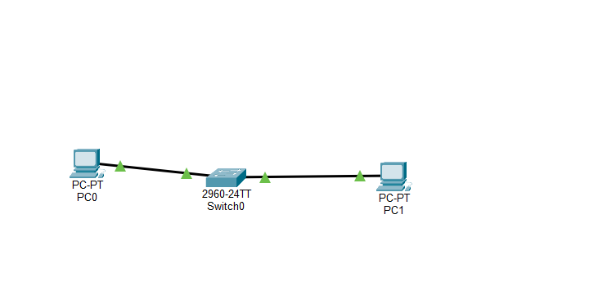
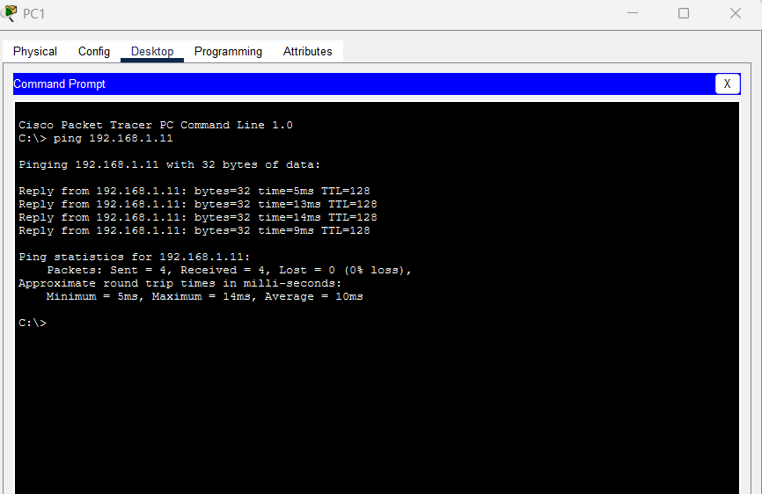
TASK 06
Cisco Packet Tracer - LAN Setup
IP CONFIGURATION
PC1: 192.168.1.10/24
PC2: 192.168.1.11/24
RESULT
4 packets sent, 4 received, 0% packet loss.
DG Interns Hub | Cybersecurity Internship | Week 2
08

Slide 9
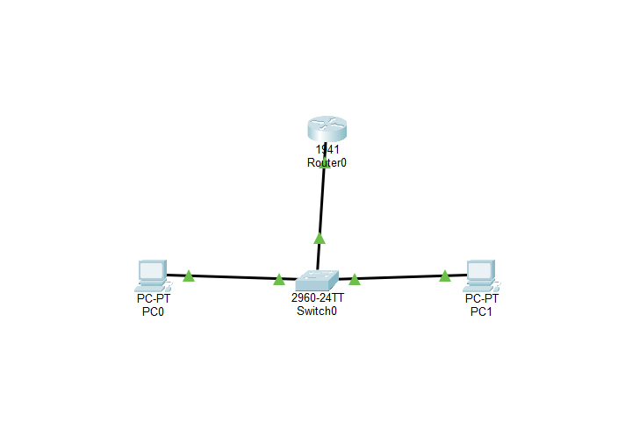
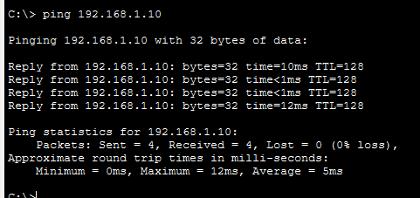
TASK 07
MITM Concept - Safe Simulation
CONCEPT
RISKS
PREVENTION
Attacker attempts to sit logically between victim and gateway/endpoint.
Data theft, credential exposure and session interception.
HTTPS/TLS, trusted VPN, secure networks and certificate verification.
DG Interns Hub | Cybersecurity Internship | Week 2
09

Slide 10
SUMMARY
Week 2 Learning Outcomes
WIRESHARK
NMAP
PACKET TRACER
Captured and filtered DNS and HTTPS/TLS traffic.
Identified open ports, services and versions on an authorized target.
Built a LAN, verified connectivity and modeled MITM safely.
• Improved understanding of how real network traffic looks
• Connected networking theory with practical cybersecurity tools
• Practiced safe and ethical network analysis
THANK YOU
DG Interns Hub | Cybersecurity Internship | Week 2
10

