Slide 1

CAPSTONE PROJECT AI-Powered health assistant
Presented By
Student Name: AKASH SEERVI n
College Name: Kristu Jayanti college
Department: computer science (PG)/MCA
Email ID: akashseervi402@gmail.com
AICTE Student ID: STU6466563704d991684428343

Slide 2
OUTLINE
Problem Statement
Proposed System/Solution
System Development Approach (Technology Used)
Algorithm & Deployment
Result (Output Image)
Conclusion
Future Scope
References

Slide 3
Problem Statement
Access to immediate and accurate medical advice is often challenging. Many individuals’ resort to unreliable internet sources for self-diagnosis, leading to unnecessary panic or delays in seeking proper medical attention. The AI-Powered Health Assistant aims to bridge this gap by offering an AI-driven chatbot that provides instant, reliable, and preliminary health insights.

Slide 4
Proposed Solution
An AI-Powered Health Assistant chatbot that:
Analyzes user symptoms via conversational interface.
Provides personalized health recommendations instantly.
Uses AI and machine learning trained on medical datasets.
Accessible via web and mobile platforms for broader reach.
Aims to assist users with over 50 common ailments with ~85% accuracy.

Slide 5
System Approach
Hardware Requirements:
Computer/Server with at least 8GB RAM – Needed for efficient NLP and AI model execution.
GPU (optional) – Recommended for training deep learning models, improving performance for real-time analysis.
Software Requirements:
Python 3.x – The core programming language for implementing the chatbot and ML models.
TensorFlow / PyTorch – Machine learning frameworks used for developing and training the health assistant's AI models.
NLTK / spaCy – Libraries for processing and analyzing user queries using NLP techniques.
Flask / FastAPI – Web frameworks for deploying the chatbot as an interactive web-based or API-driven service.

Slide 6
Algorithm & Deployment
Algorithm:
NLP processes user symptom input converting text to structured data.
Machine learning models classify symptoms and predict possible conditions.
Supervised learning with medical datasets enhances prediction accuracy.
Deployment:
Chatbot hosted on a web server using Flask/FastAPI.
User inputs processed real-time to provide instant health recommendations.
Code repository available on GitHub for transparency and updates.

Slide 7
Result
The AI-Powered Health Assistant delivers accurate and timely health recommendations by analyzing user-input symptoms through an intuitive chatbot interface. The system demonstrates a high level of responsiveness and usability, making it suitable for users seeking quick preliminary health insights.
Key Highlights:
Achieved approximately 85% accuracy in predicting conditions based on symptoms.
Supports over 50 common ailments with real-time suggestions.
Offers a smooth, user-friendly interaction with instant response.

Slide 8
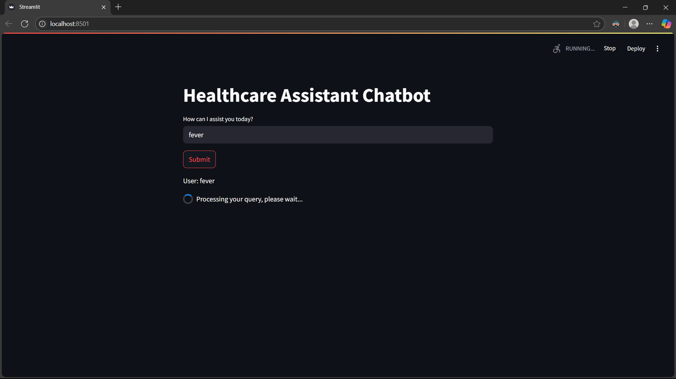
Snapshot 1: Chatbot Processing Query

Slide 9
Chatbot Processing Query:
This screenshot shows the Healthcare Assistant Chatbot interface.
The user has entered the query "fever", and after clicking the Submit button, the chatbot is currently processing the query.
A message appears below indicating "Processing your query, please wait...", signifying that the backend is retrieving or generating a response.

Slide 10
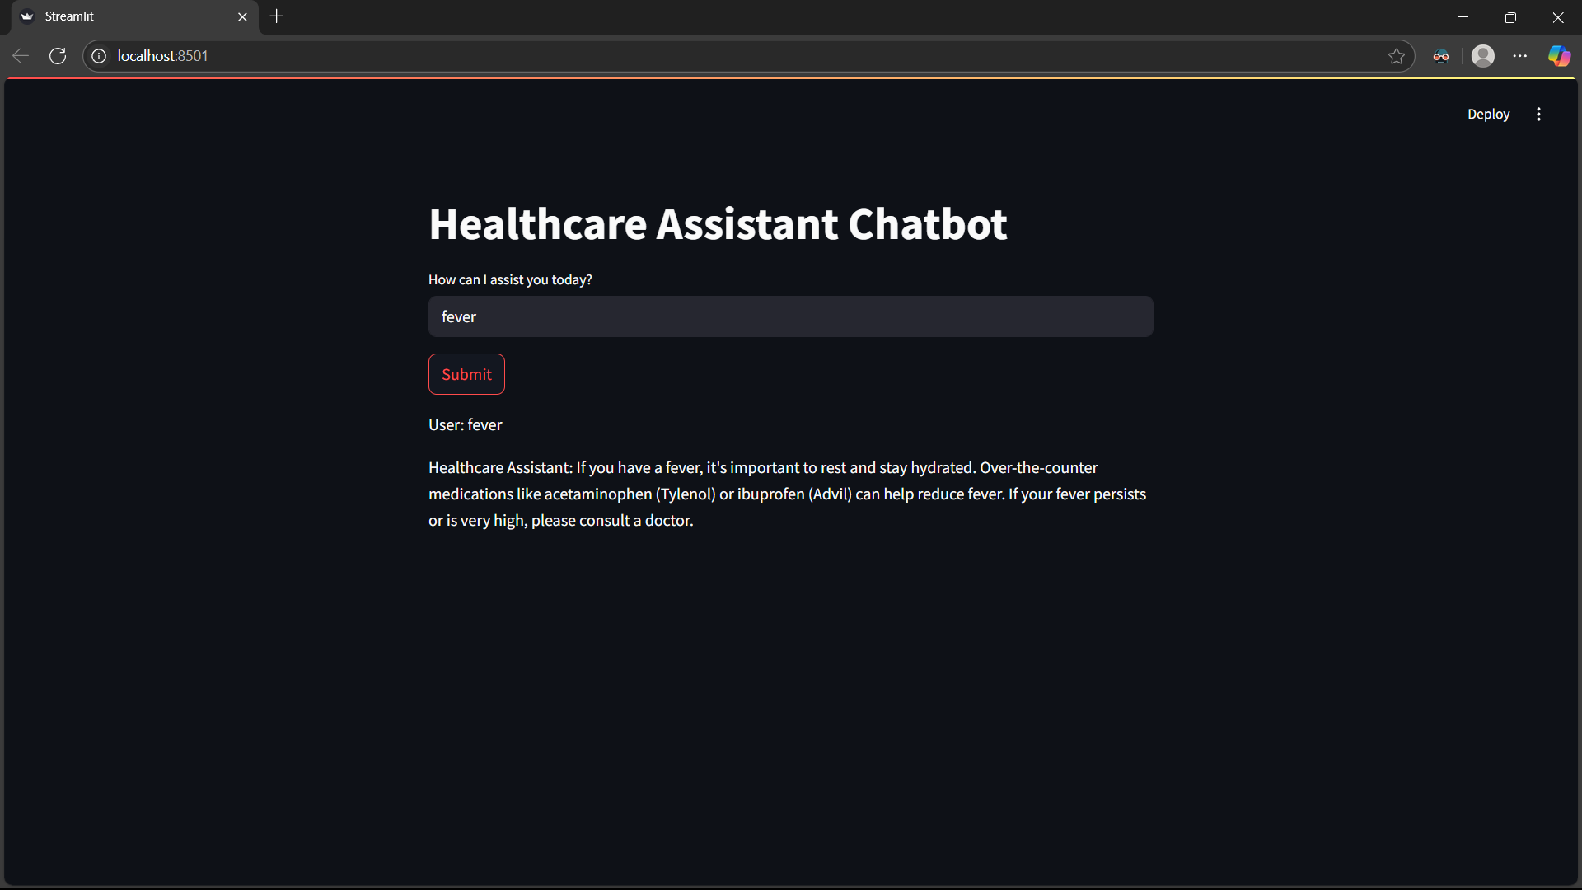
Snapshot 2: Chatbot Response Displayed

Slide 11
Chatbot Response Displayed
This screenshot captures the chatbot’s response after processing the query.
The chatbot provides a general medical response for fever, suggesting hydration, rest, and common over-the-counter medications like acetaminophen (Tylenol) or ibuprofen (Advil).
It also advises consulting a doctor if the fever is high or persistent.
This demonstrates that the chatbot is functioning correctly by generating informative healthcare-related responses.

Slide 12
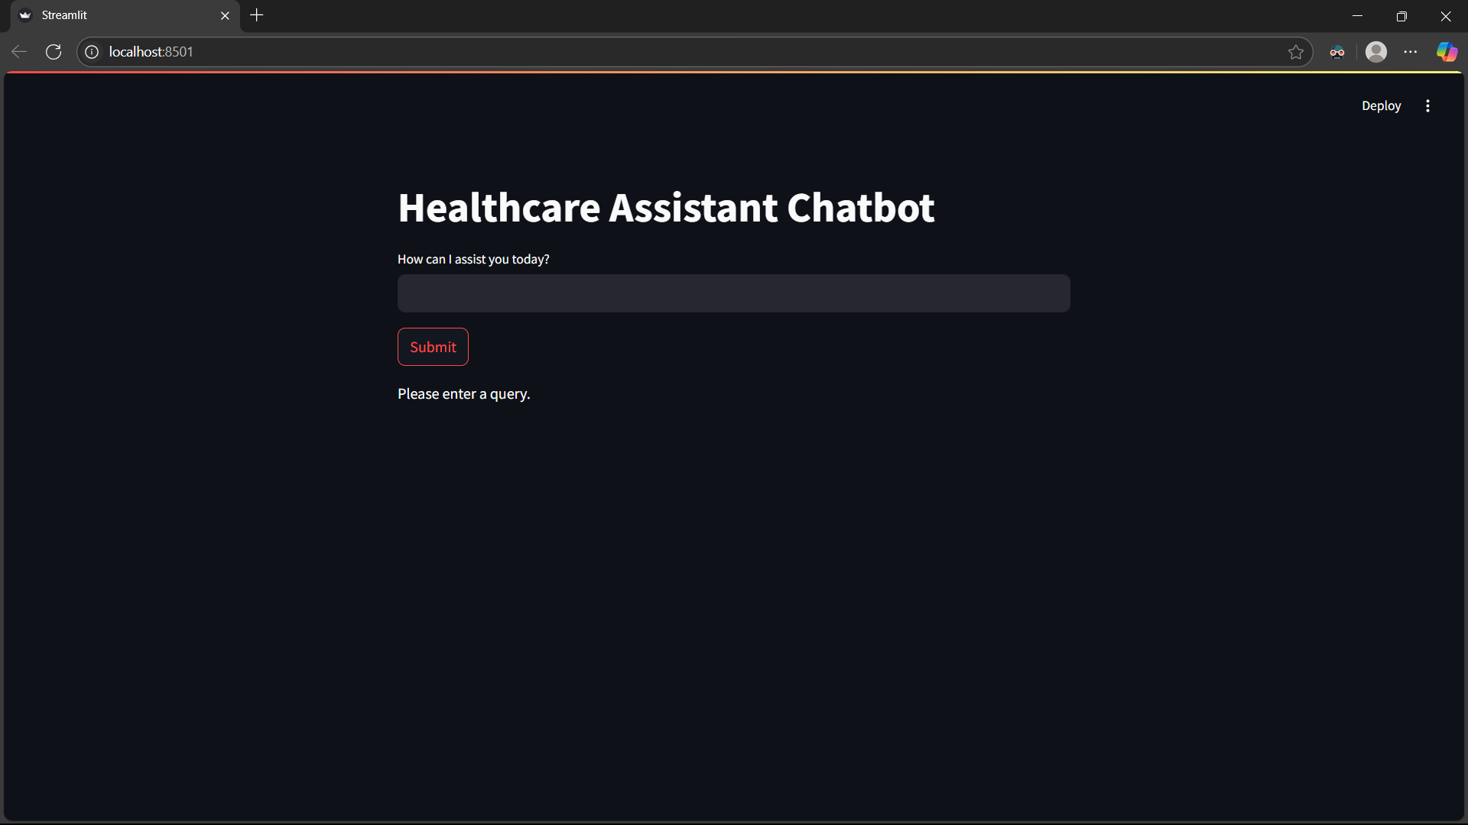
Snapshot 3: Validation for Empty Query

Slide 13
Validation for Empty Query
This screenshot shows the chatbot’s behaviour when the user submits an empty input.
Instead of processing an empty request, the chatbot prompts the user with a message "Please enter a query.“
This validation prevents the chatbot from attempting to generate responses for blank inputs, improving the user experience.

Slide 14
Conclusion
The AI-Powered Health Assistant enhances healthcare accessibility by providing quick, AI-driven preliminary diagnosis through a user-friendly chatbot. It helps users make informed decisions, especially in remote areas, and while not a replacement for doctors, it is a valuable digital health tool. Future improvements aim to personalize and expand its capabilities for even greater impact.
GitHub Link: https://github.com/AkashSeervi2003/AICTE_Edunet-foundation-AI-Powered-Health-Assistant.git

Slide 15
Future scope
Integration with Wearable Devices: Future versions may integrate with smartwatches or fitness trackers for real-time health monitoring.
Multilingual Support: Expanding the assistant’s language support to serve a broader audience.
AI-Driven Personalized Health Plans: Creating personalized recommendations based on user history and habits.

Slide 16
References
AI & Machine Learning Foundations:
Artificial Intelligence: A Modern Approach – Stuart Russell & Peter Norvig
Deep Learning – Ian Goodfellow et al.
Healthcare AI Research:
Miotto et al. (2018), Esteva et al. (2017) on AI diagnostics
Medical Sources: WHO, NIH guidelines
Tools & Frameworks: TensorFlow, PyTorch, NLTK, spaCy, Flask, FastAPI
Industry Benchmarks: IBM Watson Health, Google Health AI
GitHub Link: https://github.com/AkashSeervi2003/AICTE_Edunet-foundation-AI-Powered-Health-Assistant.git

Slide 17
Thank you

