Slide 1
C PROGRAM ON REAL ESTATE ADVISOR
By:Akash v poojary
Akash shetty
Dhanush
Karthik
Karthik Shettigar

Slide 2



Introduction
This C program is a Real Estate Advisor system that allows both administrators and users to interact with a property database. The program features functionalities such as displaying available properties, inserting new properties, deleting properties, searching for properties, buying properties, selling properties, and more.

Slide 3
Features:
Here's a brief overview of the key components and functionalities of the program:
1)Admin and User Modes: The program offers two modes of operation: admin and user. Users can choose their mode based on their login type (admin or user).
2)Admin Mode: In admin mode, administrators can perform various tasks, including displaying all properties, inserting new properties, deleting properties, searching for properties, and modifying property details. Admins need to enter a password (e.g., 1234) for authentication.
3)User Mode: In user mode, regular users can view available properties, search for properties based on location, buy properties, sell properties from their list of owned properties, and display the properties they own.3

Slide 4
4)Property Database: The program maintains a property database stored in text files (techpro.txt for available properties and user.txt for owned properties). Property details include an ID, type, location, and price.
5)Purse: The program keeps track of a user's purse balance, allowing users to buy properties if they have sufficient funds and earn money by selling properties.
6)Data Handling: File handling is used to read and write property data from/to files. Temporary files are also employed for various operations like buying and selling properties.
The program provides a user-friendly menu-based interface for performing these real estate-related tasks in both admin and user modes.

Slide 5
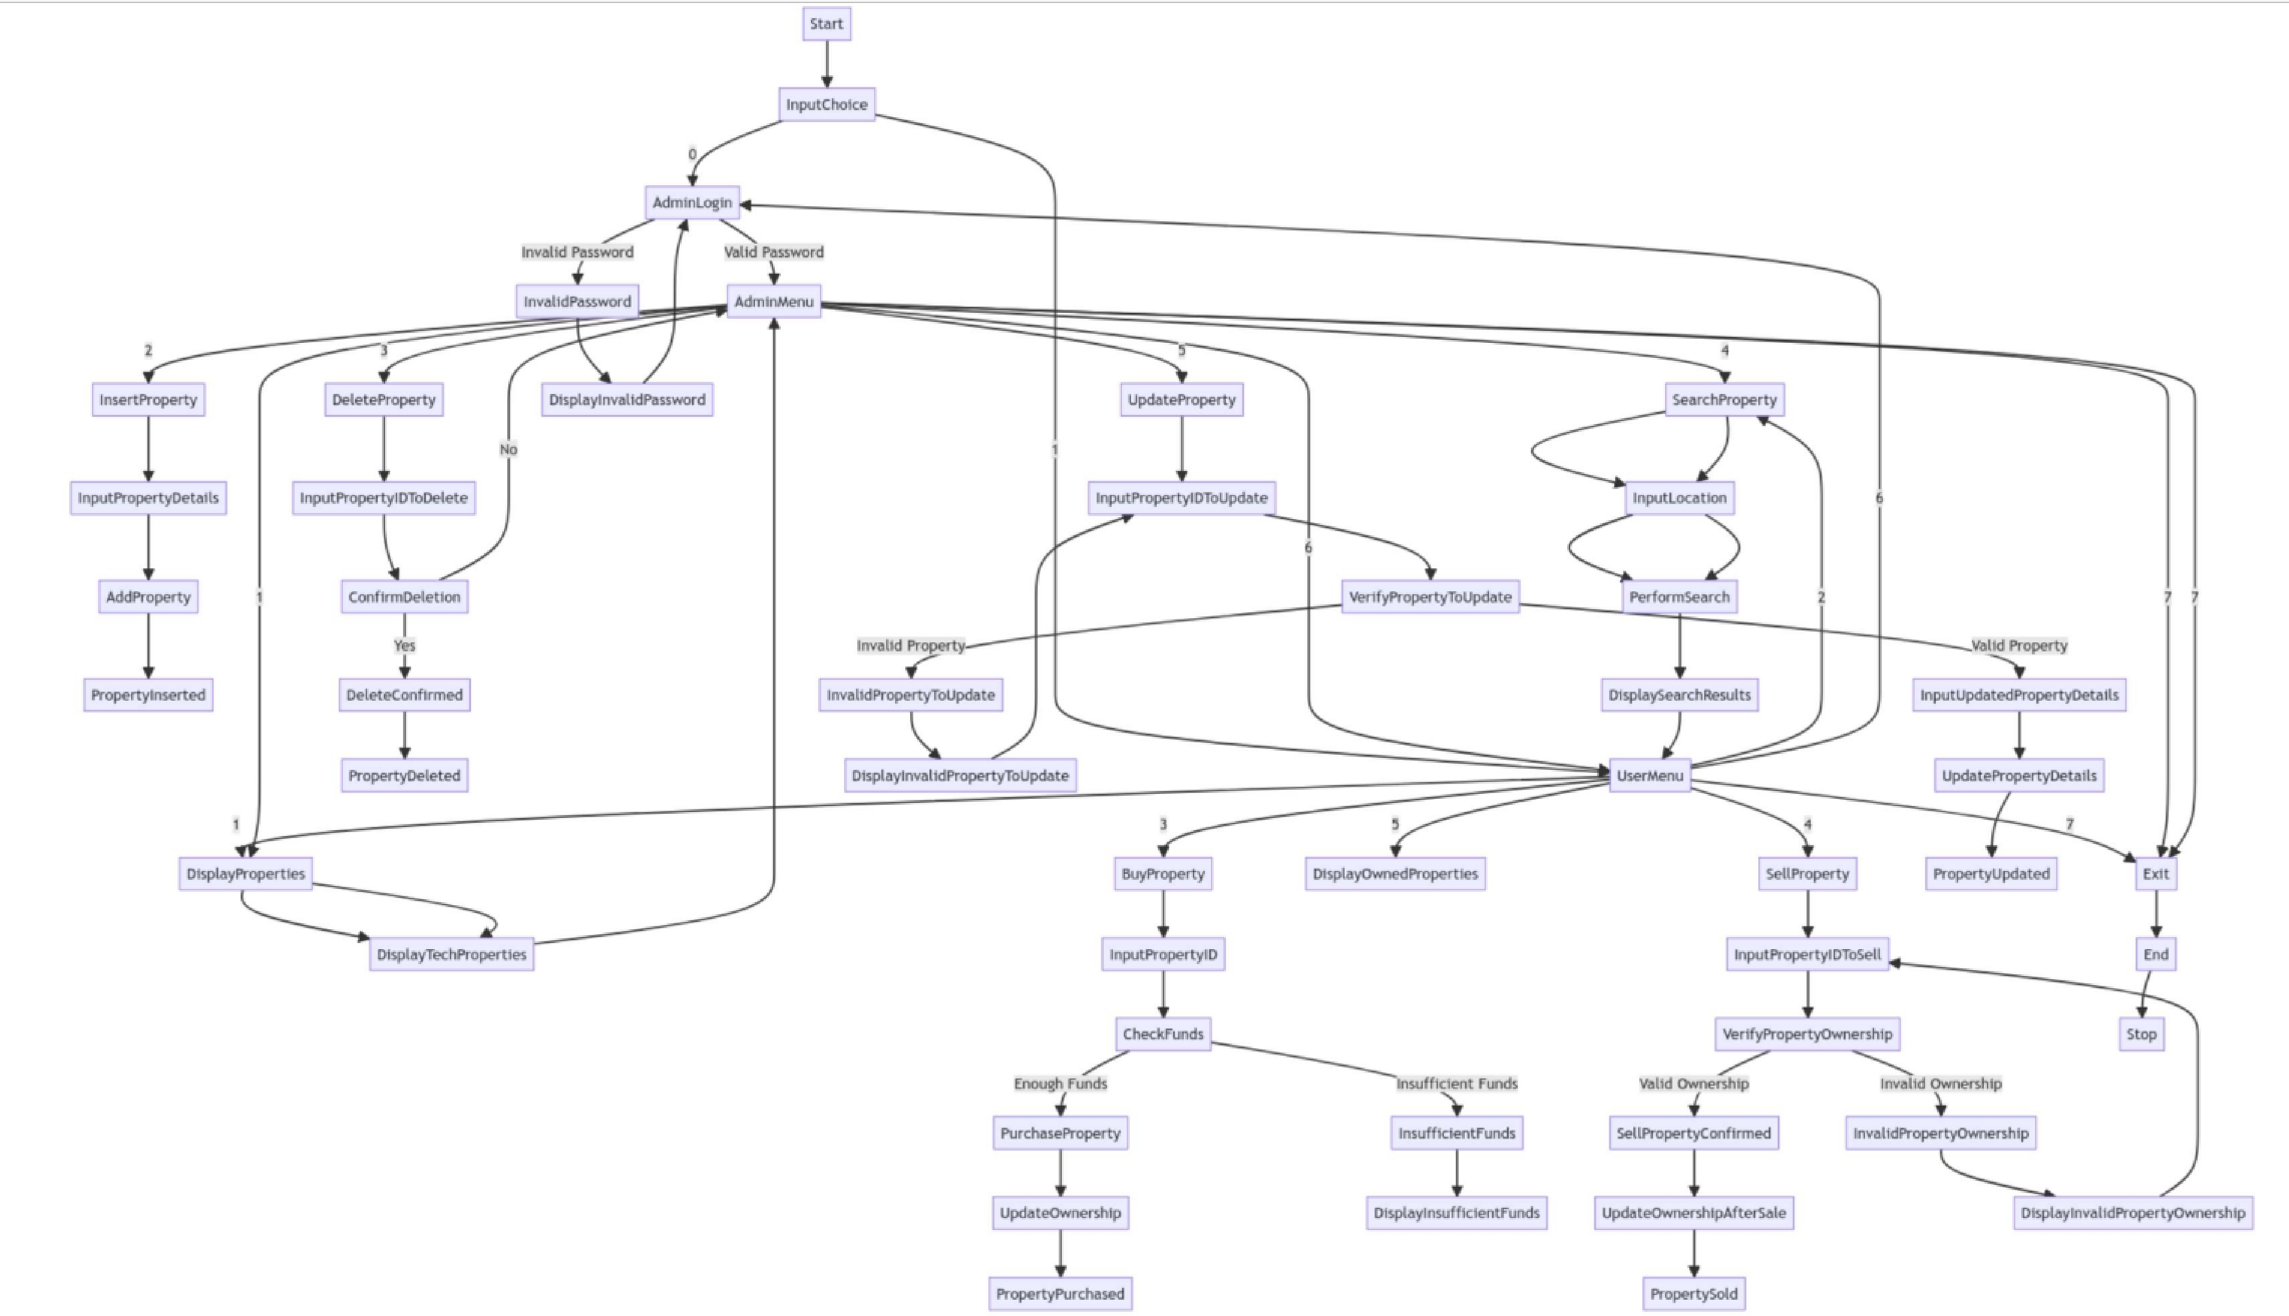
Flowchart

Slide 6
Outcomes
key outcomes and features of this program:
User Authentication: The program starts by asking the user to choose between admin and user modes. Admins must enter a password (1234) for access.
Admin Functionality: In admin mode, administrators can manage the property database. They can display, insert, delete, search for, and modify property records.
User Functionality: In user mode, regular users can interact with the property database. They can view all available properties, search for properties by location, buy properties (if they have enough funds), sell properties they own, and view their owned properties.
Property Database: The program maintains property records with attributes such as ID, type, location, and price. Available properties are stored in the "techpro.txt" file, while user-owned properties are stored in the "user.txt" file.

Slide 7
Financial Tracking: Users have a virtual purse with an initial balance of 100,000 units of currency. When users buy properties, their purse balance is updated, and they can earn money by selling properties.
Data Handling: The program employs file handling to read and write property data to and from text files. Temporary files are used for operations like buying and selling properties.
User-Friendly Interface: Both admin and user modes offer a menu-driven interface that simplifies property management tasks.
Mode Switching: Users can switch between admin and user modes as needed during the program's execution.
Error Handling: The program includes error handling for cases where files cannot be found or opened.
Flexibility: This code provides a foundational structure for a real estate management system that can be extended and customized to meet specific requirements or enhanced with additional features.

Slide 8
CONCLUSION:
The provided C program offers a simple yet effective Real Estate Advisor system with distinct admin and user modes. It allows users to manage property-related tasks efficiently, maintaining property records, financial balances, and offering various operations.
In essence, this code provides a functional real estate management system suitable for educational purposes or as a starting point for more advanced property management software development. Its user-centric design and fundamental features make it accessible and adaptable to various scenarios.

Slide 9
Thank you

