Slide 1
Emerging Business Opportunities
Springboard Training Project
TEAM 8
SANDEEP KUMAR KAIRAMKONDA AKASH SHINDE GOKUL RAM
Confidential
27-05-2922

Slide 2
OBJECTIVES
● Understanding Customer preferences
● Computing clients market share
● Identifying potential competitors for our client
● Point out the emerging themes
● Understanding the effect of various parameters on the sales
● Build a model to predict future sales
● Suggestions to improve the sales of client

Slide 3
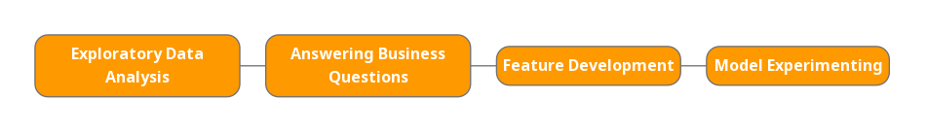
ROUTE TO MODELING
Exploratory data analysis
Answering business questions.
Feature development
Model experimenting.
The time granularity considered by default is from 2014-19 unless mentioned otherwise.

Slide 4
01
EXPLORATORY DATA ANALYSIS

Slide 5
Analysis of DataSets
Social media dataset is missing 40% of the values in theme id column.
No duplicate values are present in any of the datasets.
Outliers are more prominent when compared to other anomalies in the datasets.
In sales data we have values exceeding the normal in terms of all types of sales values.
In social media dataset providing information about the number of posts, show some time spans with abnormal values.
Regarding google search data, the amount of people searching about a claim is abnormally high during some time spans.

Slide 6
02
ANSWERING BUSINESS QUESTIONS

Slide 7
List of Themes across DataSets
Google Search DataSet
Social Media DataSet
Sales DataSet
There are 160 unique themes mentioned in google search dataset.
Among those, ethical - environment, shrimp, sugar free, honey, health (passive) are the top themes in terms of the search volume over the time span of 2014-19.
The social media dataset has 193 unique themes.
The most prominent among them being health (passive), boar, rabbit, probiotic, pumpkin respectively.
This contains 49 unique themes.
Here the products which doesn’t belong to any theme performed well.
The others following closely are low carb, low carb, no additives/ preservatives, stroganoff, apple cinnamon.

Slide 8
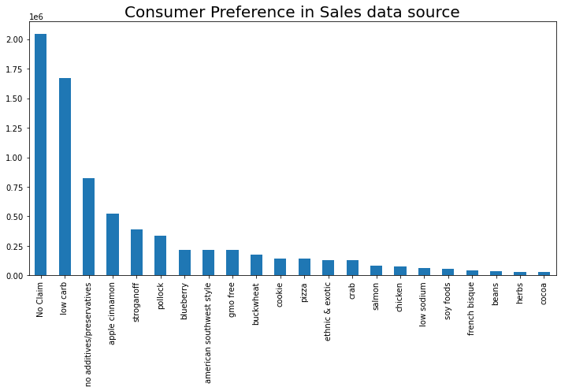
Customer Preference according to Sales data

Slide 9
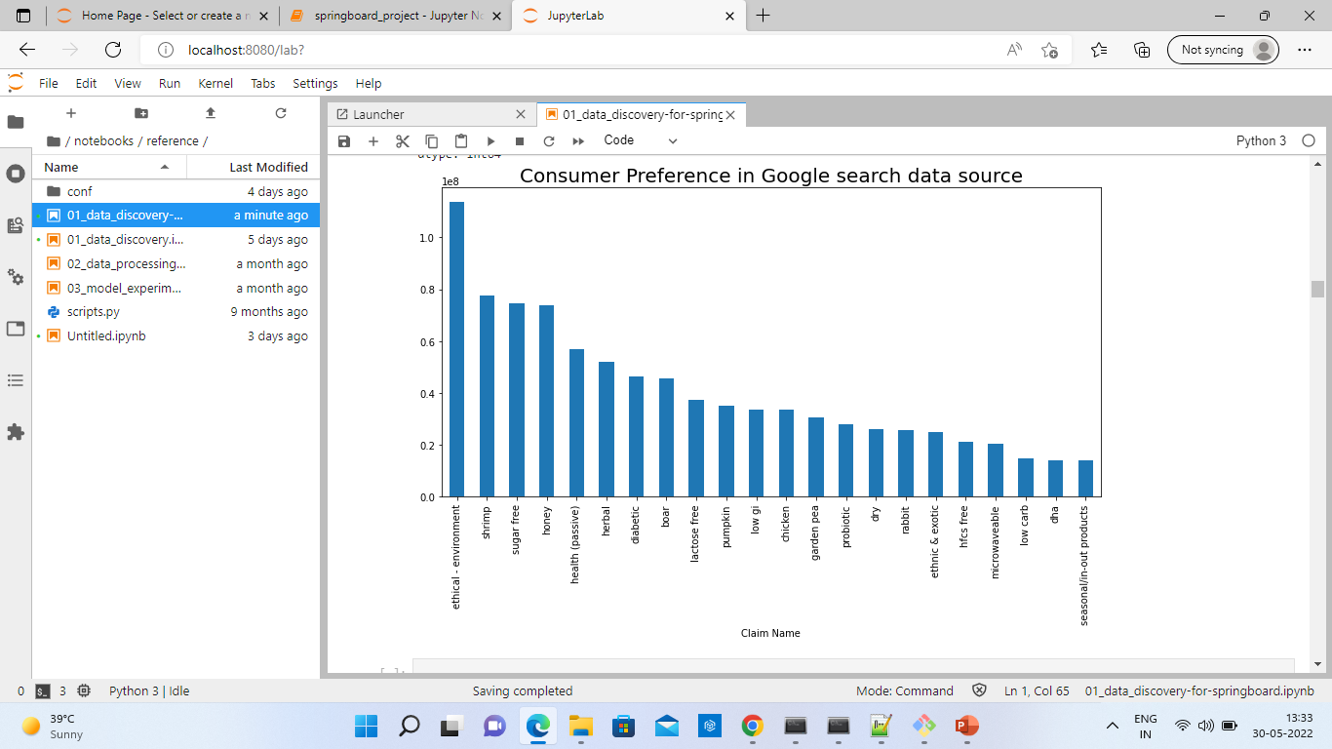
Customer Preference according to Google_search data

Slide 10
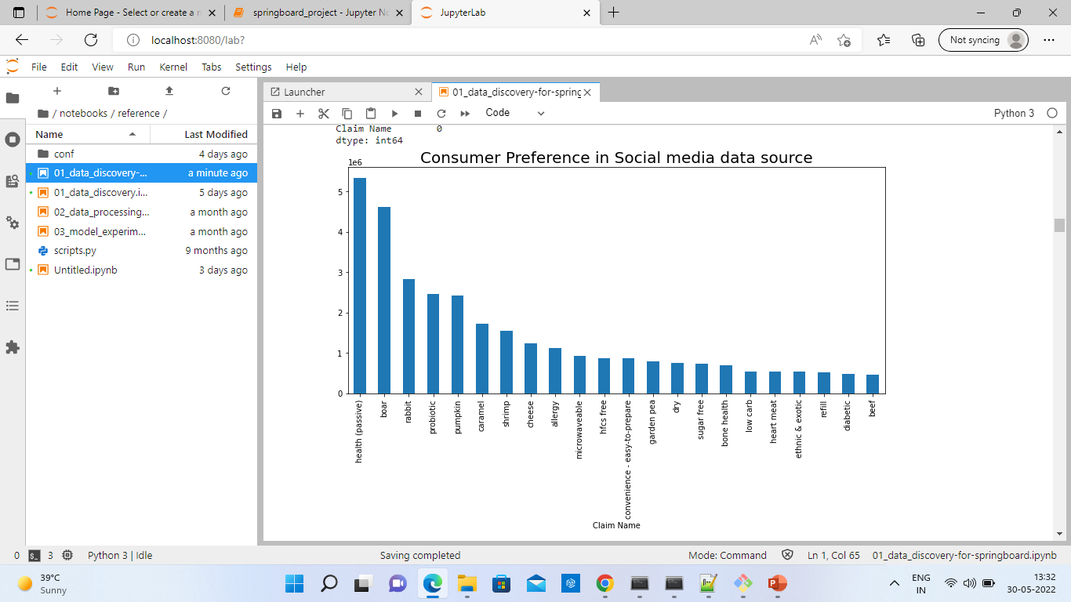
Customer Preference according to Social media data

Slide 11
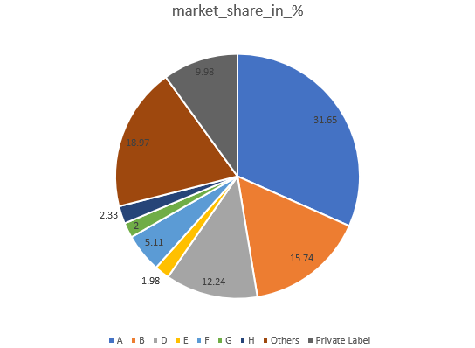
Overall market share of our client

Slide 12
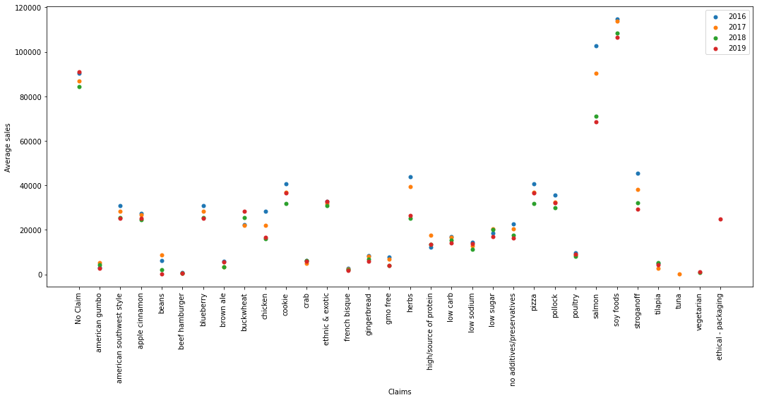
Year wise Average Sales for Client A

Slide 13
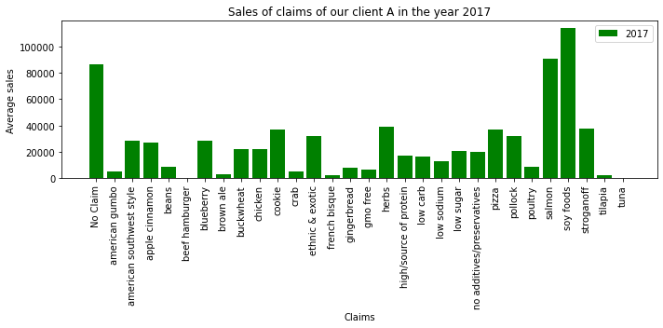
Average Sales of Client A

Slide 14
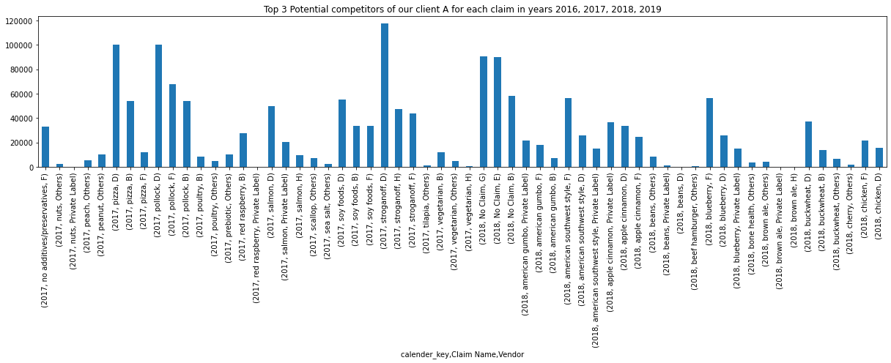
Potential competitors in each theme

Slide 15
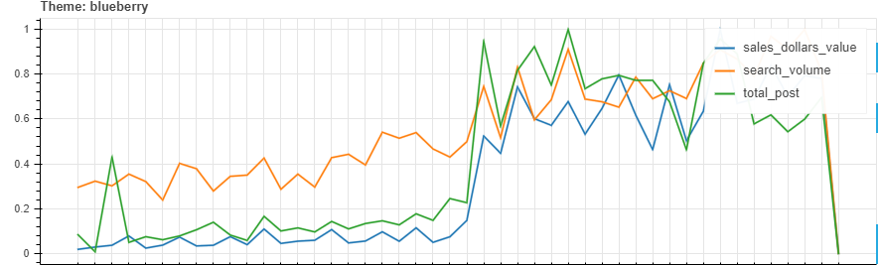
Trend flows from Social -> Search -> Sales

Slide 16
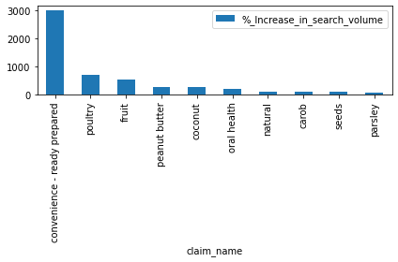
Emerging themes In Google Search Data(2018-2019)

Slide 17
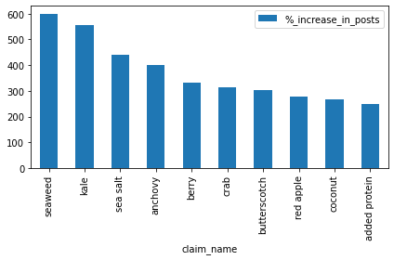
Emerging themes In Social Data(2018-2019)

Slide 18
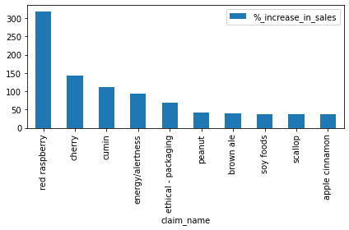
Emerging themes in Sales Data(2018-2019)

Slide 19
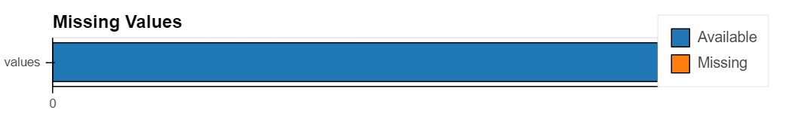
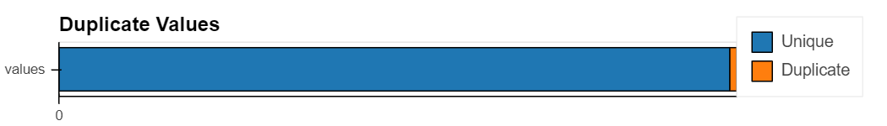
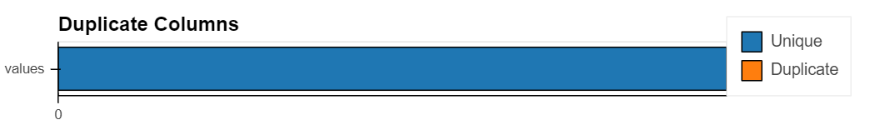
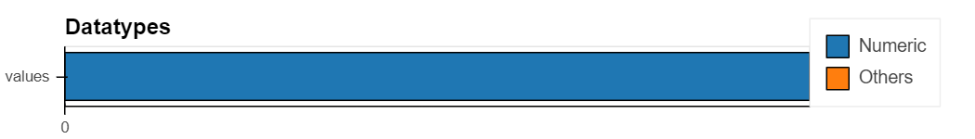
Data health summary for the Final Dataset for model building

Slide 20
Model Performance Metrics (Client A)
Linear Regression
XGBoost
 | test | train
MAE | 33804.24 | 33801.35
score | 74.031 | 74.586
RMSE | 63373.90 | 63607.57
R^2 | 0.7496 | 0.7442
 | test | train
MAE | 33698.32 | 33698.004
score | 75.18 | 74.52
RMSE | 63422.58 | 63662.404
R^2 | 0.7492 | 0.7437

Slide 21
Model Performance Metrics (with all vendors)
Linear Regression
XGBoost
 | test | train
MAE | 14933.45 | 14929.44
MAPE | 61.0366 | 58.8649
RMSE | 36708.15 | 36708.015
R^2 | 0.703 | 0.707
 | test | train
MAE | 14789.61 | 14793.445
MAPE | 180.1426 | 175.6427
RMSE | 36716.138 | 36765.805
R^2 | 0.703 | 0.707

Slide 22
Thank You
Do you have any questions?
Name
addyouremail@tigeranalytics.com
Add you phone number

