Slide 1

Government of India
Ministry of Social Justice & Empowerment
Department of Social Justice & Empowerment
How Citizens Find Schemes
Ten options for four parts of the website.
MoSJE Design Research · September 2026
Notes:
Presented live. The order is the one asked for on 8 September: the idea behind every option first, then the home page, then the menu, then the Schemes page, then the assistant, then what has to come first. The menu was added on 14 September. Only Schemes page Option C shows scheme counts, one on each heading; that was decided on 14 September. Every other option shows none.

Slide 2
ONE IDEA BEHIND EVERY OPTION
Who You Are. What You Need.
Every option for finding a scheme is built on these two lists.
Who Is Looking for Support
What the Department Provides
Students
Scholarships and Fellowships
Scheduled Castes
Residential Schools, Hostels and Coaching
Other Backward Classes
Loans and Credit
De-notified, Nomadic and Semi-Nomadic Tribes
Skill Training and Livelihood
Safai Karamcharis
Care, Shelter and Health
Senior Citizens
De-addiction and Counselling
Transgender Persons
Protection, Relief and Grievance
Persons Affected by Substance Use
Grants to Voluntary Organisations
Persons Engaged in Begging
Housing and Settlement
Victims of Atrocities
Awards and Recognition
Voluntary Organisations
Notes:
The one idea. On the left, the person: the groups the Department's own mandate names, plus the three its schemes name — students, victims of atrocities, and the voluntary organisations it funds. On the right, what the Department gives, in its own words. A scheme is findable under every group it names and every kind of support it provides, at once. Everything that follows is a view over these two lists. Not stage of life, not State: the review cut those, and a scheme record is tagged on these two axes only.

Slide 3
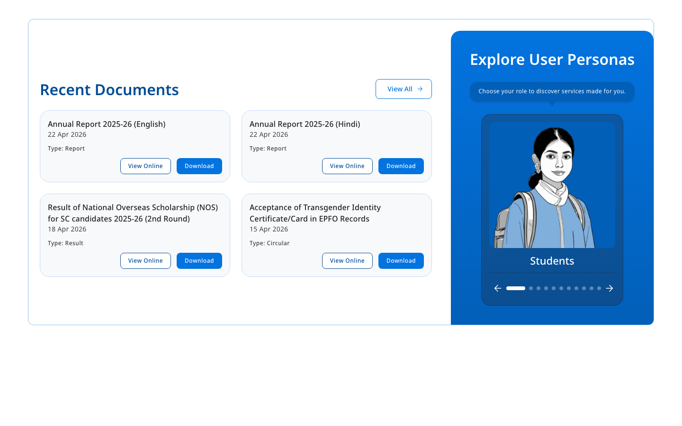
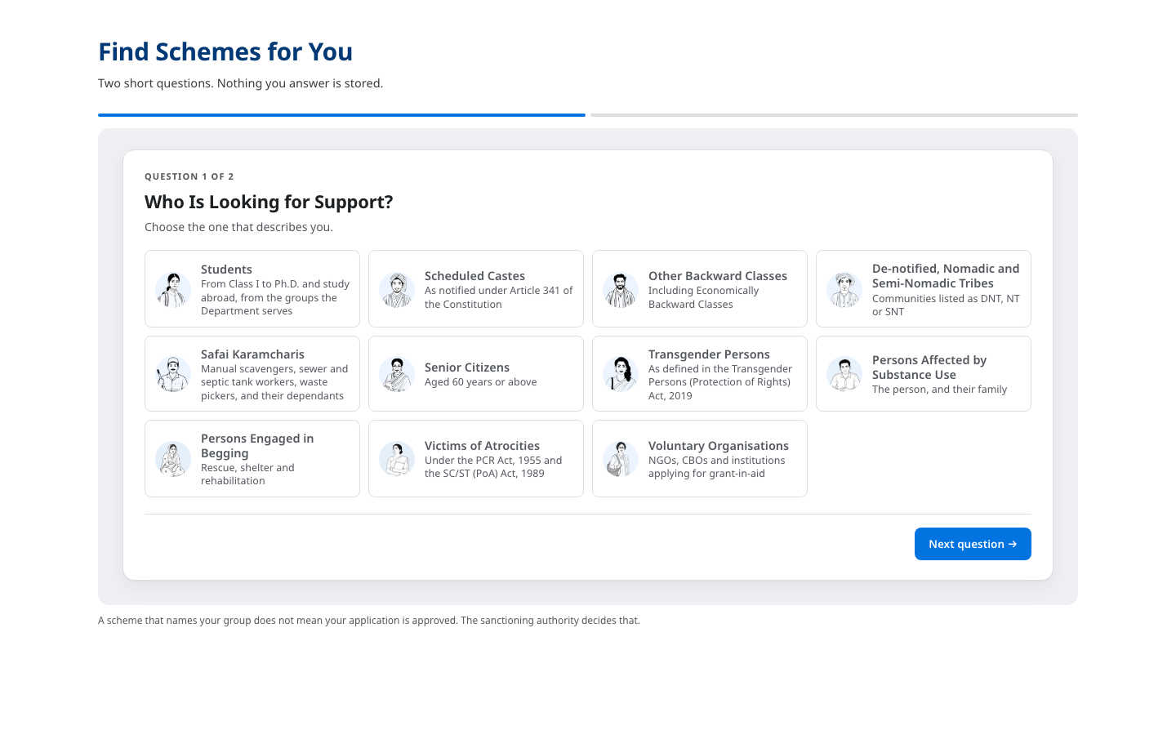
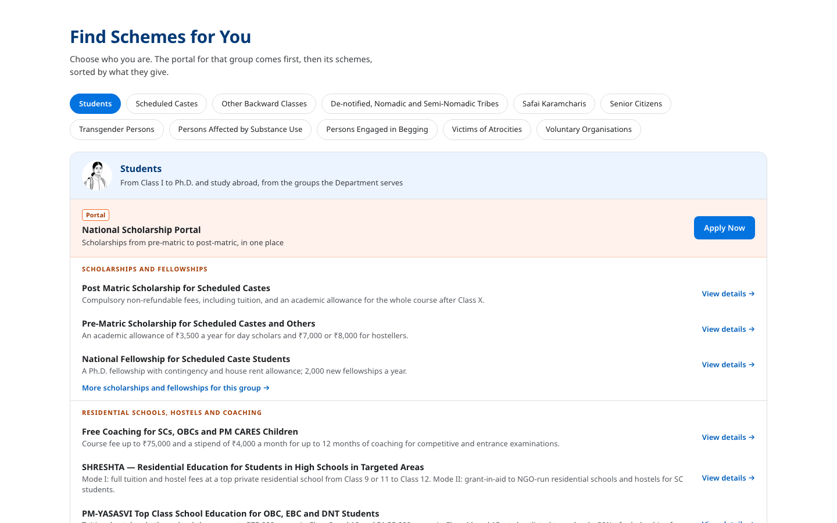
THE HOME PAGE
Three Options
A is on the site today. B or C would take the section below the banner, where Our Offerings sits now.
A
Explore User Personas
B
Two Questions
C
One Tap
ON THE SITE TODAY
OPTION B
OPTION C
One group at a time. Kept as it is.
Who you are, then what you need. Ends with the schemes and a link to see them all.
Pick your group. First the portal for that group, then its schemes.
B and C take the place of Our Offerings, so the page does not get longer.
Notes:
Three options for the home page. A stays where it is. B or C takes the section below the banner. C is for the visitor who will not answer questions. The next three pages show each one being used.

Slide 4
EXPLORE USER PERSONAS
The Home Page · Option A of 3
ON THE SITE TODAY
WHAT IT IS
The panel already on the home page. It shows one group at a time, and you move between them with the arrows.
HOW IT WORKS
Tap the arrows to move between the groups
Tap a group to open the Schemes page for that group
WHY IT HELPS
The smallest change: only the link behind each picture is new
The pictures work in any language
Notes:
The panel already on the home page: one group at a time, moved with arrows. The list of groups is the same eleven the other options use, in the same order. Today, choosing a group filters nothing on the Schemes page; every option fixes that.

Slide 5
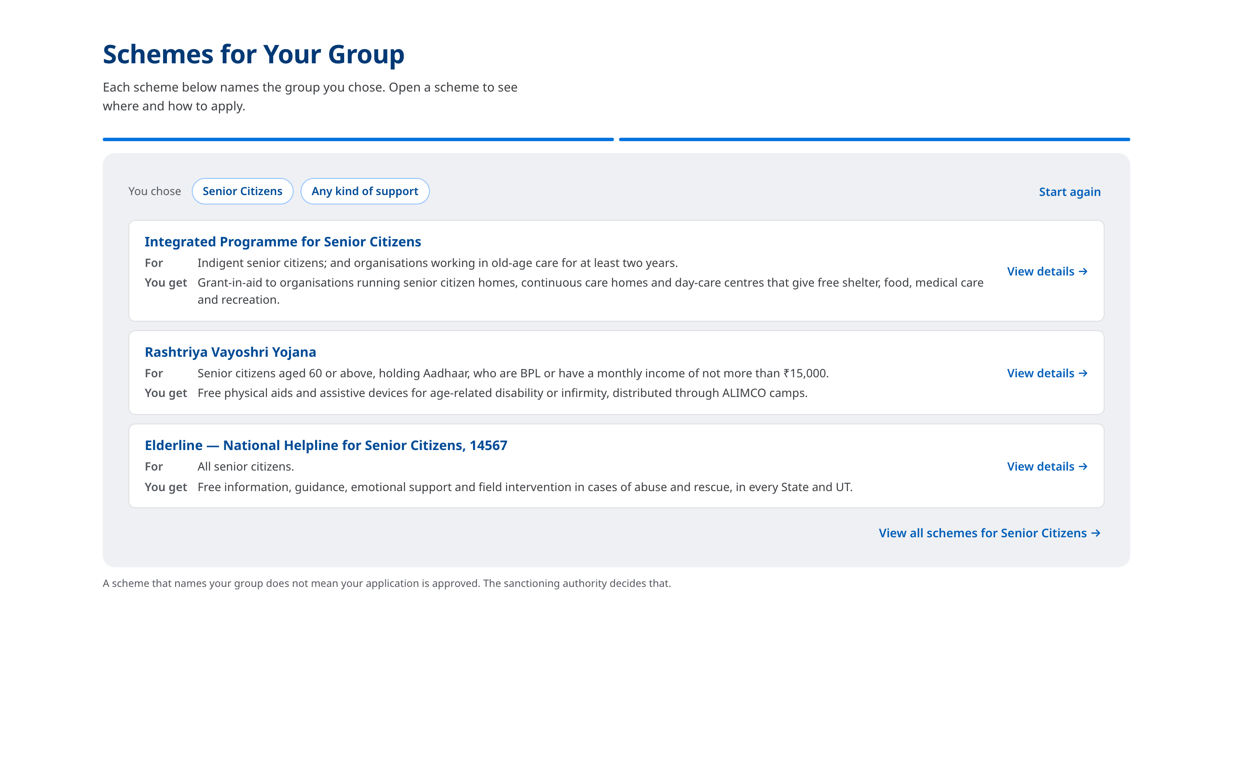
TWO QUESTIONS
The Home Page · Option B of 3
TO BE BUILT
WHAT IT IS
Two short questions on the home page: who you are, and what kind of support you need.
HOW IT WORKS
Question 2 can be skipped, which shows everything for the group
The answer shows three schemes, each with a link to its own page
One more link opens the Schemes page, already filtered to the same two answers
WHY IT HELPS
Both questions change what you see; nothing is asked for its own sake
A visitor gets an answer without leaving the home page
▶ Recorded: Scheduled Castes, then Scholarships. Then Senior Citizens with the second question skipped.
Notes:
Two short questions over the Department's own list of schemes. The second may be skipped, which widens the list. The answer shows both choices, three schemes, and a link to the Schemes page filtered to the same choices. There is no apply button here: the scheme's own page says where to apply. Before this can be built, every scheme has to be tagged on both lists; that is on the page near the end. Press play: it is a real page being used, not an animation.

Slide 6
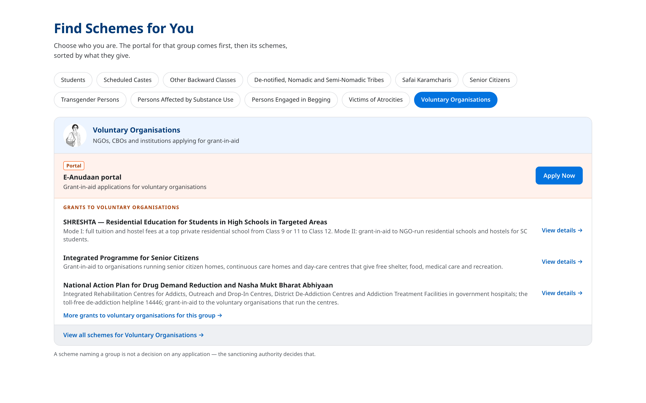
ONE TAP
The Home Page · Option C of 3
TO BE BUILT
WHAT IT IS
A row of the groups. Pick yours and the schemes appear. No questions asked.
HOW IT WORKS
The first band is the portal or helpline the Department runs for that group
Below it, the schemes for the group, sorted by what they give
Each scheme links to its page, and one link opens the full list
WHY IT HELPS
One tap and nothing to answer
The portal a group already uses comes first
▶ Recorded: Scheduled Castes, Senior Citizens, Transgender Persons, Voluntary Organisations. One tap each.
Notes:
A row of the groups. Tapping one shows the portal or helpline for that group first, where the Department has one, then the schemes that name the group, sorted by what they give. Each links to its own page. The larger groups get long lists, which is why the list is cut at three per kind of support with a link to the rest. Press play: it is a real page being used, not an animation.

Slide 7
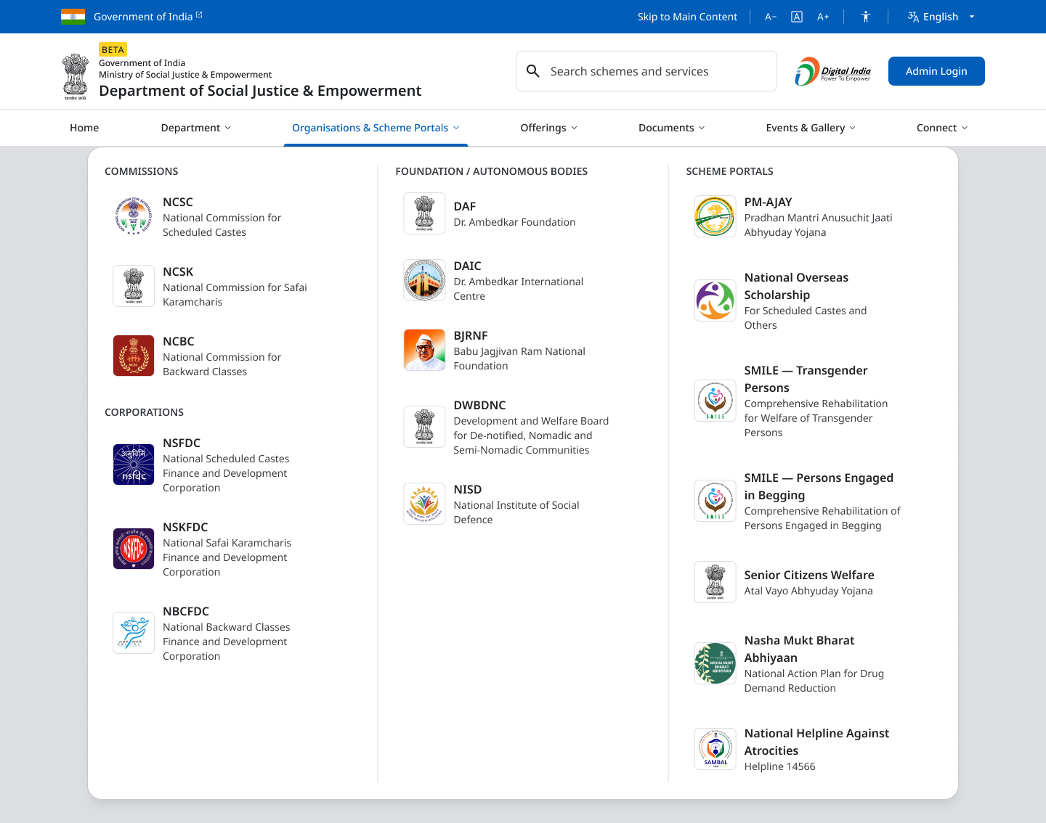
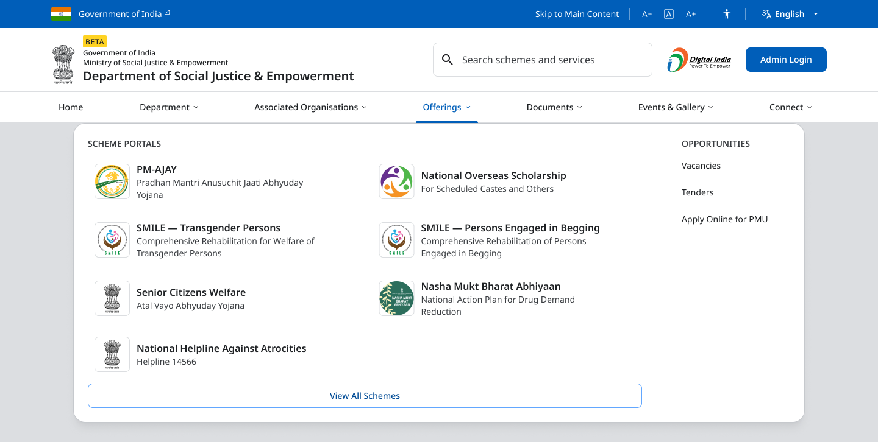
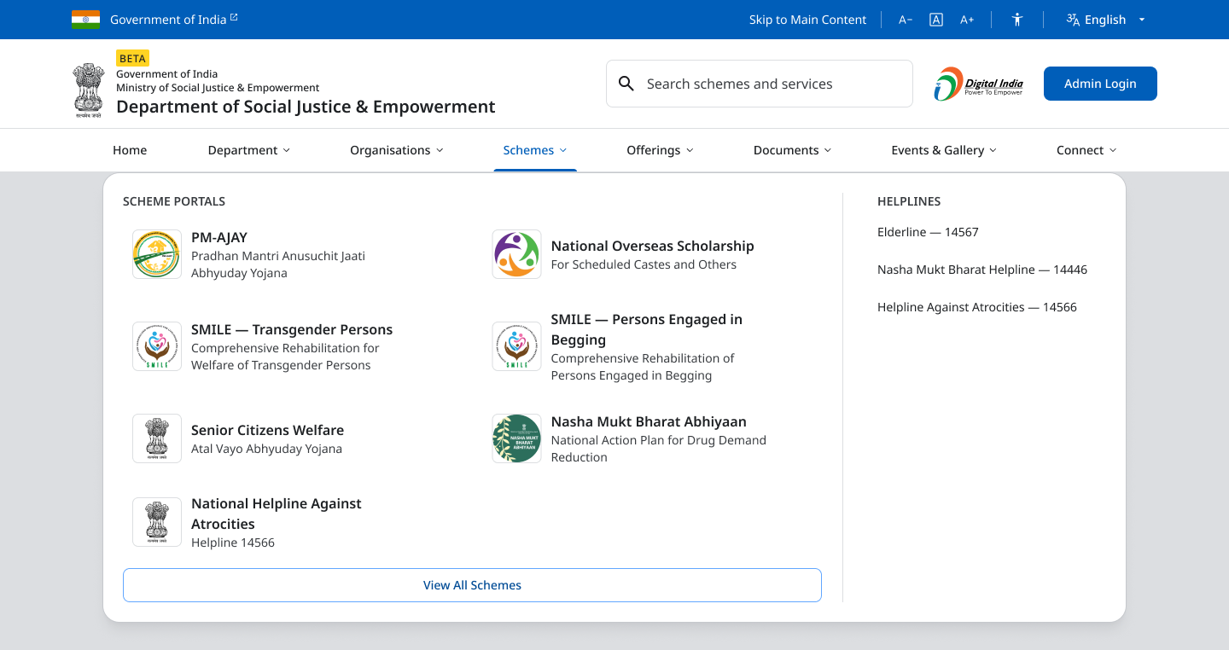
THE MENU
Three Options
Where the Department's scheme portals sit. Today they are listed under Associated Organisations.
A
Rename Only
B
Portals under Offerings
C
Schemes as Its Own Menu
OPTION A
OPTION B
OPTION C
Associated Organisations becomes Organisations & Scheme Portals. Everything listed today stays.
The portals move to Offerings, with a button to all schemes.
A new Schemes entry holds the portals and the helplines.
All three list the same seven portals and open the same pages.
Notes:
Added after the internal review of 14 September. The feedback was that a scheme portal is not an organisation, so it should not sit under Associated Organisations. A answers that with the name alone. B moves the portals into Offerings. C gives schemes a place of their own in the top row. The next three pages show each one open.

Slide 8
RENAME ONLY
The Menu · Option A of 3
TO BE BUILT
WHAT IT IS
The menu keeps everything it lists today. Only its name changes, so it says that scheme portals are inside.
HOW IT WORKS
Associated Organisations becomes Organisations & Scheme Portals
Commissions, Corporations and Foundations stay; the portals get a column of their own
The Schemes page filter uses the same name
WHY IT HELPS
The smallest change to the menu
A returning visitor finds everything where it was
Notes:
The lightest of the three, added on 14 September. Nothing moves; the name of the menu now covers what is in it. Wherever the site says All Organisations today, including the Schemes page filter, it would say Organisations & Scheme Portals. The longer name fits on a desktop screen and still has to be checked on a smaller laptop.

Slide 9
PORTALS UNDER OFFERINGS
The Menu · Option B of 3
TO BE BUILT
WHAT IT IS
The seven portals move out of Associated Organisations and into Offerings, beside Vacancies and Tenders.
HOW IT WORKS
Each portal is listed with the scheme it serves
A full-width button under the portals opens the list of all schemes
Associated Organisations keeps only the organisations
WHY IT HELPS
The top row of the menu does not change
Organisations and portals are no longer mixed
Notes:
The portals leave Associated Organisations and join Offerings. View All Schemes is a full-width button under the portals, as asked on 14 September, so the list of all schemes is not reduced to a small link. The top row stays as it is.

Slide 10
SCHEMES AS ITS OWN MENU
The Menu · Option C of 3
TO BE BUILT
WHAT IT IS
A new Schemes entry in the top row holds the seven portals and the Department's helplines.
HOW IT WORKS
Schemes sits between Organisations and Offerings
Associated Organisations is shortened to Organisations to make room
A button under the portals opens the list of all schemes
WHY IT HELPS
The word Schemes can be seen without opening anything
Helplines are listed beside the portals they support
Notes:
The top row gains an eighth entry. It only fits because Associated Organisations becomes Organisations, and that name changes on every page. A new entry was felt to crowd the row on smaller screens, so this is the option to take only if schemes should not sit near the organisations at all.

Slide 11
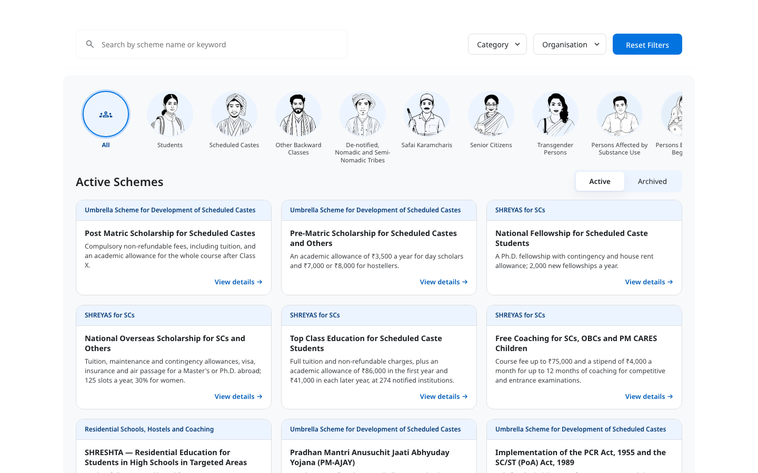
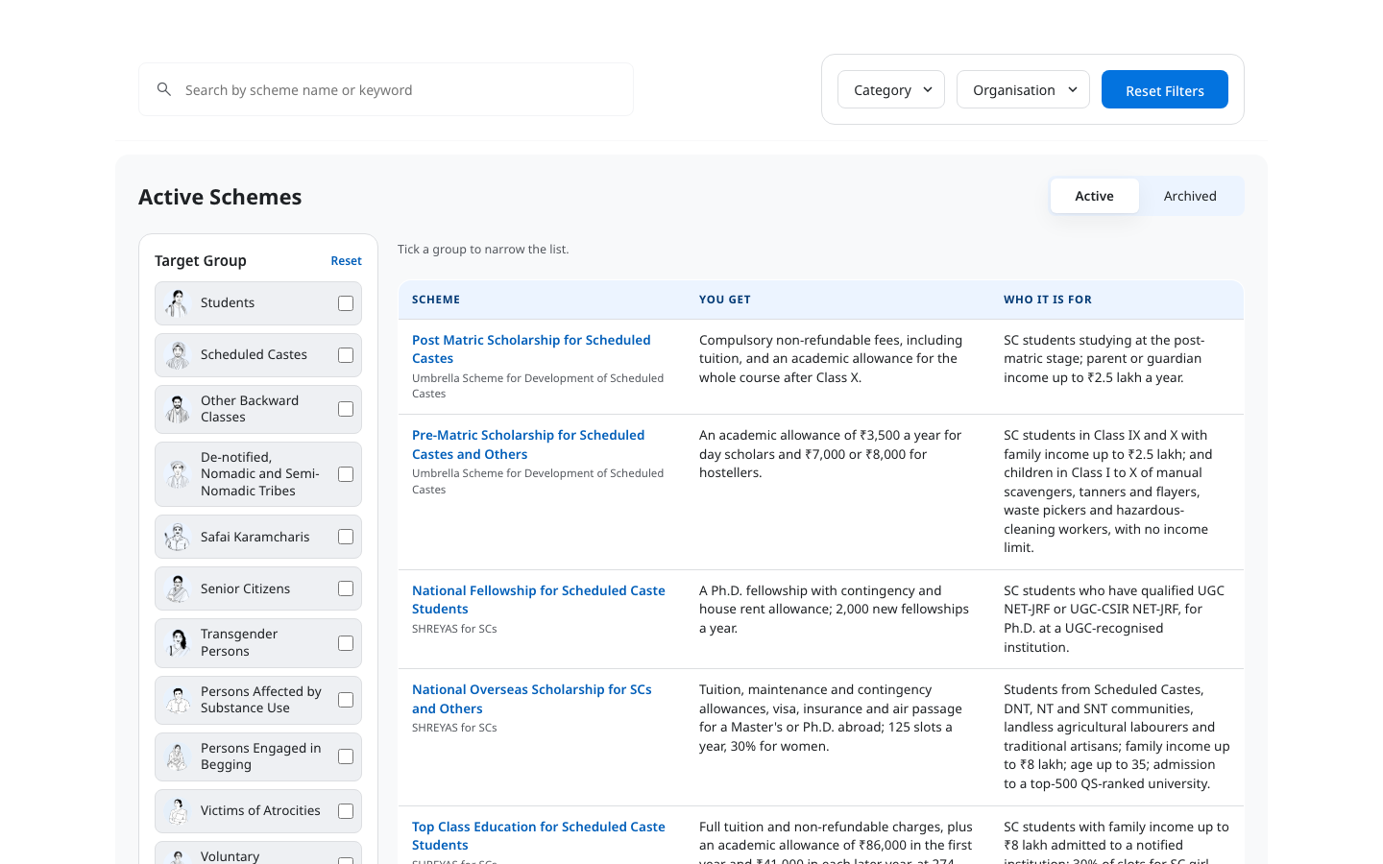
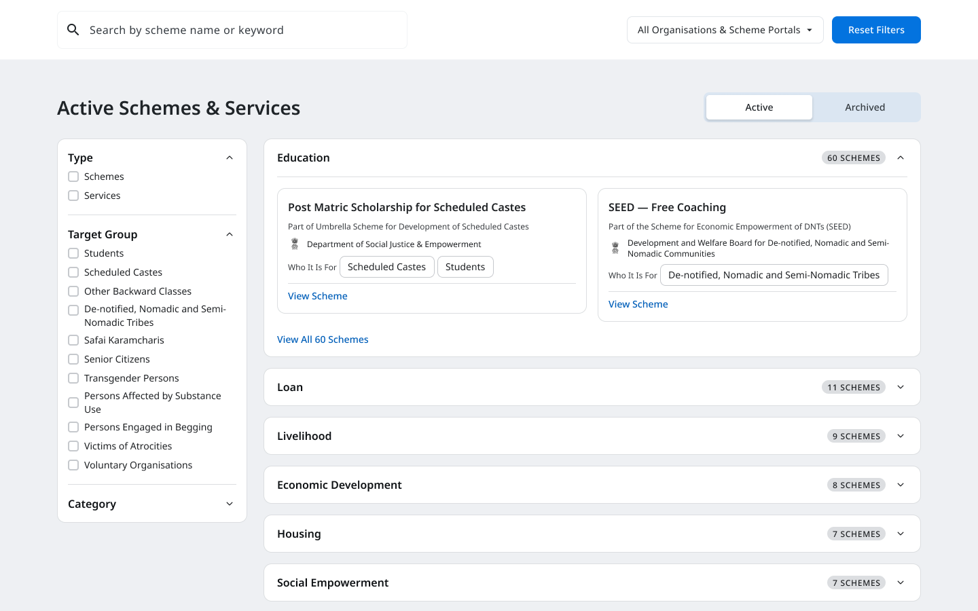
THE SCHEMES PAGE
Three Options
Where a person lands from the home page, and where officers and voluntary organisations work.
A
Pictures of the Groups, with Cards
B
Filter Panel with a Table
C
Filter Panel with Headings
OPTION A
OPTION B
OPTION C
A picture for every group in one row, then cards. For browsing.
Tick one or more groups on the left; the table says who each scheme is for. For comparing.
Filters on the left; schemes grouped under the kind of support they give.
Notes:
The internal page. Three arrangements of the same filters. A and B were shown on 9 September; C was drawn after the review of 14 September. The next three pages show each one.

Slide 12
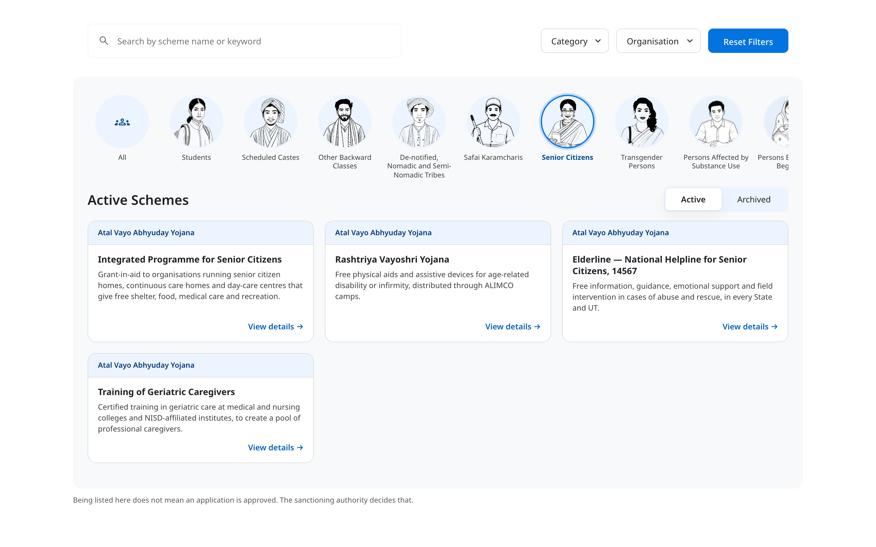
PICTURES OF THE GROUPS, WITH CARDS
The Schemes Page · Option A of 3
TO BE BUILT
WHAT IT IS
Every group as a picture in one row. Pick one and its schemes appear as cards.
HOW IT WORKS
Pick a group from the row; it scrolls sideways
Category and Organisation narrow the list further
Cards show what a scheme gives; nine to a page
WHY IT HELPS
A picture for every group, so you spot yours at a glance
The same groups as the home page, so the same idea is met twice
▶ Recorded: Safai Karamcharis, Transgender Persons, then Senior Citizens.
Notes:
The layout from before the review, with the review's changes: one filter, the group, no counts, and paged cards so the page keeps its height. This is for browsing. Press play: it is a real page being used, not an animation.

Slide 13

FILTER PANEL WITH A TABLE
The Schemes Page · Option B of 3
TO BE BUILT
WHAT IT IS
A panel of the groups on the left, where more than one can be ticked, and a table on the right.
HOW IT WORKS
Tick one or more groups; the chosen ones show above the table
Category and Organisation narrow the list further
The table says what each scheme gives and who it is for
WHY IT HELPS
Two groups can be compared in one list
A group that would leave nothing is greyed, never counted
▶ Recorded: Other Backward Classes ticked, then Students added, then one removed, then Reset.
Notes:
The reference layout with the filter panel: tick one or more groups, and the table on the right says what each scheme gives and who it is for, ten rows a page, no counts. This is for comparing and deciding. Press play: it is a real page being used, not an animation.

Slide 14
FILTER PANEL WITH HEADINGS
The Schemes Page · Option C of 3
TO BE BUILT
WHAT IT IS
The filters sit in a panel on the left. Schemes are grouped under headings for the kind of support they give.
HOW IT WORKS
Choose Schemes or Services first, then a group, then a category
Each heading opens to show its schemes, with a link to the rest
Each card names the organisation or portal that runs the scheme
WHY IT HELPS
A visitor sees every kind of support before reading a single scheme
The organisation filter uses the same name as the menu
Notes:
Drawn after the review of 14 September. Services are a choice of their own because some portals, Senior Citizens Welfare among them, offer services as well as schemes. The first visit still opens on the Department's own schemes; choosing any filter widens it to all organisations and portals. Each heading shows how many schemes sit under it, as socialjustice.gov.in does, so a visitor knows how much is there before opening it. The counts are read from the list when the page loads, never typed in, so they change as schemes are added or cleaned up. This is the only option in the deck that shows a count. The headings are the categories dosje.gov.in uses today; they would become the list on the second slide once every scheme is tagged. A second version, grouped by organisation, is drawn beside this one.

Slide 15
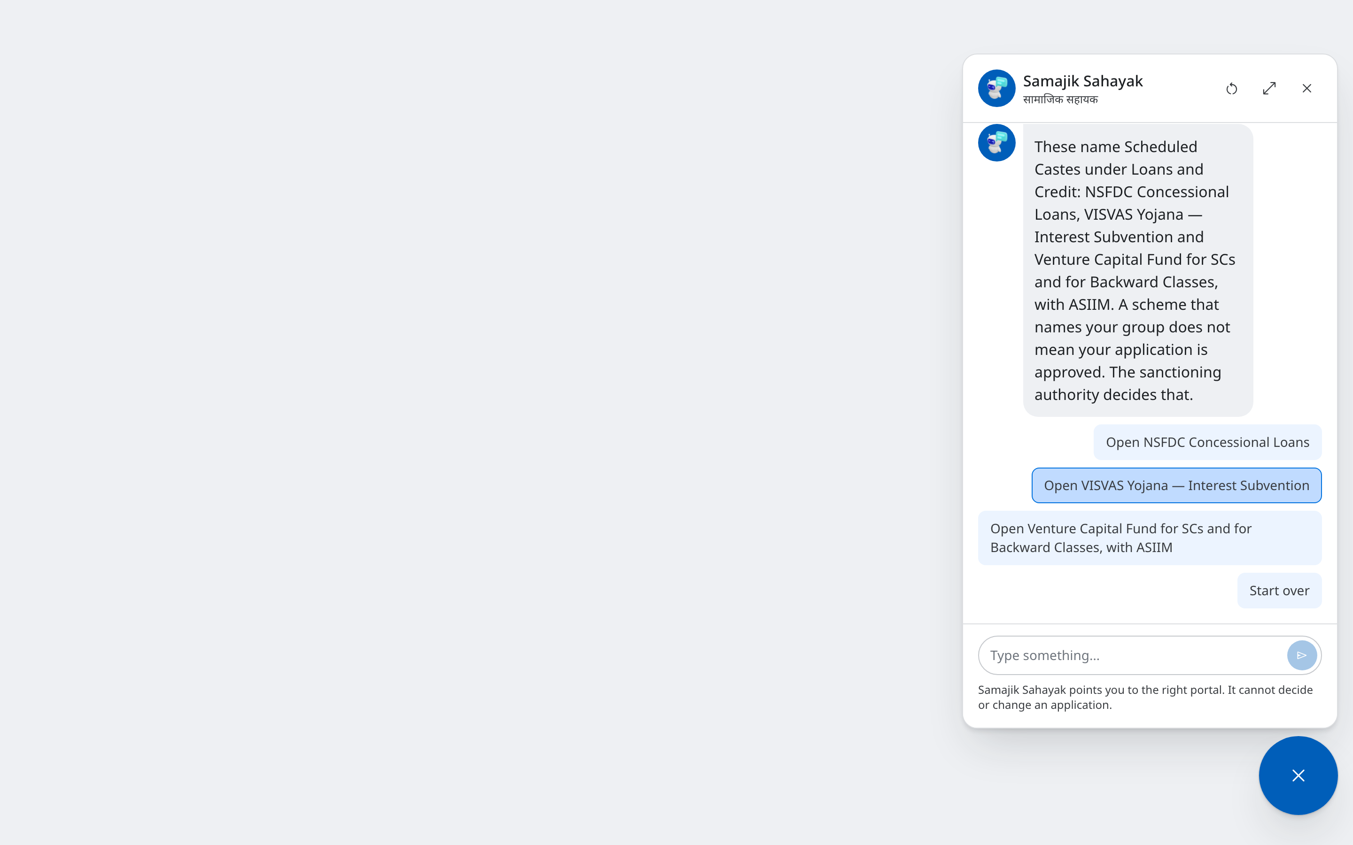
THE SAME TWO QUESTIONS, IN CHAT
The Assistant · Samajik Sahayak
THE CHAT IS ON THE SITE · THE TWO QUESTIONS ARE NEW
WHAT IT IS
The chat button in the corner of every page asks the same two questions, one at a time.
HOW IT WORKS
Pick your group, then the kind of support
The reply names the schemes and offers to open each one
It reads the same list as the home page, so the answers always match
WHY IT HELPS
Reachable from every page, even one that leads nowhere else
One question per screen suits a phone
▶ Recorded: the assistant opened from an ordinary page. Scheduled Castes, then Loans and Credit.
Notes:
The same two questions, asked one at a time in the chat window that is already built and reachable from every page. It reads the same list as the home page, so it can never name different schemes for the same person. It says plainly that it cannot decide or change an application. Press play: it is a real page being used, not an animation.

Slide 16
IN SUMMARY
Ten Options, Four Parts of the Site
Each part is decided on its own. Every way of finding a scheme starts from who you are.
The home page
A · Explore User Personas
On the site today. One group at a time.
B · Two Questions
Two questions, then three schemes and a link to all.
C · One Tap
Pick your group. Its portal first, then its schemes.
The menu
A · Rename Only
Organisations & Scheme Portals. Nothing moves.
B · Portals under Offerings
Portals join Offerings; a button opens all schemes.
C · Schemes as Its Own Menu
A new top-row entry for the portals and helplines.
The Schemes page
A · Pictures of the Groups, with Cards
Every group in one row, then cards. For browsing.
B · Filter Panel with a Table
Tick groups on the left; a table on the right.
C · Filter Panel with Headings
Filters on the left, schemes under headings.
The assistant
Samajik Sahayak
The same two questions, in the chat on every page.
Before any of them is built: the two lists are confirmed by the divisions, every scheme is tagged on both, and the development team estimates the re-tagging.
Notes:
The ten options, in one place. Each part of the site is decided on its own; any combination can be taken. Whatever is chosen, the two lists have to be confirmed, every scheme tagged on both, and the re-tagging estimated before the build starts.

