Slide 1

Government of India
Ministry of Social Justice & Empowerment
Department of Social Justice & Empowerment
How Citizens Find Schemes
Six options for the website. One idea behind all of them.
MoSJE Design Research · September 2026
Notes:
Presented live. The order is the one asked for on 8 September: the idea behind every option first, then the home page, then the Schemes page, then the assistant, then what has to come first. No scheme count appears anywhere in the deck — a number nobody can defend invites a challenge.

Slide 2
ONE IDEA BEHIND EVERY OPTION
Who You Are. What You Need.
Every option is built on these two lists.
Who Is Looking for Support
What the Department Provides
Students
Scholarships and Fellowships
Scheduled Castes
Residential Schools, Hostels and Coaching
Other Backward Classes
Loans and Credit
De-notified, Nomadic and Semi-Nomadic Tribes
Skill Training and Livelihood
Safai Karamcharis
Care, Shelter and Health
Senior Citizens
De-addiction and Counselling
Transgender Persons
Protection, Relief and Grievance
Persons Affected by Substance Use
Grants to Voluntary Organisations
Persons Engaged in Begging
Victims of Atrocities
Voluntary Organisations
Notes:
The one idea. On the left, the person: the groups the Department's own mandate names, plus the three its schemes name — students, victims of atrocities, and the voluntary organisations it funds. On the right, what the Department gives, in its own words. A scheme is findable under every group it names and every kind of support it provides, at once. Everything that follows is a view over these two lists. Not stage of life, not State: the review cut those, and a scheme record is tagged on these two axes only.

Slide 3
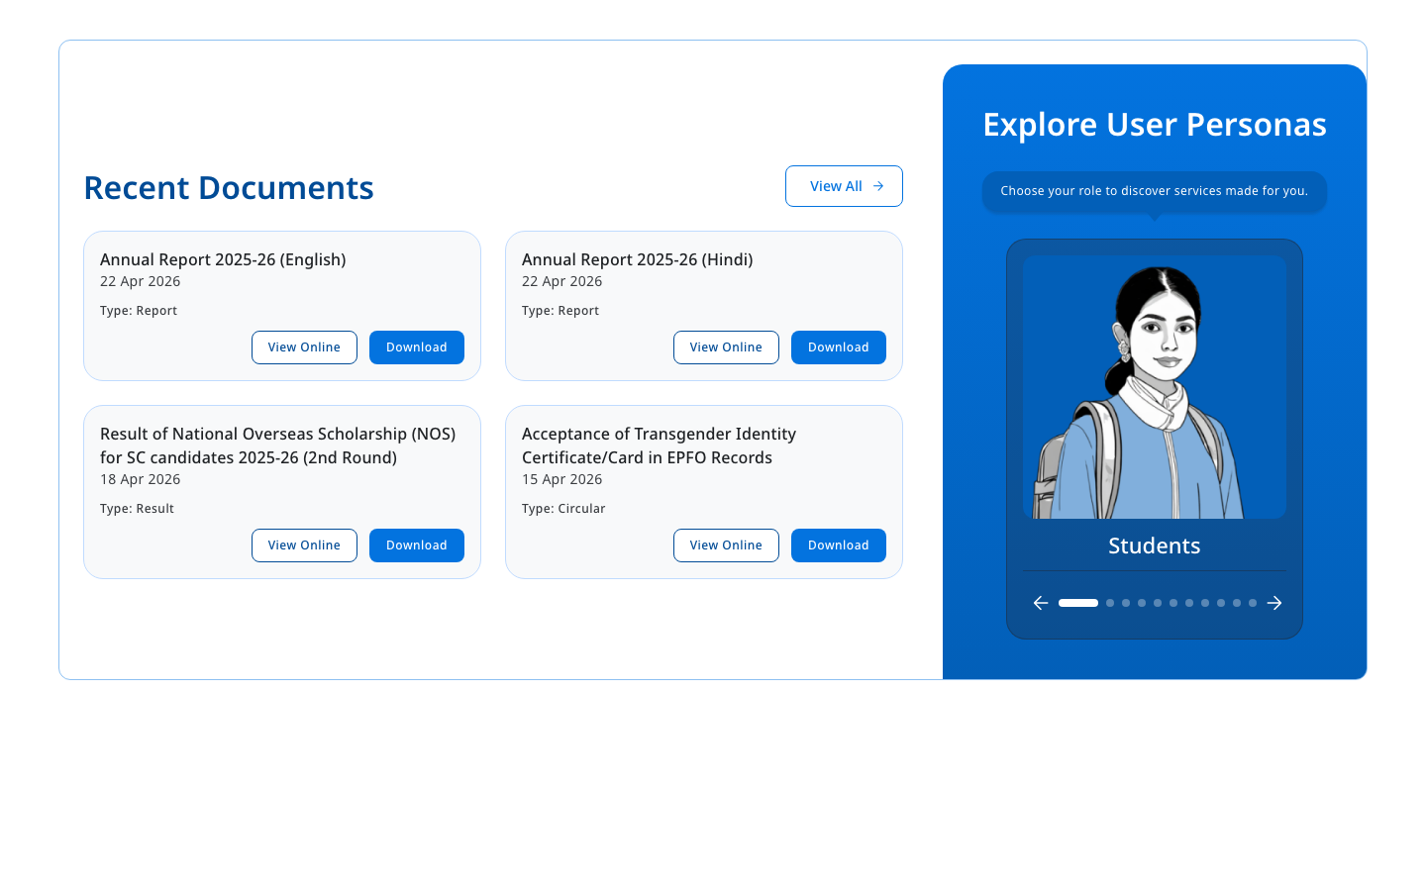
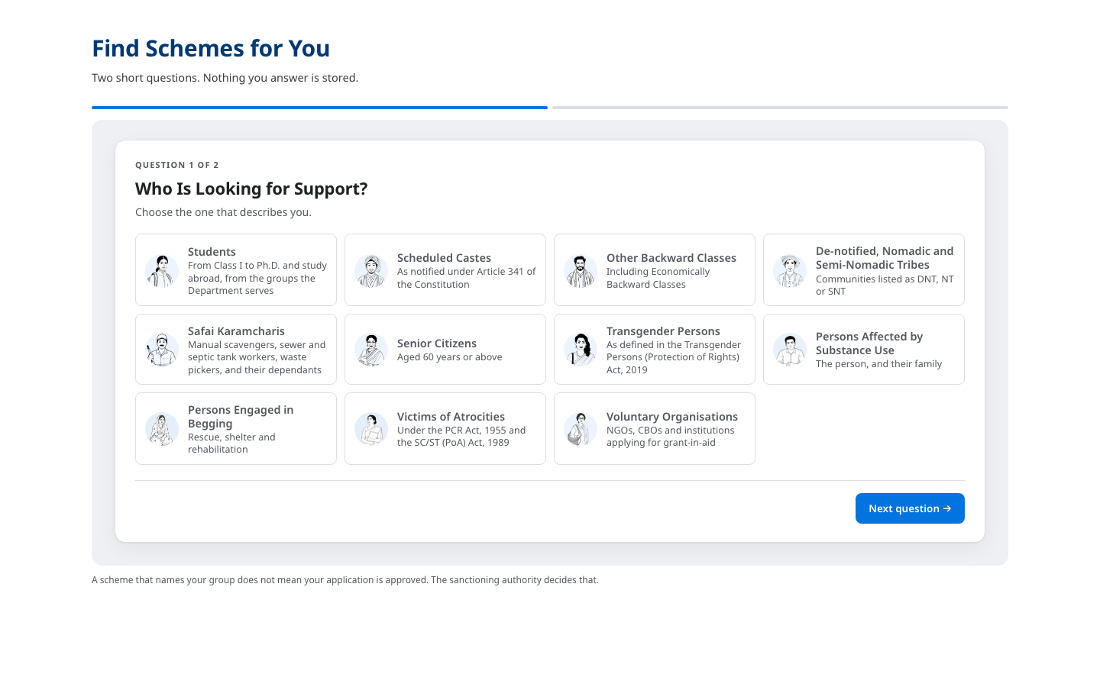
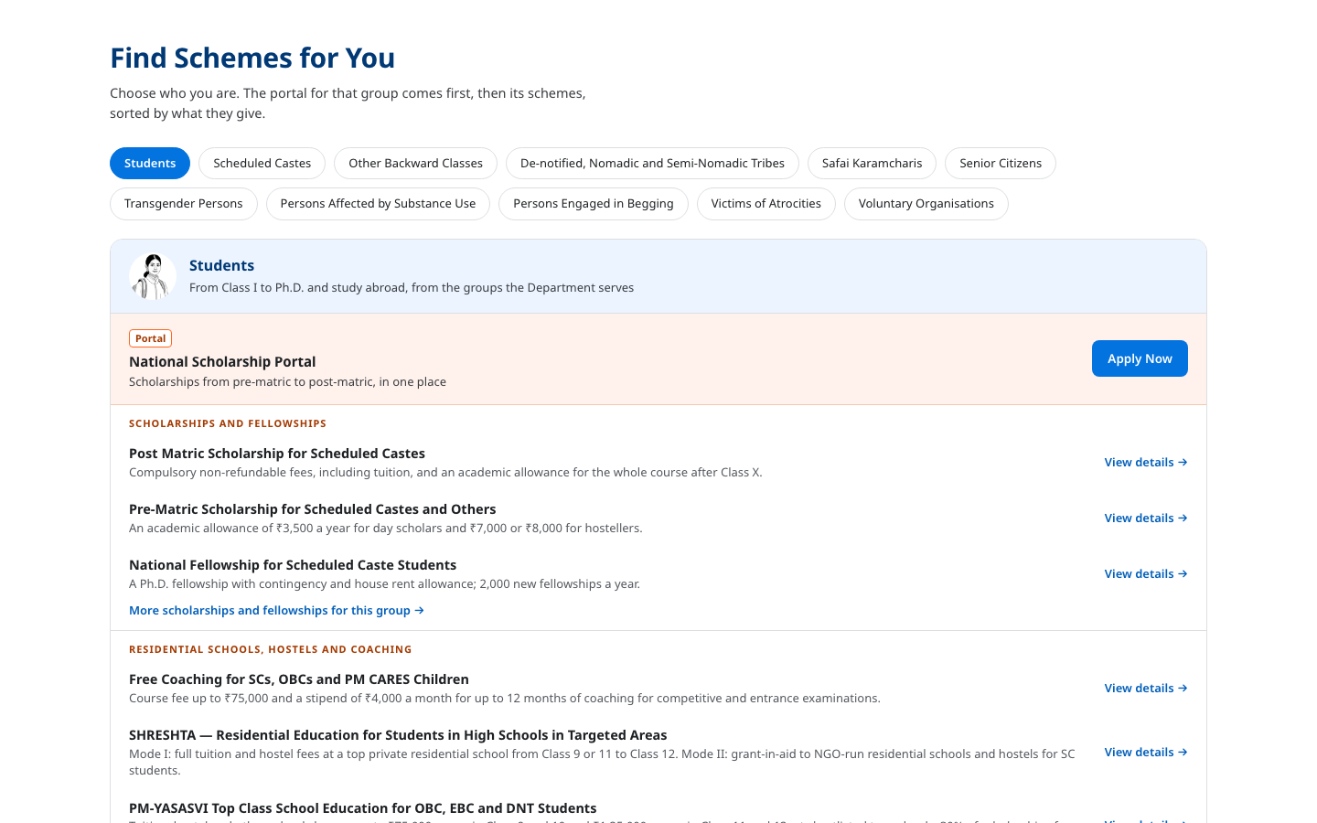
THE HOME PAGE
Three Options
A is on the site today. B or C would take the section below the banner, where Our Offerings sits now.
A
Explore User Personas
B
Two Questions
C
One Tap
ON THE SITE TODAY
OPTION B
OPTION C
One group at a time. Kept as it is.
Who you are, then what you need. Ends with the schemes and a link to see them all.
Pick your group. First the portal for that group, then its schemes.
B and C take the place of Our Offerings, so the page does not get longer.
Notes:
Three options for the home page. A stays where it is. B or C takes the section below the banner. C is for the visitor who will not answer questions. The next three pages show each one being used.

Slide 4
EXPLORE USER PERSONAS
The Home Page · Option A of 3
ON THE SITE TODAY
WHAT IT IS
The panel already on the home page. It shows one group at a time, and you move between them with the arrows.
HOW IT WORKS
Tap the arrows to move between the groups
Tap a group to open the Schemes page for that group
WHY IT HELPS
The smallest change: only the link behind each picture is new
The pictures work in any language
The panel as it is on the site today.
Notes:
The panel already on the home page: one group at a time, moved with arrows. The list of groups is the same eleven the other options use, in the same order. Today, choosing a group filters nothing on the Schemes page; every option fixes that.

Slide 5
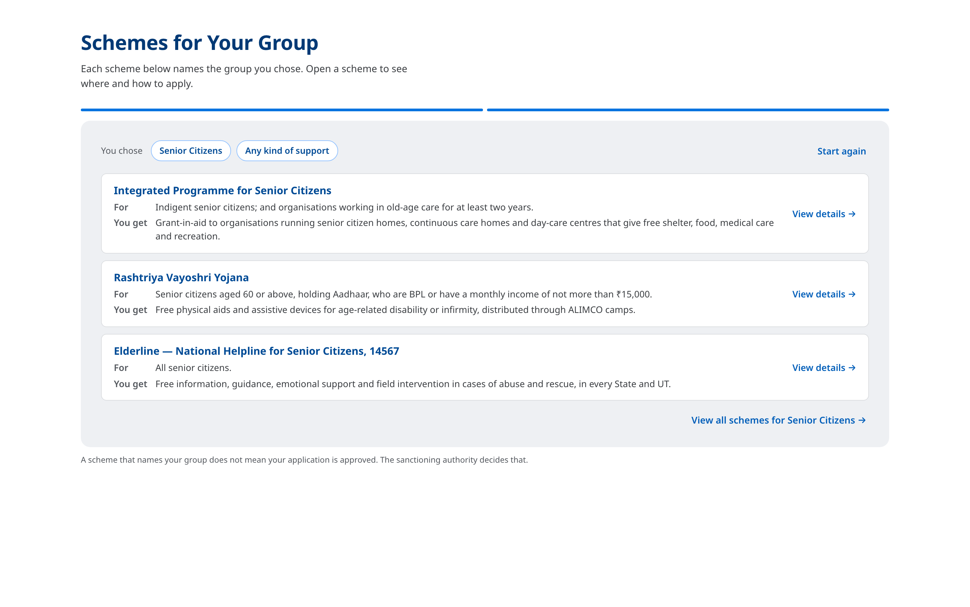
TWO QUESTIONS
The Home Page · Option B of 3
TO BE BUILT
WHAT IT IS
Two short questions on the home page: who you are, and what kind of support you need.
HOW IT WORKS
Question 2 can be skipped, which shows everything for the group
The answer shows three schemes, each with a link to its own page
One more link opens the Schemes page, already filtered to the same two answers
WHY IT HELPS
Both questions change what you see; nothing is asked for its own sake
A visitor gets an answer without leaving the home page
▶ Recorded: Scheduled Castes, then Scholarships. Then Senior Citizens with the second question skipped.
Notes:
Two short questions over the Department's own list of schemes. The second may be skipped, which widens the list. The answer shows both choices, three schemes, and a link to the Schemes page filtered to the same choices. There is no apply button here: the scheme's own page says where to apply. Before this can be built, every scheme has to be tagged on both lists; that is on the page near the end. Press play: it is a real page being used, not an animation.

Slide 6
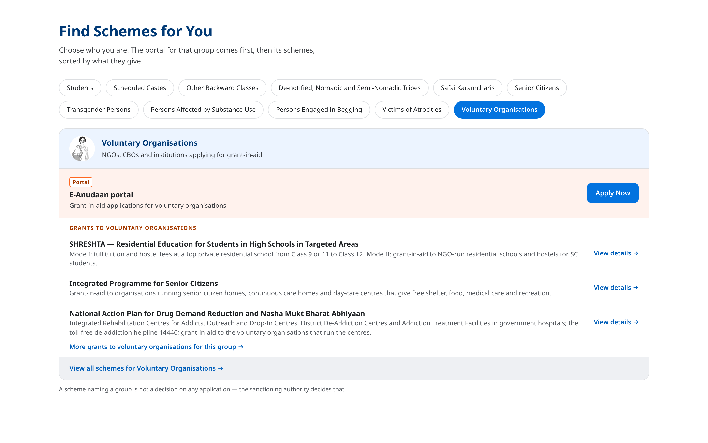
ONE TAP
The Home Page · Option C of 3
TO BE BUILT
WHAT IT IS
A row of the groups. Pick yours and the schemes appear. No questions asked.
HOW IT WORKS
The first band is the portal or helpline the Department runs for that group
Below it, the schemes for the group, sorted by what they give
Each scheme links to its page, and one link opens the full list
WHY IT HELPS
One tap and nothing to answer
The portal a group already uses comes first
▶ Recorded: Scheduled Castes, Senior Citizens, Transgender Persons, Voluntary Organisations. One tap each.
Notes:
A row of the groups. Tapping one shows the portal or helpline for that group first, where the Department has one, then the schemes that name the group, sorted by what they give. Each links to its own page. The larger groups get long lists, which is why the list is cut at three per kind of support with a link to the rest. Press play: it is a real page being used, not an animation.

Slide 7
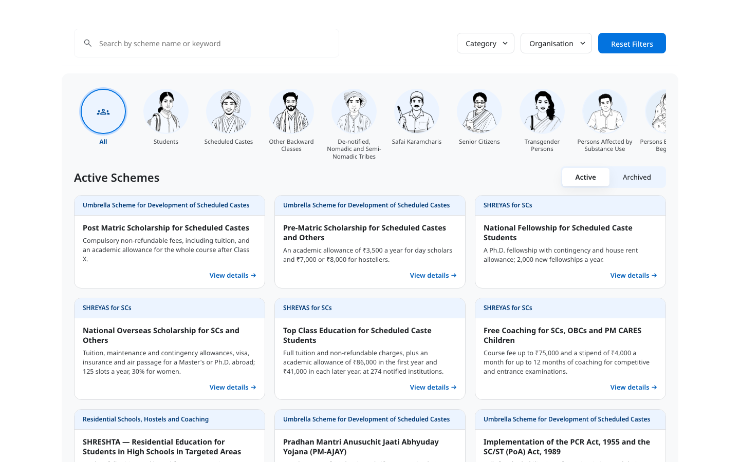
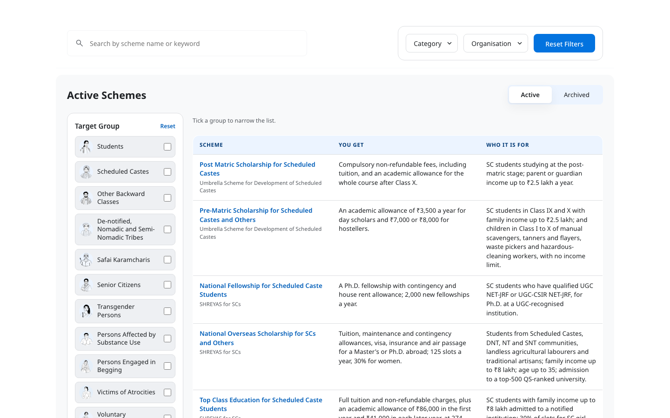
THE SCHEMES PAGE
Two Options
Where a person lands from the home page, and where officers and voluntary organisations work.
A
Pictures of the Groups, with Cards
B
Filter Panel with a Table
OPTION A
OPTION B
A picture for every group in one row, then cards. For browsing.
Tick one or more groups on the left; the table says who each scheme is for. For comparing.
Notes:
The internal page. Two arrangements of the same two filters. The next two pages show each being used.

Slide 8
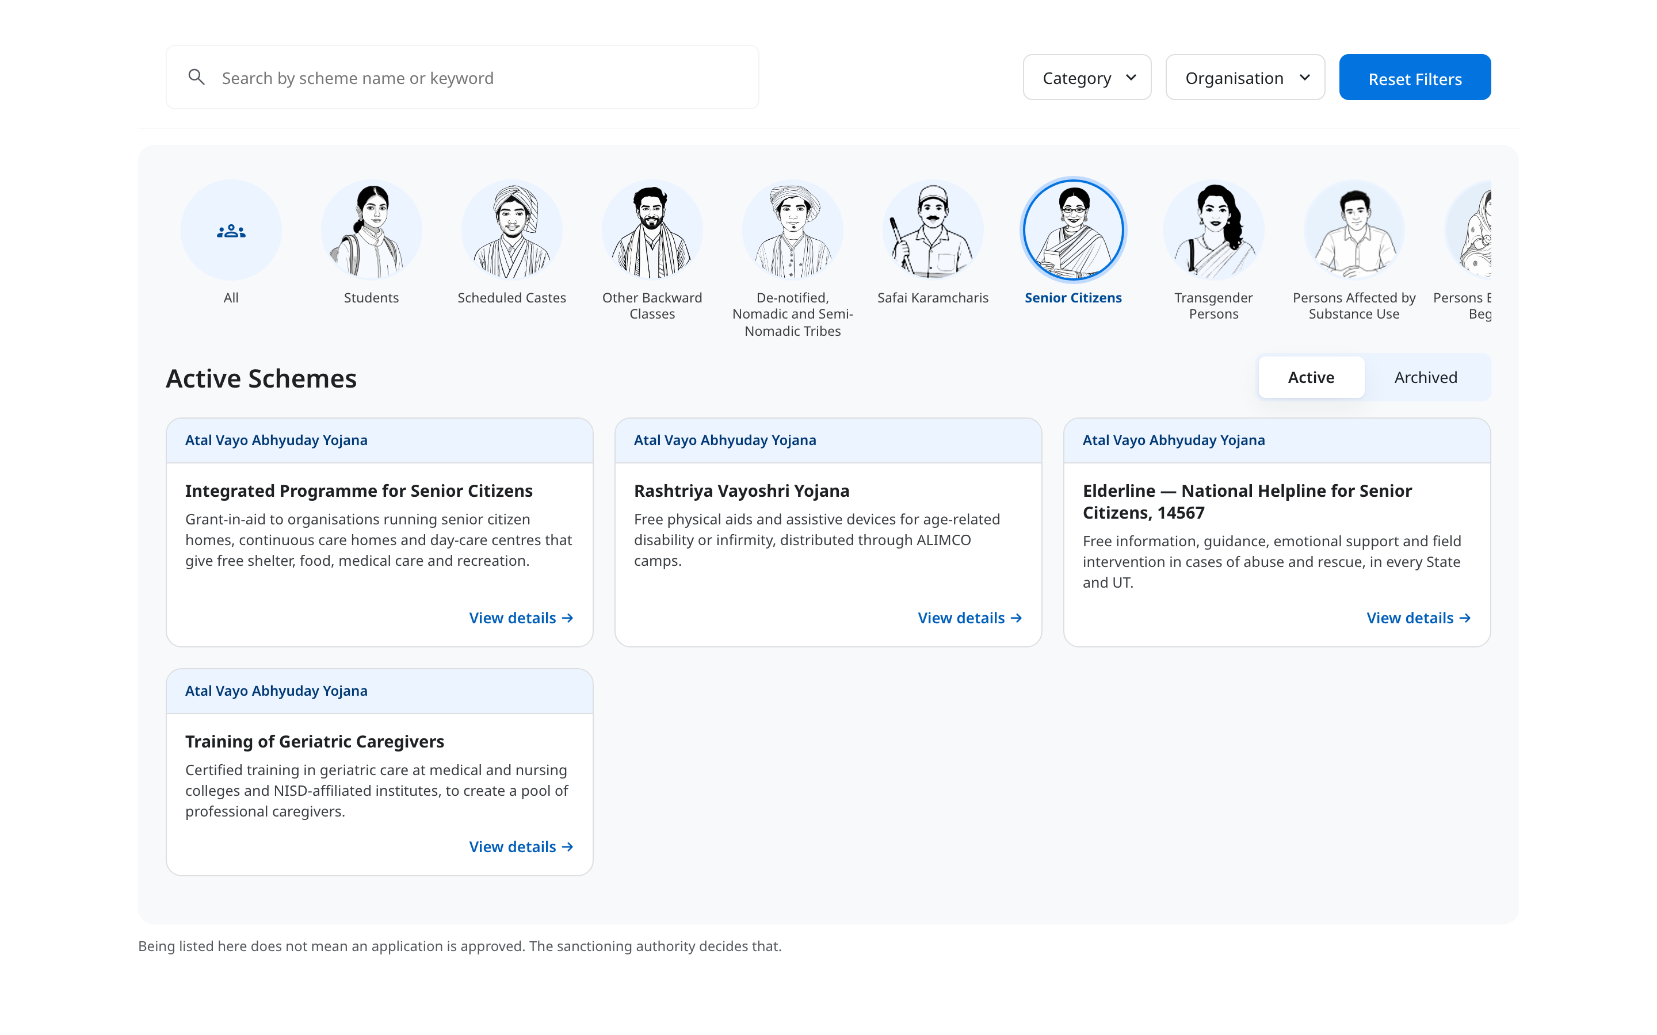
PICTURES OF THE GROUPS, WITH CARDS
The Schemes Page · Option A of 2
TO BE BUILT
WHAT IT IS
Every group as a picture in one row. Pick one and its schemes appear as cards.
HOW IT WORKS
Pick a group from the row; it scrolls sideways
Category and Organisation narrow the list further
Cards show what a scheme gives; nine to a page
WHY IT HELPS
A picture for every group, so you spot yours at a glance
The same groups as the home page, so the same idea is met twice
▶ Recorded: Safai Karamcharis, Transgender Persons, then Senior Citizens.
Notes:
The layout from before the review, with the review's changes: one filter, the group, no counts, and paged cards so the page keeps its height. This is for browsing. Press play: it is a real page being used, not an animation.

Slide 9

FILTER PANEL WITH A TABLE
The Schemes Page · Option B of 2
TO BE BUILT
WHAT IT IS
A panel of the groups on the left, where more than one can be ticked, and a table on the right.
HOW IT WORKS
Tick one or more groups; the chosen ones show above the table
Category and Organisation narrow the list further
The table says what each scheme gives and who it is for
WHY IT HELPS
Two groups can be compared in one list
A group that would leave nothing is greyed, never counted
▶ Recorded: Other Backward Classes ticked, then Students added, then one removed, then Reset.
Notes:
The reference layout with the filter panel: tick one or more groups, and the table on the right says what each scheme gives and who it is for, ten rows a page, no counts. This is for comparing and deciding. Press play: it is a real page being used, not an animation.

Slide 10
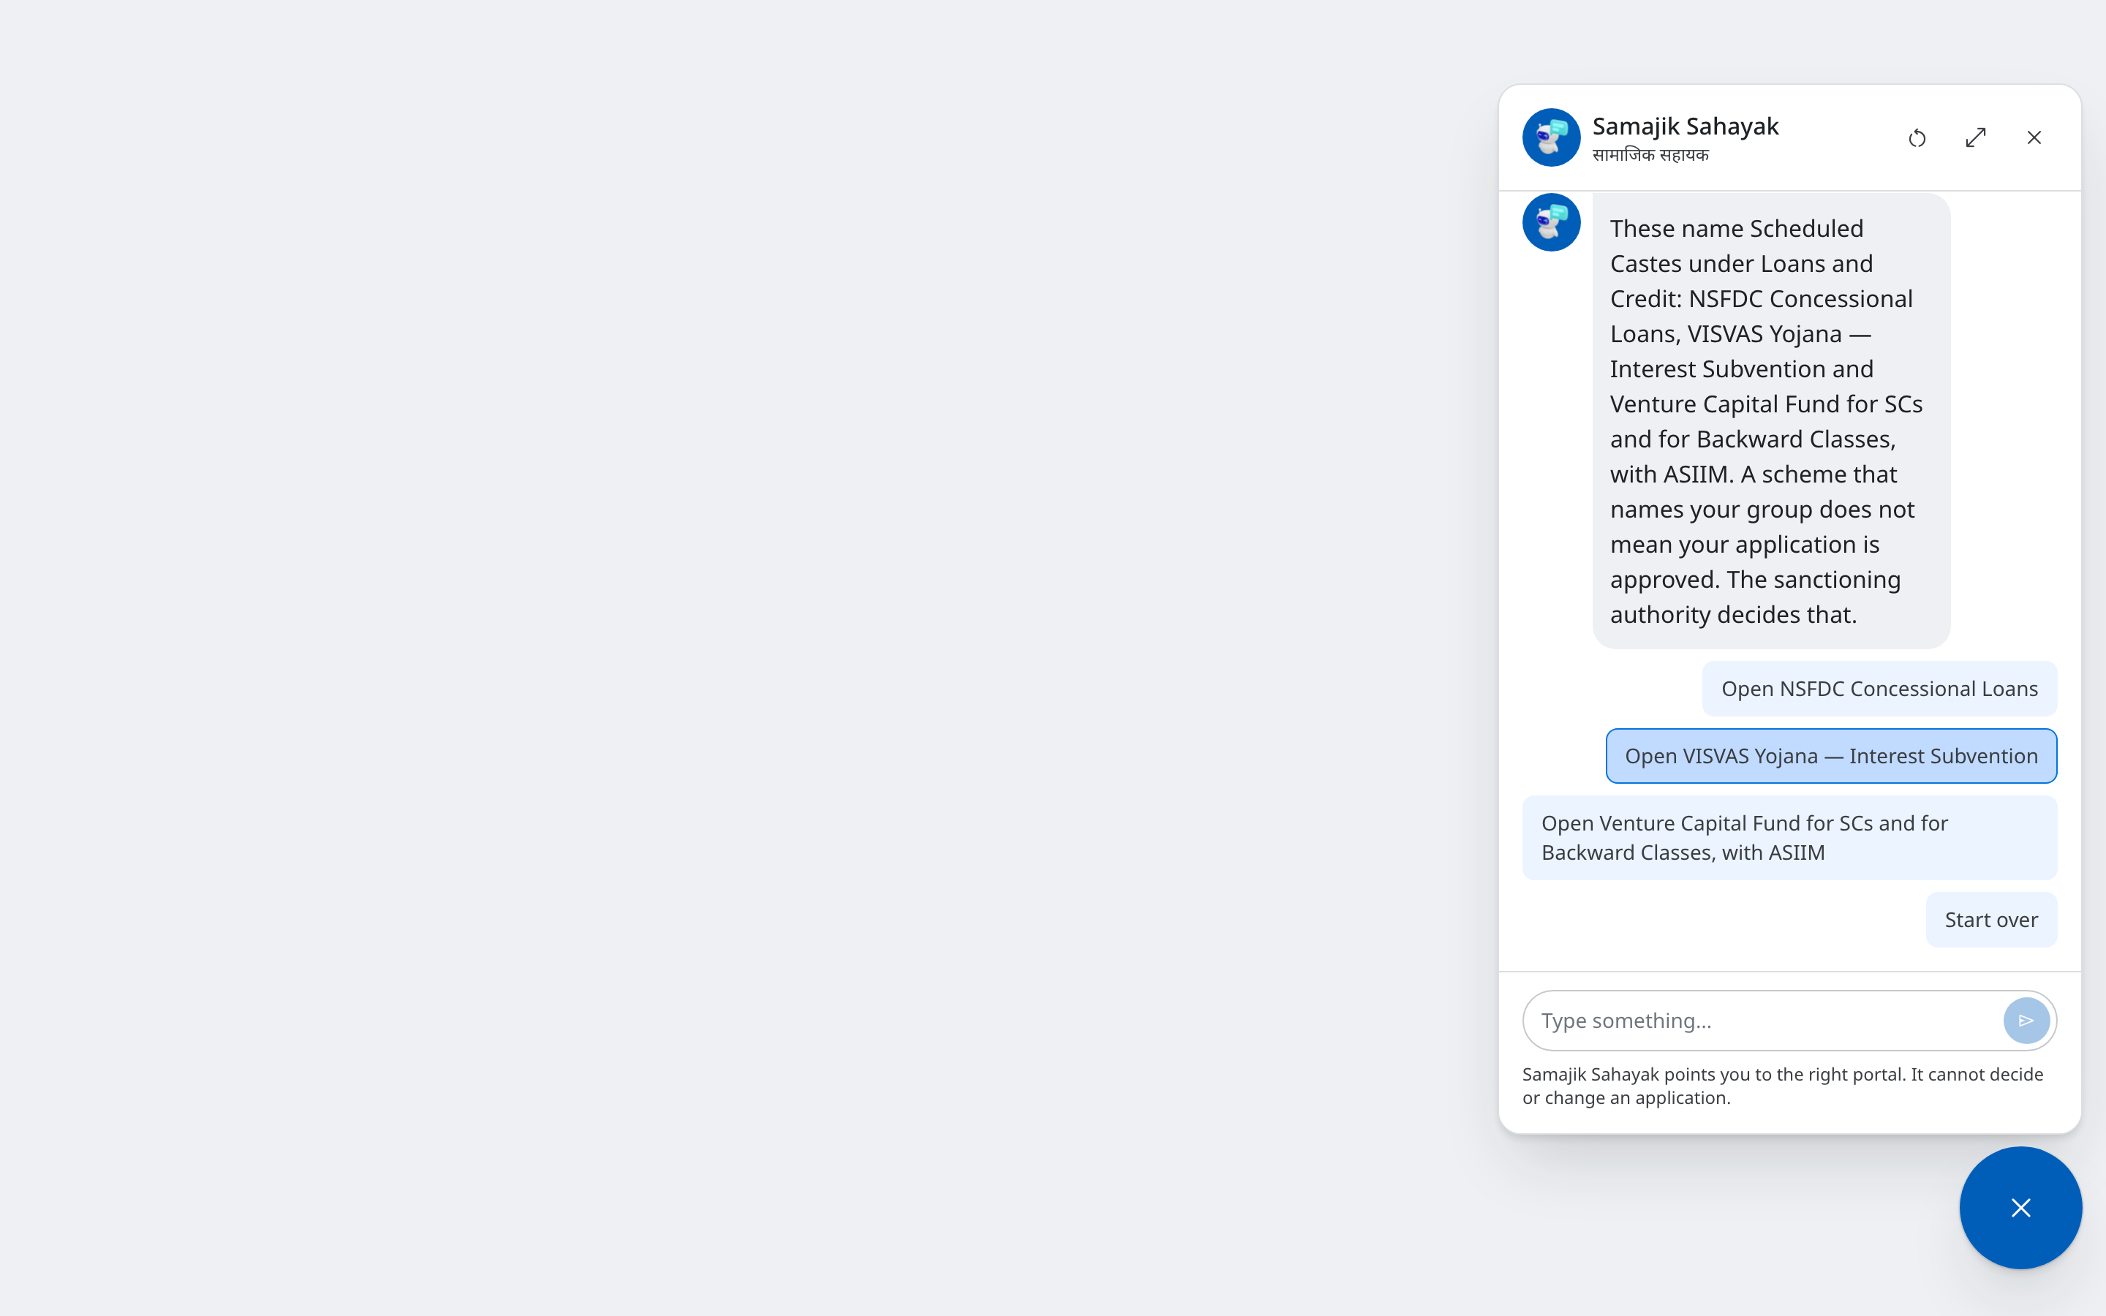
THE SAME TWO QUESTIONS, IN CHAT
The Assistant · Samajik Sahayak
THE CHAT IS ON THE SITE · THE TWO QUESTIONS ARE NEW
WHAT IT IS
The chat button in the corner of every page asks the same two questions, one at a time.
HOW IT WORKS
Pick your group, then the kind of support
The reply names the schemes and offers to open each one
It reads the same list as the home page, so the answers always match
WHY IT HELPS
Reachable from every page, even one that leads nowhere else
One question per screen suits a phone
▶ Recorded: the assistant opened from an ordinary page. Scheduled Castes, then Loans and Credit.
Notes:
The same two questions, asked one at a time in the chat window that is already built and reachable from every page. It reads the same list as the home page, so it can never name different schemes for the same person. It says plainly that it cannot decide or change an application. Press play: it is a real page being used, not an animation.

Slide 11
IN SUMMARY
Six Options, Three Parts of the Site
Every option starts from who you are. Each part is decided on its own.
The home page
A · Explore User Personas
On the site today. One group at a time.
B · Two Questions
Who you are, then what you need. Three schemes and a link to all of them.
C · One Tap
Pick your group. Its portal first, then its schemes.
The Schemes page
A · Pictures of the Groups, with Cards
Every group in one row, then cards. For browsing.
B · Filter Panel with a Table
Tick groups on the left, table on the right. For comparing.
The assistant
Samajik Sahayak
The same two questions, in the chat window on every page.
Before any of them is built: the two lists are confirmed by the divisions, every scheme is tagged on both, and the development team estimates the re-tagging.
Notes:
The six options, in one place. Each part of the site is decided on its own; any combination can be taken. Whatever is chosen, the two lists have to be confirmed, every scheme tagged on both, and the re-tagging estimated before the build starts.

