Slide 1


Multi-Language Translator
AKTU Roll no:
2302841530016
Name:
Akash Shukla
Under Supervision
Mr. Aashish Kapoor

Slide 2
Outline
This project introduces a browser accessible, AI powered translator supporting 20+ languages with automatic source detection and real-time translation. Built using open-source tools (deep translator, langdetect, Gradio), it eliminates API dependencies and prioritizes accessibility.
Designed for scalability, it sets the stage for tone-aware, voice-enabled, and culturally sensitive translation systems.
→ 20+ language support
→ Auto language detection
→Gradio-based UI
→ Google Colab compatible deployment

Slide 3
Introduction
Multi-Language Translator
This project presents a Multi-Language Translator built using Python, leveraging open-source libraries like deep-translator, langdetect, and Gradio.
It allows users to input text in any supported language, auto-detects the source language, and translates it into the desired target language all without requiring an API key.
The project aims to make language translation accessible, fast, and user-friendly, especially for educational and multilingual environments.

Slide 4
Objectives
The objective of this project is to Auto-detect the input language using langdetect.
Translate text using Google Translate via deep-translator.
Build an interactive and user-friendly interface using Gradio.
Avoid reliance on paid APIs.
Showcase real world application of Python and open source libraries.

Slide 5
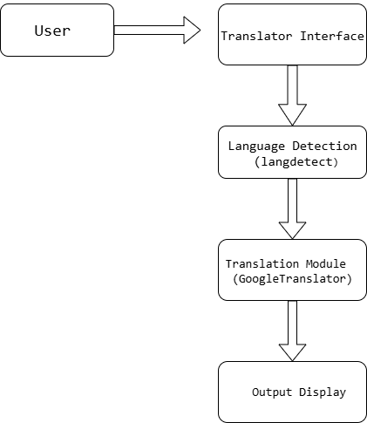
Diagram

Slide 6
ADVANTAGES
No API Key Required
Auto Language Detection
Supports 20+ Languages
User-Friendly Interface

Slide 7
LIMITATIONS
Limited Language Detection Accuracy
No Support for Voice or File Input
No Offline Functionality
UI Limitations

Slide 8
Future Work
Add voice interaction support.
Integrated with web/mobile apps.
Use LLM models for better responses.
Add more language support.

Slide 9
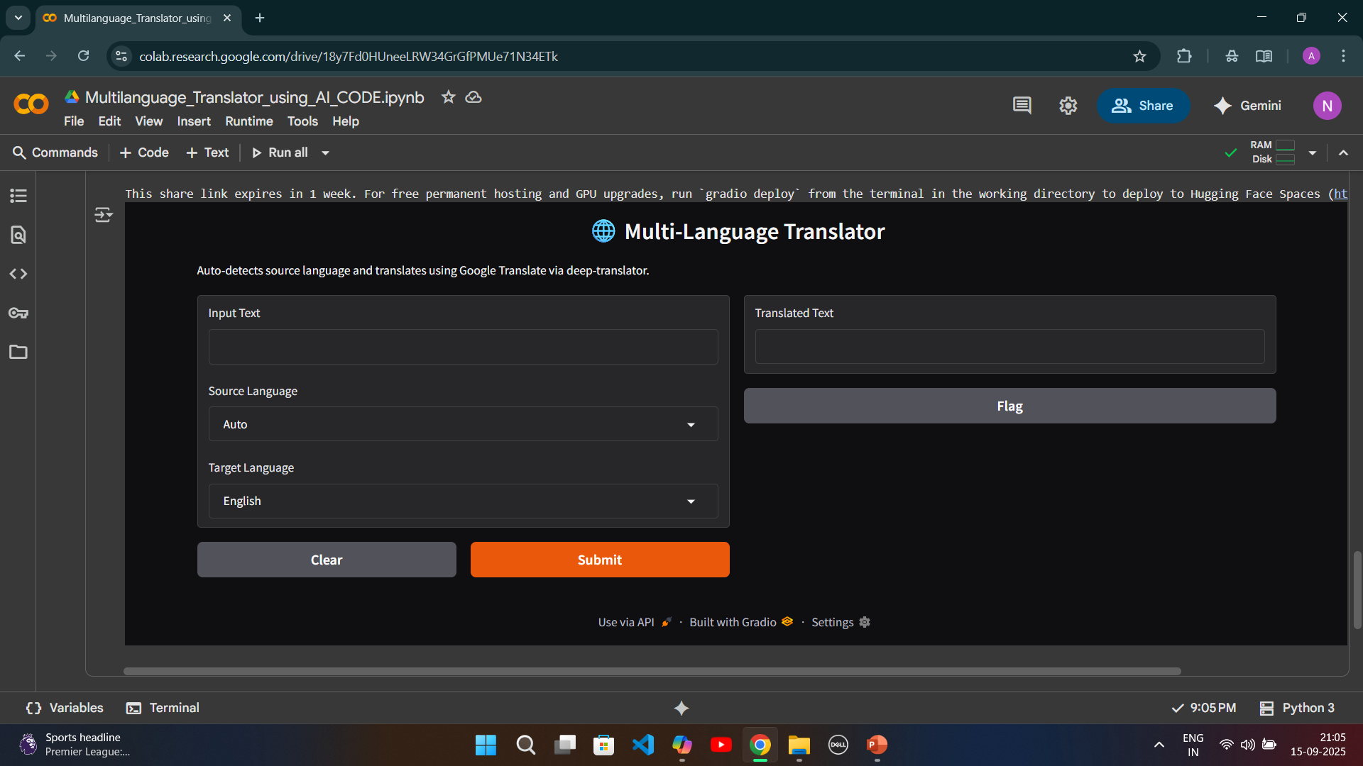
USER INTERFACE

Slide 10
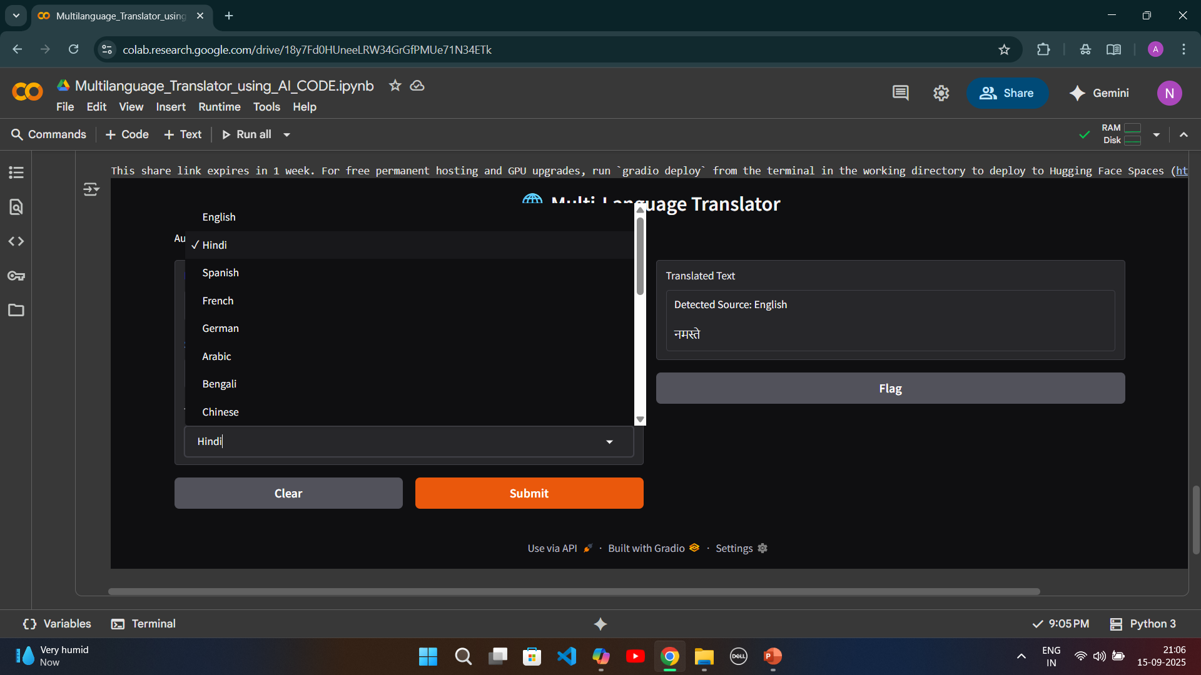
USER INTRFACE (2)

Slide 11
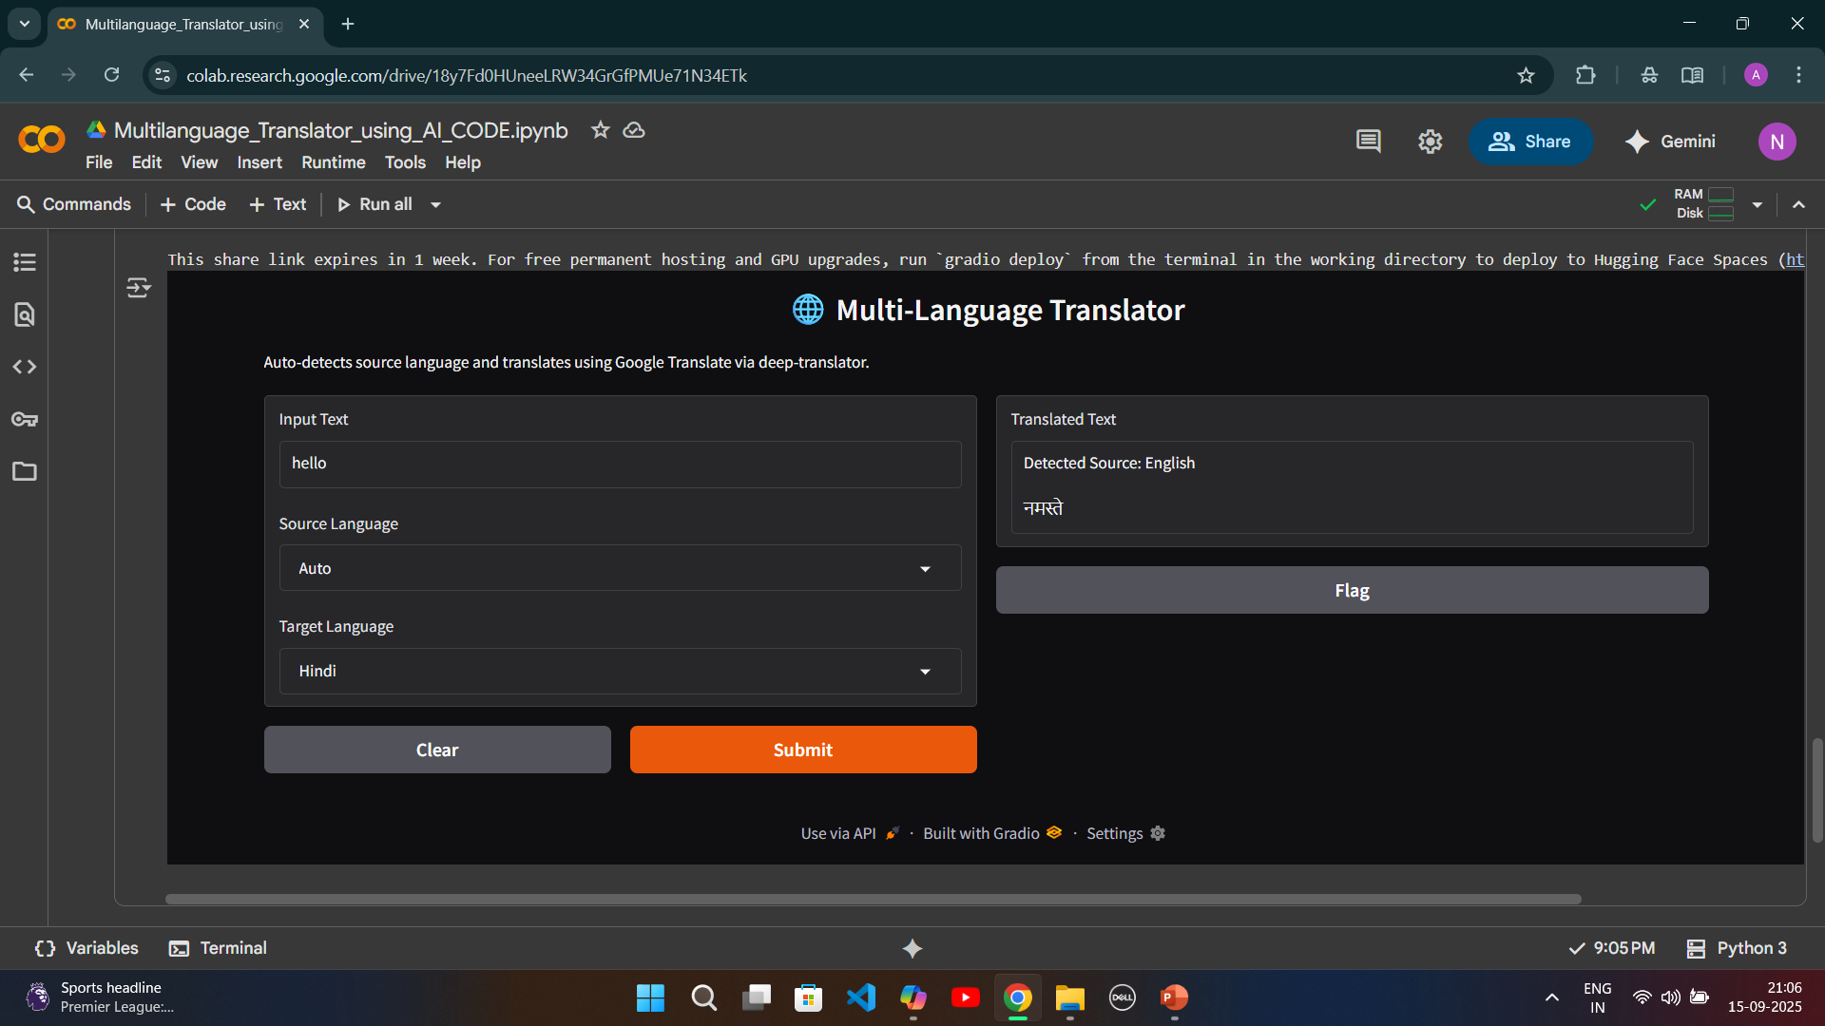
USER INTRFACE (3)

Slide 12
Conclusion
It supports over 20 languages, auto-detects input language, and provides real-time translation—all without requiring an API key or paid service.
The Multi-Language Translator successfully demonstrates how open-source tools like deeptranslator, langdetect, and Gradio can be combined to build a smart, accessible, and user-friendly translation app.
It supports over 20 languages, auto-detects input language, and provides real-time translation all without requiring an API key or paid service.
The project highlights practical applications of Python in Natural Language Processing (NLP), UI design, and inclusive technology.
While there are limitations in offline access and contextual accuracy, the app lays a strong foundation for future enhancements like voice input, file translation, and domain-specific tuning
Overall, this project reflects a hands-on approach to solving real-world communication barriers and showcases the power of open-source development

Slide 13
References
Official documentation of deep-translator, langdetect, and Gradio.
Python tutorials and NLP resources.
GitHub repositories and Stack Overflow threads consulted

Slide 14
THANK YOU !

