Slide 1
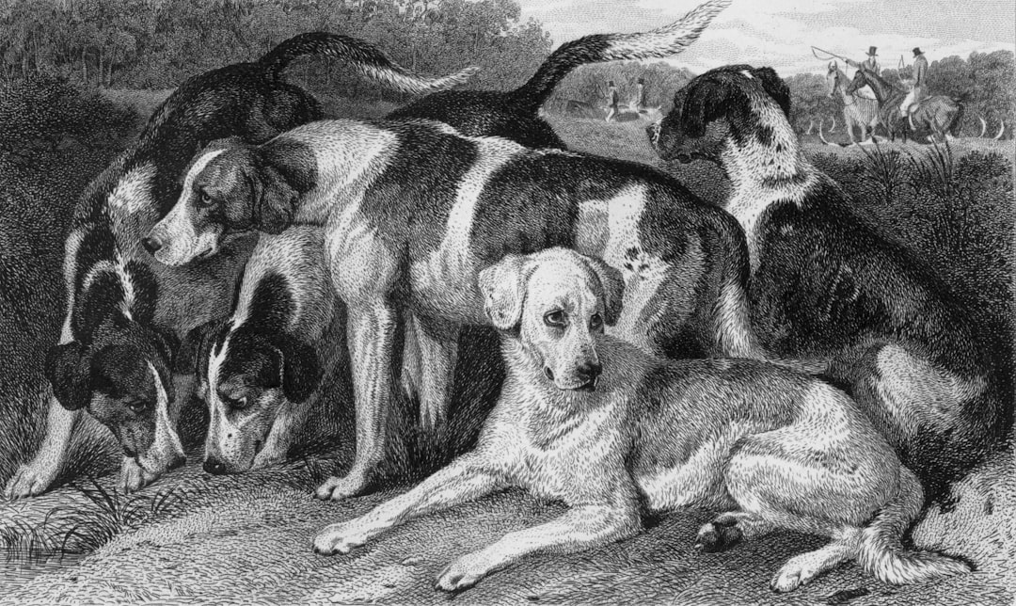
Canine Companions: An Introduction to Dogs
Dogs, belonging to the Canis lupus familiaris species, are domesticated descendants of wolves.
Their domestication dates back tens of thousands of years, significantly impacting human history and society.
Dogs exhibit remarkable diversity in size, shape, coat, and temperament, resulting from selective breeding across various breeds.

Slide 2
Dog Breeds and Their Characteristics
Working breeds, like German Shepherds and Border Collies, are known for their intelligence and stamina, excelling in tasks such as herding and protection.
Toy breeds, such as Chihuahuas and Pomeranians, are typically smaller and better suited for apartment living, requiring less exercise.
Sporting breeds, including Labrador Retrievers and Golden Retrievers, are energetic and friendly, often participating in activities like hunting and retrieving.

Slide 3
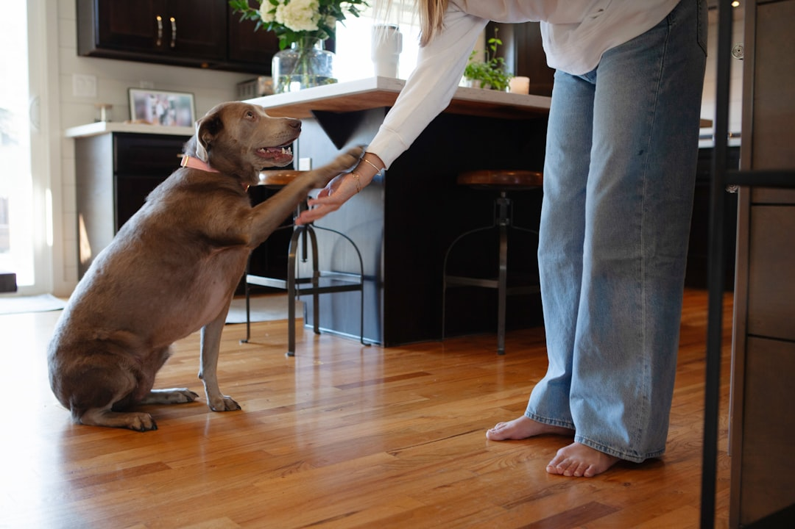
Understanding Canine Behavior
Body language is crucial for interpreting canine communication; postures, tail wags, ear positions, and vocalizations all convey meaning.
Positive reinforcement training methods, focusing on rewards and encouragement, are highly effective for building a strong bond and teaching desired behaviors.
Early socialization is vital for welladjusted adult dogs, enabling them to interact appropriately with other animals and people.

Slide 4
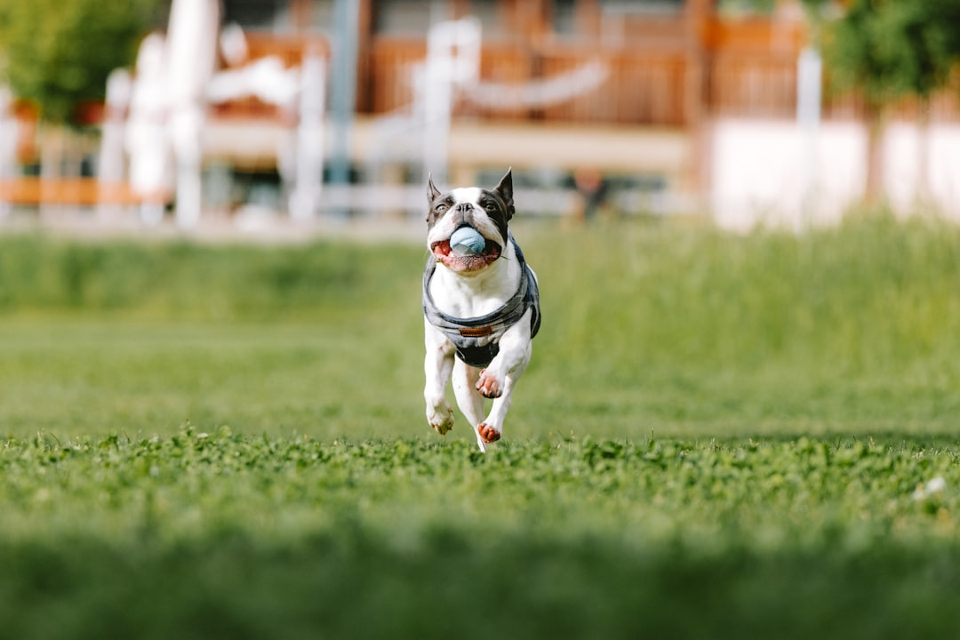
Caring for Your Canine Friend
Regular veterinary checkups are essential for maintaining your dog's health, preventing diseases, and addressing any potential health issues promptly
A balanced diet, tailored to your dog's breed, age, and activity level, is critical for maintaining optimal physical condition and preventing obesity.
Daily exercise, appropriate to their breed and age, is crucial for both physical and mental wellbeing; this can range from a brisk walk to a vigorous game of fetch.

Slide 5

The Human-Canine Bond
The unique relationship between humans and dogs is characterized by mutual affection, companionship, and a shared history spanning millennia.
Dogs offer unconditional love, emotional support, and a sense of belonging, playing a significant role in mental and emotional wellbeing for many owners.
Responsible dog ownership involves understanding the commitment involved in providing proper care, training, and enriching experiences for a dog's entire life.

Slide 6
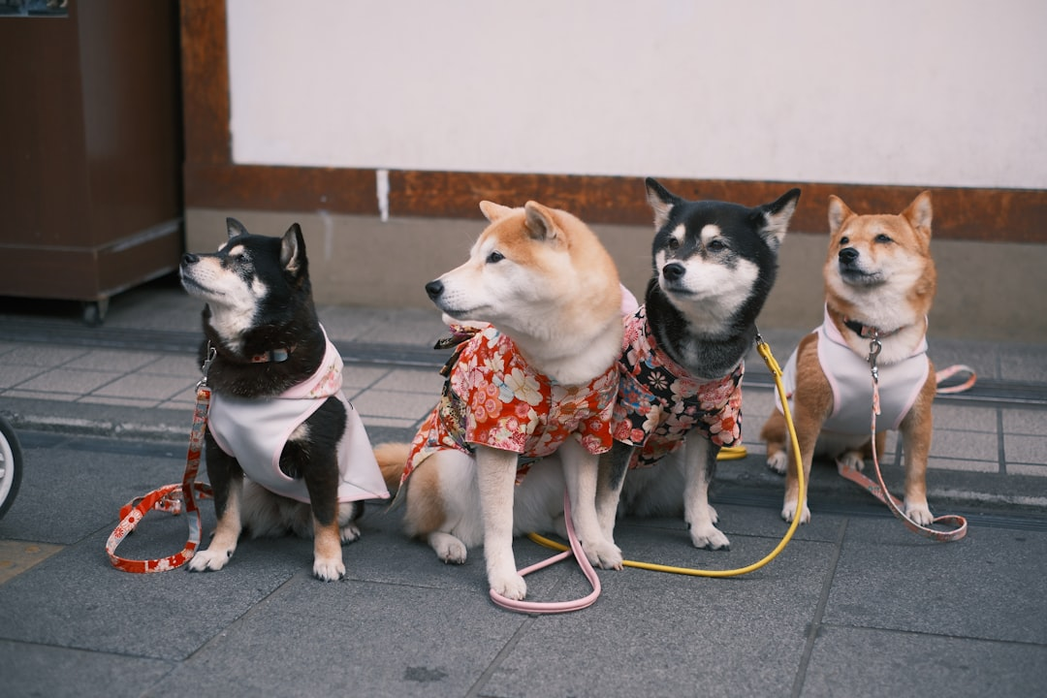
Resources for Responsible Dog Ownership
Consult your veterinarian for breedspecific advice and health recommendations.
Explore reputable dog training organizations and resources for positive reinforcement techniques and socialization guidance.
Connect with local dog parks and communities to provide social interaction and exercise opportunities for your canine companion
Remember to always prioritize responsible dog ownership and contribute to your community's wellbeing.

