Slide 1
Hotel Reservation Analysis with SQL
MENTORNESS TASK – 2 (PROJECT -1)
Batch - MIP-DA-04
by AKASH A

Slide 2
Introduction
Hotel reservation analysis plays a pivotal role in understanding guest preferences, booking trends, and revenue generation within the hospitality industry. Through SQL queries, we delve into the dataset to extract valuable insights regarding occupancy rates, popular booking channels, seasonal variations, and customer demographics.

Slide 3
Events – Data analysis process
1st Event | 2nd Event | 3rd Event | 4th Event | 5th Event
Data Collection | Data Cleaning | Data Transfer to Snowflake | Data Querying with SQL | Data Storytelling

Slide 4
Problem Statement
The hotel industry relies on data to make informed decisions and provide a better guest experience. In this internship, you will work with a hotel reservation dataset to gain insights into guest preferences, booking trends, and other key factors that impact the hotel's operations. You will use SQL to query and analyze the data, as well as answer specific questions about the dataset.

Slide 5
Dataset Details
The dataset includes the following columns:
Booking_ID: A unique identifier for each hotel reservation.
no_of_adults: The number of adults in the reservation.
no_of_children: The number of children in the reservation.
no_of_weekend_nights: The number of nights in the reservation that fall on weekends.
no_of_week_nights: The number of nights in the reservation that fall on weekdays.
type_of_meal_plan: The meal plan chosen by the guests.
room_type_reserved: The type of room reserved by the guests.
lead_time: The number of days between booking and arrival.
arrival_date: The date of arrival.
market_segment_type: The market segment to which the reservation belongs.
avg_price_per_room: The average price per room in the reservation.
booking_status: The status of the booking.

Slide 6
Questions for the Project
1. What is the total number of reservations in the dataset?
2. Which meal plan is the most popular among guests?
3. What is the average price per room for reservations involving children?
4. How many reservations were made for the year 20XX (replace XX with the desired year)?
5. What is the most commonly booked room type?
6. How many reservations fall on a weekend (no_of_weekend_nights > 0)?
7. What is the highest and lowest lead time for reservations?
8. What is the most common market segment type for reservations?
9. How many reservations have a booking status of "Confirmed"?
10. What is the total number of adults and children across all reservations?
11. What is the average number of weekend nights for reservations involving children?
12. How many reservations were made in each month of the year?
13. What is the average number of nights (both weekend and weekday) spent by guests for each room type?
14. For reservations involving children, what is the most common room type, and what is the average price for that room type?
15. Find the market segment type that generates the highest average price per room.

Slide 7
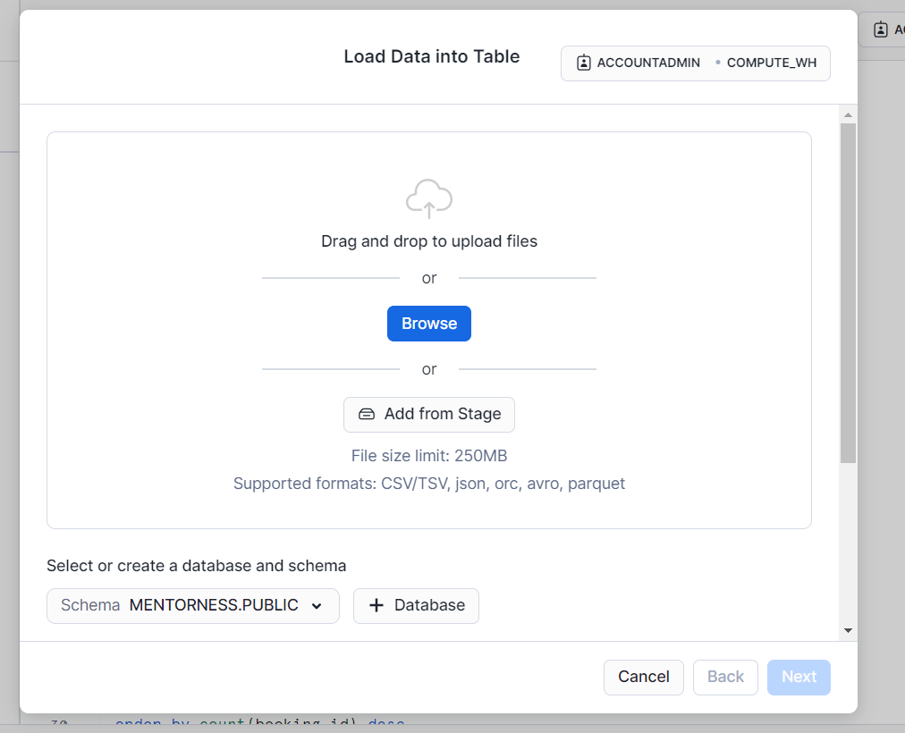
Convert the xlsx file to CSV file and load it in Snowflake SQL server

Slide 8
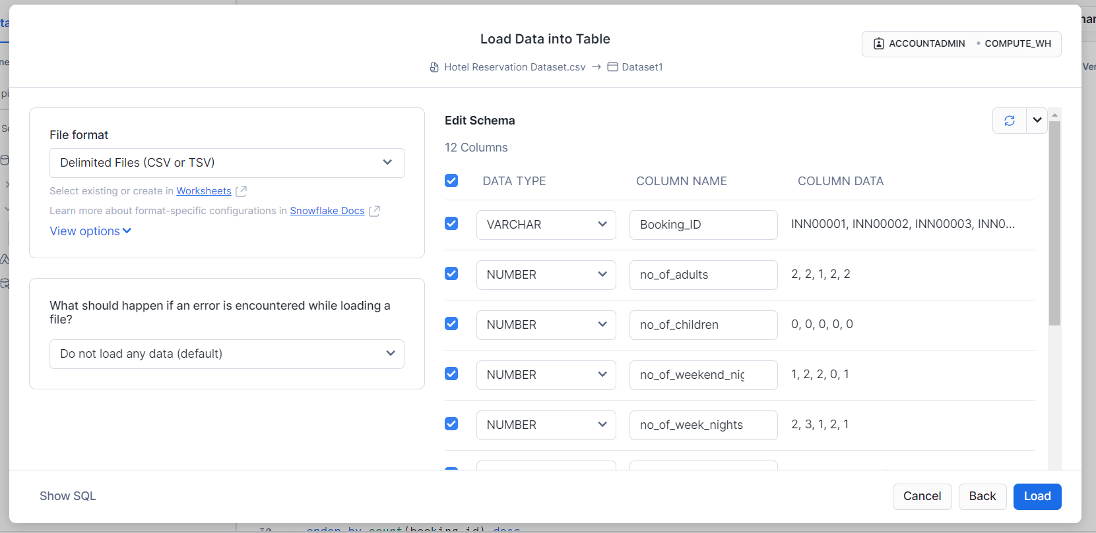

Slide 9
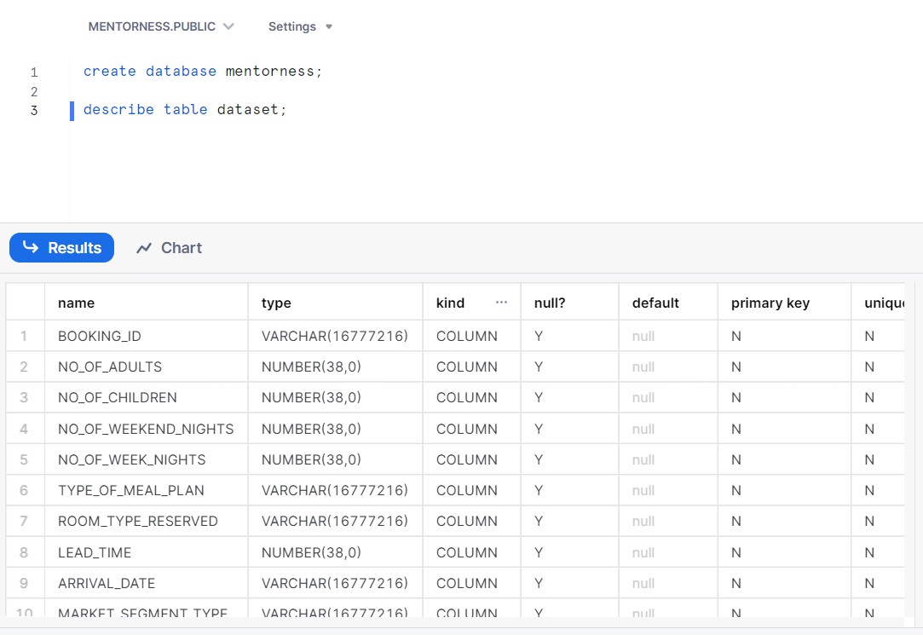
Dataset Info by Querying

Slide 10
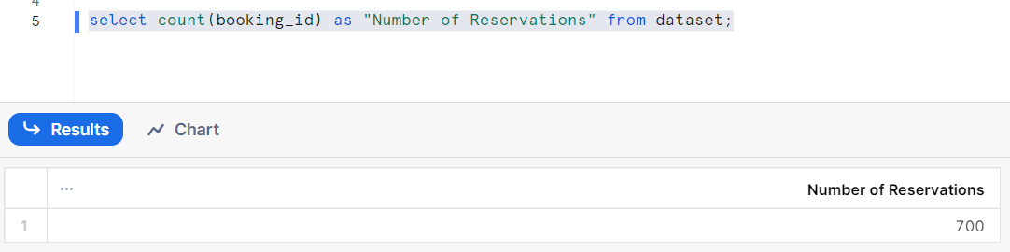
1. What is the total number of reservations in the dataset ?

Slide 11
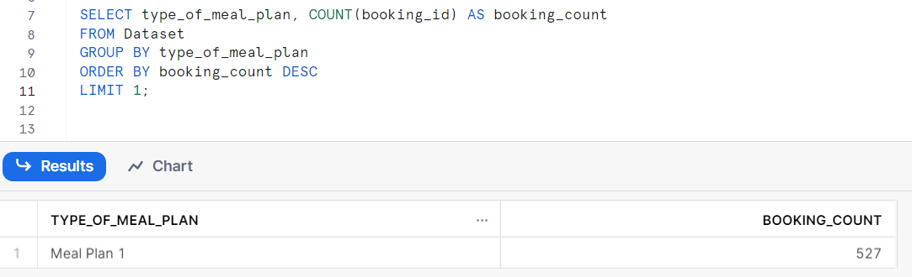
2. Which meal plan is the most popular among guests?

Slide 12
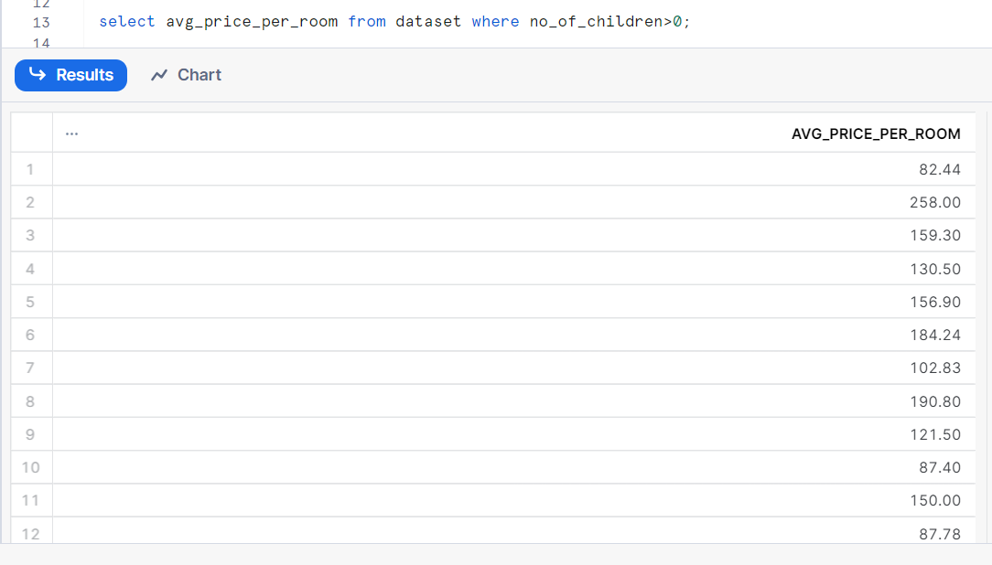
3. What is the average price per room for reservations involving children?

Slide 13
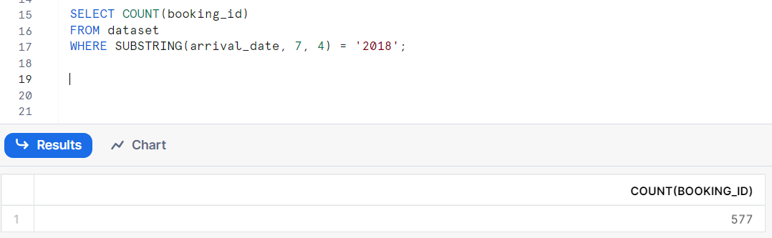
4. How many reservations were made for the year 20XX (replace XX with the desired year)?

Slide 14
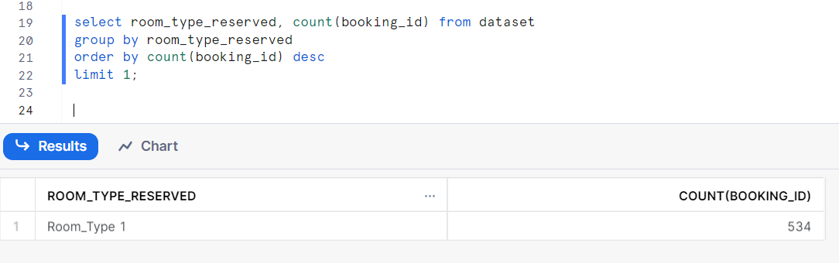
5. What is the most commonly booked room type?

Slide 15
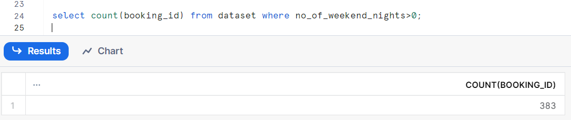
6. How many reservations fall on a weekend (no_of_weekend_nights > 0)?

Slide 16
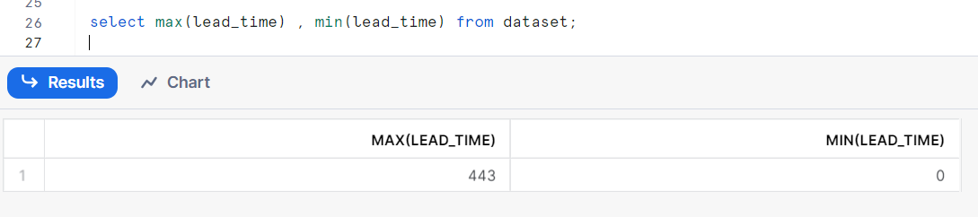
7. What is the highest and lowest lead time for reservations?

Slide 17
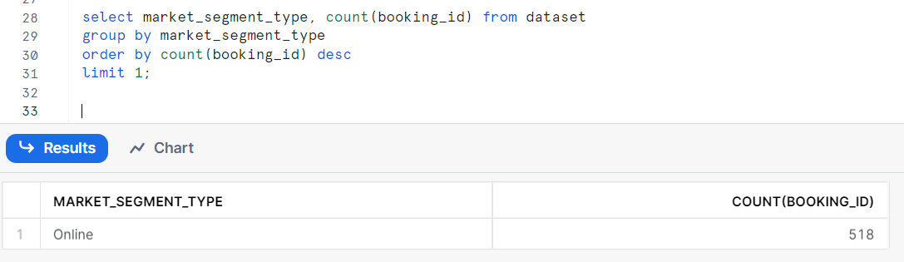
8. What is the most common market segment type for reservations?

Slide 18
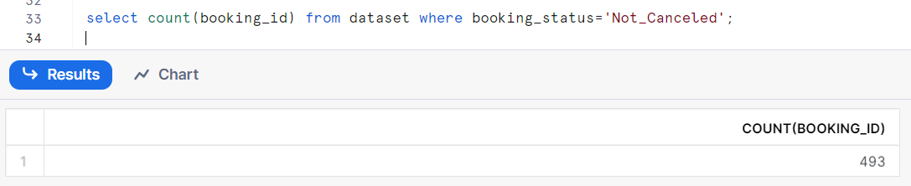
9. How many reservations have a booking status of "Confirmed“ ?

Slide 19
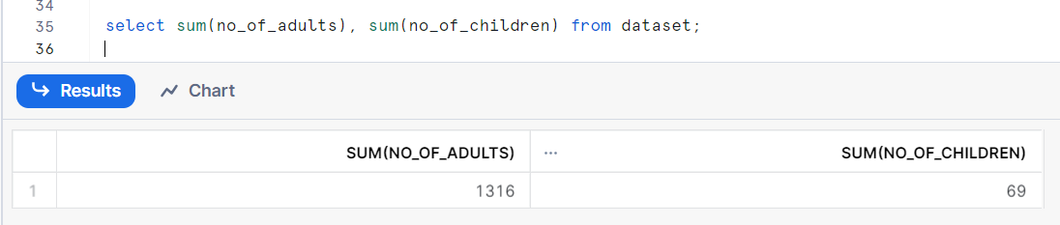
10. What is the total number of adults and children across all reservations?

Slide 20
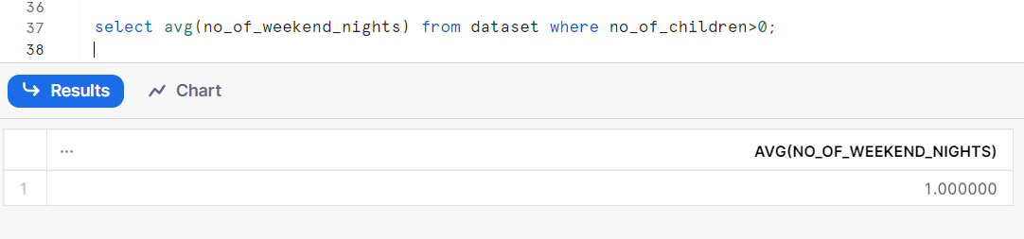
11. What is the average number of weekend nights for reservations involving children?

Slide 21
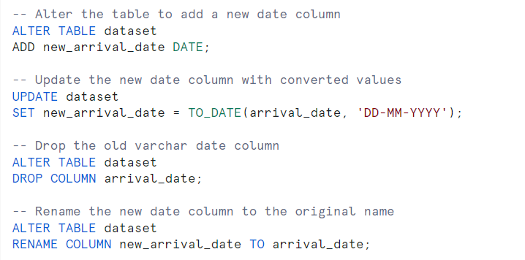
To change the datatype of data column from VARCHAR to DATE format the below query is executed, it is for the next question

Slide 22
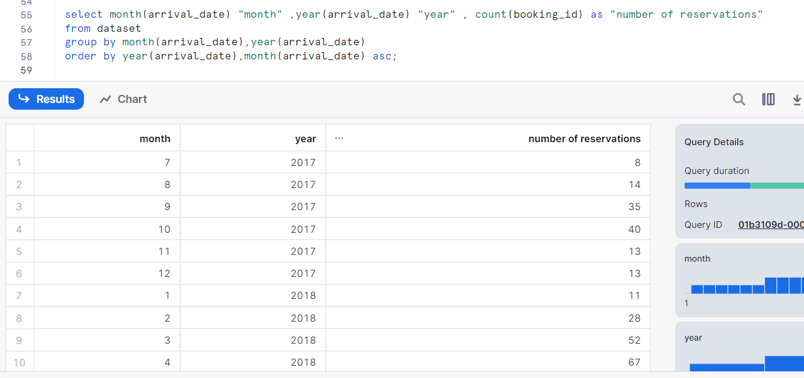
12. How many reservations were made in each month of the year?

Slide 23
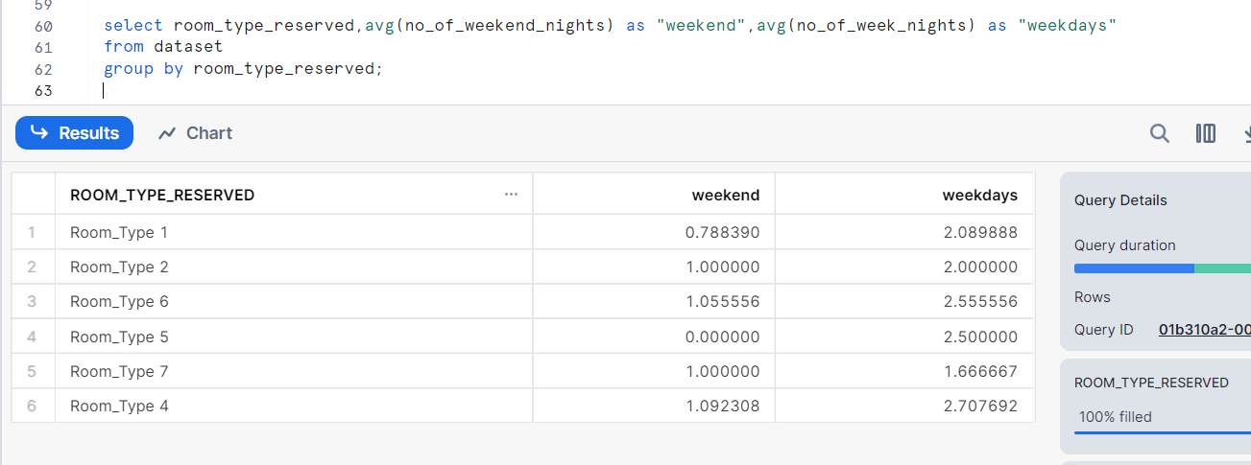
13. What is the average number of nights (both weekend and weekday) spent by guests for each room type?

Slide 24
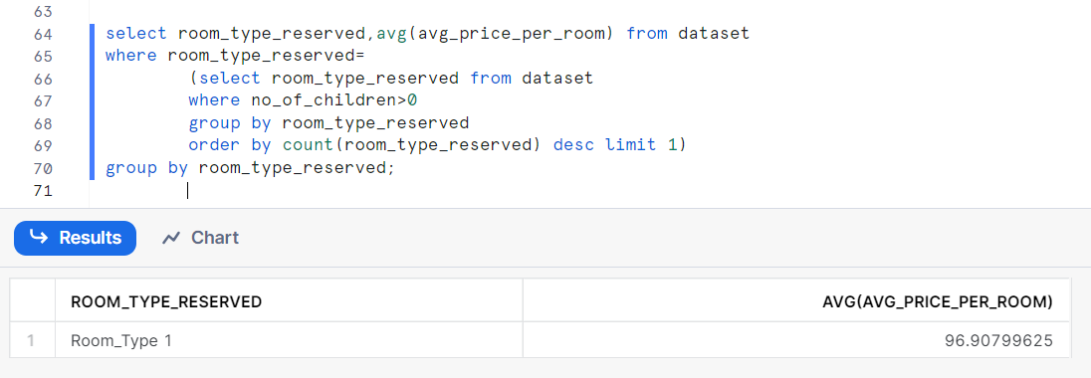
14. For reservations involving children, what is the most common room type, and what is the average price for that room type?

Slide 25
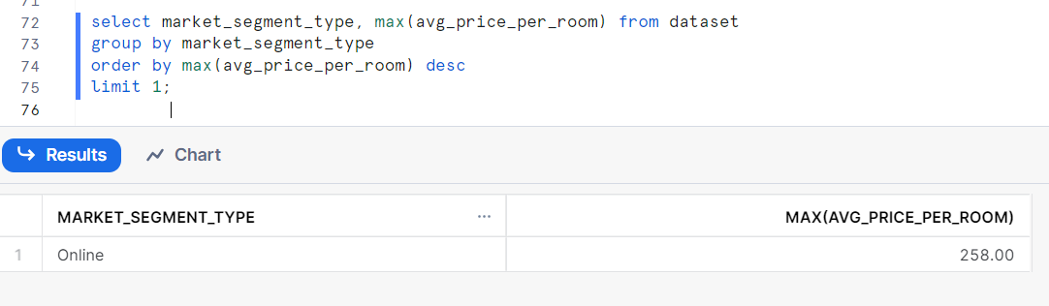
15. Find the market segment type that generates the highest average price per room.

Slide 26
Conclusion
In conclusion, the innovative data analysis project conducted on the hotel reservation dataset has yielded valuable insights poised to significantly impact the firm's decision-making processes. By leveraging these insights, the company can enhance operational efficiency, refine marketing strategies, and improve overall customer satisfaction.

